Slide 1


Deep Learning for Software Vulnerability Detection: A Case Study on C/C++ Projects
Amrita School of Computing
Amritapuri Campus
Basanth M S
AM.SC.R4CSE25007-PT
Notes:
Good afternoon.
Welcome to my presentation on “Deep Learning for Software Vulnerability Detection: A Case Study on C/C++ Projects.”
In this presentation, I will discuss how deep learning techniques can be applied to identify software vulnerabilities in C/C++ source code. Software vulnerabilities are a major concern in modern applications, and detecting them early can help improve system security and reliability.

Slide 2
Introduction Why Vulnerability Detection Matters?
▸ Software vulnerabilities cause security breaches, service disruption, and data exposure
▸ Healthcare software is especially critical — vulnerabilities can compromise:
Electronic Health Records (EHR) and patient data confidentiality
Clinical decision support and diagnostic workflows
Regulatory compliance (HIPAA, GDPR)
▸ Traditional SAST tools have high false-positive rates and limited generalization
▸ Dl & LLM-based approaches show promise but are often computationally expensive
Notes:
▸ Software vulnerabilities cause security breaches, service disruption, and data exposure
▸ Healthcare software is especially critical — vulnerabilities can compromise:
Electronic Health Records (EHR) and patient data confidentiality
Clinical decision support and diagnostic workflows
Regulatory compliance (HIPAA, GDPR)
▸ Traditional SAST tools have high false-positive rates and limited generalization
▸ Dl & LLM-based approaches show promise but are often computationally expensive

Slide 3
Problem Statement
Software vulnerabilities remain a serious threat to the security and reliability of modern systems, often leading to data breaches, financial loss, privacy violations, and operational disruption.
Although traditional detection methods and deep learning approaches show promise, their practical effectiveness depends on how well they perform on real-world datasets and specific vulnerability categories.
This study investigates the use of deep learning to detect high-impact vulnerabilities in C/C++ source code, including injection flaws, buffer overflows, insecure deserialization, and access control issues.
Notes:
Software vulnerabilities remain a serious threat to the security and reliability of modern systems, often leading to data breaches, financial loss, privacy violations, and operational disruption.
Although traditional detection methods and deep learning approaches show promise, their practical effectiveness depends on how well they perform on real-world datasets and specific vulnerability categories.
This study investigates the use of deep learning to detect high-impact vulnerabilities in C/C++ source code, including injection flaws, buffer overflows, insecure deserialization, and access control issues.

Slide 4
Objectives
To examine the use of deep learning for software vulnerability detection in a practical setting.
To study how deep learning models learn patterns from source code and vulnerability-related information.
To detect high-impact vulnerabilities in C/C++, including injection flaws, buffer overflows, insecure deserialization, and access control issues.
To evaluate model performance using Accuracy, Precision, Recall, F1-score, and False Positive Rate.
To identify the strengths, limitations, and practical implications of deep learning-based vulnerability detection.

Slide 5
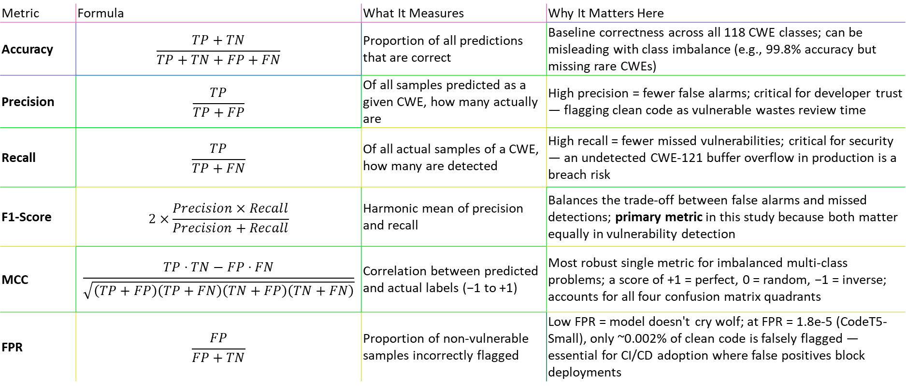
Evaluation Metrics — Definitions & Relevance to
CWE Classification
Metric | Formula | What It Measures | Why It Matters Here
Accuracy | $$\frac{TP+TN}{TP+TN+FP+FN}$$ | Proportion of all predictions that are correct | Baseline correctness across all 118 CWE classes; can be misleading with class imbalance (e.g., 99.8% accuracy but missing rare CWEs)
Precision | $$\frac{TP}{TP+FP}$$ | Of all samples predicted as a given CWE, how many actually are | High precision = fewer false alarms; critical for developer trust — flagging clean code as vulnerable wastes review time
Recall | $$\frac{TP}{TP+FN}$$ | Of all actual samples of a CWE, how many are detected | High recall = fewer missed vulnerabilities; critical for security — an undetected CWE-121 buffer overflow in production is a breach risk
F1-Score | $$2×\frac{Precision×Recall}{Precision+Recall}$$ | Harmonic mean of precision and recall | Balances the trade-off between false alarms and missed detections; primary metric in this study because both matter equally in vulnerability detection
MCC | $$\frac{TP⋅TN−FP⋅FN}{\sqrt{\left(TP+FP\right)\left(TP+FN\right)\left(TN+FP\right)\left(TN+FN\right)}}$$ | Correlation between predicted and actual labels (−1 to +1) | Most robust single metric for imbalanced multi-class problems; a score of +1 = perfect, 0 = random, −1 = inverse; accounts for all four confusion matrix quadrants
FPR | $$\frac{FP}{FP+TN}$$ | Proportion of non-vulnerable samples incorrectly flagged | Low FPR = model doesn't cry wolf; at FPR = 1.8e-5 (CodeT5-Small), only ~0.002% of clean code is falsely flagged — essential for CI/CD adoption where false positives block deployments

Slide 6
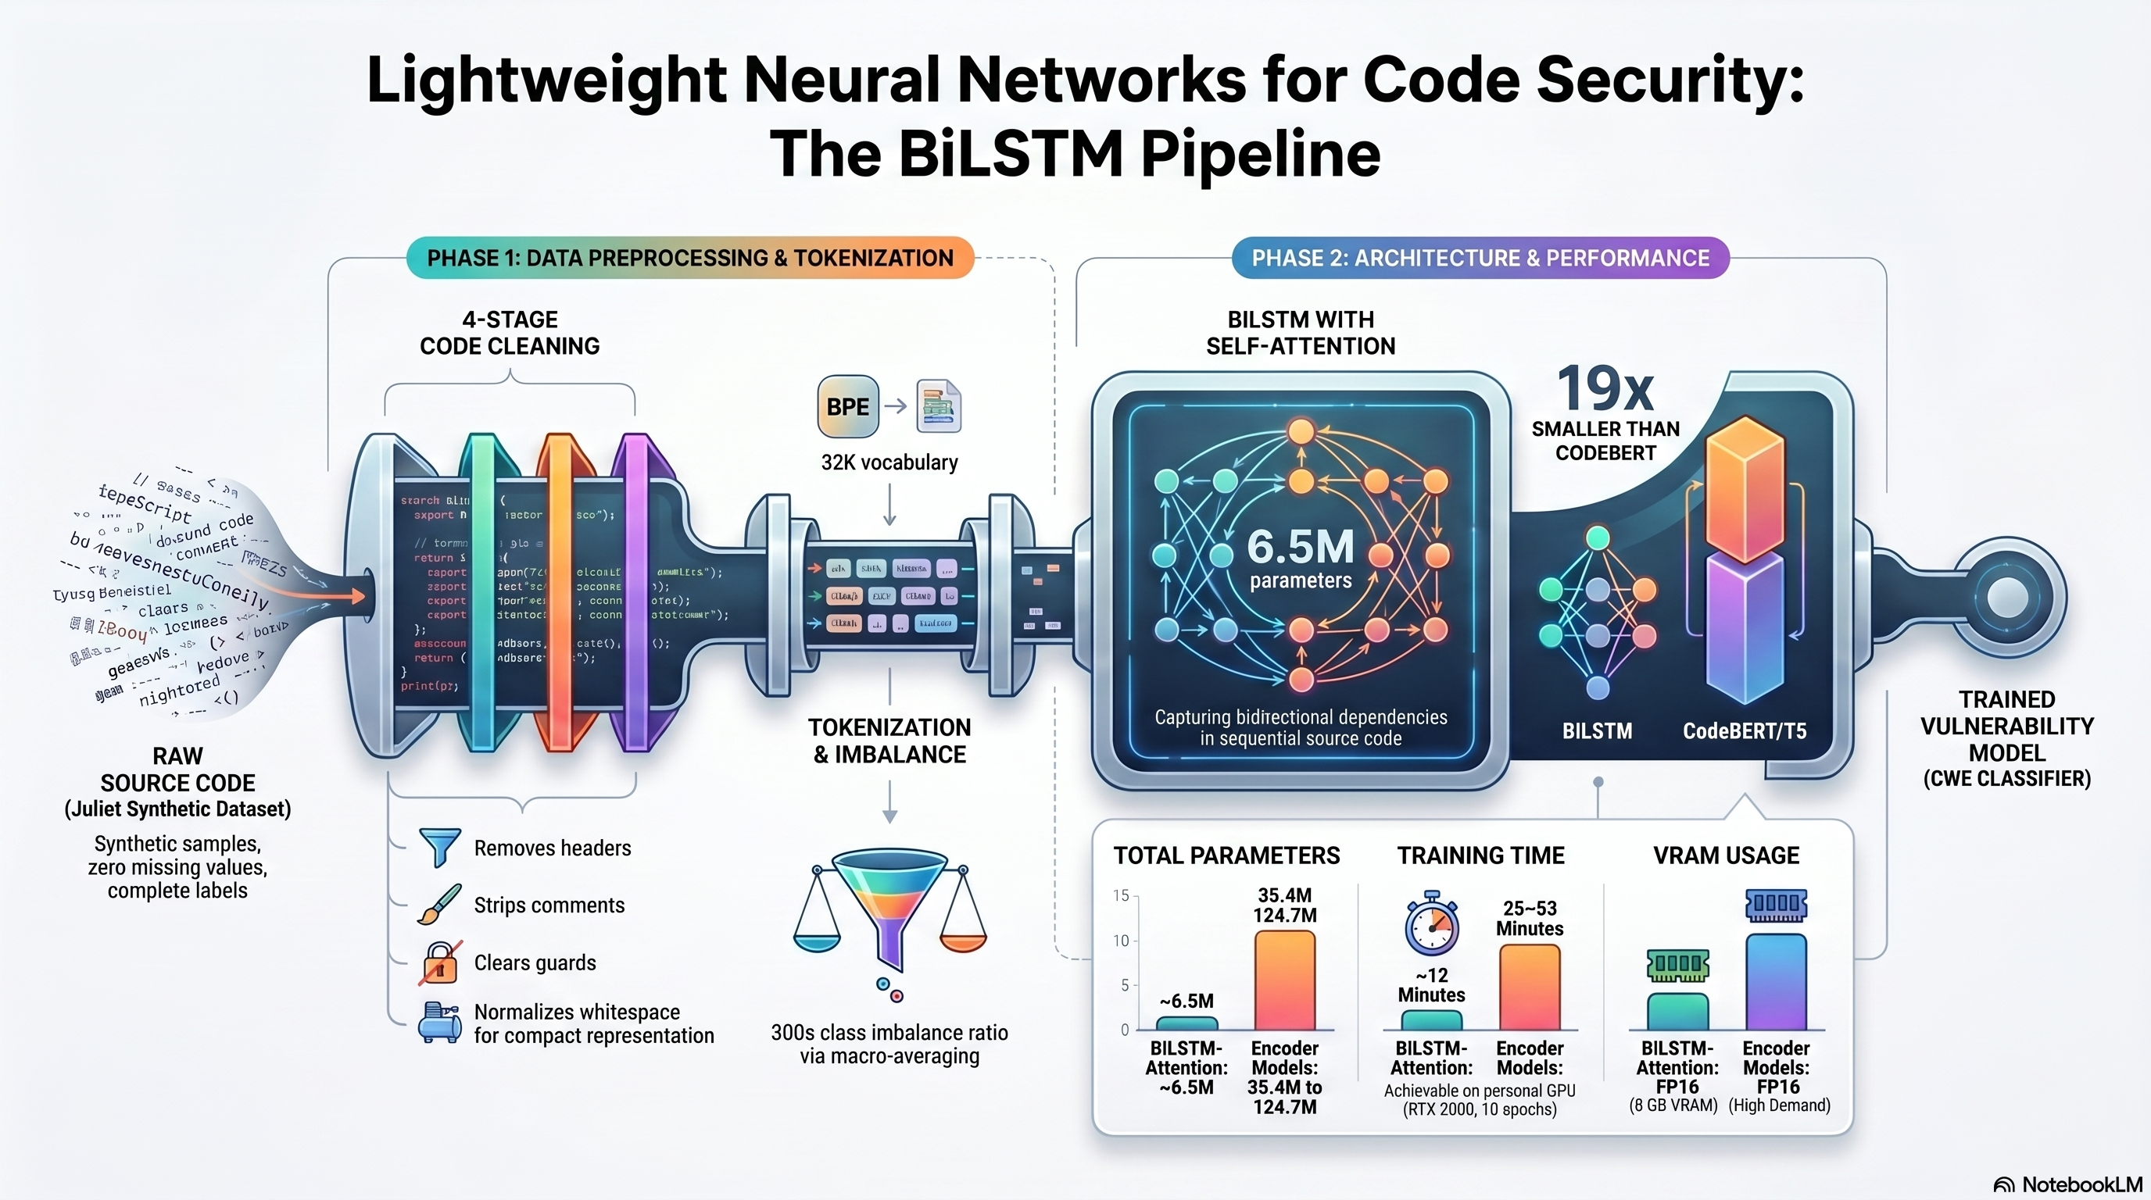
Methodology
Notes:
BiLSTM with Self-Attention Model Architecture for CWE Classification
Data: 4-stage code cleaning and BPE (Byte Pair Encoding (BPE)) tokenization; severe 300x class imbalance is addressed using macro-averaging rather than oversampling.
Model: Lightweight 2-layer BiLSTM with Self-Attention (~6.5M parameters) ending in a 118-class prediction head.
Training: Uses AdamW and FP16 mixed precision, completing in just ~12 minutes on a standard laptop GPU.
The Macro F1 score is a classification evaluation metric that calculates the unweighted mean of F1 scores across all classes in a multi-class problem. It treats all classes equally, regardless of their frequency, making it ideal for identifying performance issues on smaller, minority classes

Slide 7
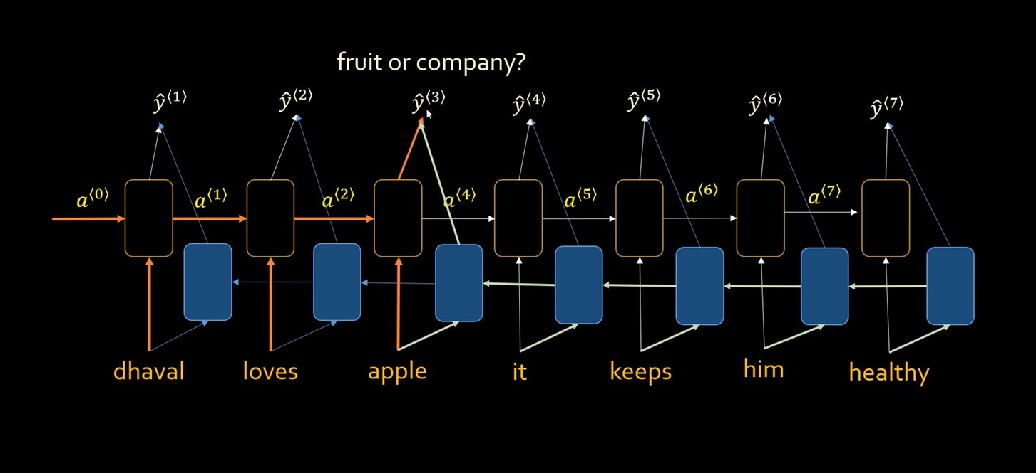
Methodology
BiLSTM with Self-Attention Model Architecture
Notes:
This diagram shows an BiLSTM-based sequence model trying to understand the word “apple” in the sentence:
“dhaval loves apple it keeps him healthy”
Here, the model must decide whether apple means a fruit or a company.
A normal RNN reads words one by one and passes information forward using hidden states like a¹, a², a³.... The problem is that when the sentence is long, earlier information becomes weaker as it passes through many steps.
This is called the vanishing gradient problem.
It means the model slowly “forgets” important earlier or later context. For example, the word healthy appears later and helps confirm that apple = fruit, but a simple RNN may struggle to connect apple with healthy if the sequence is long.
So, RNNs struggle with long sequences because they cannot reliably remember distant context.
LSTM solves this better by using memory gates, allowing it to keep important information for a longer time and forget unnecessary information.
BiLSTM = Bidirectional Long Short-Term Memory — reads code tokens in both forward and reverse directions, capturing context from both preceding and following tokens
2-layer stacked BiLSTM with hidden dimension 256 — produces a 512-dimensional representation (256 forward + 256 backward) per token
Self-Attention layer on top — learns which tokens in the sequence are most relevant to the vulnerability pattern, assigning higher weights to suspicious code constructs (e.g., strcpy, unchecked array indices)
No pretraining — trained from scratch on Juliet data using random initialisation, unlike CodeT5/CodeBERT which leverage pretrained language models
Tokenisation — uses CodeT5-Small's tokenizer (subword) to convert source code into input IDs; embedding layer (dim=128) maps tokens to dense vectors
Classification head — attention-weighted representation → Dropout(0.3) → Linear(512 → 118 CWE classes)
6.5M parameters — 17–20× smaller than transformer encoders (110–125M)
Training — AdamW (lr=1e-3), batch size 32, 10 epochs, patience 3, FP16 mixed precision
Result — F1 = 0.9993, Accuracy = 0.9982, Latency = 17.4 ms

Slide 8
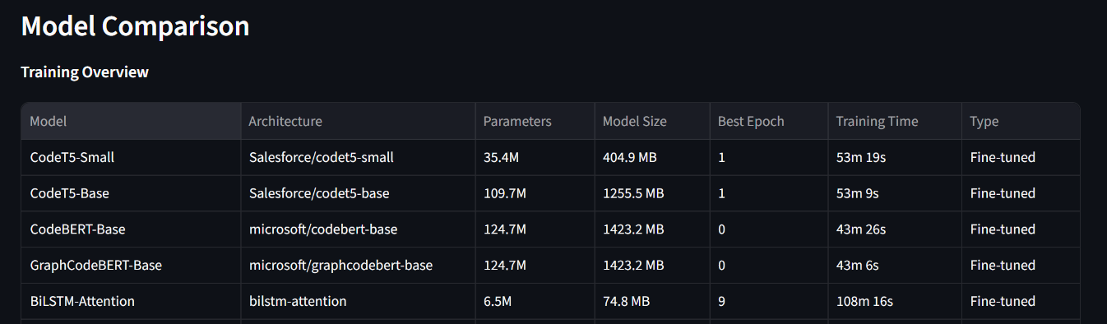
Case Study Details
Notes:
Dataset
NIST Juliet Test Suite v1.3 — a standardised benchmark of 144,109 C/C++ labelled samples spanning 118 CWE classes (e.g., CWE-121 Stack Buffer Overflow, CWE-78 OS Command Injection, CWE-190 Integer Overflow).
CodeGemma - 2 billion (2B)
Gemma 4 - 5.1B

Slide 9
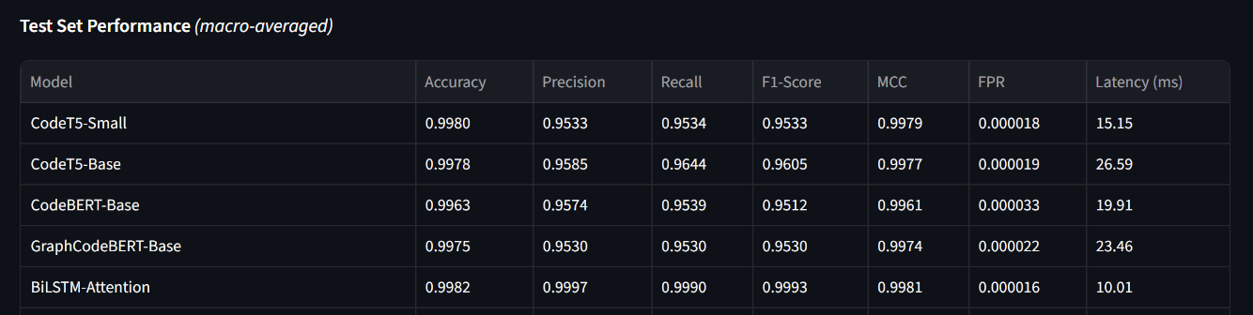
Case Study Details
Notes:
Dataset
NIST Juliet Test Suite v1.3 — a standardised benchmark of 144,109 C/C++ labelled samples spanning 118 CWE classes (e.g., CWE-121 Stack Buffer Overflow, CWE-78 OS Command Injection, CWE-190 Integer Overflow).

Slide 10
Case Study Details
Experimental Design — 7 Experiments
▸ Exp A: Juliet-118 Baseline — 82K train / 22K test, 4 encoder models
▸ Exp B: Juliet-19 Subset — 19 CWEs overlapping with Big-Vul
▸ Exp C: Juliet + Big-Vul Combined — real-world code added (19 CWEs)
▸ Exp D: Big-Vul Only — 55 CWEs from real-world vulnerability commits
▸ Exp E: Juliet + Big-Vul Union — 187 CWEs, maximum coverage
▸ Exp F: Union Extended — 6 epochs, patience=3 (longer training)
▸ Exp G: BiLSTM-Attention DL Baseline — 118 CWEs, 10 epochs
◦ Primary DL case study experiment
◦ Tests whether a ~6.5M-param LSTM can match 125M-param transformers
◦ Addresses: can simpler architecture learn structured vulnerability patterns?

Slide 11
Analysis & Interpretation of the Findings
BiLSTM-Attention achieves highest F1 (0.9993) — lightweight sequential model surpasses all transformers on structured Juliet code, with only 6.5M parameters vs 35–125M
85% of CWE classes (74/87) reach perfect F1=1.00 — model reliably distinguishes the majority of vulnerability types with zero misclassification
Consumer-grade GPU is sufficient — all models trained on a single 8GB RTX 2000 Ada in 43–53 minutes; inference latency 17–27ms enables real-time CI/CD integration
Key Limitations
Synthetic-to-real gap: The Juliet Test Suite's formulaic structure inflates metrics
Class imbalance: 1,500:1 sample ratio across 118 CWEs biases predictions toward high-frequency buffer CWEs
BiLSTM generalizability: Exceptional Juliet performance may not transfer to diverse real-world code patterns
Notes:
BiLSTM-Attention achieves highest F1 (0.9993) — lightweight sequential model surpasses all transformers on structured Juliet code, with only 6.5M parameters vs 35–125M
85% of CWE classes (74/87) reach perfect F1=1.00 — model reliably distinguishes the majority of vulnerability types with zero misclassification
Consumer-grade GPU is sufficient — all models trained on a single 8GB RTX 2000 Ada in 43–53 minutes; inference latency 17–27ms enables real-time CI/CD integration
Key Limitations
Synthetic-to-real gap: The Juliet Test Suite's formulaic structure inflates metrics
Class imbalance: 1,500:1 sample ratio across 118 CWEs biases predictions toward high-frequency buffer CWEs
BiLSTM generalizability: Exceptional Juliet performance may not transfer to diverse real-world code patterns

Slide 12
Results: Comparative Performance of Deep Learning Models for CWE Vulnerability
Experiment — Juliet-118 Baseline (Fine-Tuned Models)
Model | Accuracy | Precision | Recall | F1-Score | Latency (ms) | Epochs
BiLSTM-Attention | 0.9982 | 0.9997 | 0.9990 | 0.9993 | 17.4 | 10
CodeT5-Base | 0.9978 | 0.9585 | 0.9644 | 0.9605 | 24.9 | 2
CodeT5-Small | 0.9980 | 0.9533 | 0.9534 | 0.9533 | 17.2 | 2
GraphCodeBERT | 0.9975 | 0.9530 | 0.9530 | 0.9530 | 26.9 | 2
CodeBERT | 0.9963 | 0.9574 | 0.9539 | 0.9512 | 19.4 | 2

Slide 13
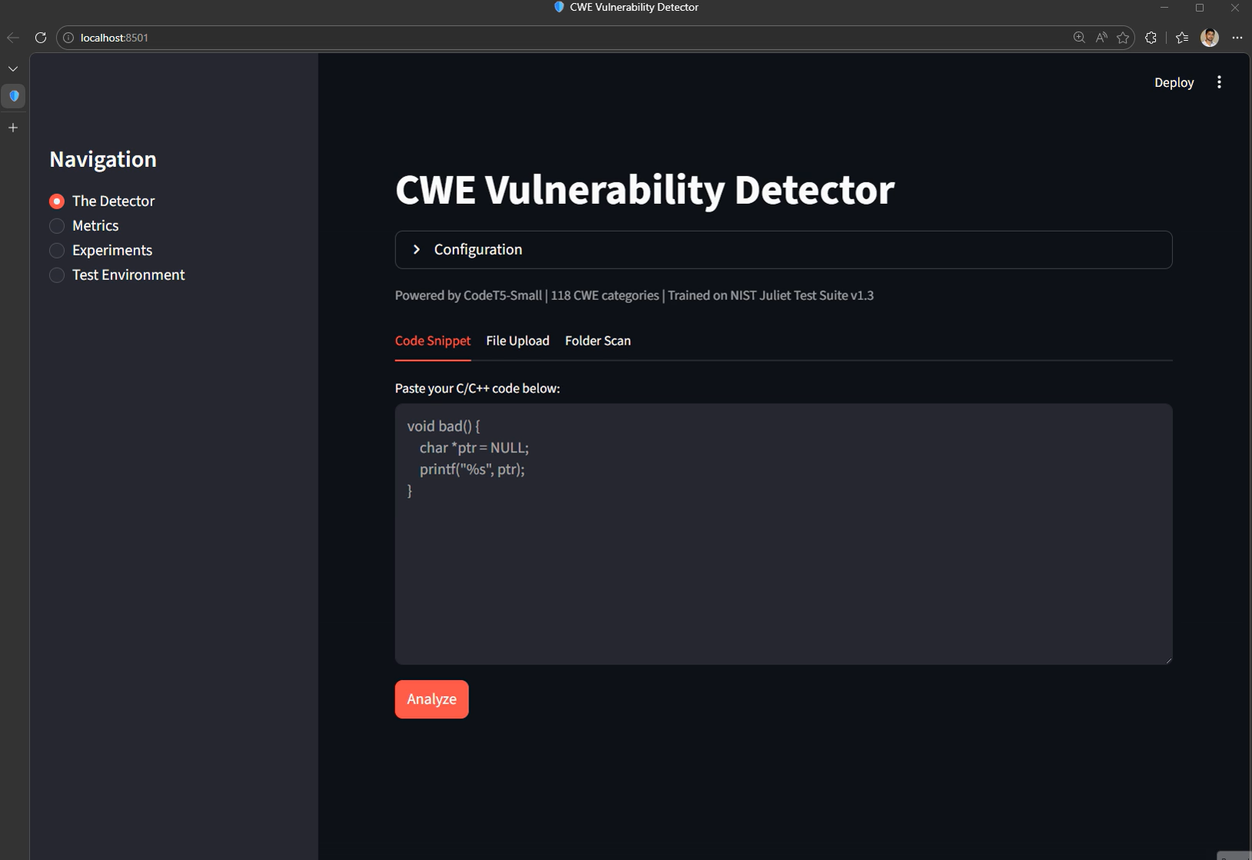

Slide 14
Discussion – Insights, implications, or comparisons
The BiLSTM-Attention model's dominance (F1=0.9993) over pretrained transformers challenges the assumption that larger, pretrained models are always superior.
High accuracy on Juliet should not be interpreted as readiness for production deployment.
Architecture Matters More Than Model Size. CodeT5-Base (110M params, F1=0.9605) outperforms both CodeBERT and GraphCodeBERT (125M params each, F1 ≈ 0.95) despite having fewer parameters.
Class Imbalance Drives Systematic Error. The concentration of 57.5% of errors on CWE-126 is not a model deficiency but a data distribution artefact. CWE-126 has 554 test samples while 31 CWE classes have zero test samples.
Notes:
Lightweight models can dominate BiLSTM-Attention achieved F1 = 0.9993, challenging the idea that larger pretrained transformers are always better.
Juliet accuracy ≠ production readiness High benchmark performance should not be treated as proof of real-world deployment readiness.
Architecture matters more than size CodeT5-Base outperformed larger CodeBERT and GraphCodeBERT models despite having fewer parameters.
Errors reflect data imbalance The high error concentration on CWE-126 is mainly due to uneven test sample distribution, not necessarily model weakness.

Slide 15
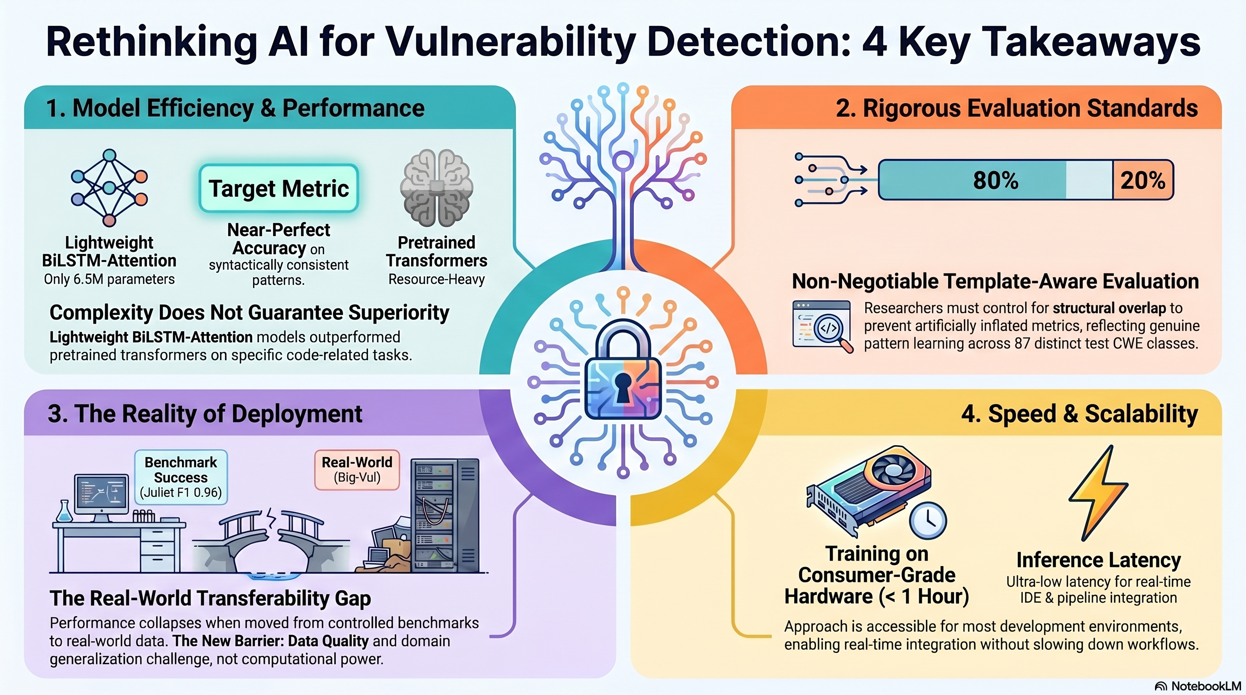
Key Takeaways
Notes:
Efficiency over complexity Lightweight BiLSTM-Attention models can outperform larger pretrained transformers on focused code-related tasks.
Use rigorous evaluation Avoid inflated results by controlling structural or template overlap between training and test data.
Benchmarks are not deployment Strong benchmark scores may not transfer to real-world datasets due to data quality and domain differences.
Speed matters in practice Fast training and low-latency inference enable integration into IDEs, pipelines, and developer workflows.
Key message Practical vulnerability detection needs efficient models, realistic testing, and scalable deployment.

Slide 16
Key References (1/2)
[1] Li et al. (2018) — VulDeePecker: BiLSTM-based vulnerability detection, NDSS [2] Lu et al. (2024) — GRACE: Graph-enhanced LLM vulnerability detection, J. Sys. & SW [3] Yang et al. (2025) — DLAP: DL-augmented LLM prompting, J. Sys. & SW [4] Tian et al. (2025) — FUSEVUL: Multi-modal vulnerability detection, Inf. Fusion [5] Mao et al. (2025) — LLMVulExp: Explainable vulnerability detection, IEEE TSE [6] Liu et al. (2025) — VulACLLM: Lightweight LLM, J. Info. Sec. & Apps. [7] Ferrag et al. (2025) — SecureFalcon: Compact LLM for vuln. classification, IEEE TSE [8] Qiu et al. (2026) — RLV: Context-aware detection via retrieval, J. Sys. & SW [9] Chen et al. (2026) — GPTVD: Static slicing + CoT, Auto. SW Eng. [10] NSA/NIST (2017) — Juliet Test Suite for C/C++ v1.3

Slide 17
Key References (2/2)
[11] Wang et al. (2021) — CodeT5: Identifier-aware Unified Pre-trained Encoder-Decoder, EMNLP [12] Feng et al. (2020) — CodeBERT: Pre-trained Model for Programming Languages, EMNLP [13] Guo et al. (2020) — GraphCodeBERT: Pre-training Code Representations with Data Flow [14] Dettmers et al. (2023) — QLoRA: Efficient Finetuning of Quantized LLMs, NeurIPS [15] CodeGemma Team (2024) — CodeGemma: Open Code Models [16] Fan et al. (2020) — Big-Vul: Large-scale vulnerability dataset, MSR [17] Zhou et al. (2019) — Devign: Effective vulnerability identification, NeurIPS [18] Dolcetti & Iotti (2025) — Dual perspective review on LLMs and code verification, Frontiers [19] Shaon & Akter (2025) — Modern approaches to software vulnerability detection, Electronics

Slide 18
Thank You

