Slide 1


Research
Amrita School of Computing
Amritapuri Campus

Slide 2
SHARP-LLM
A Secure and Resource-Efficient Framework for Source Code Vulnerability Analysis and Healthcare-Specific Risk Prioritization
Basanth M S (AM.SC.R4CSE25007-PT), Gopakumar G
Dept. of Computer Science and Engineering, School of Computing Amrita Vishwa Vidyapeetham, Amritapuri, India
Notes:
Hi, I am Basanth M S, presenting my research work titled SHARP-LLM — which stands for Secure Healthcare-code vulnerability Analysis and Risk Prediction via Lightweight Language Models.
This work was carried out under the guidance of Dr. Gopakumar G at the Department of Computer Science and Engineering, School of Computing, Amrita Vishwa Vidyapeetham, Amritapuri.
The central idea of this work is not just detecting vulnerabilities in source code, but translating those detections into healthcare-specific risk priorities.

Slide 3
Introduction
Why This Matters for Healthcare Software
▸ Healthcare software handles some of the most sensitive data in any industry
Electronic Health Records (EHR) and patient data confidentiality
Regulatory compliance (HIPAA, GDPR, DISHA, DPDPA)
▸ A vulnerability in healthcare software is not just a bug — it can compromise:
Patient safety and data privacy
Regulatory compliance and institutional trust
▸ Existing approaches have key limitations:
Traditional SAST tools: high false-positive rates, limited generalization
LLM-based methods: computationally expensive, no domain-specific guidance
No framework bridges code analysis → healthcare-specific risk prioritization
Notes:
Healthcare software is unique because vulnerabilities here have consequences far beyond typical software failures.
A vulnerability in an Electronic Health Records system can expose patient data — names, diagnoses, treatment histories. In clinical decision support, a compromised system could affect diagnostic outcomes. Telemedicine platforms and connected medical devices are increasingly internet-facing, expanding the attack surface.
And there's the regulatory dimension — HIPAA in the US, GDPR in Europe, DISHA and DPDPA in India — non-compliance carries severe penalties.
Now, existing tools for finding these vulnerabilities have limitations. Traditional static analysis tools have high false-positive rates. Recent LLM-based approaches show promise, but they typically require expensive GPU infrastructure — 40 GB or more of VRAM — making them impractical for most development teams.
Most importantly, the existing framework not bridging the gap between "we found a CWE" and "here's how critical this is for your healthcare system." That's the gap SHARP-LLM addresses.

Slide 4
What is SHARP-LLM?
▸ Secure Healthcare-Code Vulnerability Analysis and Risk Prediction via Lightweight LLMs
▸ A secure and lightweight framework for source code vulnerability detection
Classifies C/C++ code into 118 CWE categories
Fine-tuned lightweight LLMs (35M–125M parameters)
Runs on consumer-grade GPU (8 GB VRAM)
▸ Healthcare-oriented risk prioritization layer:
Maps CWEs to LINDDUN privacy threat types
Links to policy-relevant control domains
Produces ordinal priority levels (Critical / High / Medium / Low)
Notes:
SHARP-LLM — which stands for Secure Healthcare-code vulnerability Analysis and Risk Prediction via Lightweight Language Models.

Slide 5
Literature Review & Research Gap
Related Work — Existing Approaches
Framework | Authors | Focus | Limitation
GRACE | Lu et al. (2024) | Graph-enhanced LLM + ICL | Prompt sensitivity, limited languages
DLAP | Yang et al. (2025) | DL-guided prompting | Dependent on DL model quality
FUSEVUL | Tian et al. (2025) | Multi-modal detection | Limited to C/C++, basic prompting
LLMVulExp | Mao et al. (2025) | Explainable via teacher-student | High annotation & compute cost
VulACLLM | Liu et al. (2025) | AST+CFG+LoRA/distillation | Performance trade-off from compression
SecureFalcon | Ferrag et al. (2025) | Compact LLM classification | Limited to known patterns
RLV | Qiu et al. (2026) | Repository-level context | Context-length limits
Notes:
ICL – In Context Learning
“Multi-modal detection.” - It means detecting or identifying something by using multiple types of data together. Medical image + patient report
XAI - Explainable Artificial Intelligence – Why modal made a particular decision.
AST = Abstract Syntax Tree CFG = Control Flow Graph LoRA = Low-Rank Adaptation
Distillation = Knowledge Distillation Training a smaller model to learn from a larger model.
EHR – Electronic Health Record

Slide 6
Key Research Gaps
▸ Gap 1: No Domain-Specific Risk Prioritization
◦ Literature focuses on detection accuracy alone — all CWEs treated equally
◦ A buffer overflow in an EHR system ≠ a buffer overflow in a game engine
◦ No framework translates detection results into healthcare-relevant risk signals
▸ Gap 2: Limited Healthcare-Oriented Security Resources
◦ Privacy-aware vulnerability resources for healthcare are scarce
◦ Missing link: mapping technical CWE findings to patient-data and compliance risks
Notes:
We identified two key gaps in the literature.
The first and most critical gap is the absence of domain-specific risk prioritization. Current literature treats all vulnerabilities equally — a buffer overflow gets the same severity whether it's in a video game or in an EHR system handling patient records. But clearly, the impact is very different. A CWE-119 buffer overflow in a system that processes patient data has confidentiality and compliance implications that don't exist in other domains. No existing framework provides this contextual prioritization for healthcare.
The second gap is the scarcity of healthcare-oriented security resources. There is very limited work that maps technical CWE findings to privacy threats relevant to healthcare — things like patient data linkability, identifiability, or regulatory non-compliance. The missing link is translating raw technical vulnerability findings into signals that healthcare security teams can act on.

Slide 7
Novelty / Problem Statement
Existing vulnerability detection methods identify vulnerable code but do not adequately prioritize risks in healthcare contexts. Hence, a resource-efficient and framework is needed to convert detected vulnerabilities into healthcare-specific risk signals.
Novelty
Healthcare-Oriented Risk Prioritization Pipeline
Lightweight, Practical CWE Classification and Analysis
Notes:
Our primary contribution is the Healthcare-Oriented Risk Prioritization Pipeline. This is a three-stage post-analysis pipeline. First, we map each detected CWE to LINDDUN privacy threat types — these include linkability, identifiability, information disclosure, and others. Then we map those threats to policy-relevant control domains like confidentiality protection and access control. Finally, we compute a weighted risk score that produces ordinal priority levels — Critical, High, Medium, or Low.
This transforms a raw CWE prediction like "CWE-119 detected with 95% confidence" into an actionable statement like "Critical priority — this buffer overflow in a patient data module threatens data confidentiality and violates access control requirements."
Our second contribution is demonstrating that lightweight models — 35 to 125 million parameters — can perform CWE classification at good quality on consumer-grade hardware. All our models run on an 8 GB VRAM laptop GPU with fast inference, making them viable for integration into CI/CD pipelines or IDE plugins. We classify into 118 CWE categories — this is multi-class classification, not just binary vulnerable-or-not detection.

Slide 8
Methodology
Dataset & Preprocessing
▸ NIST Juliet Test Suite for C/C++ v1.3
◦ 105,183 source code samples across 118 CWE categories
◦ Training: 82,736 samples (1,323 templates)
◦ Test: 22,447 samples (366 templates, 87 CWEs)
◦ Zero template overlap (80/20 split, seed=42)
▸ 4-Stage Preprocessing Pipeline:
◦ Stage 1: Header removal (template-generated comment blocks)
◦ Stage 2: Comment stripping (state machine, preserves string literals)
◦ Stage 3: Guard removal (#ifndef OMITBAD, #ifndef OMITGOOD, etc.)
◦ Stage 4: Whitespace normalization (compact representation)

Slide 9
Models Evaluated
Model | Paradigm | Params | Size (MB) | Key Details
CodeT5-Small | Encoder FT | 35.4M | 405 | Full fine-tuning, FP16
CodeT5-Base | Encoder FT | 109.7M | 1,256 | Full fine-tuning, FP16
CodeBERT-Base | Encoder FT | 124.7M | 1,423 | Full fine-tuning, FP16
GraphCodeBERT | Encoder FT | 124.7M | 1,423 | Full fine-tuning, FP16
CodeGemma-2B | Zero-Shot | 2.51B | 4,677 | Beam search B=10
Gemma-4-E2B-IT | Zero-Shot | 5.13B | 9,561 | Instruction-tuned, B=2
Notes:
The model is fully fine-tuned using 16-bit precision to reduce memory usage and speed up training.
Benefits:
• Uses less GPU memory • Training is faster • Allows larger models/batches to fit on GPU • Slight risk of numerical instability compared to FP32
4-bit NF4, LoRA r=16, α=32 means the model is fine-tuned using QLoRA.
4-bit NF4 The base model weights are stored in 4-bit NormalFloat format, which greatly reduces GPU memory usage.
LoRA r=16 Only small adapter matrices are trained. Here, r=16 means the adapter rank is 16, giving a balance between learning capacity and efficiency.
α=32 Alpha controls the strength/scaling of the LoRA update. With r=16 and α=32, the scaling factor is:
α / r = 32 / 16 = 2
LoRA makes fine-tuning lightweight by training small adapters, while QLoRA further reduces memory usage by loading the base model in 4-bit quantized form.
LoRA vs QLoRA
Aspect : LoRA : QLoRA
Full form : Low-Rank Adaptation : Quantized Low-Rank Adaptation
Base model : Kept in FP16 or BF16 : Loaded in 4-bit quantized format
Trainable weights : Only LoRA adapter weights are trained : Only LoRA adapter weights are trained
Memory usage : Lower than full fine-tuning : Much lower than LoRA
Quantization : Not mandatory : Uses 4-bit quantization, often NF4
Best suited for : Models that fit in available GPU memory : Larger models with limited GPU memory
Summary: LoRA trains small adapter layers, while QLoRA further reduces memory by loading the base model in 4-bit quantized form.

Slide 10
Training Configuration
▸ Classification Head: Mean pooling → Dropout → Linear → Softmax → 118-dim
▸ Encoder Models:
◦ Learning rate: 5×10⁻⁵, AdamW optimizer, batch size 8
◦ Max sequence length: 256 tokens, 2 epochs, FP16 precision
◦ Early stopping: patience=1
▸ QLoRA (CodeGemma-2B):
◦ Learning rate: 2×10⁻⁴, PagedAdamW 8-bit, effective batch 8
◦ LoRA targets: q, k, v, o, gate, up, down projections
◦ Memory: ~5.5 GB (FP16) → ~1.8 GB (NF4), only ~0.5% params trained
▸ Hardware: NVIDIA RTX 2000 Ada (8 GB VRAM), Intel i7-13850HX
▸ Stack: Python 3.13, PyTorch ≥2.0, HuggingFace Transformers ≥5.5
Notes:
The model uses a 118-class classification head with mean pooling, dropout, linear layer, and softmax. • Encoder models are fine-tuned using AdamW with learning rate 5×10⁻⁵, batch size 8, max sequence length 256, and FP16 precision. • Early stopping with patience 1 is used to avoid unnecessary training. • CodeGemma-2B is fine-tuned using QLoRA with learning rate 2×10⁻⁴ and PagedAdamW 8-bit optimizer. • QLoRA targets attention and projection layers such as q, k, v, o, gate, up, and down. • Memory usage is reduced from about 5.5 GB to 1.8 GB by using NF4 quantization. • Only around 0.5% of parameters are trained, making the approach resource-efficient. • Experiments are run on RTX 2000 Ada GPU with 8 GB VRAM using Python, PyTorch, and HuggingFace Transformers.

Slide 11
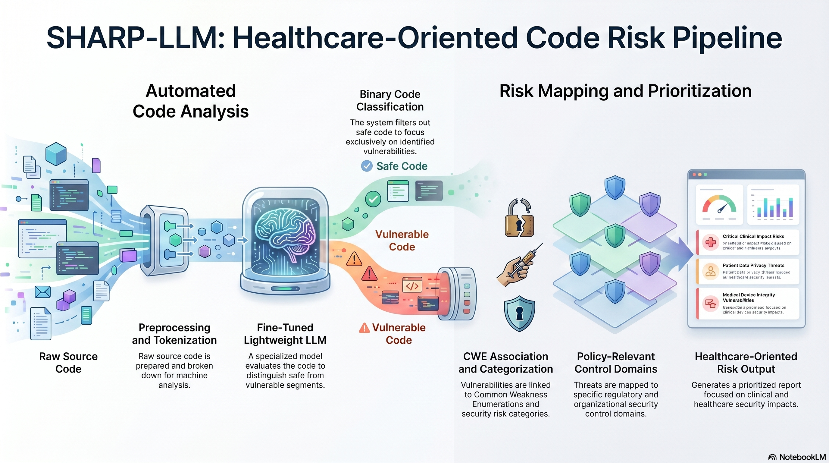
Block Diagram
SHARP-LLM Pipeline Overview
Notes:
This slide shows the SHARP-LLM pipeline diagram.
We use the NIST Juliet Test Suite for C/C++ version 1.3 and Big-Vul datasets as our datasets.
The code goes through a 4-stage preprocessing pipeline: header removal, comment stripping, guard removal, and whitespace normalization.
We evaluated models across three paradigms: full encoder fine-tuning with CodeT5-Small, CodeT5-Base, CodeBERT, and GraphCodeBERT; QLoRA parameter-efficient fine-tuning with CodeGemma-2B; and zero-shot generative inference with CodeGemma-2B and Gemma-4.
After classification, the healthcare risk prioritization layer takes over — which I'll detail on the next slide.

Slide 12
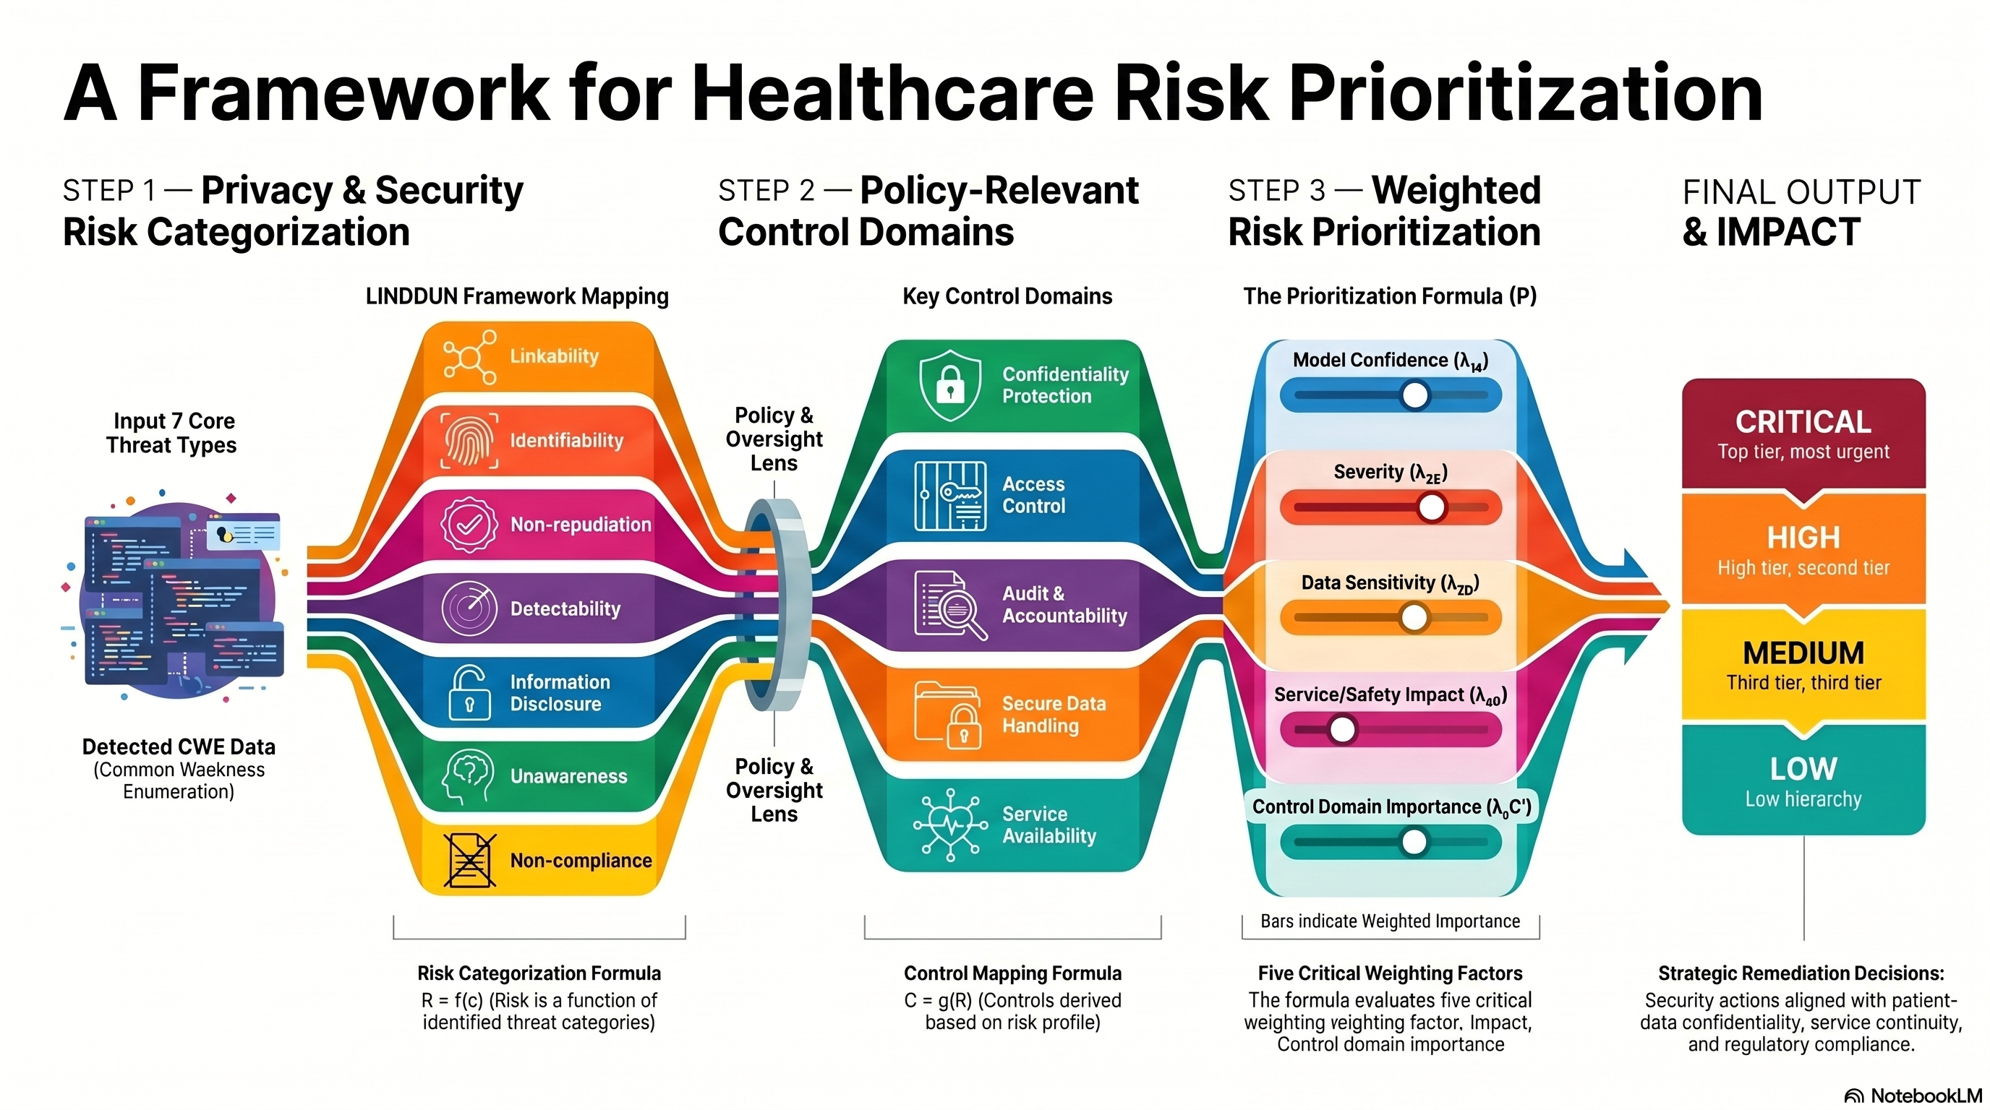
Notes:
This is the core contribution of our work — the healthcare risk prioritization pipeline.
Step 1 applies a risk categorization to the detected CWE. This maps each CWE to one or more LINDDUN privacy threat types. For example, CWE-200 — Information Exposure — maps to Information Disclosure and Identifiability threat types.
Step 2 applies a control domain mapping function. This maps risk categories to policy-relevant control domains — confidentiality protection, access control, audit and accountability, secure data handling, and service availability.
Step 3 computes the final weighted risk score P using five factors: model confidence s, technical severity E, data sensitivity D, service and safety impact S, and control domain importance C-prime. The weights lambda-1 through lambda-5 can be configured per healthcare deployment context.
The output is an ordinal priority level — Critical, High, Medium, or Low — that directly guides remediation decisions. This means a security team doesn't just see "CWE-119 detected" — they see "Critical: this affects patient data confidentiality in a system subject to HIPAA compliance, prioritize immediate remediation.

Slide 13
Results
Model Comparison — Full Test Set (22,447 samples)
Model | Params | Accuracy | Precision | Recall | F1 | MCC | Latency
CodeT5-Small | 35.4M | 0.9980 | 0.9533 | 0.9534 | 0.9533 | 0.9979 | 17.2 ms
CodeT5-Base | 109.7M | 0.9978 | 0.9585 | 0.9644 | 0.9605 | 0.9977 | 24.9 ms
CodeBERT-Base | 124.7M | 0.9963 | 0.9574 | 0.9539 | 0.9512 | 0.9961 | 19.4 ms
GraphCodeBERT | 124.7M | 0.9975 | 0.9530 | 0.9530 | 0.9530 | 0.9974 | 26.9 ms
CodeGemma-2B (ZS) | 2.51B | 0.2500 | 0.1755 | 0.0832 | 0.0948 | 0.3022 | 3,277 ms
Gemma-4-E2B-IT (ZS) | 5.13B | 0.7800 | 0.6990 | 0.7167 | 0.6988 | 0.7799 | 396,273 ms

Slide 14
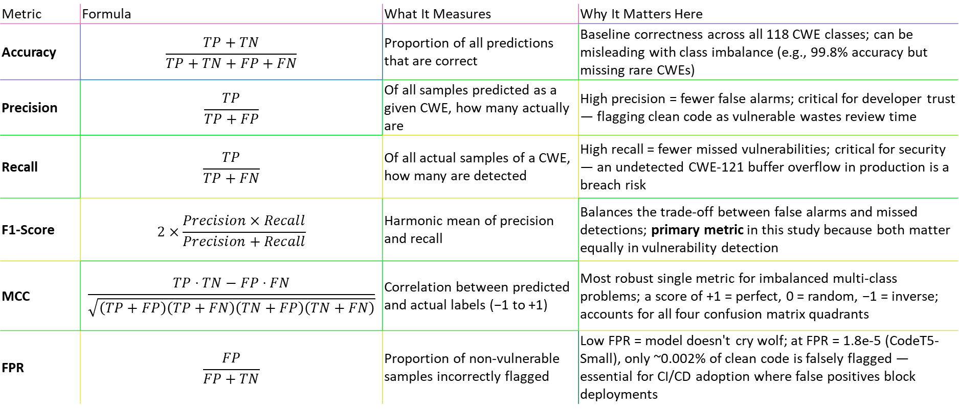
Evaluation Metrics — Definitions & Relevance to
CWE Classification
Metric | Formula | What It Measures | Why It Matters Here
Accuracy | $$\frac{TP+TN}{TP+TN+FP+FN}$$ | Proportion of all predictions that are correct | Baseline correctness across all 118 CWE classes; can be misleading with class imbalance (e.g., 99.8% accuracy but missing rare CWEs)
Precision | $$\frac{TP}{TP+FP}$$ | Of all samples predicted as a given CWE, how many actually are | High precision = fewer false alarms; critical for developer trust — flagging clean code as vulnerable wastes review time
Recall | $$\frac{TP}{TP+FN}$$ | Of all actual samples of a CWE, how many are detected | High recall = fewer missed vulnerabilities; critical for security — an undetected CWE-121 buffer overflow in production is a breach risk
F1-Score | $$2×\frac{Precision×Recall}{Precision+Recall}$$ | Harmonic mean of precision and recall | Balances the trade-off between false alarms and missed detections; primary metric in this study because both matter equally in vulnerability detection
MCC | $$\frac{TP⋅TN−FP⋅FN}{\sqrt{\left(TP+FP\right)\left(TP+FN\right)\left(TN+FP\right)\left(TN+FN\right)}}$$ | Correlation between predicted and actual labels (−1 to +1) | Most robust single metric for imbalanced multi-class problems; a score of +1 = perfect, 0 = random, −1 = inverse; accounts for all four confusion matrix quadrants
FPR | $$\frac{FP}{FP+TN}$$ | Proportion of non-vulnerable samples incorrectly flagged | Low FPR = model doesn't cry wolf; at FPR = 1.8e-5 (CodeT5-Small), only ~0.002% of clean code is falsely flagged — essential for CI/CD adoption where false positives block deployments
Notes:
MCC = Matthews Correlation Coefficient
It is an evaluation metric used for classification models, especially when the dataset is imbalanced.
MCC checks how well the model handles:
True Positives
True Negatives
False Positives
False Negatives

Slide 15
Key Experimental Findings
▸ CodeT5-Base is the best model: highest macro-F1 (0.9605) despite fewer params
▸ Early stopping is critical: CodeBERT & GraphCodeBERT overfit at epoch 2
▸ Template-aware splitting prevents inflated metrics: still >99.6% accuracy
▸ Consumer-grade GPU sufficient: all encoder models train in <53 min on 8 GB VRAM
▸ Instruction-tuning improves zero-shot 3× (Gemma-4 78% vs CodeGemma 25%)
▸ Sub-30 ms latency — viable for CI/CD, IDE plugins, real-time code review
Notes:
Here are the classification results on the full test set of 22,447 samples.
Among the fine-tuned encoder models, CodeT5-Base achieved the highest macro-F1 of 0.9605 with 99.73% accuracy and 24.9 milliseconds inference latency. CodeT5-Small, despite having only 35 million parameters, achieved 0.9533 F1 with the fastest inference at 17.2 milliseconds.
GraphCodeBERT and CodeBERT, both at 125 million parameters, achieved 0.9530 and 0.9512 F1 respectively.
The QLoRA approach with CodeGemma-2B achieved 0.9168 F1 while training only 0.5% of its parameters and using just 1.8 GB of memory — demonstrating that parameter-efficient fine-tuning is viable even on constrained hardware.
The key takeaway here is that these lightweight models provide the classification backbone that feeds into our risk prioritization pipeline. The detection quality is strong enough to support reliable downstream risk assessment.

Slide 16
Per-Class Performance & Error Analysis
▸ 74 of 87 test CWE categories achieve perfect F1 = 1.00 (85.1%)
▸ Weighted macro-F1 = 0.9979, confirming accuracy on the vast majority of samples
▸ Dominant error: misclassification toward CWE-126 (Buffer Over-read)
◦ 23 of 40 total errors are misclassified as CWE-126
◦ CWE-127 (Buffer Under-read): 6 errors
▸ Root cause: buffer access CWEs share syntactic patterns
◦ Pointer arithmetic, array indexing, similar code structures
▸ 3 categories with F1 = 0.00 each have only 1 test sample
◦ CWE-561, CWE-562, CWE-674 — insufficient data, not model failure

Slide 17
Training Convergence
▸ CodeT5-Small: Best at epoch 2, 53 min total — continued improving
▸ CodeT5-Base: Best at epoch 2, 53 min total — continued improving
▸ CodeBERT-Base: Best at epoch 1, 22 min/epoch — overfits at epoch 2
◦ F1: 0.9512 → 0.9377 (-1.35 pp)
▸ GraphCodeBERT: Best at epoch 1, 23 min/epoch — overfits at epoch 2
◦ F1: 0.9530 → 0.8952 (-5.78 pp)
▸ Inference Latency (speedup vs CodeGemma-2B zero-shot):
◦ CodeT5-Small: 17.2 ms (190× faster)
◦ CodeT5-Base: 24.9 ms (131× faster)
◦ CodeBERT: 19.4 ms (169× faster)
◦ GraphCodeBERT: 26.9 ms (122× faster)
◦ Gemma-4-E2B-IT: 396,273 ms (6.6 min/sample!)

Slide 18
What the Paper Does Not Do — And Can Improve
▸ Synthetic dataset only (Juliet Test Suite)
Template-generated code lacks real-world complexity (multi-file, third-party libraries)
Models may not generalize to production healthcare codebases without further validation
▸ Risk prioritization layer is not yet empirically validated
The CWE → LINDDUN → priority mapping is proposed but not tested on real healthcare incidents
Future work: apply pipeline to real CVE databases from healthcare breaches
▸ Sequence length constraint (256 tokens)
Sufficient for Juliet's short functions; may cause information loss on real-world code
Notes:
First, our experiments use only the Juliet Test Suite — which is synthetic, template-generated code. It lacks the complexity of real-world software — multi-file dependencies, third-party libraries, non-standard coding styles. Models trained on Juliet may not generalize directly to production healthcare codebases without additional fine-tuning or domain adaptation. We have begun experiments with the Big-Vul real-world vulnerability dataset, and early results show that real-world code remains significantly more challenging.
Second, and importantly, the risk prioritization pipeline — while theoretically grounded in LINDDUN and established security frameworks — has not yet been empirically validated on real healthcare security incidents. The CWE-to-LINDDUN mapping and the weighted scoring formula need validation against actual healthcare breach data. This is a clear direction for future work.
Third, all models truncate input at 256 tokens. This is sufficient for Juliet's short, self-contained functions, but real-world vulnerable code often spans hundreds of lines. Extending the context window is necessary for production deployment.
These limitations are acknowledged transparently, and each points to concrete future work directions.
Thank you.

Slide 19
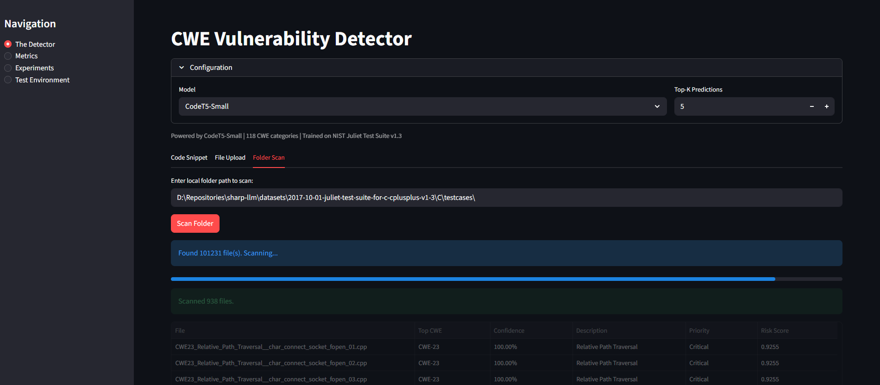
Thank You

Slide 20
References
[1] Lu et al. (2024) — GRACE: Graph-enhanced LLM vulnerability detection, J. Sys. & SW
[2] Yang et al. (2025) — DLAP: DL-augmented LLM prompting, J. Sys. & SW
[3] Tian et al. (2025) — FUSEVUL: Multi-modal vulnerability detection, Inf. Fusion
[4] Mao et al. (2025) — LLMVulExp: Explainable vulnerability detection, IEEE TSE
[5] Liu et al. (2025) — VulACLLM: Lightweight LLM, J. Info. Sec. & Apps.
[6] Ferrag et al. (2025) — SecureFalcon: Compact LLM for vuln. classification, IEEE TSE
[7] Qiu et al. (2026) — RLV: Context-aware detection via retrieval, J. Sys. & SW
[8] Chen et al. (2026) — GPTVD: Static slicing + CoT, Auto. SW Eng.
[9] Ameh et al. (2025) — C3-VULMAP: Privacy-aware healthcare vuln. dataset, Electronics
[10] NSA/NIST (2017) — Juliet Test Suite for C/C++ v1.3

Slide 21
References
[11] Wang et al. (2021) — CodeT5: Identifier-aware Unified Pre-trained Encoder-Decoder, EMNLP
[12] Feng et al. (2020) — CodeBERT: Pre-trained Model for Programming Languages, EMNLP
[13] Guo et al. (2020) — GraphCodeBERT: Pre-training Code Representations with Data Flow
[14] Dettmers et al. (2023) — QLoRA: Efficient Finetuning of Quantized LLMs, NeurIPS
[15] CodeGemma Team (2024) — CodeGemma: Open Code Models
[16] Li et al. (2018) — VulDeePecker: Deep learning-based vulnerability detection, NDSS
[17] Fan et al. (2020) — Big-Vul: Large-scale vulnerability dataset, MSR
[18] Zhou et al. (2019) — Devign: Effective vulnerability identification, NeurIPS
[19] Dolcetti & Iotti (2025) — Dual perspective review on LLMs and code verification, Frontiers
[20] Shaon & Akter (2025) — Modern approaches to software vulnerability detection, Electronics

