Slide 1
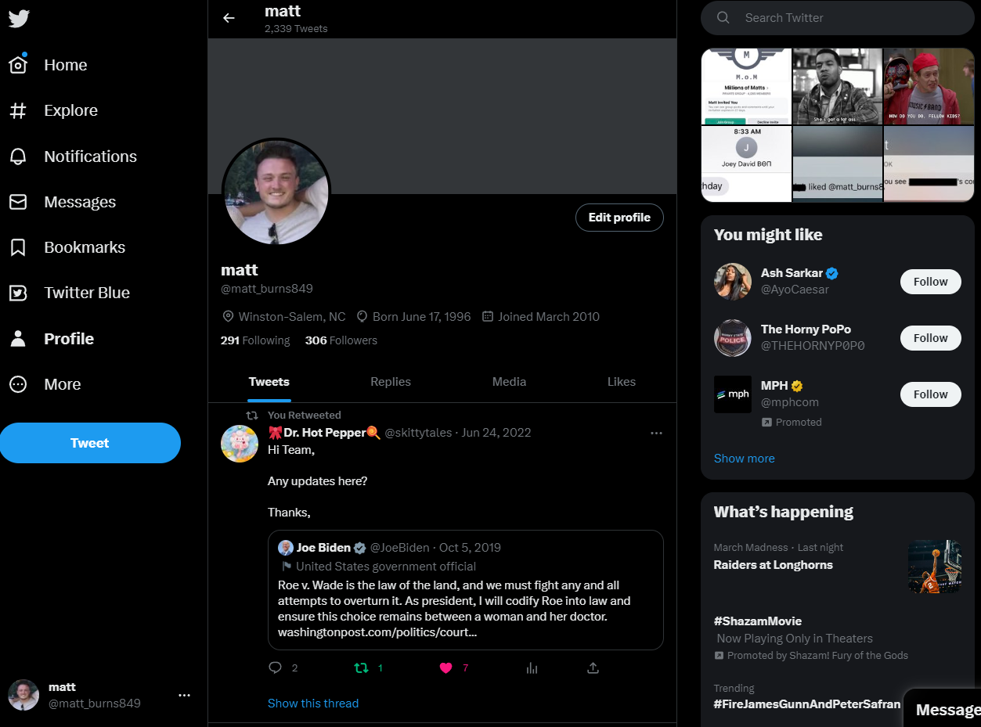

Slide 2
Sidebar
ProfilePane
Suggestions

Slide 3
ProfilePaneHeader
Profile__Banner
ProfilePaneHeader
Profile__Info
Profile__Top
Profile__Info
Profile__Tabs
Profile__Tweets

