Slide 1
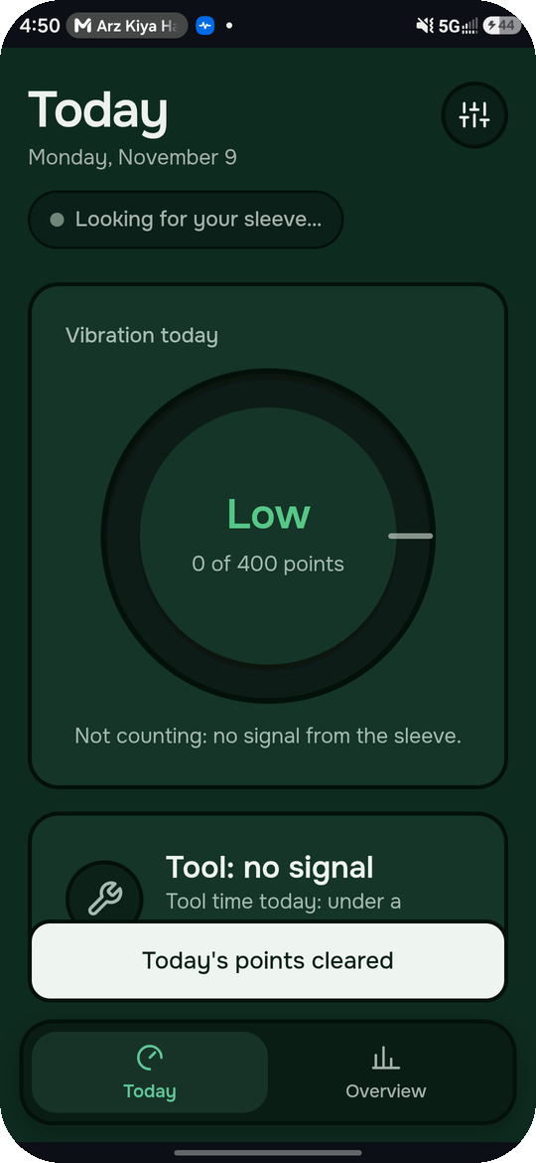
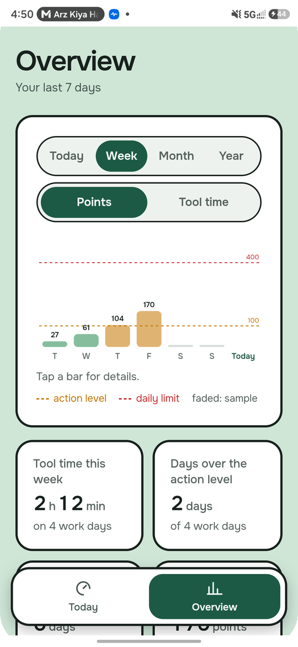
NATHACKS 2026 · CONSTRUCTION & MANUFACTURING
HAVen
A forearm sleeve that tracks how much vibration a worker’s hands really take, and warns them before it becomes permanent damage.
[Team name] · University of Alberta
Notes:
RUBRIC: Pitch & Demonstration. ~10 s. “We’re [team], and this is HAVen: HAV for hand-arm vibration, and a safe haven from it.” Then straight to the team.

Slide 2

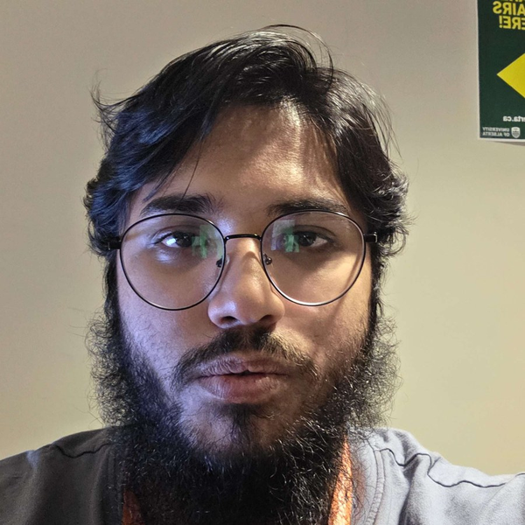
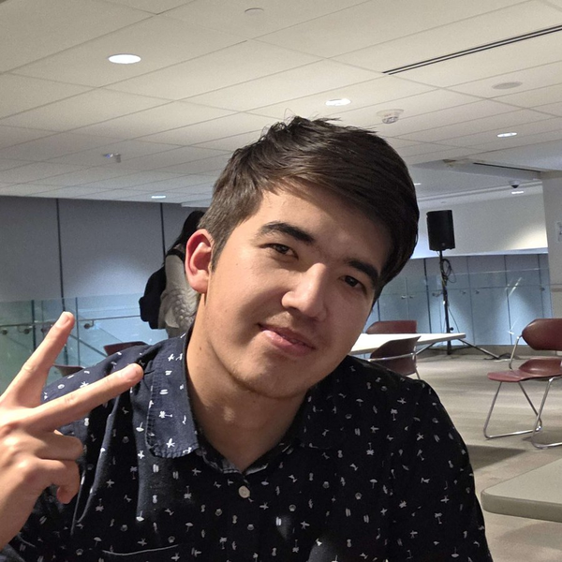
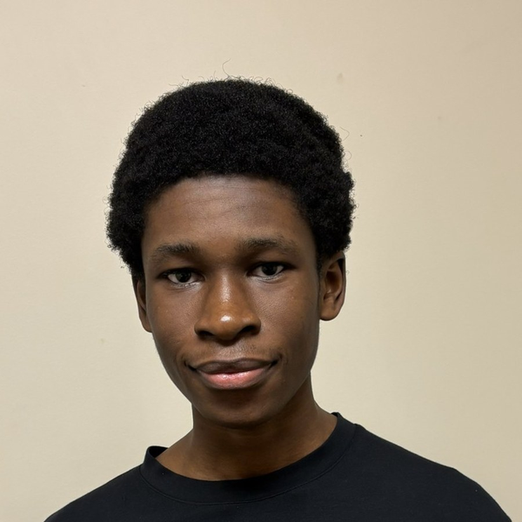
THE TEAM
Five builders, one sleeve
A
Fahad
Salaar
Abduljabbar
Ali
Collins
Exposure engine · frontend
Firmware · signals
Backend · app
CAD · parts
Hardware · sleeve
CS 3rd Year
CS 4th Year
CS 2nd Year
Electrical Eng 2nd Year
02
Notes:
RUBRIC: Division bonus (team composition, up to 3 pts). ~15 s. Name each person’s program and what they built, and stress the mix: hardware, firmware, backend and app. That mix is what the Standard Division bonus rewards.
STILL TO ADD: Abduljabbar’s program and year, and Ali’s photo. Check each role matches what that person actually built.

Slide 3
THE PROBLEM
Power tools slowly destroy workers’ hands, and nobody is counting
Permanent
266,100
No limit
Hand-arm vibration syndrome damages nerves, blood vessels and muscles. There is no cure.
people work in Alberta construction (March 2025).
Alberta has no numeric vibration limit, and few HAVS claims are accepted in Canada.
Sources: Job Bank Alberta construction profile; OHS Insider; Journal of the Canadian Acoustical Association
03
Notes:
RUBRIC: Impact & Real-World Relevance (10). ~40 s. Make it human first: “Imagine using a jackhammer every day. Years later your fingers go white and numb in the cold, and you can’t button your shirt. That’s hand-arm vibration syndrome, and it’s permanent.” Then the three numbers.
If asked how common it is: it depends heavily on the tool and years of exposure; go to the Impact backup slide (18).

Slide 4
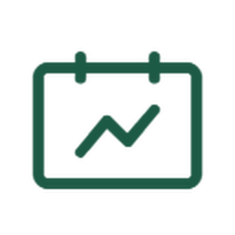



OUR SOLUTION
A sleeve that measures the worker, plus an app that tells them when to stop
Vibration
An accelerometer at the wrist measures how hard the tool shakes.
Grip effort
EMG over the forearm muscles reads how hard the worker squeezes, which a watch can’t reach.
TECH USED · PHONE APP
Real contact time
Java and Swift
Exposure only counts while the tool is shaking and actually gripped.
Java on Android, Swift on iPhone, both use the same exposure engine
04
Notes:
RUBRIC: Creativity & Innovation (10). ~40 s. Hold up the sleeve. “Our sleeve has two sensors. At the wrist, an accelerometer measures the tool’s vibration. Up on the forearm, EMG electrodes read your grip muscles. We only count exposure while the tool is shaking AND gripped, and it fits under the gloves workers already wear.”
If asked “why not a watch?”: the grip muscles are in the forearm, not the wrist.

Slide 5
THE LIMIT
How much vibration is too much?
0 points
100 · action level
400 · daily limit
ACTION LEVEL
DAILY LIMIT
EXAMPLE: JACKHAMMER
100 points
400 points
21 → 83 min
Start cutting exposure: rotate tasks, take breaks.
Stop vibrating tool work for the rest of the day.
Minutes to reach the action level, then the limit.
THE FORMULA · ISO 5349-1 DAILY EXPOSURE
A(8) = a × √(T / 8 h)
Points = 100 × (A(8) / 2.5)²
The EU and UK legal values, using the ISO 5349-1 formula. Our wrist sensor is unweighted, so the app gives an estimate, not a certified measurement.
a = vibration at the wrist (m/s²) · T = hours of tool use · 2.5 m/s² = 100 points · 5.0 m/s² = 400 points
05
Notes:
RUBRIC: Technical Execution (10) + Impact. ~30 s. “So how do we know how much vibration is too much? We don’t invent it. Europe and the UK set two legal lines, measured with the ISO 5349 method: 100 points, the action level, where you must start cutting exposure, and 400 points, the daily limit, where you stop. A jackhammer at a typical 12 m/s² hits the action level in about 21 minutes and the limit in about 83.”
Formula on the slide: A(8) = a × √(T / 8 h), the ISO 5349-1 daily exposure, where a is the vibration magnitude and T the hours of tool use. Points = 100 × (A(8) / 2.5)², which equals 2 × a² × hours. Math if asked: points = 2 × a² × hours. 2 × 12² = 288 points per hour; 100/288 h ≈ 21 min, 400/288 h ≈ 83 min. 12 m/s² is HSE’s typical road-breaker value. 400 isn’t double 100 because harm follows vibration energy (acceleration squared): 5 m/s² is twice 2.5, so four times the points.

Slide 6


HOW WE BUILT IT
A wireless sleeve and a phone that does all the math
The sleeve
WI-FI
The phone app
ESP32 with an EMG front end on the forearm and an accelerometer at the wrist, streaming over Wi-Fi.
Runs the whole engine live: filtering, tool-use detection, the ISO 5349 dose and the alarms.
Problems we solved
Telling tool vibration from normal arm movement, and calibrating grip for any wearer.
06
Notes:
RUBRIC: Technical Execution & Problem-Solving (10). ~20 s. “Under the hood: the sleeve is an ESP32 with an EMG front end on the forearm and an accelerometer at the wrist, streaming over Wi-Fi. The phone app does all the math live, with no server. The hard parts were separating real tool vibration from normal arm movement, and a two-step grip calibration so it works on anyone’s arm.”
CHECK with Salaar/Abduljabbar that each line matches what you built (EMG 1 kHz, IMU 500 Hz, Wi-Fi, phone computes everything) and swap in your real hardest problem if it’s different. Judges score technical execution partly on the problems you solved, so name one concretely.

Slide 7
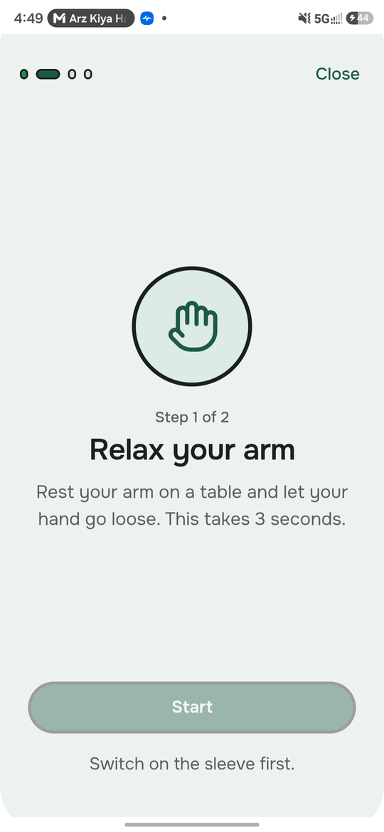
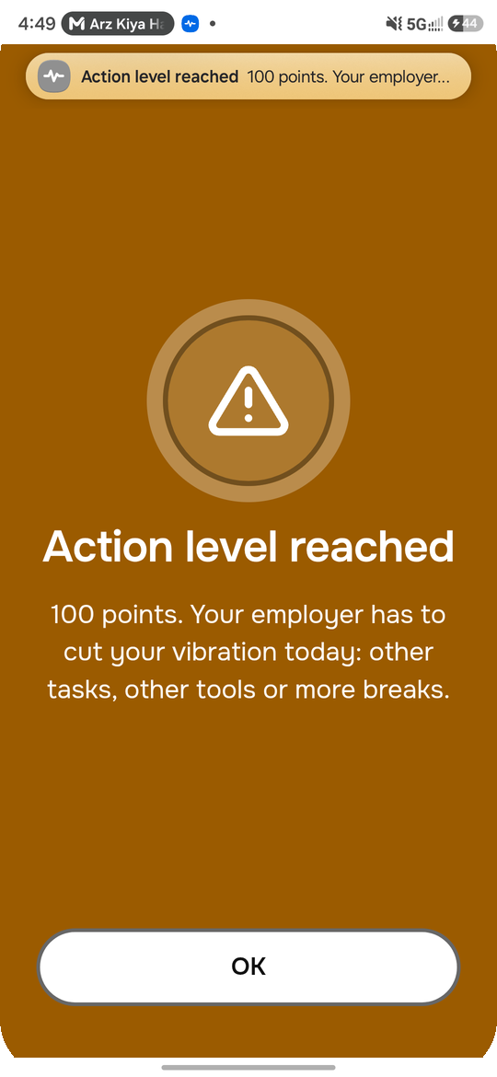
THE DEMO · ABOUT TWO MINUTES
Live demo
One continuous run on the phone and the sleeve. A massage gun stands in for a power tool.
1
Calibrate Relax, then squeeze. The app learns this wearer’s grip.
2
Tool on Points climb. The ring and sleeve light go green to yellow.
3
Time left Shows the minutes left at this pace, until the action level.
4
Hit 100 points The action-level alarm sounds on the phone.
5
Tool down Counting stops. Only time with the tool running adds points.
6
Overview Week, month and year of history.
07
Notes:
RUBRIC: Prototype Functionality & Usability (10) + Pitch & Demonstration (10). ~2 min. One person demos, one narrates. Turn demo speed on and press “Reset demo” / “Clear today’s points” before you start.
1. Calibrate the wearer (relax, squeeze).
2. Massage gun on: tool use detected, points climb.
3. Point at the time left counting down.
4. Reach 100 points: the action-level alarm fires.
5. Put the gun down: counting stops (it only counts while the tool shakes and is gripped).
6. Open the Overview and flip week → month → year (sample history, labelled).
REHEARSE each step on the real app: drop any step that isn’t working rather than demoing it live. If the hardware fails, play the backup video immediately. Don’t debug live.RUBRIC: Prototype Functionality & Usability (10) + Pitch & Demonstration (10). ~2 min. One person demos, one narrates. Turn demo speed on and press “Reset demo” / “Clear today’s points” before you start.
1. Calibrate the wearer (relax, squeeze).
2. Massage gun on: tool use detected, points climb.
3. Point at the time left counting down.
4. Reach 100 points: the action-level alarm fires.
5. Put the gun down: counting stops (it only counts while the tool shakes and is gripped).
6. Open the Overview and flip week → month → year (sample history, labelled).
REHEARSE each step on the real app: drop any step that isn’t working rather than demoing it live. If the hardware fails, play the backup video immediately. Don’t debug live.

Slide 8
OVER TIME, NOT JUST TODAY
From today’s dose to a worker’s long-term risk
EXPOSURE SCALE · POINTS IN A DAY · YEARS ASSUME EVERY WORKING DAY SITS AT THAT LEVEL
0 points
100 · action level
400 · daily limit
about 12 years
about 6 years
1
2
3
4
Today
Trends
Years to risk
Act early
Today’s points, against the 100 (action level) and 400 (daily limit) lines.
The same points charted by week, month and year, so patterns show over time.
About 12 years at the action level, 6 at the limit, until 1 in 10 similar workers get white finger. Not a prediction.
EU and UK advice matched to the worker’s own history. A supervisor can set a lower daily limit.
08
Notes:
RUBRIC: Feasibility & Continuation (10) + Impact. ~20 s. “Today’s dose is only half the story. The app keeps every day, so a worker and their supervisor can see weeks, months and a year at a glance. It shows the ISO standard’s years-to-risk estimate and gives advice from EU and UK guidance, and a supervisor can lower one worker’s daily limit.” The numbers: 31.8 × A(8)^−1.06 (ISO 5349-1 Annex C). At the action level, A(8) = 2.5 m/s²: about 12 years. At the daily limit, A(8) = 5.0 m/s²: about 6 years. The standard’s formula is an older fit, and later research suggests it is conservative. Our A(8) comes from an unweighted wrist sensor, so the input is an estimate too.
Say “group estimate”, never “this worker will get HAVS in X years”. The risk numbers come from ISO 5349 and the EU/UK rules, not our own medical judgement. Historical days in the demo are sample data and are labelled that way in the app.

Slide 9
Thank you
Every monitor measures the tool. HAVen measures the worker.
Next: validate against a reference meter, then pilot with an Alberta contractor.
Questions?
09
Notes:
RUBRIC: Feasibility & Continuation (10). ~10 s. Land the takeaway, say the one-line next step, and stop talking. Stay on this slide during Q&A until a question matches a backup slide (index on slide 10).

Slide 10
BACKUP · Q&A INDEX
If a judge asks…
11
Who else does this?
16
How big is the market?
12
What makes you different?
17
What’s next?
13
What does it cost?
18
What’s the impact?
14
What would the real product look like?
19
What would you charge?
15
Who would buy it?
10
Notes:
Presenter-only cheat sheet. In Present mode type a slide number and press Enter to jump to it. Practise jumping to 11, 13 and 15: competition, cost and who buys are the most likely questions.

Slide 11
BACKUP · COMPETITION
A proven market, led by UK products
Product | Form | Measures | Traction | Price
Reactec R-Link | Wrist watch + tool tags | Vibration, tool time | ~70k workers, 900 firms (2021); £5.6M revenue (2023) | Quote only
Svantek SV 103 | Pro dosimeter | Palm vibration, contact force | Used for formal assessments | £2.3–3.5k
Castle HAVi | Watch + tool timer | Trigger time only | UK safety supplier | £1,150
HAVen | Forearm sleeve | Vibration, grip muscle effort, fatigue | Prototype · built for Canada | C$18.69 parts
Sources: Dealroom; Project Scotland; AcSoft; Castle shop. Our cost: per sleeve at 100 units.
11
Notes:
Q: “Who else does this?” Answer: “Glad you asked. This is a proven market: Reactec alone serves tens of thousands of workers and grew revenue about 41% in 2023. Today’s products are watches, tool tags and professional meters that measure the tool. We measure the worker, with a sleeve that fits under any glove, at about C$19 in parts.”
Don’t quote market share %; no public data exists. If a judge names another product, acknowledge it and go to the edge slide (12).

Slide 12
BACKUP · OUR EDGE
Others measure the tool. We measure the worker.
Fits under any glove
Muscle, not just force
A sleeve, not a glove, so it doesn’t change how a worker holds the tool or replace the anti-vibration gloves they already wear.
Forearm EMG shows grip effort, sustained muscle load and fatigue, which are strain risks on their own.
Long-term view
Built for Canada
Day-to-year history, years-to-risk and rule-based advice in one app.
No incumbent here and no numeric Alberta limit, at a fraction of UK device prices.
12
Notes:
Q: “What makes you different?” Answer: walk the four boxes in ~20 seconds: the sleeve under any glove (practical), muscle effort and fatigue (technical), the long-term view (prevention), built for Canada (market).
Don’t claim nobody else senses grip; say we read grip MUSCLE effort and fatigue from the forearm, in a sleeve.

Slide 13
BACKUP · COST
Commodity parts, a fraction of the price
Manufacturing cost per sleeve (100 units)
Compared with
Part | Cost (CAD)
ESP32-C3-MINI-1 module | C$2.52
MPU-6050 accelerometer* | C$1.36
Muscle BioAmp (EMG) | C$9.21
PCB, power and charging | C$4.25
Compression arm sleeve | C$1.35
Total per sleeve (100 units) | C$18.69
Castle HAVi watch system
£1,150
Svantek SV 103 dosimeter
£2,262–3,457
Competitor prices: Castle shop; AcSoft (excl. VAT). PCB line includes assembly and fees.
13
Notes:
Q: “How much does it cost?” Answer: “At 100 units, one HAVen sleeve costs about C$18.69 to make: the ESP32 module, accelerometer, EMG board, a factory-assembled PCB with power and charging, and a compression sleeve. Competitor devices start around £1,150 for a watch system and go past £2,000 for a professional meter.”
That’s parts and assembly, not retail price or software; say so if asked. FILL IN what the * on the MPU-6050 line means (e.g. price assumption or substitute part), or delete the asterisk.

Slide 14
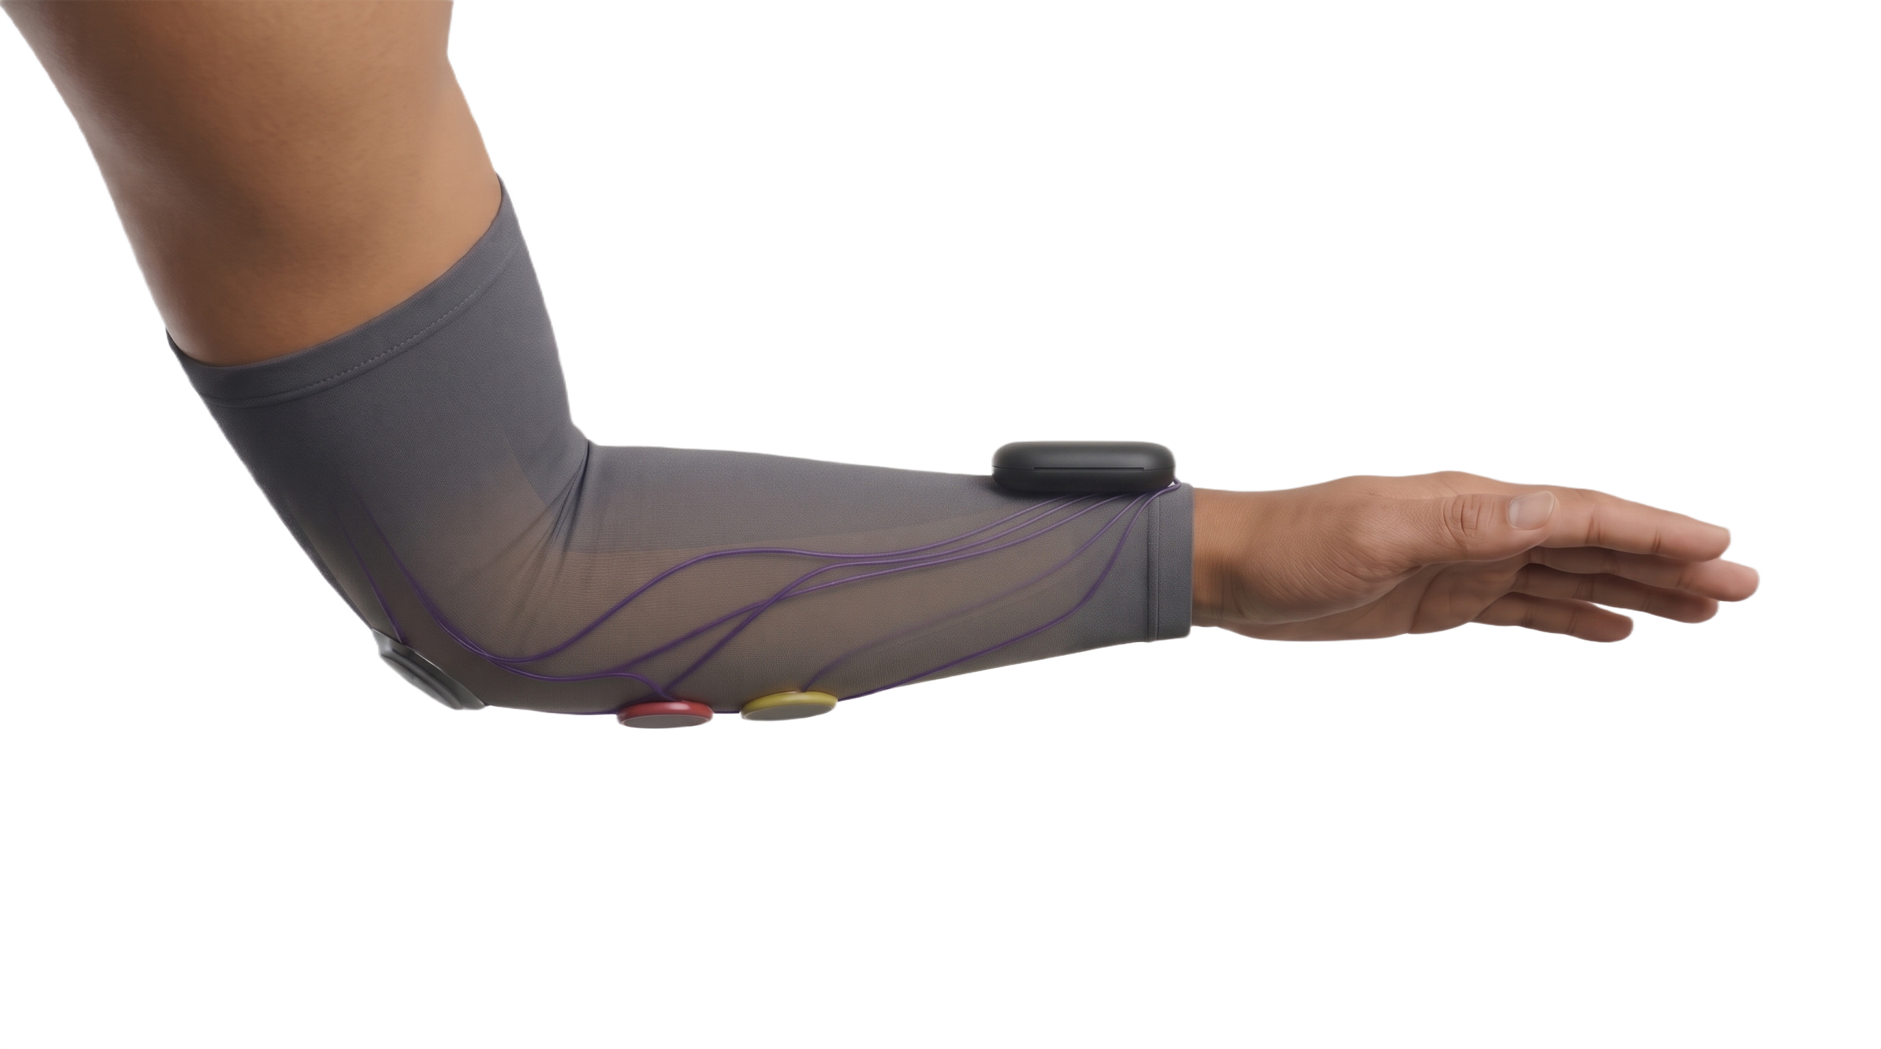
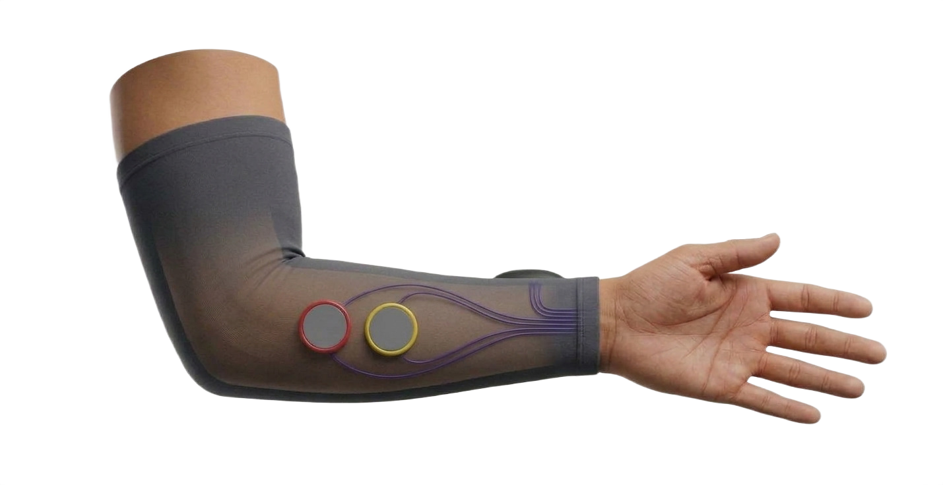
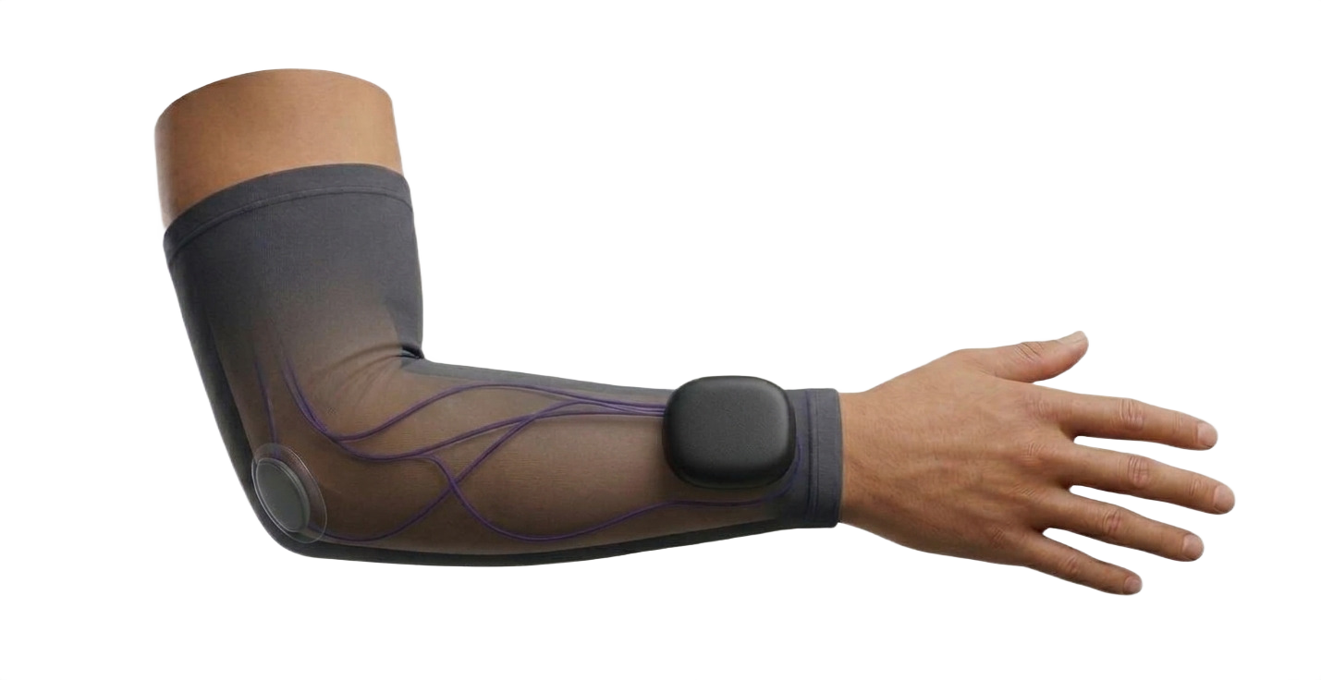
BACKUP · THE REAL PRODUCT
Prototype to site-ready sleeve
BUSINESS MODEL
Sealed pod: accelerometer + EMG pill
Parts cost C$18.69
Price $25–35
AT $25
25%
C$6.31 kept per sleeve
AT $30
38%
C$11.31 kept per sleeve
AT $35
47%
C$16.31 kept per sleeve
Dry electrodes (EMG)
We can sell it for $25 to $35 a sleeve.
Gross margin 25% to 47% at 100 units. Parts and assembly only.
Concept CAD renders of the production design, not a built part.
14
Notes:
Q: “What would the real product look like?” / “Would workers actually wear this?” Answer: point at the renders and walk the four upgrades: the wrist pod (sealed electronics, rigid wrist mount), the two electrodes built into the sleeve, the washable sleeve itself. Be clear the prototype uses dev boards and gel electrodes; the production design removes setup. These are concept renders of the design, not CAD or a built part: say so if asked. WHY BACKUP: a budget prototype can make judges doubt feasibility. This slide answers that only when asked, without spending pitch time on a product that doesn’t exist yet. Annotations: the black pod on the forearm is the sealed electronics, with the accelerometer and the EMG pill inside; the red and yellow discs are the dry electrodes. Right-hand panel: the price and margin (full version on backup slide 19).

Slide 15
BACKUP · WHO BUYS
More buyers than just the employer
Buyer | Why they’d pay | Evidence
Contractors | Exposure records strengthen their safety program and WCB rebates | WCB Alberta PIR: 10% refund first COR year, 5% after
Unions & workers | A worker-owned exposure history to back a future compensation claim | HAVS claims are rarely accepted in Canada
Tool rental firms | Rent the sleeve with every breaker or grinder | Speedy Hire offered HAV meters to customers (2009)
Safety associations | Bundle with COR training and audits | ACSA members earned $34M in PIR rebates (2016)
Big project owners | Require safety certification from every contractor | City of Calgary requires COR to prequalify
Sources: WCB Alberta; ACSA; JCAA; KHL (Speedy Hire); City of Calgary
15
Notes:
Q: “Who would buy this?” / “Why would a company pay for something that might show they’re over the limit?” Answer: “Our advisor raised exactly that, so we looked beyond employers. Unions and workers want their own exposure record, because HAVS compensation claims are hard to prove in Canada. Rental companies can rent it with the tool; Speedy Hire in the UK already did this with HAV meters. And employers have a financial reason: Alberta’s WCB gives COR-certified companies a 10% premium refund in year one and 5% after, so a better safety program pays for itself.” CAUTION: the WCB refund is for COR certification overall, not for buying this device; say “supports their safety program”, not “gets them a rebate”. The union/worker angle is a hypothesis to validate with real union reps. WHY BACKUP: the “who pays” question comes up in almost every Q&A, and your advisor specifically flagged it.

Slide 16
BACKUP · MARKET
Start in Alberta, then expand
BEACHHEAD
PROOF IT SELLS
NEXT
266,100
~70,000
Beyond construction
Alberta construction workers (March 2025). The share using vibrating tools daily: [__%].
workers on Reactec’s HAVwear by 2021, mostly in the UK, where limits are law.
Mining, oil and gas, manufacturing, forestry, rail: anywhere hands meet vibrating tools.
Sources: Job Bank Alberta construction profile; Project Scotland (Reactec, 2021)
16
Notes:
Q: “How big is the market?” Answer: “We’d start with Alberta construction, about 266,000 workers, and sell through contractors, unions and rental firms. The UK shows the demand is real: one company alone had about 70,000 workers on its wearable. After construction: mining, oil and gas, manufacturing, forestry, rail.” DON’T invent a total market size in dollars. If you want one, compute it live and say it’s an assumption: e.g. 10% of Alberta construction workers × your monthly price × 12. WHY BACKUP: a beachhead + proof + expansion story answers “is this a business?” in 20 seconds without made-up market-size numbers.

Slide 17
BACKUP · WHERE THIS GOES
From prototype to pilot
NOW
NEXT 3 MONTHS
6–12 MONTHS
THEN
Working prototype
Validate
Productize
Pilot & scale
Sleeve, app, ISO-based exposure, limits and trends.
Compare against a reference meter; talk to Edmonton unions and contractors.
Custom board, dry electrodes, ISO frequency weighting, AI tool recognition.
Paid site pilot, supervisor dashboard, then mining and manufacturing.
natHacks funding would go to: [reference meter, production parts, pilot]
17
Notes:
Q: “What’s next?” / “What would you do with the prize?” Answer: walk left to right in ~20 seconds, then name what the prize money funds. Validation comes first because accuracy is your biggest open question. FILL IN: the bottom line with concrete uses of the seed funding and in-kind services (e.g. a reference vibration meter rental, a production PCB run, a pilot with one contractor). WHY BACKUP: Feasibility & Continuation is 10 points, and the prize is development funding. If a judge doesn’t ask, consider pulling one sentence of this into the thank-you.

Slide 18
BACKUP · IMPACT
Measuring exposure cuts cases
1,210 → 220
145,000
Rare
new UK HAVS benefit cases, 2010 vs 2024, after limits became law in 2005.
vibration white finger claims settled for former UK coal miners.
accepted HAVS claims in Canada: workers can’t prove exposure they never recorded.
Sources: HSE IIDB statistics; UK National Audit Office; JCAA
18
Notes:
Q: “What impact would this have?” / “Does this matter to companies?”
Answer: “Where exposure is regulated and measured, cases fall: new UK HAVS benefit cases dropped from about 1,200 in 2010 to about 220 in 2024. Where it isn’t managed, the bill comes later: around 145,000 vibration white finger claims were settled for former British Coal miners. And in Canada few claims are accepted, partly because workers have no exposure record; HAVen gives them one.”
CAREFUL: the UK drop is correlation (regulation, monitoring and fewer exposed jobs all play a part). The coal schemes’ total cost (about £4.1bn compensation plus £2.3bn admin) covers vibration AND lung disease, so only quote the 145,000 VWF claims as vibration-specific.

Slide 19
BACKUP · PRICE AND MARGIN
We can sell it for $25 to $35 a sleeve
Parts cost C$18.69
Price $25–35
$0
$10
$20
$30
$40
AT $25
AT $30
AT $35
25% gross margin
38% gross margin
47% gross margin
C$6.31 kept per sleeve
C$11.31 kept per sleeve
C$16.31 kept per sleeve
Gross margin = (price − parts cost) ÷ price. Parts and assembly at 100 units; excludes software, shipping, warranty and sales. Prices assumed in the same currency as the cost (CAD).
19
Notes:
Q: “What would you charge?” Answer: “We’d price it at $25 to $35 per sleeve. At 100 units it costs about C$18.69 to make, so the gross margin is roughly 25% at $25 and 47% at $35. That covers parts and assembly only; software, support, shipping and sales come on top.” CAUTION: the price is an assumption until we test it with contractors; say so. Margin = (price − parts cost) ÷ price.

