Slide 1
Integration of CFD Modelling Framework IC-FERST for Industrial Application in BP: Automation of pre- and post-processing using Python
ACSE9 - Independent Research Project
September 10, 2019
Dongzhen Li (CID: 01609749)
Supervisors/advisors: Asiri Obeysekara, Andre Nicolle, Chris Pain
Email: dongzhen.li18@imperial.ac.uk
Github alias: anitali555888
Notes:
Dongzhen Li, an MSC student from the course Applied Computational Science and Engineering
This is a presentation for my ACSE-9 independent research project, which has the title:
Integration of CFD Modelling Framework IC-FERST for Industrial Application in BP: Automation of pre- and post-processing using Python.
My supervisors are Dr. Asiri, Dr. Andre and Prof. Chris Pain.
Here, I did the work focusing on the post-processing part, and the pre-processing work was as what your found in the last project of another student Duncan Hunter.

Slide 2
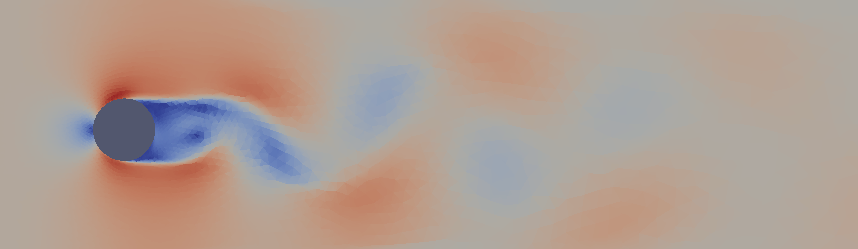
Contents
1 Project Objectives
2 Context and Motivation
3 Methodology
4 Implementation and Results
5 Conclusion
Notes:
Today I will go through the project in 5 sections: firstly, an introduction of the project objectives, then some necessary context and motivation to give a background of the industrial problem, next along the work flow to explain the methodology and implementation, finally to some results with analysis and conclusions of this project.

Slide 3
Project Objectives
1
Related to a research project between Imperial College and BP about IC-FERST.
Imperial College Finite Element Reservoir Simulator (IC-FERST):
A general-purpose code for simulating multiphase flow and transport in complex geological reservoirs; also turbulent flow modelling.
Based on an open-source CFD code Fluidity, the Control-Volume Finite Element methods, dynamic unstructured mesh optimization and parallelization using MPI.
Notes:
The proposed work in this project is related to a research project between Imperial College and BP to evaluate the advanced CFD codes IC-FERST developed in Imperial College by Applied Modelling and Computation Group (AMCG). The IC-FERST, Imperial College Finite Element Reservoir Simulator (IC-FERST):
It is a general-purpose code for simulating multiphase flow and transport in some complex geological problems; also some turbulent flow modelling issues.
And it is Based on an open-source CFD code Fluidity, using the Control-Volume Finite Element methods, dynamic unstructured mesh optimization and already be parallelized using MPI.

Slide 4
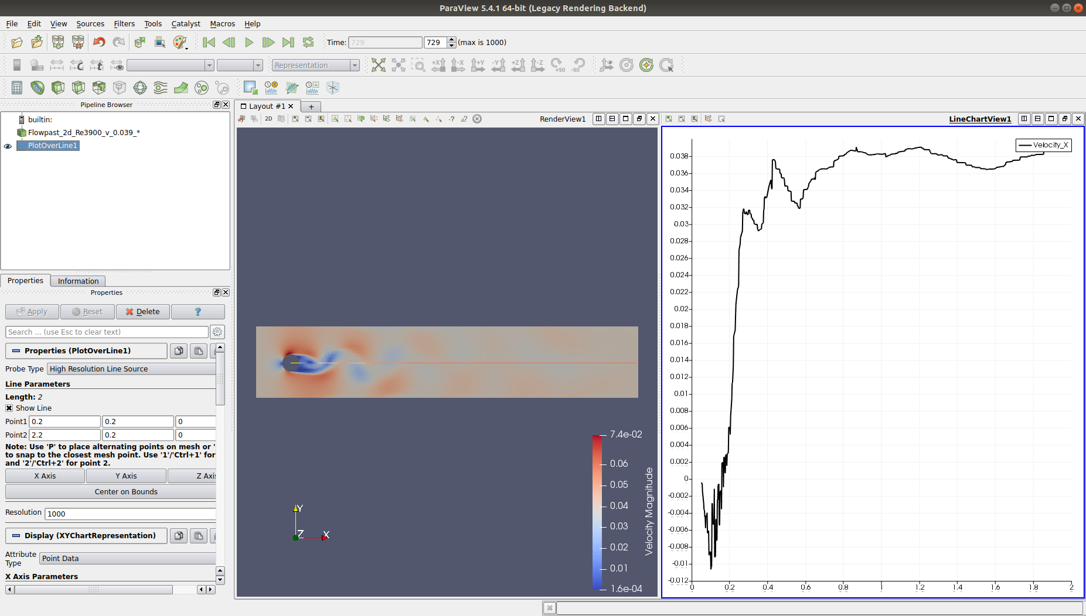
2
Post-processing: Analyse simulation results
Traditional visualization tool: ParaView
ParaView has “filters” for data analysis, but relies on a GUI
Notes:
After CFD simulations, to analyse the simulation results, it comes to the stage post-processing. A traditional visualisation platform is ParaView. There are some useful filters for the data visualisation, but it needs to be implemented on GUI, the graphical user interface.

Slide 5
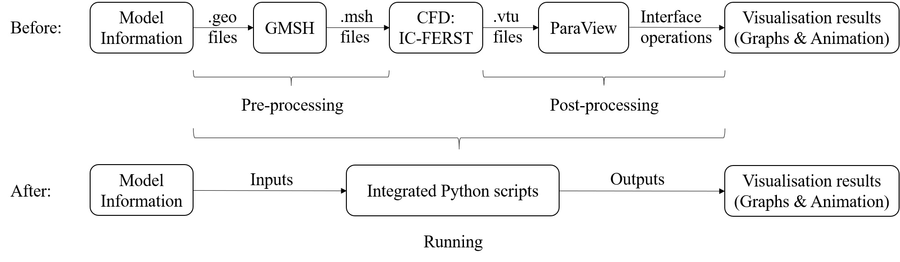
Project Objectives
3
Main objective: Integrate IC-FERST with post-processing tools.
.mpml
files
Existing ecosystem of IC-FERST
Integration for further commercial application, like HPC context of industry partner’s preference.
Notes:
And that is what I try to change and develop in this project: it is the main objective here: the Integration of IC-FERST and post-processing tools using Python scripts.
The integrated tool aims to implement similar functions as Paraview filters in scripts, due to further commercial application in HPC context of industry partner’s preference, and to more convenience and efficiency of analysing and testing purposes. This development is based on the circumstance of prepared .geo, .msh and .mpml file which means the pre-processing is done.

Slide 6
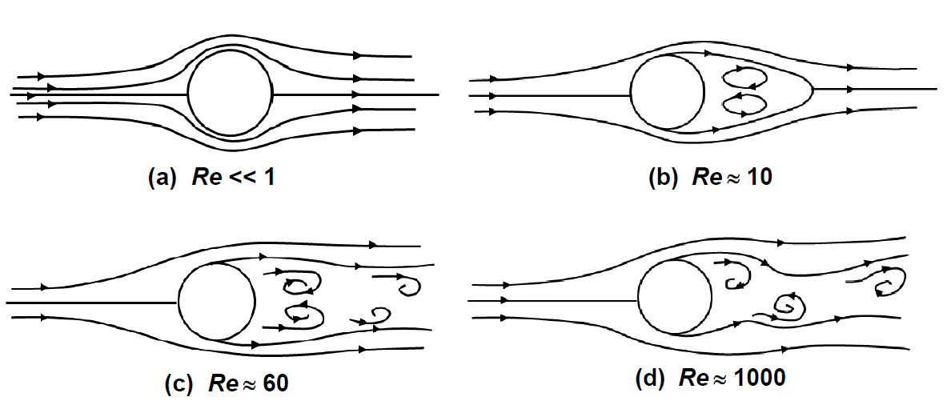
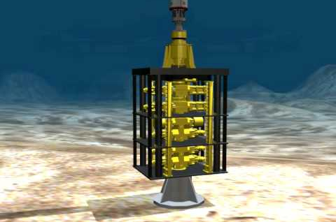
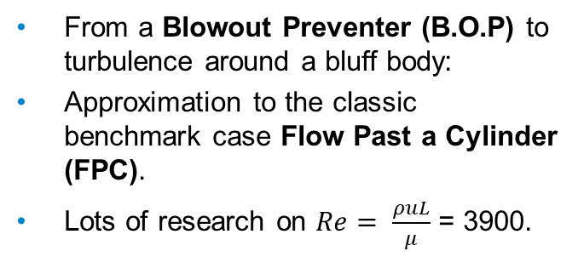
4
Context and Motivation
From a Blowout Preventer (B.O.P) to turbulence around a bluff body:
Approximation to the classic benchmark case Flow Past a Cylinder (FPC).
Lots of research on $Re= \frac{ρuL}{μ}$ = 3900.
Notes:
To the motivation of this project, there is a example of engineering problem about the Blowout Preventer B.O.P in deepwater as the picture shown here. B.O.P is a mechanical device used to seal, control and monitor oil and gas wells to prevent blowouts. When it is in the underwater condition, it can be approximated as a bluff body, like a cylinder, and this case has similar patterns as the classic benchmark case Flow Past a Cylinder (FPC) in a turbulence condition.
To find out and quantify the conditions that the B.O.P suffered, I reviewed some literature about FPC.
In the FPC case, the dimensionless value Reynolds number, which is related to the flow velocity( the u in the expression), has important influences on the flow patterns like the picture. As many research work is about flow at the important lower sub-critical value Reynolds number 3900, here I choose those experimental research results at this value to be the theoretical basis.

Slide 7
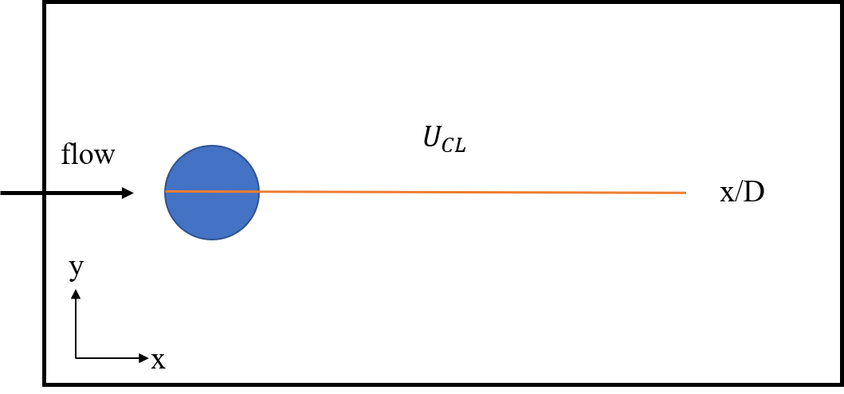
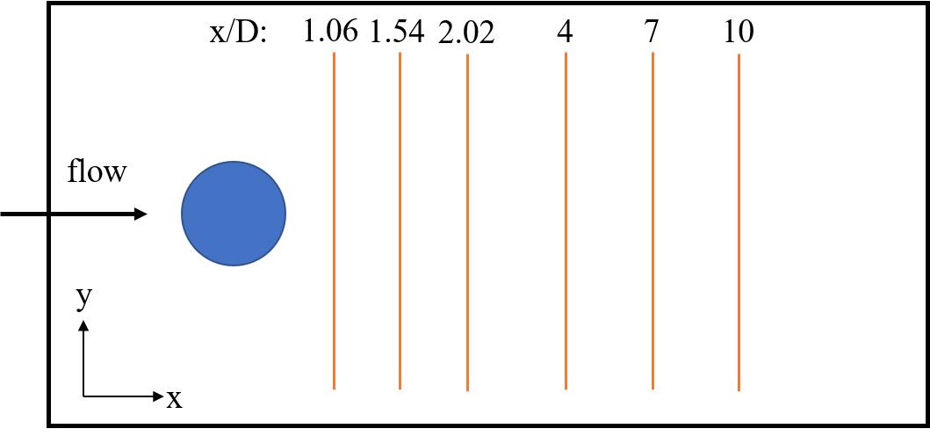
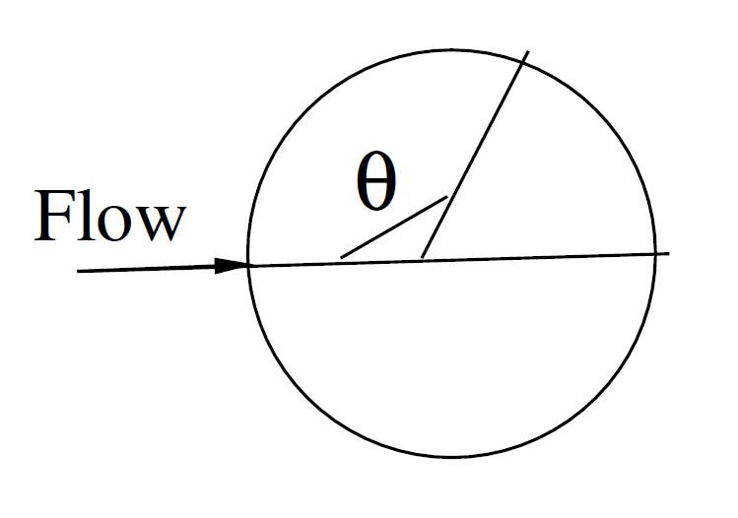
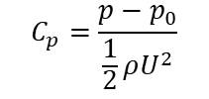
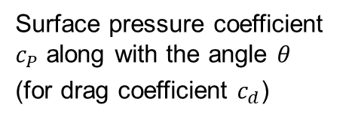
5
Context and Motivation
Important Quantities in Physical Space
$$C_{p}=\frac{p−p_{0}}{\frac{1}{2}ρU^{2}}$$
Along wake centreline
(Mean streamwise velocity)
Transverse profiles in the near and the farther wake region
(Streamwise/cross-stream velocity)
Surface pressure coefficient $c_{P}$ along with the angle $θ$
(for drag coefficient $c_{d}$)
Notes:
From the literature, there are several important quantities in analysing the FPC. As these 3 pictures shown, there are velocities along the flow centreline, and the velocities in the transverse profiles in different region at the wake, and the drag coefficient along the body surface.
Here, the velocities chosen are the streamwise velo in centreline, streamwise and cross-stream velo in wake transverse profile, the drag coefficient in pressure expression which is called pressure coefficient.

Slide 8
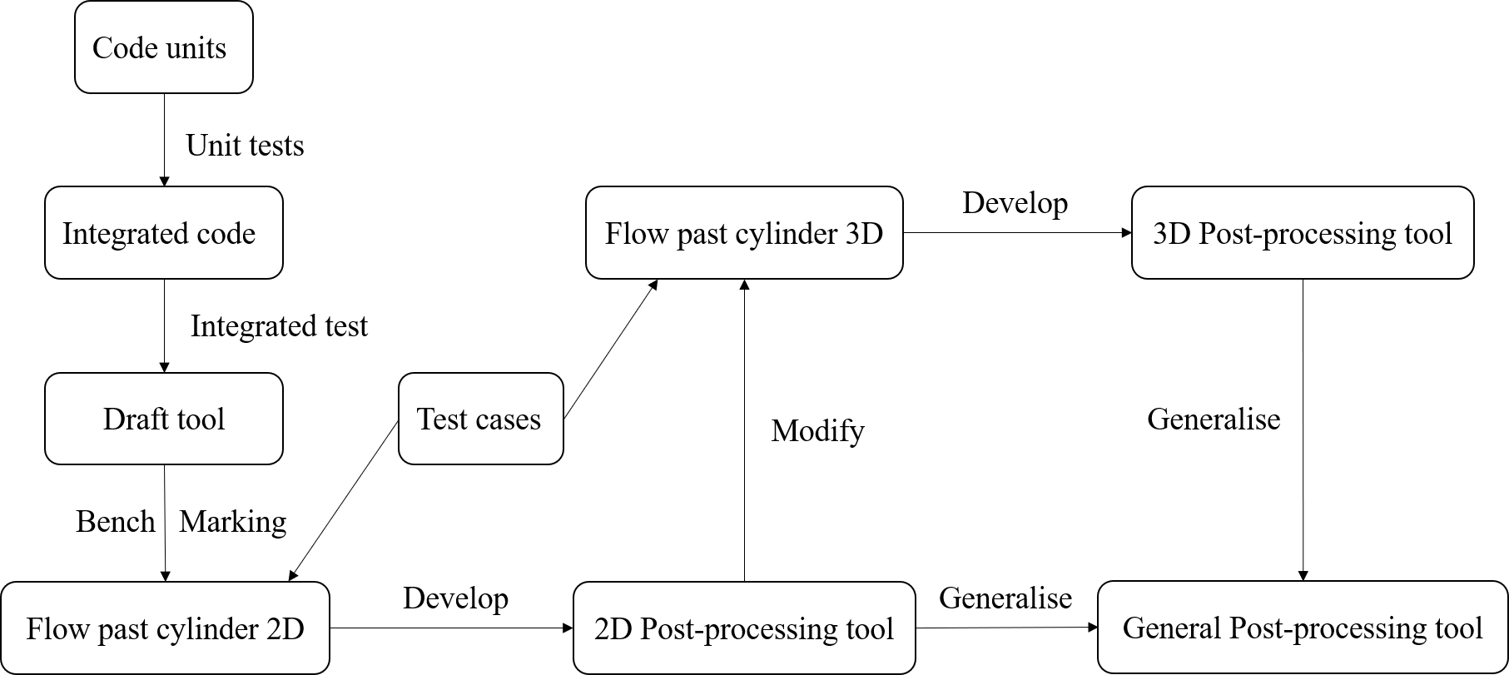
Methodology
6
Work flow of development
objectives
Benchmarking
Notes:
After the context, the development in this project is like this flow chart. Based on the objectives, it begined with some code units for each function, then is the integration and tests in every stage to a draft tool. With the FPC 2D and 3D test cases, there are some comparison to the experimental results for benchmarking and for testing its functionality.
I will go over this work flow in the rest of this presentation, as the objectives of the code, unit tests, integrated test, benchmarking test and the 3D test results.

Slide 9
Methodology
.mpml
files
7
Three main objectives of the code:
1) Run the simulation and get output files;
2) Read data from output and implement filters;
3) Plotting the data processed by filters.
Corresponding three Classes:
1) class simulation()
2) class filters()
3) class plotting()
Libraries used: vtk – reading (p)vtu, numpy – processing data in arrays, matplotlib – plotting figures.
Notes:
As I mentioned before in the existing ecosystem of IC-FERST, see the flow chart here, the main objective is the integration code. There are 3 main objectives of this code:
1) Run the simulation and get output files; (run the .mpml file with .geo and .msh)
2) Read data from output and implement filters to process the data;
3) Plotting the data after filters.
For these 3 objectives, I created 3 classes for each corresponding purpose. They are 1) class simulation(), 2) class filters(), 3) class plotting().
And the libraries used in the code are: vtk – reading (p)vtu, numpy – processing data in arrays, matplotlib – plotting figures.

Slide 10
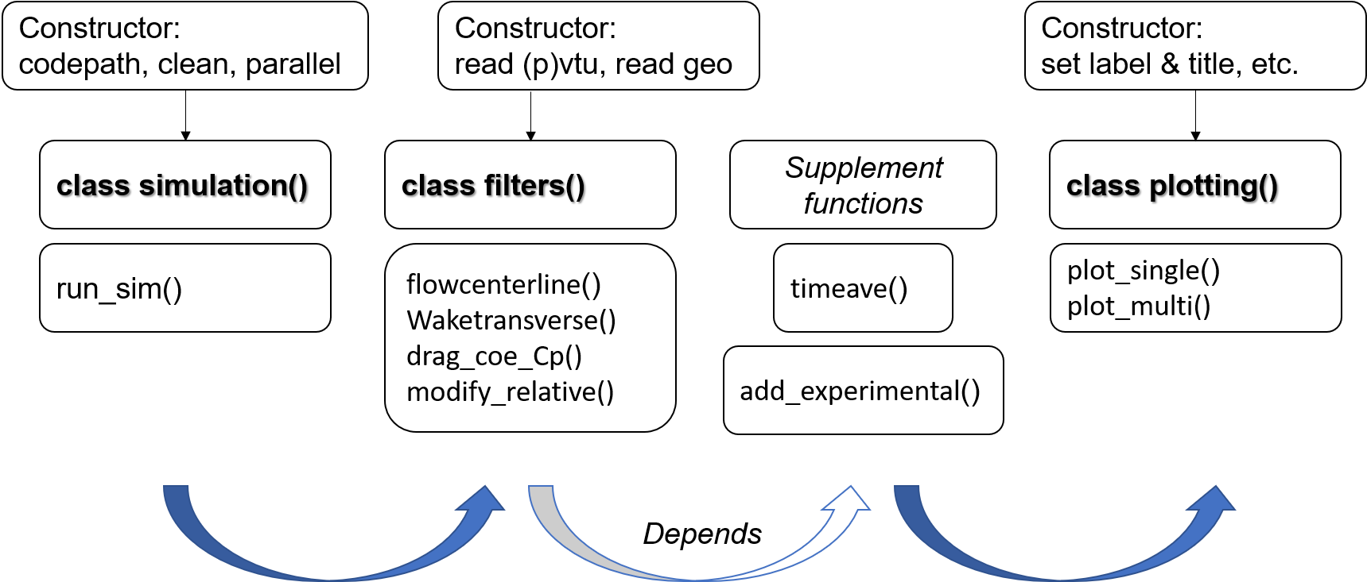
Methodology
8
Overview of classes structure
methods
w
Notes:
And this is an overview of the structure of the 3 classes.
Those methods in each class are used for different functions of different objectives, and there are two supplement methods as the options for users to call after the simulation and filters, before the plotting.
In every class, the constructor contains some useful functions for further automation purpose. For example, in the simulation class there is an attribute parallel for the options of running the simulation in serial or parallel. And in filters class there is also has an attribute parallel to read the serial output vtu or the parallel output pvtu file. Another example of the automation is that the constructor provide a method of reading the .geo file automatically and find the position and diameter of the cylinder, or the bluff body.

Slide 11



Implementation and Results
9
Unit Tests (8)
def test_flowcenterline():
def test_waketransverse():
def test_drag_coe_Cp():
def test_modify_relative():
def test_timeave():
def test_add_experimental():
def test_plot_single():
def test_plot_multi():
Pass all
Pass all
If any further development
Notes:
In the pytest.py file, there are 8 tests for 8 important functionalities of the post-processing tool. When they are all passed one by one, it means the tool is with good functionalities. And if there are any further development by future developers or users who want to modify this tool on their preference, these unit tests are still a helpful way to test the modified pieces and the code functionality.

Slide 12
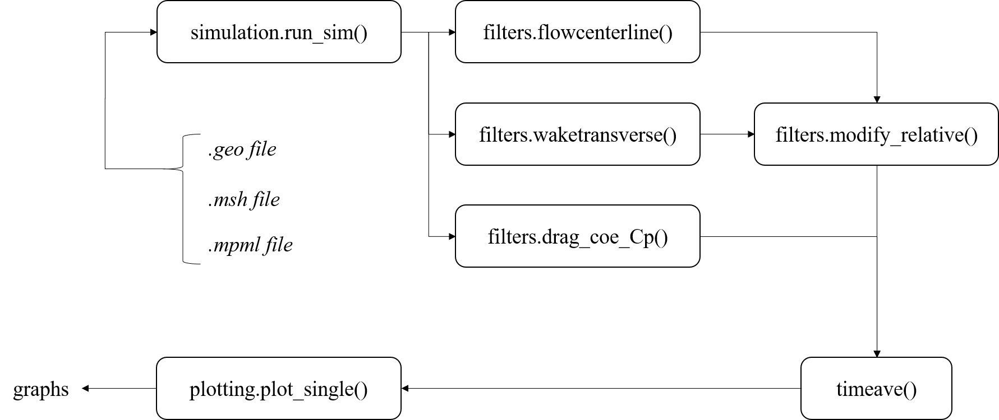
Implementation and Results
10
Integrated Test on FPC 2D
Notes:
The integrated tests test the functionality of the integrated code. Here is what the tests look like: from the 3 files to simulation, and to each filters, and to further processing, and then to plotting and making graphs. There is an example scripts in the github repository like this to guide the users to use this tool.

Slide 13
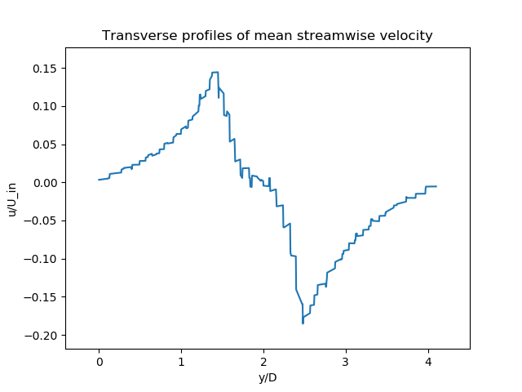
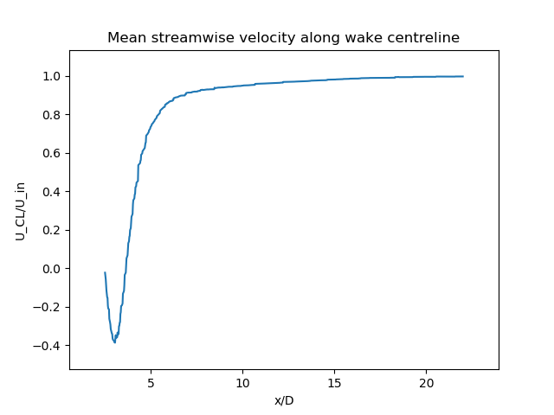
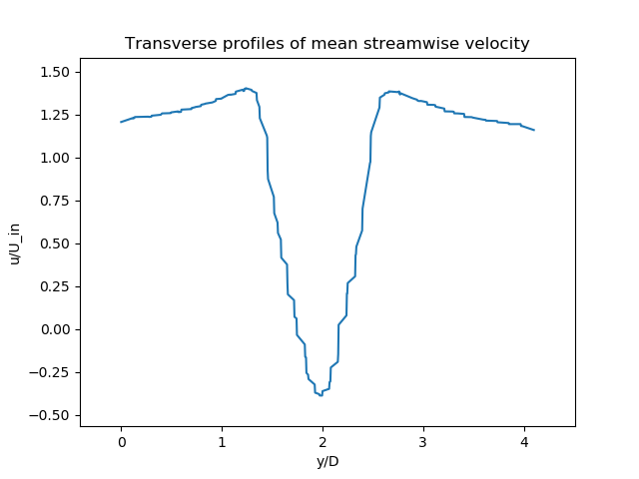
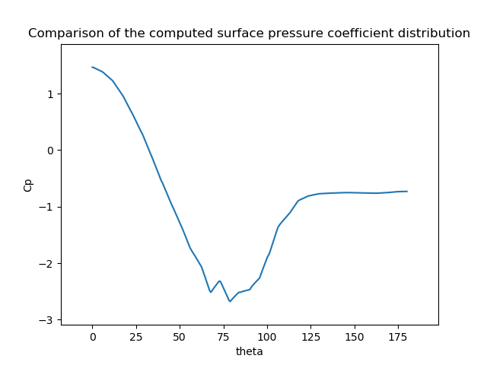




Implementation and Results
(x/D = 1.06)
cross-stream velocity
11
$$V_{tran}$$
Integrated Test on FPC 2D
$$C_{p}$$
$$U_{CL}$$
$$U_{tran}$$
Notes:
There are some pictures of the test results of the FPC 2D case. And those also are example results of the post-processing tool. These four pictures are the mean streamwise velocity along wake centerline, transverse profiles of mean streamwise and cross-stream velocity and the computed surface pressure coefficient distribution.

Slide 14
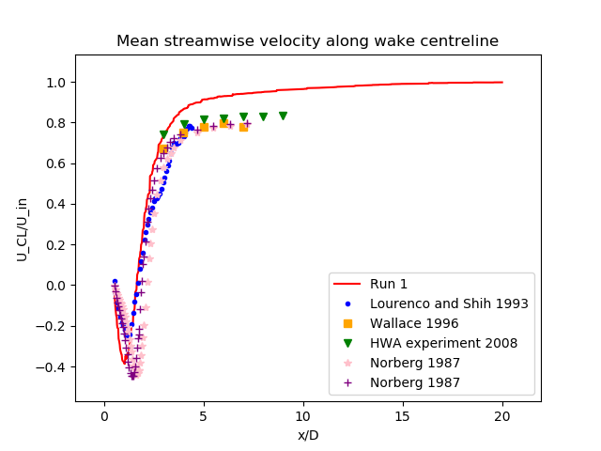
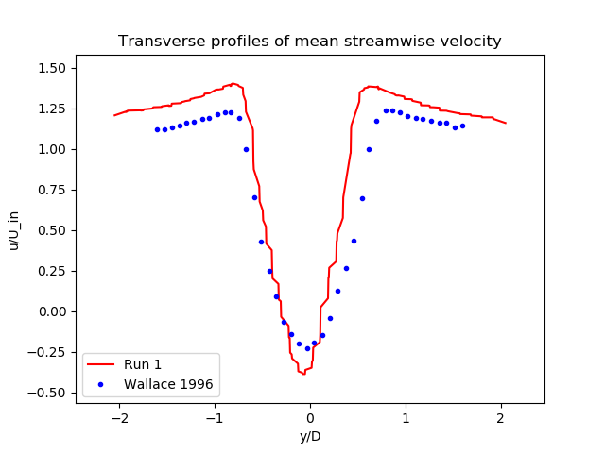
Results
12
Benchmark on FPC 2D
Notes:
Validation evidence

Slide 15
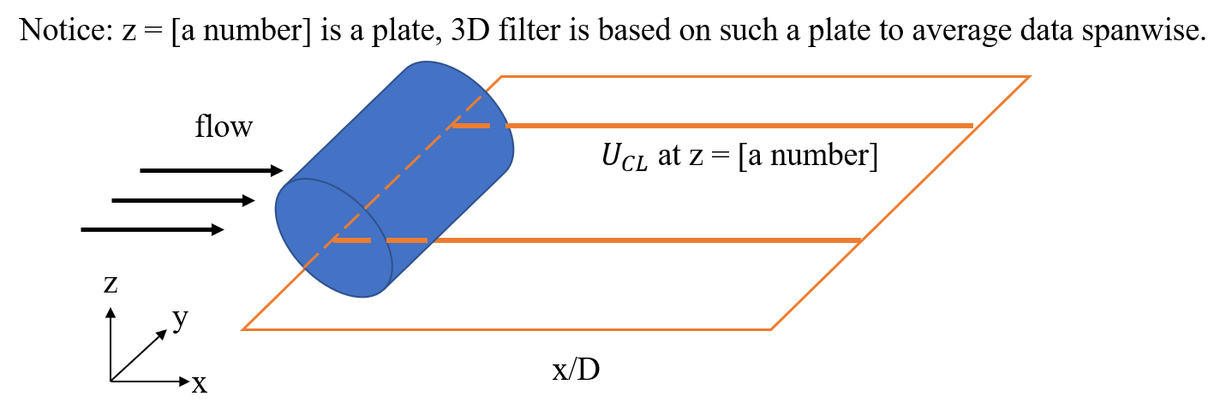
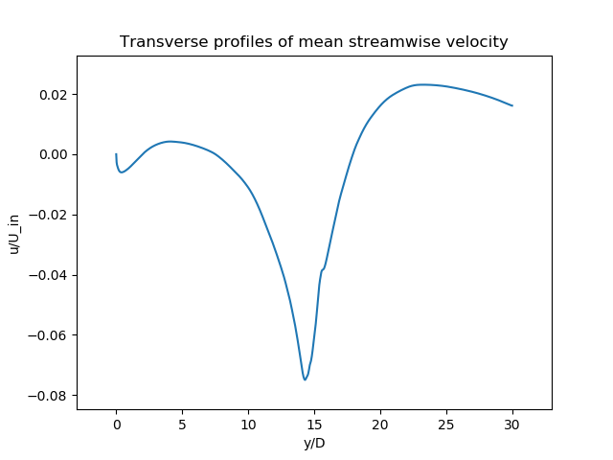


Results
13
FPC 3D results
$$U_{CL}$$
$$U_{tran}$$

Slide 16
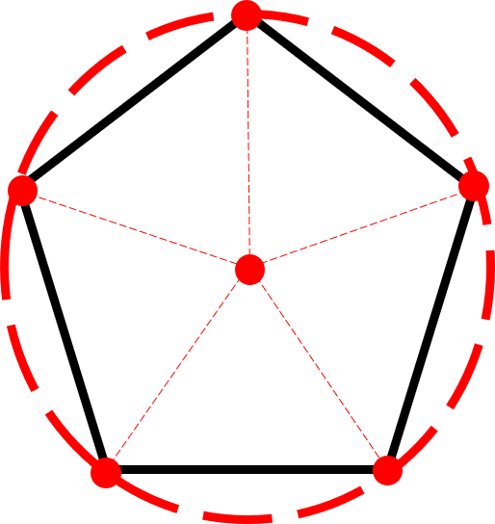
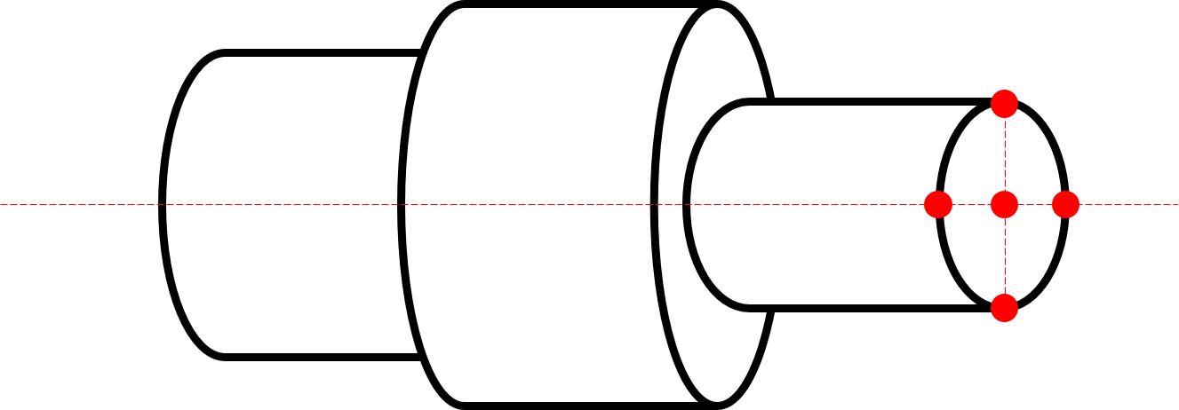
Conclusion
non-circular
various transverse shape
14
Time constraints
General tool is not actually accessible and no more test on general(industry) cases.
Further Generalization
Further automation in reading .geo file and body approximation.
Generalization and test on:
1). The bluff body with non-circular transverse shape(3D, 2D done but without tests).
2). The bluff body with various transverse shape along the body length(3D).
Notes:
To conclude this project, there are some strengths I’ve already mentioned as the integration and good functionality and some attempts to generalization as well, and also some limitations.
Like the General tool is not actually complete and accessible and there is no more test on the general cases like the industrial problems.
And the tools needs Further Generalization and Further automation in reading .geo file and body approximation. The future work of
Generalization and test are on aspects like: adapted to
1). The bluff body with non-circular transverse shape (3D, 2D done but without tests).
2). The bluff body with various transverse shape along the body length(3D).

Slide 17
ACSE9 - Independent Research Project
September 10, 2019
Thank you for listening
&
Welcome to questions
Dongzhen Li (CID: 01609749)
Supervisors/advisors: Asiri Obeysekara, Andre Nicolle, Chris Pain
Email: dongzhen.li18@imperial.ac.uk
Github alias: anitali555888

