Slide 1
Fireframe: a programmable framework using Firedrake
By: Keer Mei
For Applied Computational Science and Engineering Module 9 – Independent Research Project

Slide 2
Table of Contents
Motivation
Software Design and Implementation
Form analysis
Verification by MMS
Test Cases
Challenges
Acknowledgement
Notes:
Good morning, my name is Keer and today I will be presenting my final research project, Fireframe.

Slide 3
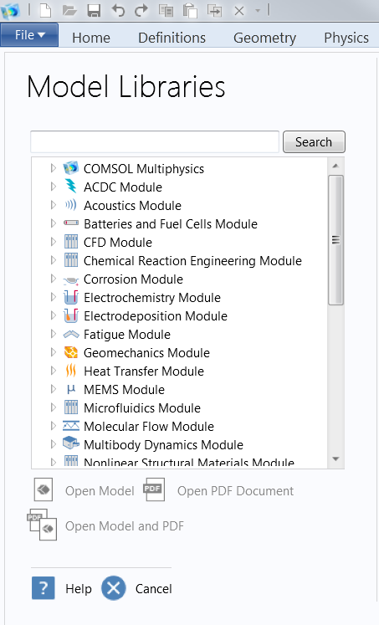
Motivation
A generalized framework to streamline the process of coupling differential equations using Firedrake
(similar to FEniCS framework^{[1]})
High level instructions
Code clarity
[1] Garth N. Wells Mikael Mortensen, Hans Petter Langtangen. A fenics-based programming framework for modelling tur-
bulent flow by the reynolds-averaged navier-stokes equations. Advances in Water Resources, 34(9)
Notes:
Fireframe is a module built on top of the Firedrake library. The aim of Fireframe is to provide users with a simplified interface to couple different PDEs together and streamline the process of solving coupled problems. If you look at most commercial multiphysics packages, they all provide users with some selection of different multiphysics libraries. In similar fashion, Fireframe attempts to mimic the capability to select different models using the underlying Firedrake functionality.
The inspiration for Fireframe came from a previously developed framework that uses the FEniCS library to study turbulence models. That framework provided the basis for Fireframe.
Ultimately, the goal of the Fireframe simplifies the process of posing and solving coupled problems using Firedrake by only requiring users to issue high level commands and eliminating many of the programming repetitions.

Slide 4
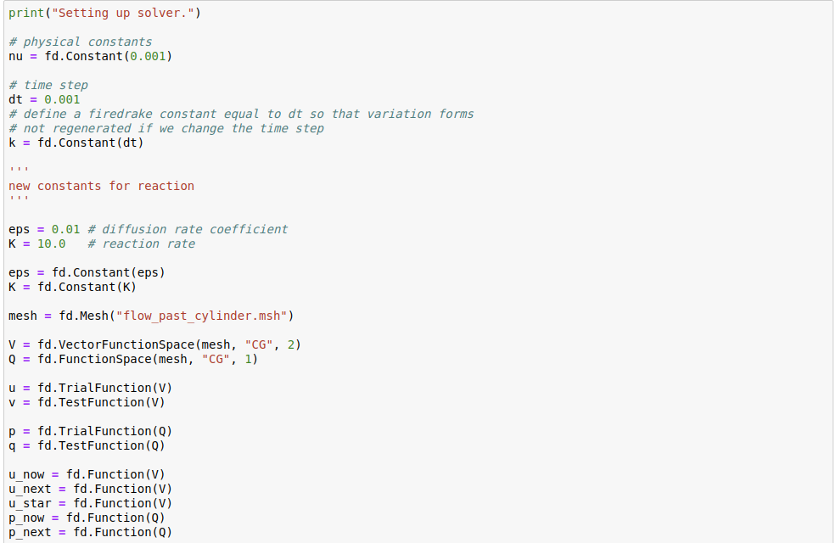
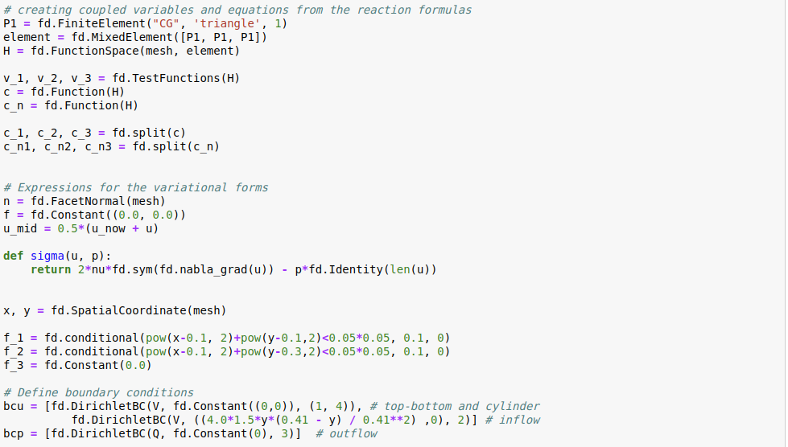
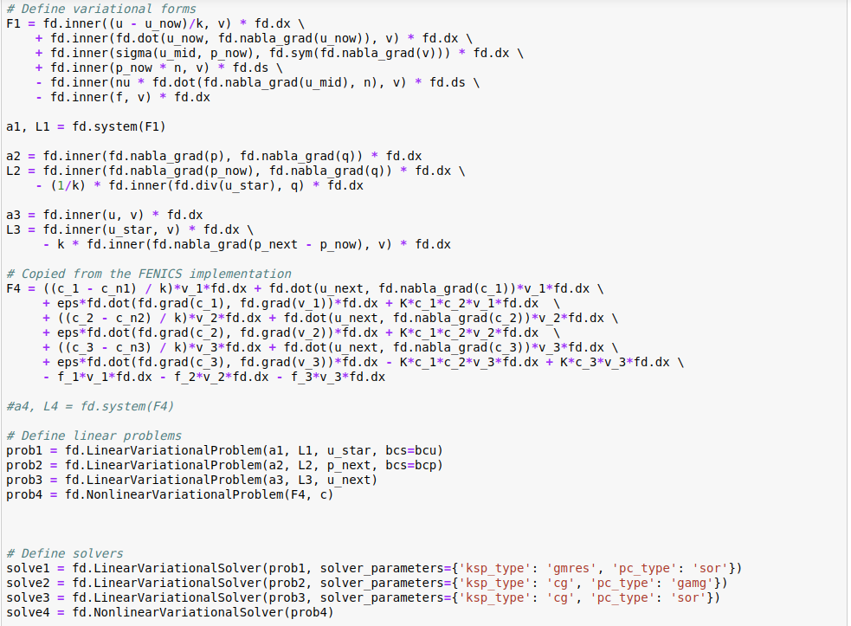
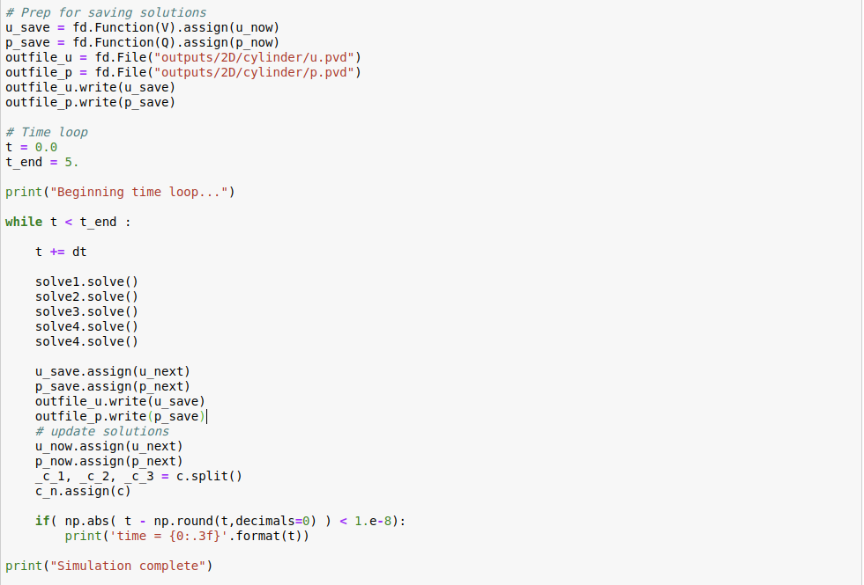
The existing approach
Firedrake is a powerful finite element library but posing a problem involves many steps
that can be safely hidden
from users
Notes:
Let’s say, for example, that we wanted to solve a reactions equation coupled to the navier stokes equation. Traditionally using Firedrake, users will have to specify many of the same commands: create function spaces for the different variables, creating trial and test functions, specifying problems and solvers objects, build their own while loop, and overall it is a onerous process involving many lines of code. Attempting to do this through a jupyter notebook for example would stretch the page. Furthermore, this old approach is ill-suited when a user wants to change the model as they may have to reprogramm all the variables. Also, one misplaced variable here or there would be difficult to debug, as I myself have come across this type of problem.

Slide 5
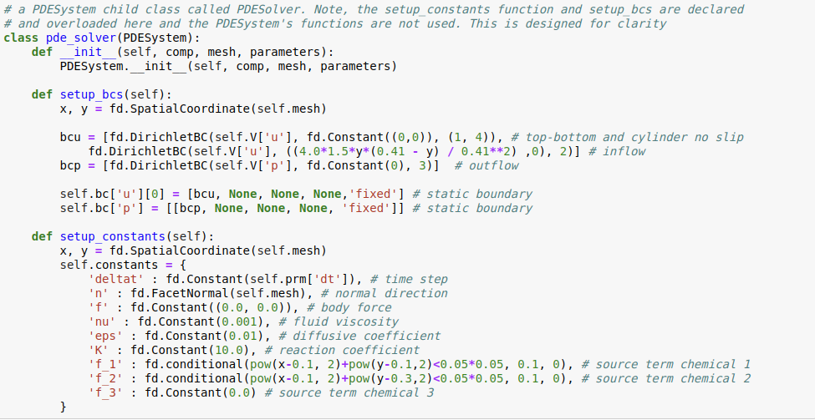
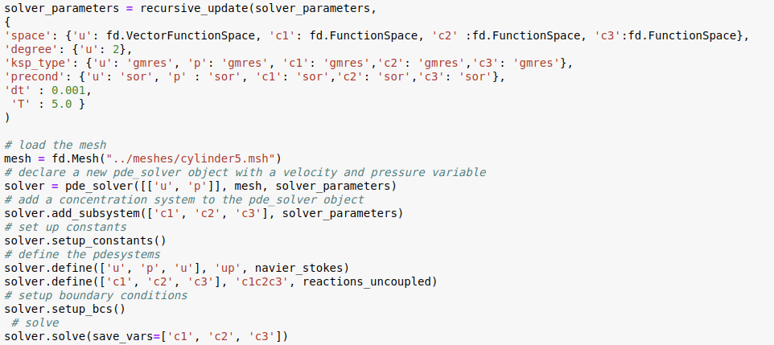
Simplification using Fireframe
Notes:
With the Fireframe interface, all that is required from users is to specify boundary conditions (if required), specify what ever constants are relevant to the problem, and the create the Fireframe objects to contain and solve the problem. Hopefully, as you can see, the interface is relatively simple, and the amount of programming that is required has been significantly reduced.

Slide 6
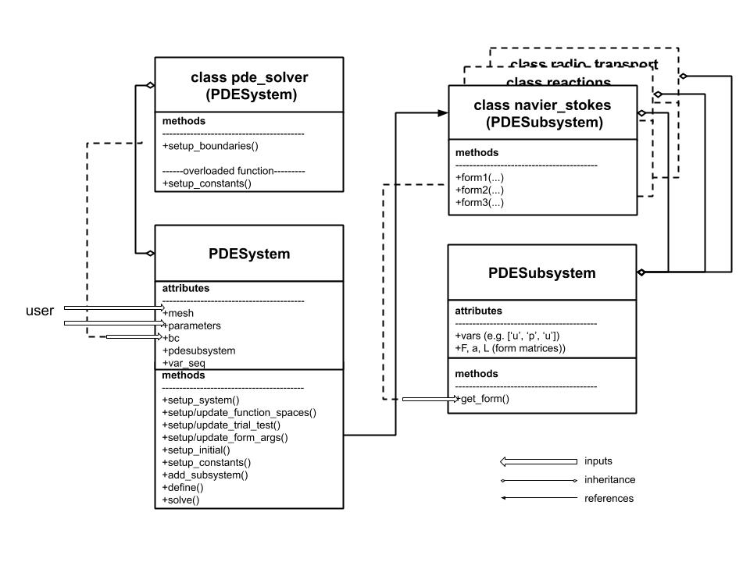
Software Architecture
Core interaction between two classes: PDESystem and PDESubsystem
Notes:
Let’s look at the software architecture that supports the Fireframe module. There are two essential classes: PDESystem and PDESubsystem. These two objects serve as the foundation to contain many different variational forms and variables, and the member functions from these two objects allow users to easily switch between PDEs. There are also auxiliary functions to conduct MMS testing, which I will discuss later on.

Slide 7
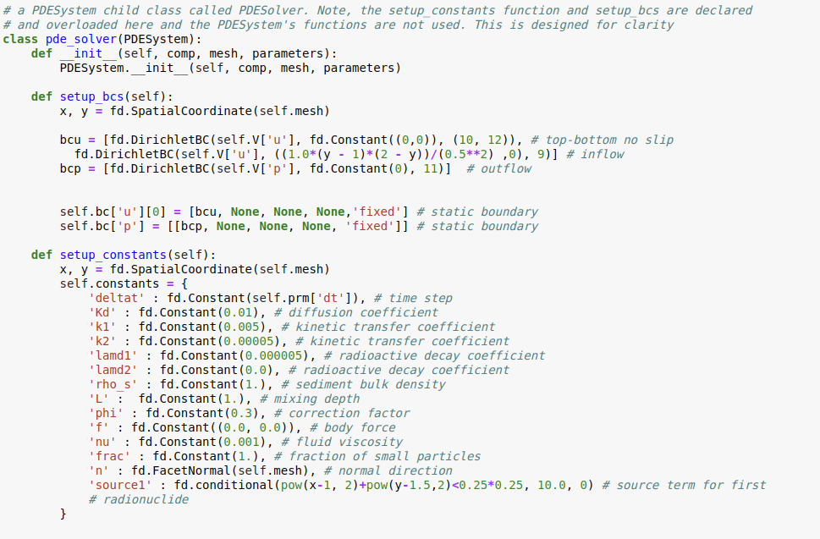
PDESystem
Responsible for specifying constants and boundary conditions
Contains the form for all of the individual subsystems
Responsible for solving the entire coupled problem
Notes:
You can think of the PDESystem as representative of the entire coupled problem. It is responsible for creating functionspaces, and trial/test functions, for all of the physical variables present in a coupled problem. For example, if you have velocity, pressure, and concentration all together, the PDESystem will create all the necessary functions for each of those variables. This is automatic and does not require additional programming from the user
Typically, the way to use Fireframe and when we specify a PDESystem, we create a solver object as you see here. This is because of complications with specifying Dirichlet boundary conditions, which I will get into later.

Slide 8
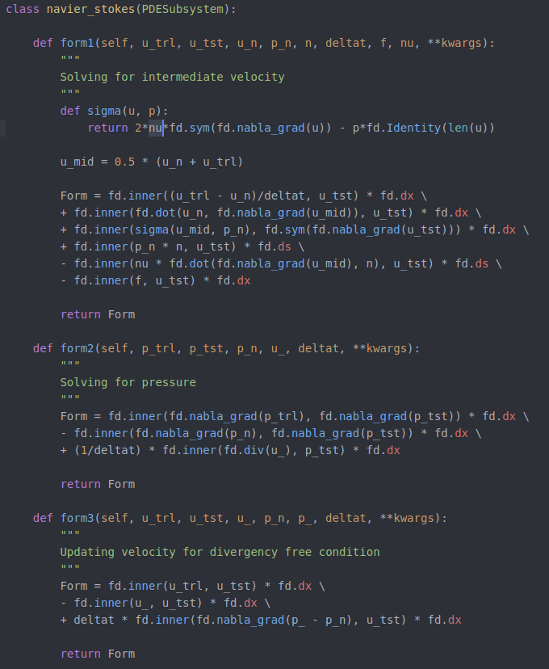
PDESubsystem
Provides the variational form for a single PDE / system of PDE
Example: Chorin’s scheme
Notes:
The PDESubsystem can be thought of as representative of a standalone PDE / set of PDEs. For example, the form for the navier-stokes equations would fall under a PDESubsystem. What the PDESubsystem is responsible for is to provide the variational forms required for solving the PDE to the overall PDESystem. So, the PDESystem provides the function spaces and functions, and the PDESubsystem provides the forms. Here, for example, is the PDESubsystem object that contains the Chorin scheme form of the navier-stokes equations.

Slide 9
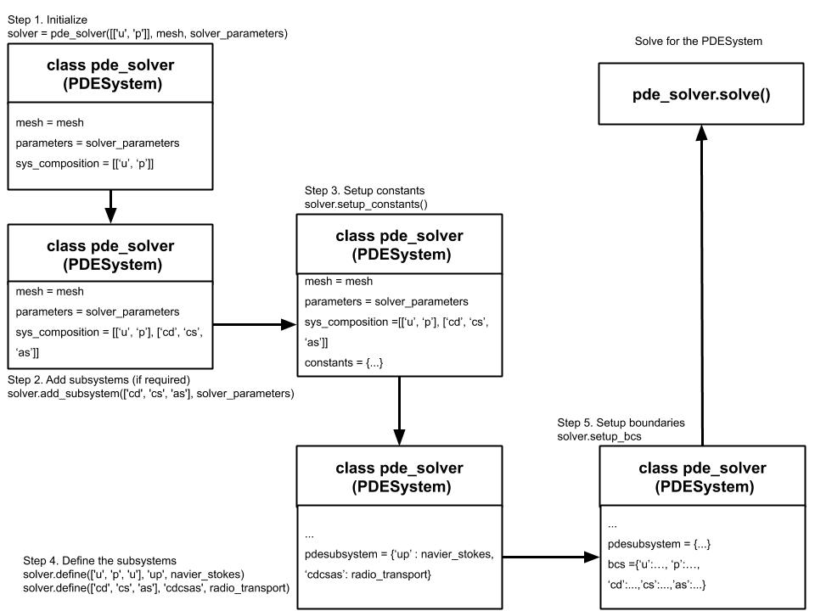
Process flow
Notes:
The overall process for solving a problem using Fireframe is this: first, users create the solver object and create the boundary conditions / constants that they will use for their problem. Next, the users will specify the variables that are to be included in their coupled problem, for example: velocity, pressure, concentration, k, epsilon, etc… Then, the users will specify which PDESubsystem objects will be used to solve for those variables. For example, I may choose the navier-stokes equation to solve for u and p, and the reactions equations to solve for c. The users will then setup the boundary conditions to create any Dirichlet BCs and finally, call the solve function to solve the entire system. In a few simple steps, users can pose and solve many different combinations of coupled problems.

Slide 10
Benefits of Fireframe
Quick deployment of already validated models
Efficient switching between different models
Simple foundation to analyze preconditioners, iterative methods, and weak forms
Streamlines code verification
Notes:
Just to reiterate what there is to be gained from using the Fireframe framework:
first, once you have already built a model, there really is no need to rewrite all the steps again in Firedrake when you want to couple to a different PDE. For example, if you are solving different turbulence models, you might want to solve a coupled k-e model or a segregated.
Using Fireframe, it is trivial to analyze different Firedrake parameters such as preconditioners, iterative methods and even different weak forms.
Finally, Fireframe provides a simple interface to conduct manufactred solutions testing

Slide 11
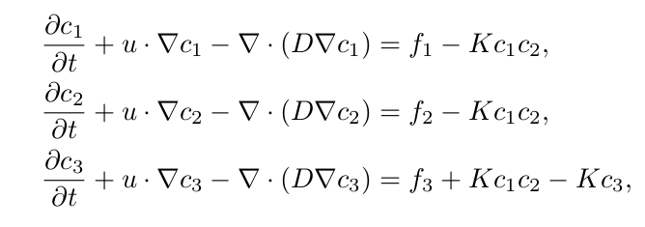
Example Test Case: 3 component 1st order chemical reactions
Notes:
So, as I’ve mentioned, one of the things you can use Fireframe for is to compare different forms. In the example presented here, these are the three mass balance equations associated with a first order reaction. This is a coupled problem because it relies on a velocity field in the advection term.
Two options for solving this set of equations: first by using Firedrake’s MixedFunctionSpace capability to contain c1 c2 and c3 all into one variable or to rewrite these three equations separately.

Slide 12
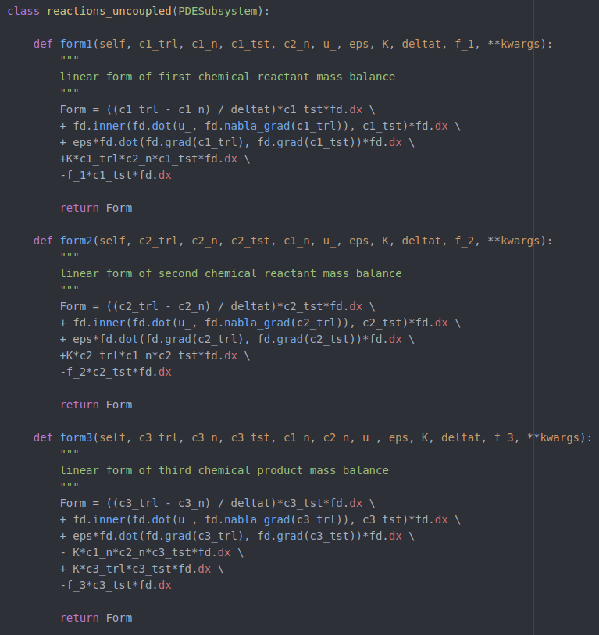
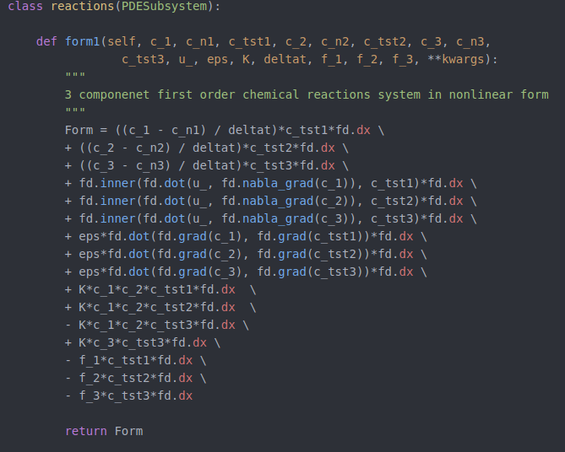
Form Analysis – chemical reactions
Notes:
On the left is a single nonlinear form using a MixedFunctionSpace variable called ‘c’. On the right are three linear equations using three different variables ‘c1’, ‘c2’, ‘c3’. To change from using the different models is as simple as revising the solver define function.

Slide 13
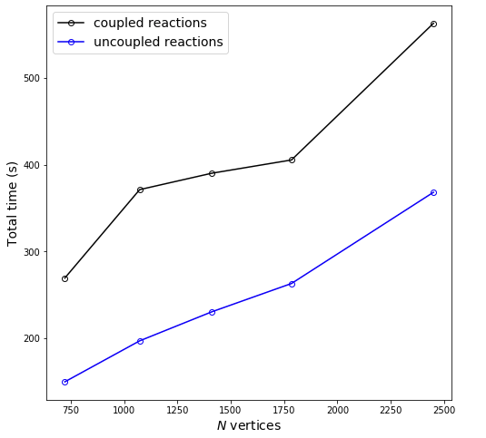
Performance comparison – chemical reactions
Simulation time = 5.0(s)
Δt = 0.0005(s)
Linear system preconditioned with SOR
Notes:
I conducted a timing test on both of these implementations. Not surprisingly, solving for three linear problems proved to be more computationally efficient than solving for a singular nonlinear problem. However, in this example, I was able to leverage the SOR preconditioner to improve the speed of the calculation.

Slide 14


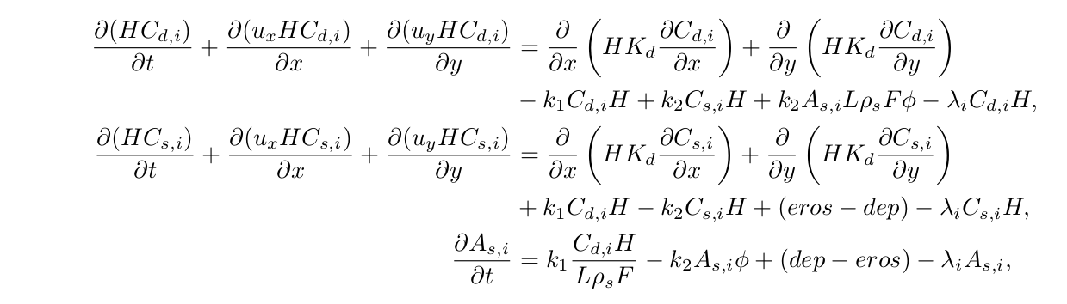
Example Test Case : 2 component radionuclide transport
form1
form2
form1
form2
form3
Radionuclide 1
Radionuclide 2
Notes:
What is not as intuitive is when we get into the radionuclide transport equations. Here, this is a one step kinetic model that details the transport of radionuclides across three phases : dissolved, suspended, and sediment. What is complicated about this problem is that you can pose this problem in multiple ways. Firstly, you can consider each phase as a Mixed variable that contains all radionuclides. Or, you can consider each radionuclide specifies as a Mixed variable that contains each of their phases. So, you can see that there are many ways to divide the problem. Again, doing all of this would be incredibly tedious in the traditional sense, but with Fireframe, all you have to do is select a different model once you have built it.

Slide 15
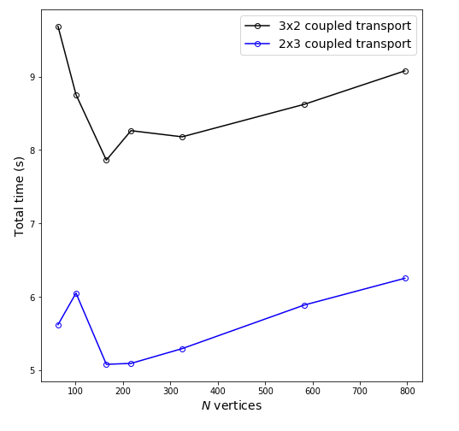
Performance comparison - radiotransport
Simulation time = 2.0(s)
Δt = 0.05(s)
No preconditioning
Notes:
So, it appears it is much more computationally efficient to solve smaller nonlinear problems than to try and digest a bigger nonlinear problem. For researchers who are interested in building computationally efficient models, this is useful feature that can be obtained easily using Fireframe’s interface.

Slide 16
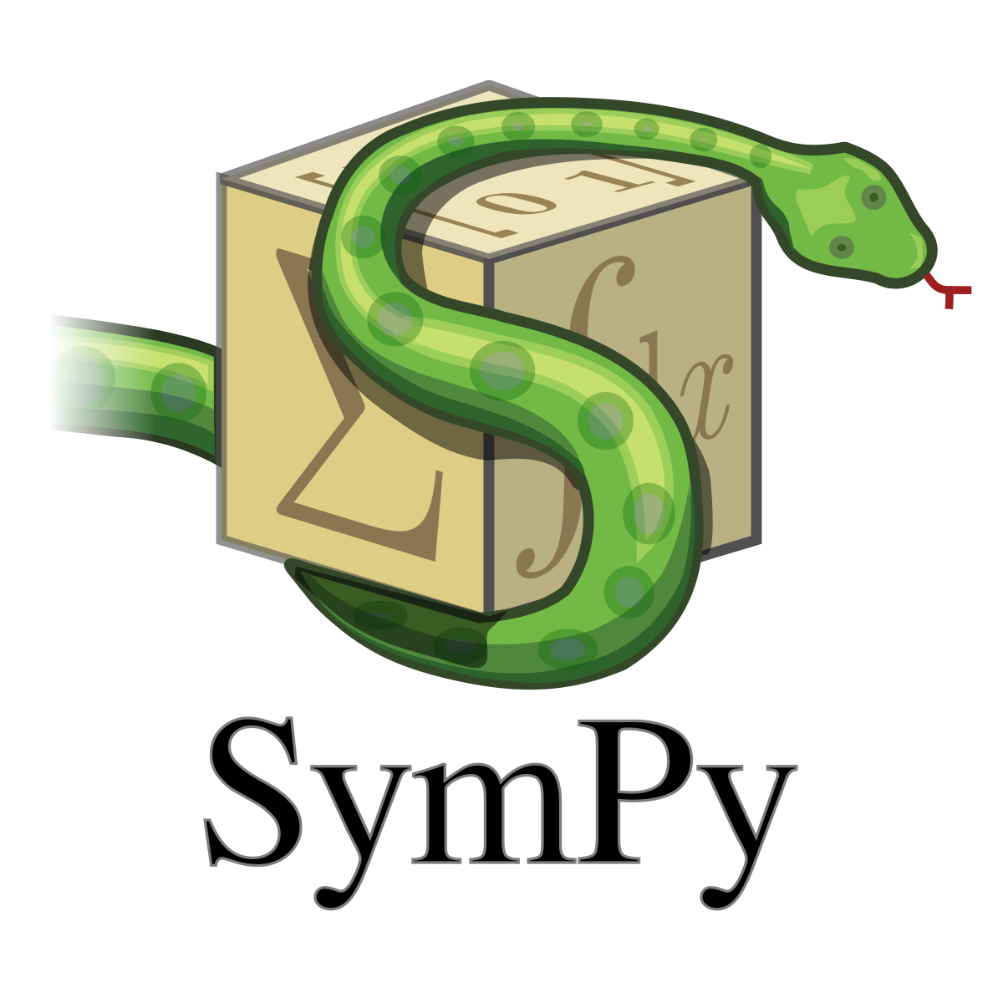
Method of Manufactured Solutions
Verification of Firedrake’s spatial discretisation
Verification of time stepping scheme used
Create source term using sympy
Unified Form Language^{[1]}
[1] Unified Form Language: A domain-specific language for weak formulations of partial differential equations
M. S. Alnaes, A. Logg, K. B. Ølgaard, M. E. Rognes and G. N. Wells
ACM Transactions on Mathematical Software, vol. 40, 2014
Notes:
One aspect of Fireframe that I previously mentioned is the built in support for the method of manufactured solutions. As with any finite element analysis, spatial and temporal convergence are necessary for ensuring the validity of the solution. There isn’t a prescribed functionality that I know of within Firedrake to conduct MMS testing.
With Fireframe, there is an interface with Sympy’s symbolic mathematics in combination with UFL to streamline the process of creating source terms

Slide 17
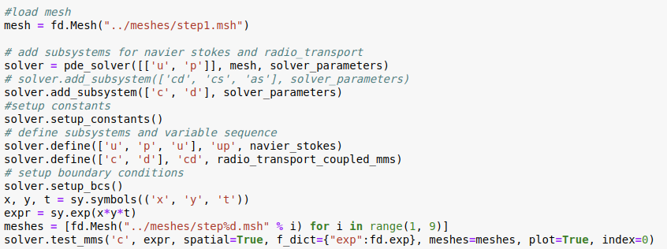
Setting up MMS
Notes:
The steps to conduct the MMS analysis using Fireframe is similar to how you would solve a problem. The only exception is to create a symbolic “analytical solution” and to pass in either a list of meshes or a list of delta t values depending on the type of convergence you are analyzing.

Slide 18

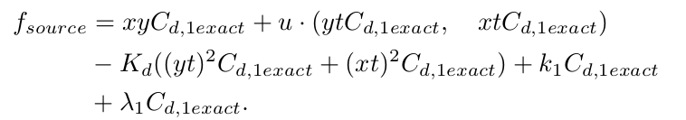
Example: MMS on the radionuclide transport problem
Notes:
For my test cases, I created a MMS solution for the dissolved radionuclide 1 concentration. Initially, I wrote out the entire source term as I hadn’t realized you could use UFL to simplify this process.

Slide 19
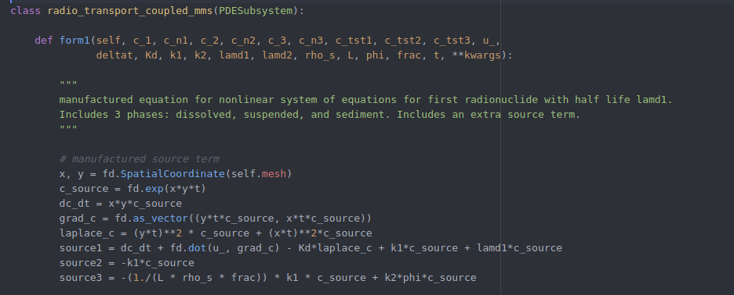
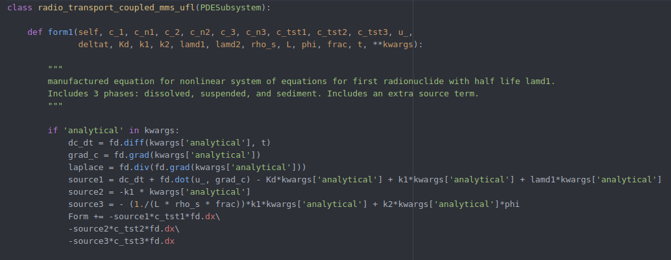
MMS on the radiotransport equation
Explicit differentiation
UFL differentiation
Notes:
On the left here, you can see my MMS implementation of the weak form. Later on, I decided to employ UFL to create the source term which is a lot simpler. For users, they can build the source terms into the PDESubsystem objects if they wish to employ the MMS functionality.

Slide 20
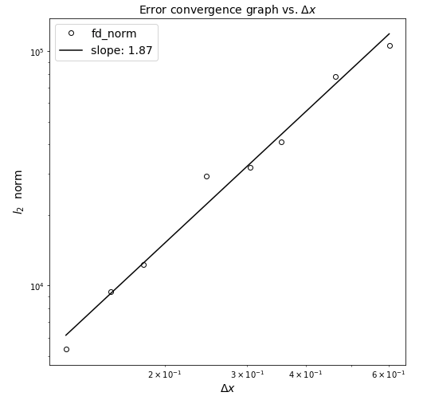
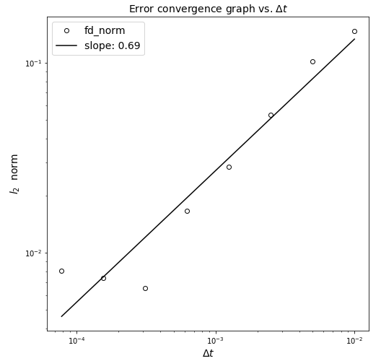
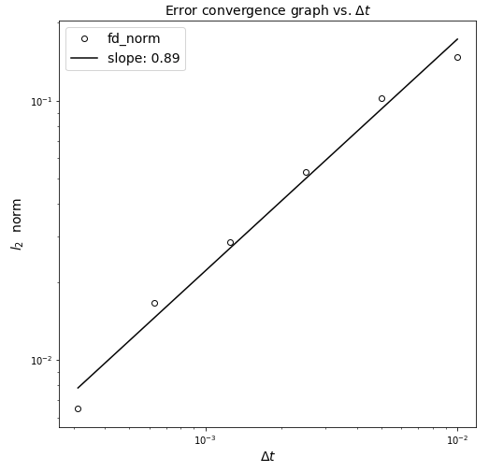
Convergence
Simulation time = 1.5(s)
Δt = 0.001(s)
Max Δx = 0.426
Min Δx = 0.087
Simulation time = 0.1(s)
Δx = 0.426
Max Δt = 0.01(s)
Min Δt = 2^-7(s)
Min Δt = 2^-5(s)
Finite Element used: 1st order ‘CG’
Time-stepping scheme used: Backwards Euler
Notes:
In the convergence analysis for the radionuclide problem, I used 1st order Continuous Galerkin finite elements and I also employed a backwards euler time stepping scheme. Spatial convergence behaved closely to the theoretical convergence order of 2, while the temporal convergence kind of deviated from the theoretical first order. However, when we reduce the range of delta t values, temporal convergence behaved more closely to ideal. This can all be explained by the way truncation error is calculated. When you calculate the error, you always get a fixed contribution from both space and time discretisations so achieving exactly the theoretical orders is difficult. However, the results indicate approximately ideal convergence which is all that we need to verify that the underlying Firedrake discretisation is behaving appropriately for this problem.

Slide 21
Test Cases Demonstrations
Reactions
Radiotransport
SWE-No_Normal
SWE-Flather
Notes:
So here, I want to present some of the different coupled test cases that I’ve built using Fireframe. The first is the three step reactions. Then, it is the radiotransport modelled coupled to the navier-stokes equation. Another example is an idealized mesh representing the strait of gibraltar, which solves the radiotransport model coupled to the shallow water equations. Here, the first boundary condition is the no-normal, which you can visibly see as the waves are reflecting off the domain. I also attempted an implementation of the flather boundary condition, but I couldn’t get the model to be stable.

Slide 22
Challenges and current limitations
Time-dependent Dirichlet boundary conditions
Mathematics / knowledge of finite element method
Lack of support for high level Firedrake functions
2D problems
MMS function limited to scalar variables
Heavy dependence on naming conventions
Notes:
With regards to some of the challenges that I’ve faced during this project:
One of the biggest difficulties is programming Fireframe to handle time-dependent Dirichlet boundary conditions during the solve loop. Basically, this required the object to reinitialize the boundary at every iteration and it makes the entire code cluttered.
Fireframe doesn’t remove the need for users to have in depth knowledge of the models and appropriate boundary conditions. I have personally faced this problem many times when trying to build new test cases.
There are many high level Firedrake capabilities that aren’t employed in Fireframe.
MMS doesn’t support source terms, yet, for vector variables such as velocity. And while Fireframe is intended partially to remove programming redundancy and errors, there is still a large reliance on users being correct.

Slide 23
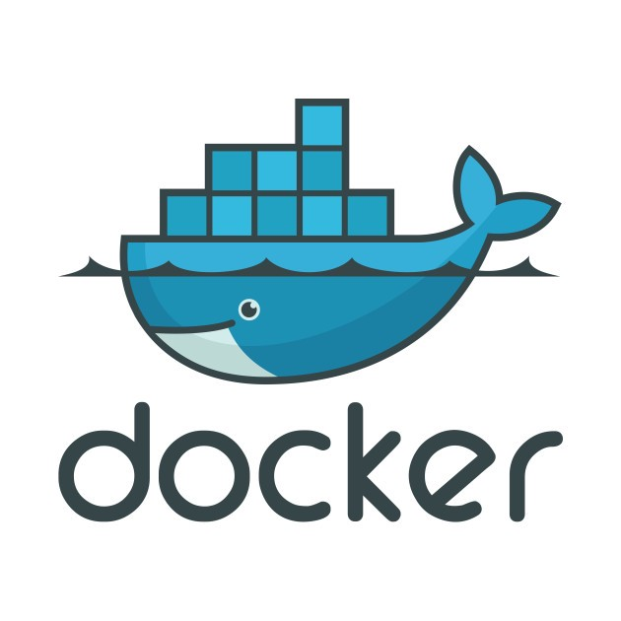

Continuous Integration
Docker image of official Firedrake repo
Travis CI and pytest
Notes:
A little big about CI. Fireframe is supported by the official Firedrake docker image and I have implemented pytests to ensure that all core PDESystem functionalities are intact. I use the Docker Image because the alternative would be to upload the entire Firedrake repo onto my github. I have tried asking Travis to install Firedrake but it simply waits too long.

Slide 24
Acknowledgements
Question?
Prof. Matthew Piggott
Firedrake Team
ACSE classmates
Imperial College London
Notes:
I like to thank my supervisor Prof. Piggott for his guidance throughout this project. I like to thank the Firedrake team for their support on using Firedrake. Thank you to all my classmates and the school for a valuable year. Thank you for coming to my presentation, I open up the floor for any questions.

