Slide 1

ACSE-9: Applying machine learning to the optimisation of numerical integration in finite element method
Liu Ye
Supervisor: Adriana Paluszny

Slide 2
Content
Introduction
FEM
Software
Multiple-Multivariate-Multidimensional Integration
Element
Machine learning
Results

Slide 3
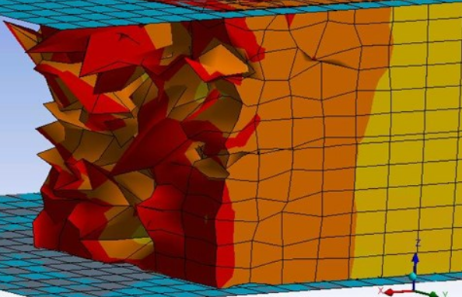
Introduction
In computational solid mechanics field, finite element method (FEM) is commonly used. Due to the requirement of high fidelity simulation, the size of the problems to be solved has been growing larger and larger as well as the computation cost.
Numerical integration as an important part in FEM actually takes a large share of computation cost in FEM.
For elements with regular shape, it only requires a small number of integration points to reach the expected error tolerance. But for those with huge distortions, more integration points is required. In traditional FEM, the integration points were manually chosen and applied on each element, this would reduce the efficiency also cause the computation waste.
https://studentcommunity.ansys.com/thread/convergence-issues-highly-distorted-elements/
Notes:
In traditional FEM, in order to reach the error tolerance, the integration points were manually chosen and applied on each element, this would cause a problem that some regular element do not did to be integrated by a large integration point, which reduce the efficiency also cause the computation waste. So we use machine learning here to predict the optimal points for each element givens the coordinate value of the element.

Slide 4
Objective
Develop a classifier using neural network, the classifier can output the optimal number of integration points given a element shape
Develop a new numerical integration method supporting the neural network
Develop a light Finite Element Method package with the new smart numerical integration
Generate proper dataset for neural network training and testing

Slide 5

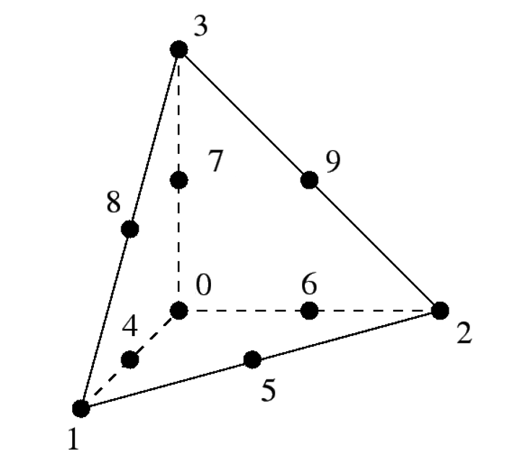
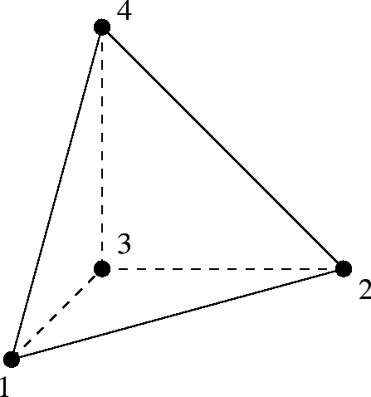
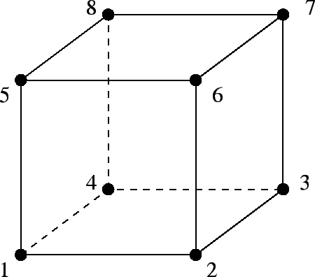
FEM Problem and Elements
Stiffness matrix in linear elasticity problem:
8-node hexahedron:
4-node tetrahedron(CST):
10-node tetrahedron:
Notes:
The FEM problem used and tested in this project is linear elasticity. Essentially, this problem is to calculate the stiffness matrix, we can see integration here.
There are the three kinds of elements generated : 8 ,4 ,10.

Slide 6
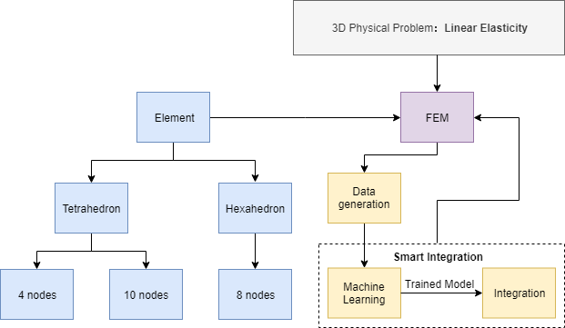
Software Architecture a smart FEM platform which combined machine learning techniques with integration
Multiple-Multivariate-Multidimensional Integration
Notes:
Here comes the software architecture. Basically, the yellow block represents the machine learning part. We combined the ml technology and numerical integration as the so called smart integration here. The output of the ml is the optimal number of integration points, which will be feed to the integration method.

Slide 7
Multiple-Multivariate-Multidimensional Integration

Slide 8

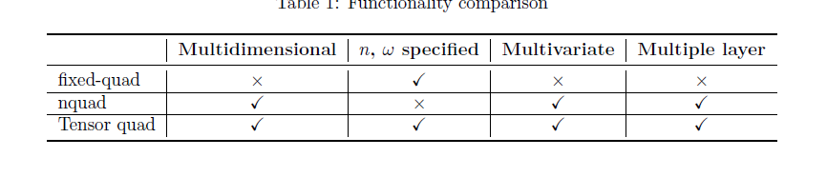


Integration Tensor quad: satisfy all requirements
3D Gaussian integration:
$$F:R^{N}⟶R^{N}$$
Scipy
Notes:
The target integrand is Multiple-Multivariate-Multidimensional, and in this project, we also need to specify the number of ip, but there is no built- in functions satisfy all these requirement.
We developed a Tensor quad method which can satify
The fixed-quad method support user-specied number of integration points but could only do one-layer one-variable scalar integration.
The nquad could do multiple-multivariate but still scalar integration, and it doesn't support tensor integration as well as integration points specication.

Slide 9
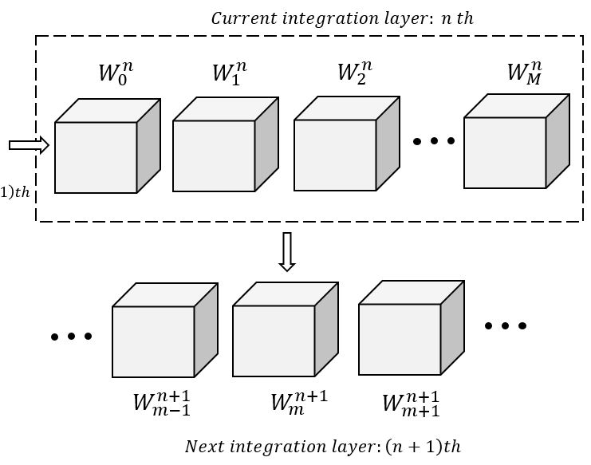
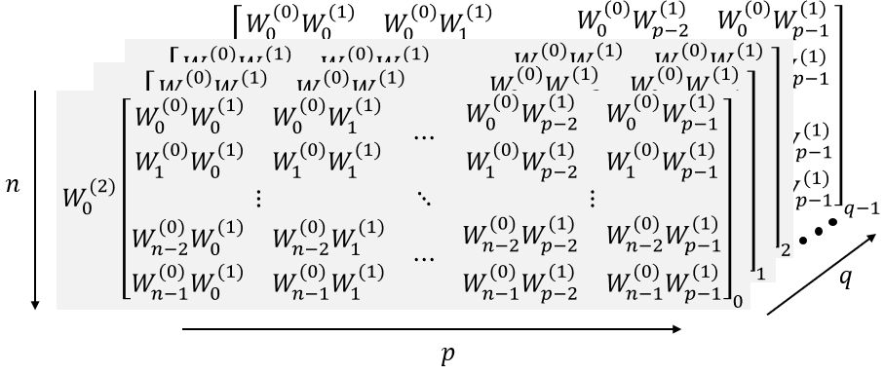
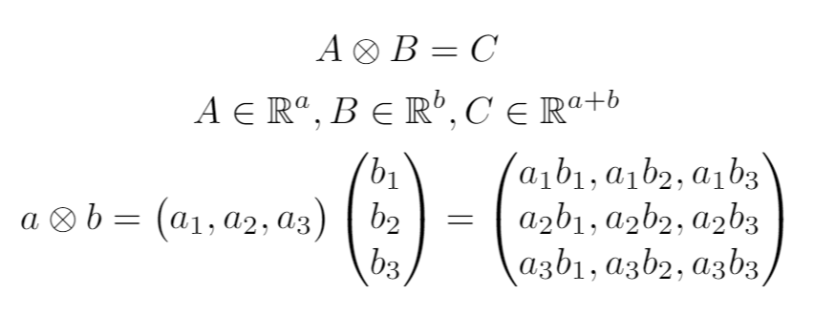

Integration Tensor-like data structure
Use recursion to implement
$$I=\sum{(Weights Tesnor ∘Function value Tensor)}$$
(entrywise product)
Use tensor product to construct the tensor
Notes:
As we know, Gaussian integration can be described as the multiplication of weight tensor and function value tensor. To make use of the tensor manipulation of Python, a tensor like data structure (shown in left figure) is utilised which contains the weights in order. 3-D integration is just a special case, shown in the left figure, by using the tensor product, It is expand to 4, 5 and more dimension. The gery box here is the left figure. Afterall, the integration results is the entrywise product of the weights tensor and the corresponding function values tensor. The detailed algorithms are described in the report.

Slide 10
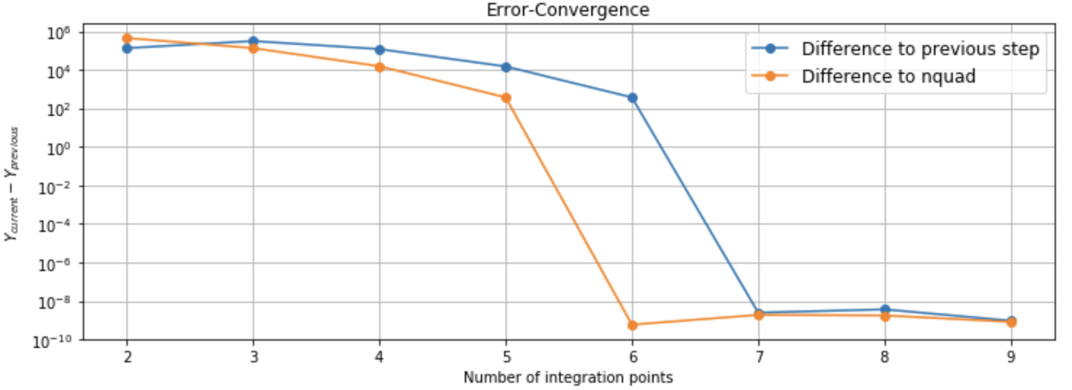
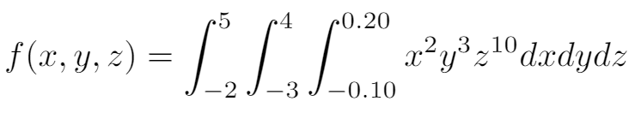
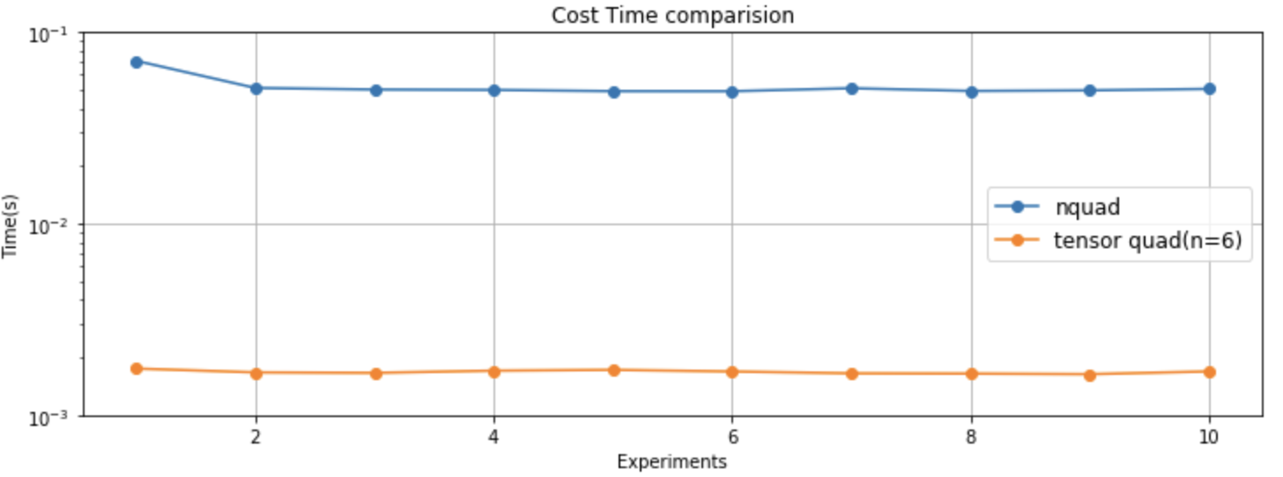
Comparison to nquad(SciPy)
Test function:
Accuracy:
The error converges at 6 , which is reasonable for a (2n-1) degree of accuracy
Efficiency:
Our method is 20 times faster than SciPy built-in method
Notes:
1.Test 2.Accuracy, 3.run time
The blue line represents the difference between the integration result of the current number and that of the previous number. The yellow line shows the difference between the result calculated by n quad.
There are 10 experiments have been conducted. It could be observed that the cost time of our method tensor quad, is about 20 times lower than Scipy nquad, which is quite a huge advantage.

Slide 11
Element

Slide 12
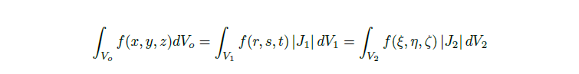

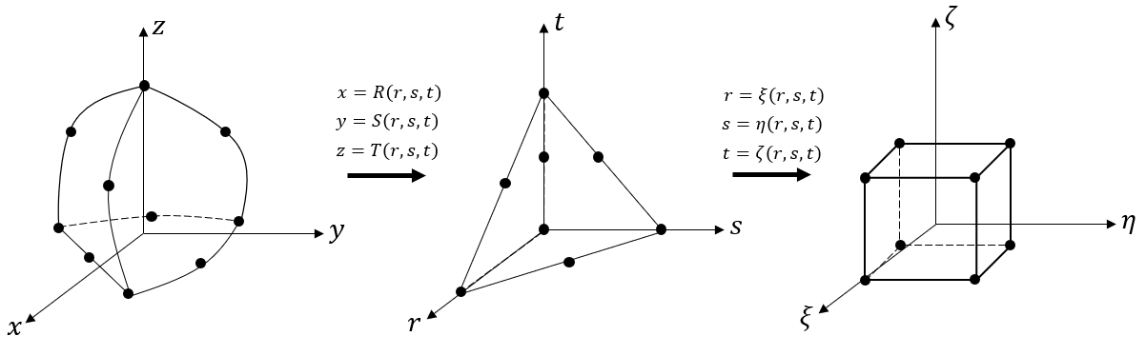
Isoparametric Elements 10-node tetrahedron
Notes:
All kinds of elements are developed in a Isoparametric way. For hex element, it will be transformed into a standard shape within the standard coordinate when conducting the integration. Notably, in order to use the high degree of accuracy Gaussian legendre rule, the 10-node tetra is transformed twice into the standard hexahedron as shown in the figure.

Slide 13
Machine Learning

Slide 14

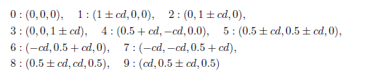
Data Generation
To model the distortion of the element, a control factor c ranges from a uniform distribution [0.5, 1.0] and a maximum change value is defined discretely as d = 0.1, 0.2, 0.3, 0.4, 0.5.
Angle Restriction: [60, 120]
Length Restriction: [0.5, 2.0]
Angle Restriction: [20, 160]
Length Restriction: [0.5, 2.0]
Central Node Restriction
Notes:
The data needed is the coordinate value which can define the shape of the element,
When generating the coordinate value, a standard shape is used as a reference.
To prevent unacceptable distortion, we have 2 restriction here.

Slide 15

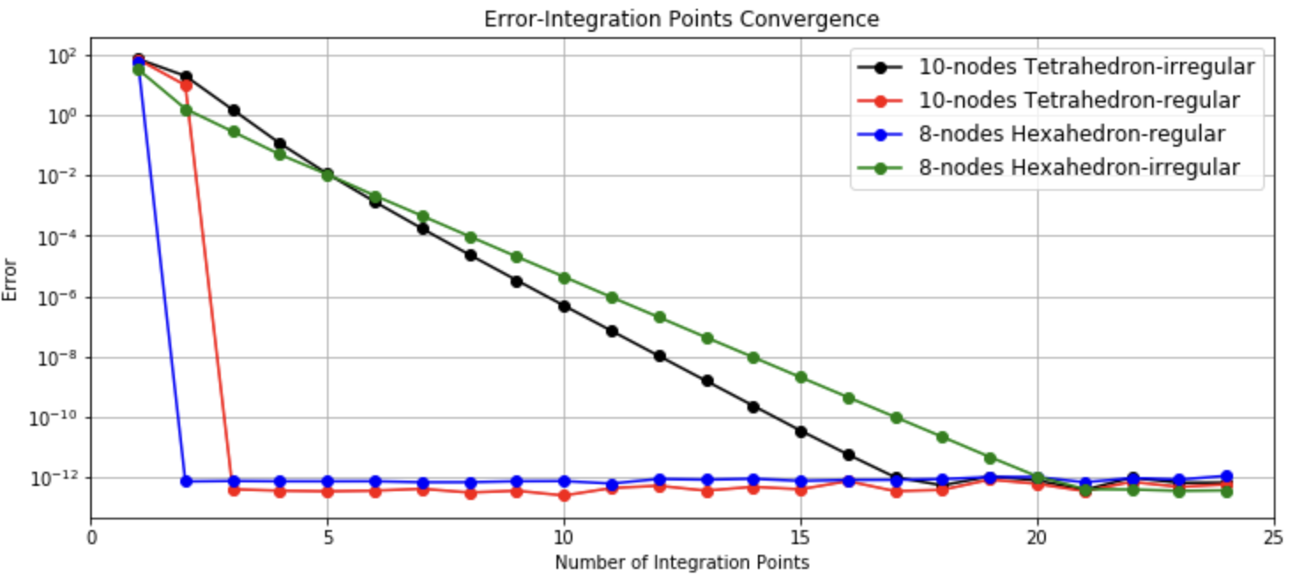
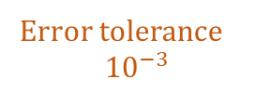
Error Convergence
Error Definition:
Error tolerance
$${10}^{−3}$$
Notes:
See the plot

Slide 16
Dataset Generation
With each element, the optimal number of integration points is calculated as the label for this data point. All these data consist of the training dataset and feed to the machine learning class for network training.
The data set is generated on imperial HPC cx1.
The whole task is divided into 10 parallel sub-tasks.
Total runtime is about 10 hours.

Slide 17
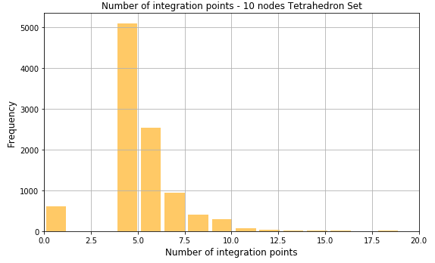
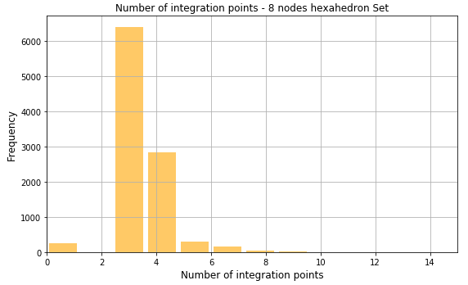
Number of Integration Points Distribution
Notes:
10000 samples
Number is for one dimension integration
0 : cannot reach the expected error tolerence

Slide 18
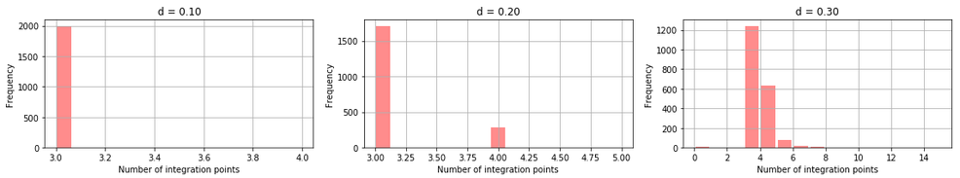
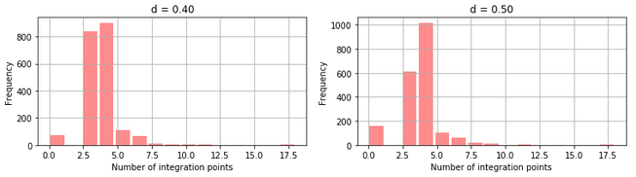
Number of Integration Distribution - Hex
d : the maximum change value range from [0.1,0.5]
Notes:
Increasing value of d, more ip are needed
0 cannot reach the error tolerance of 10-3(point zero zero one)

Slide 19
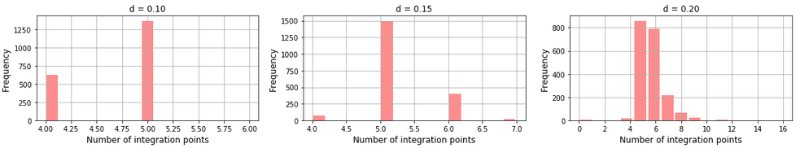
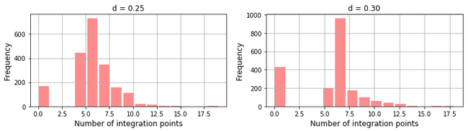
Number of Integration Distribution - Tetra
d : the maximum change value range from [0.1,0.3]

Slide 20
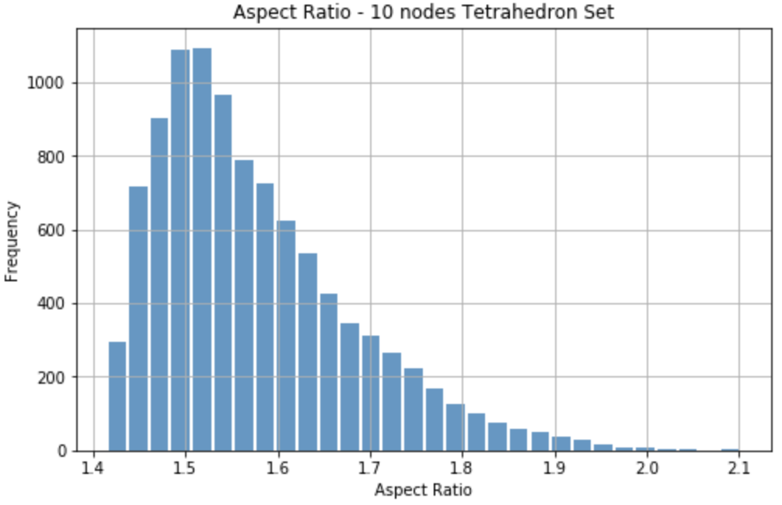
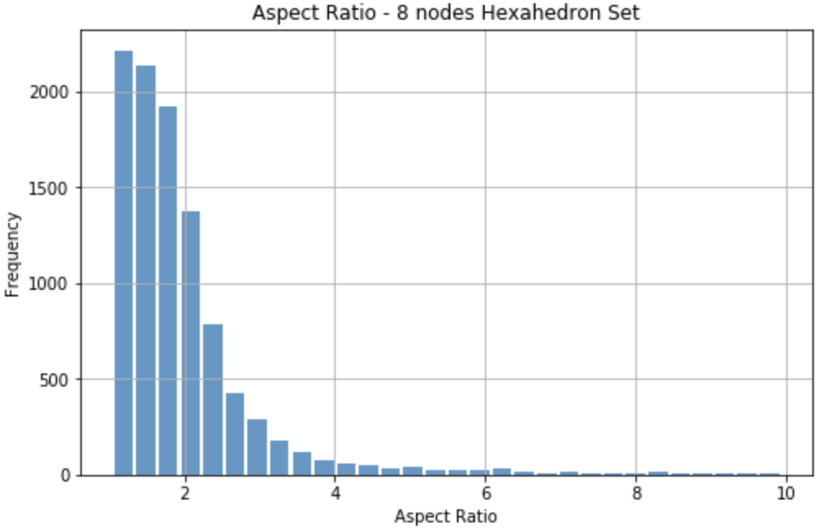
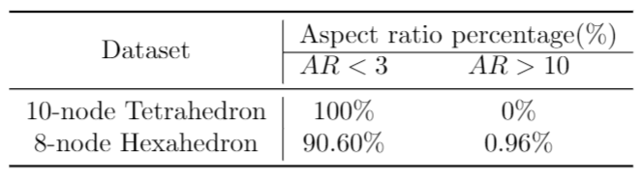
Aspect Ratio Distribution
Notes:
Aspect ratio is a measure of how elements differ from perfect shapes. Generally, a good element should has an aspect ratio smaller than 3, bigger than 10 – large distortion
If we only considered the aspect ratio, … good, but

Slide 21
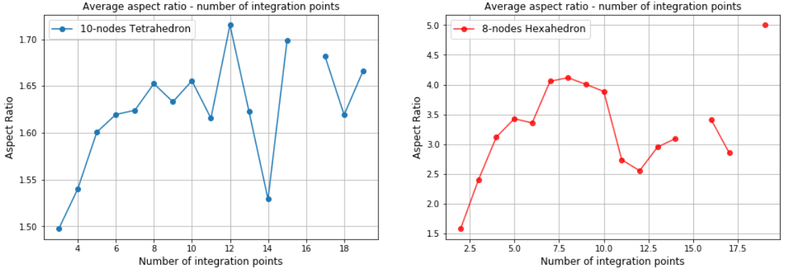
Average Aspect Ratio vs Number of Integration Points
Notes:
X axis is Y axis is
Obviously, there is no certain relationship, So aspect ratio is not enough when choosing the number of integration points.

Slide 22
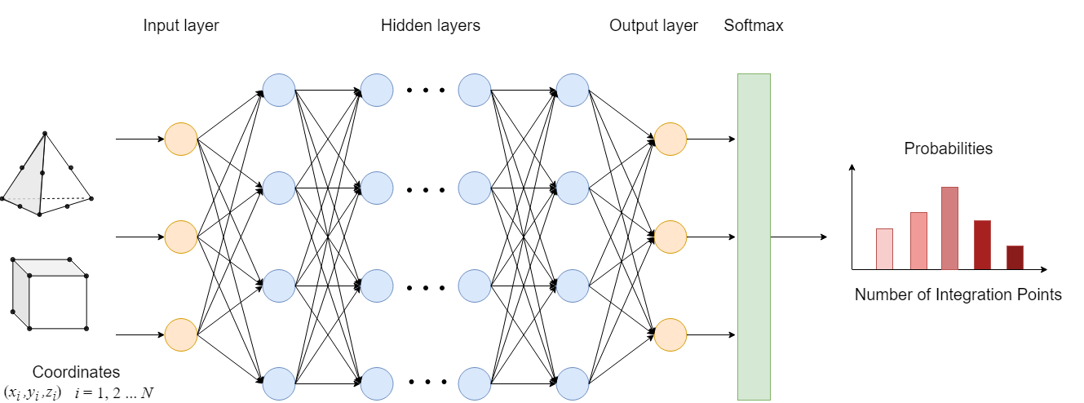
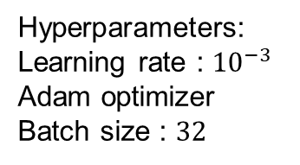
Neural Network Full-connected
Hyperparameters:
Learning rate : ${10}^{−3}$
Adam optimizer
Batch size : $32$
Notes:
To be more specific, the input of this network is a matrix contains the coordinates value, The
output of the network would be sent to a softmax function( a cross-entropy function). Then a probability
distribution of the possible number of integration points needed is calculated.

Slide 23
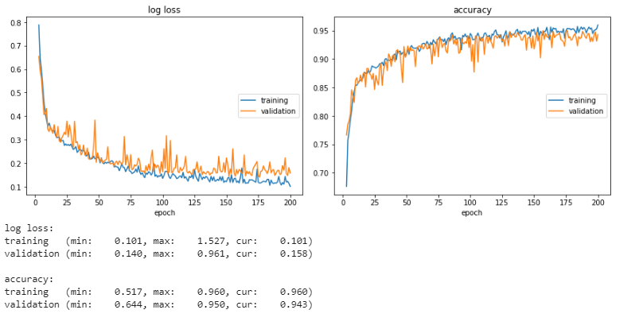
Training Process
Notes:
5000 as training set
5000 as validation set

Slide 24
Machine Learning Results

Slide 25
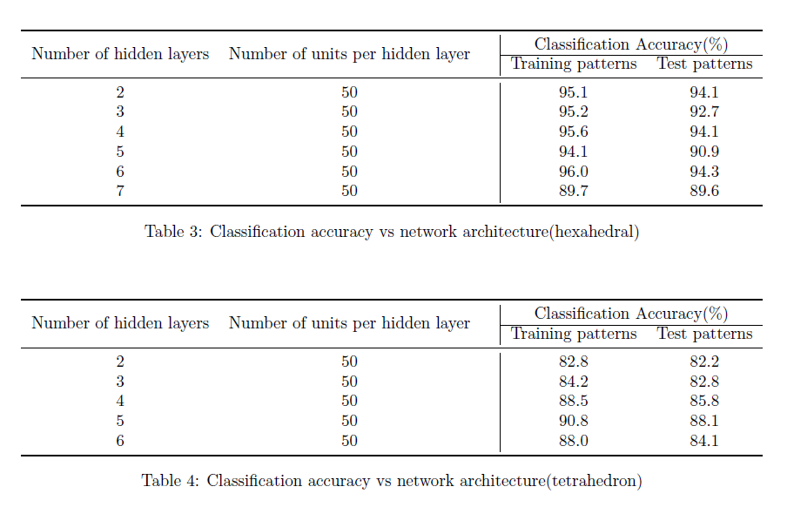
Training Results Accuracy

Slide 26
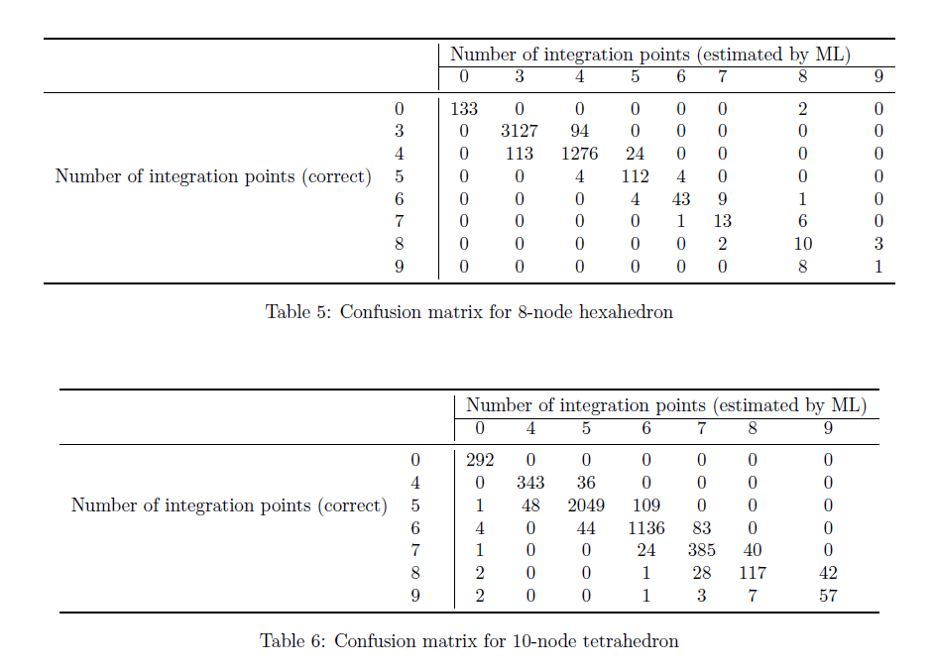
Training Results Confusion matrix
6 layers network
5 layers network

Slide 27
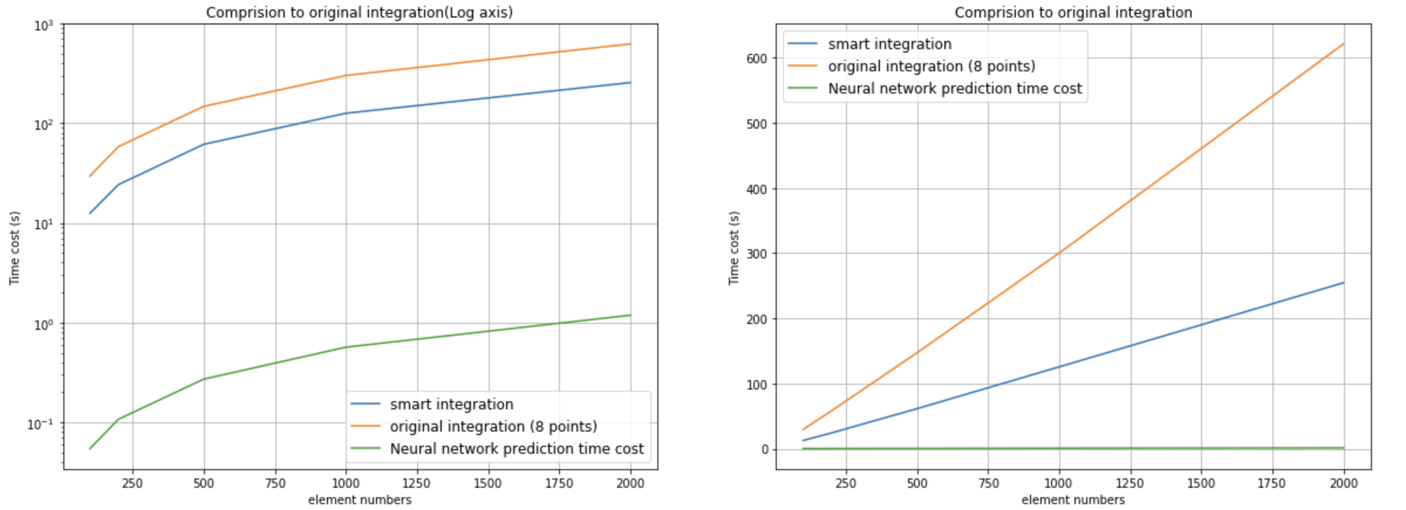

Comparison Results Run time cost comparison
Error tolerance: ${10}^{−3}$
Original
Smart integration
Notes:
The left y axis is the log plot to see the difference more clear, right one is the general plot.
Blue is smart, about 3 times faster than the original integration.

Slide 28
Discussion and future work
Conclusion
The network is trained on small dataset with 5000 samples and the classification accuracy on unseen data can reach 94.3% for 8-nodes hexahedron element and 88.1% for 10-nodes tetrahedron element.
The high accuracy proves that the smart integration method in this project can help select optimal number of integration points adaptively. This helps improve the accuracy for FEM methods, especially for those with many large distortion elements.
The comparison results to original integration shows that the new smart integration improves the computational efficiency effectively while maintaining the accuracy
Future work
It would be promising to train the model using a dataset with much more samples and extend the supporting element types. Also, the current work only applied on linear elasticity problems, it is worth applying this method on more variety and more complex problems in the future.

Slide 29
THANK YOU !

Slide 30
QUESTIONS

