Slide 1
Supplementary Slides

Slide 2

Offset scheme
642 cells, 1280 points

Slide 3
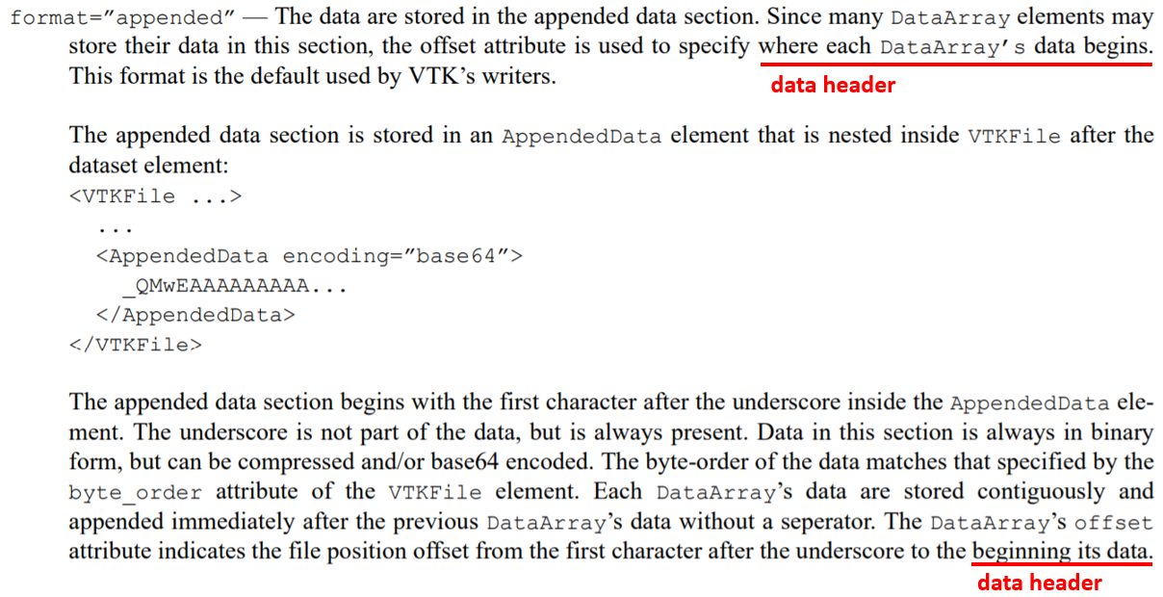
Kitware documentation xml appended

Slide 4

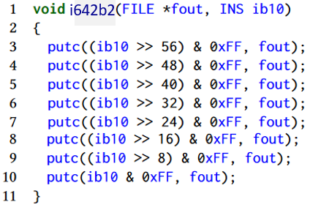
Binary Encoding Algorithm
0xFF = 0b11111111

Slide 5

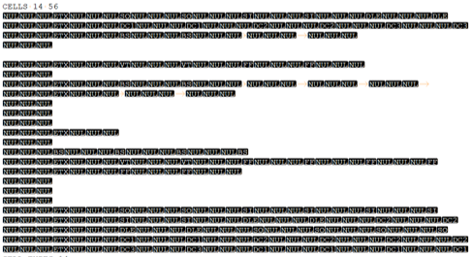
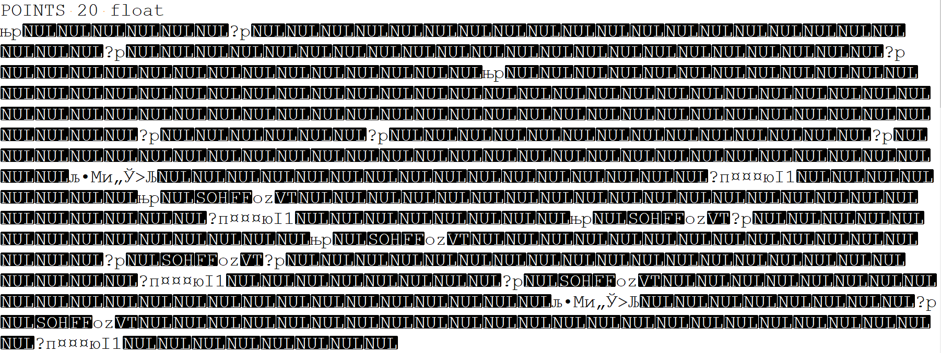
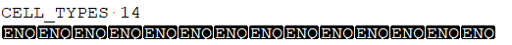
VTK Legacy Binary

Slide 6
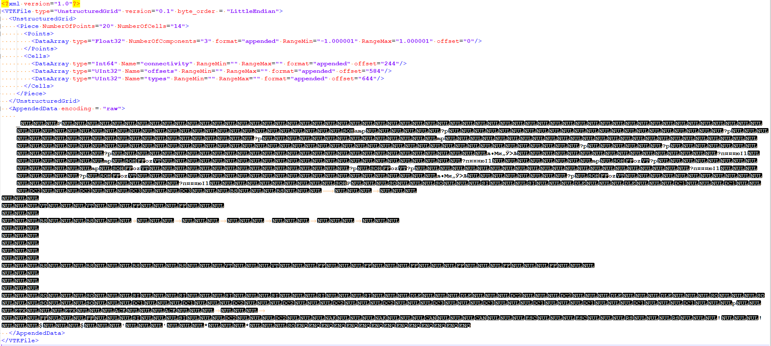
VTK XML Appended

Slide 7
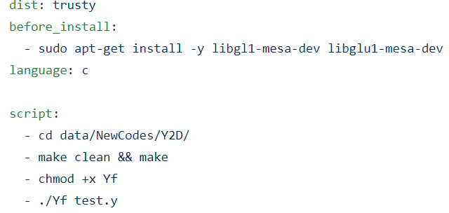
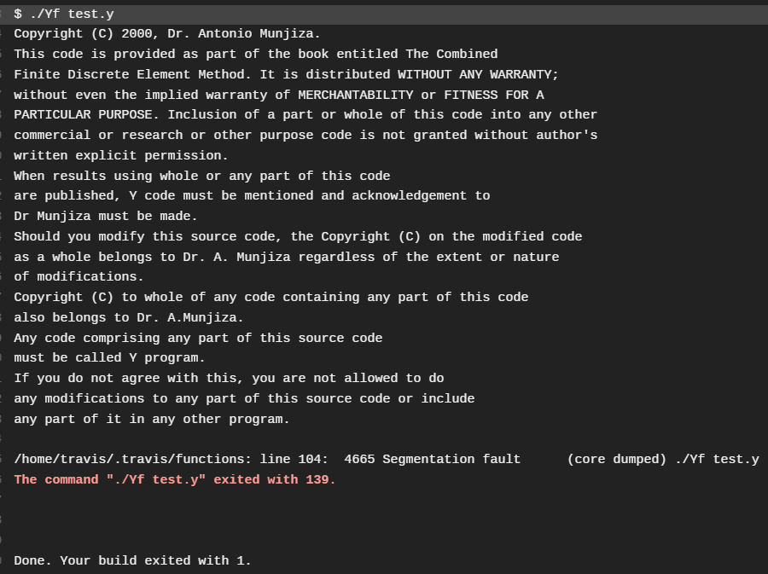
Travis

Slide 8
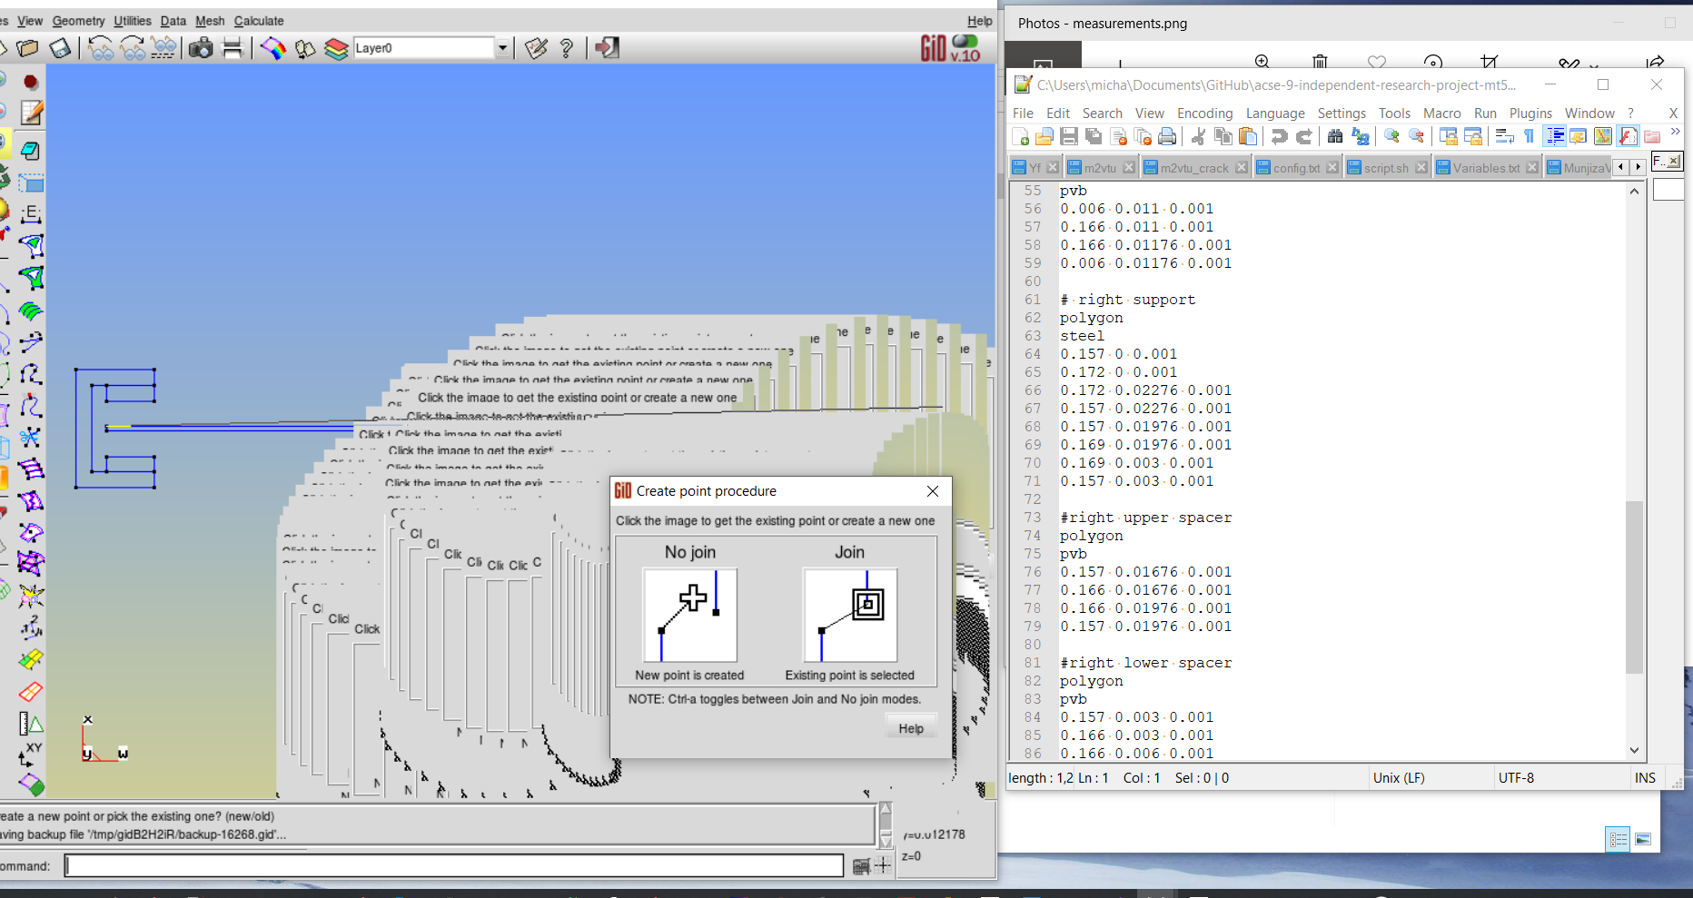
Remote Server: High Latency
Requirement: local Linux (14.04 ?)

Slide 9
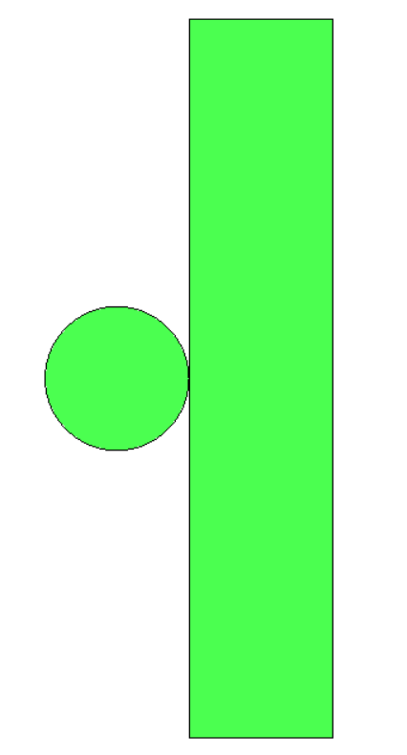
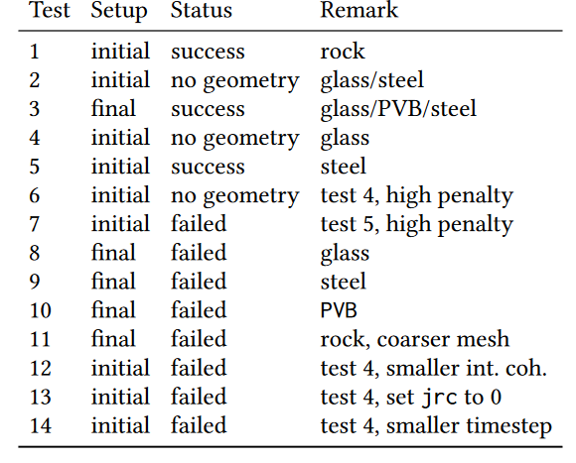

Test series
initial
final

Slide 10


Y2D Code errors

Slide 11
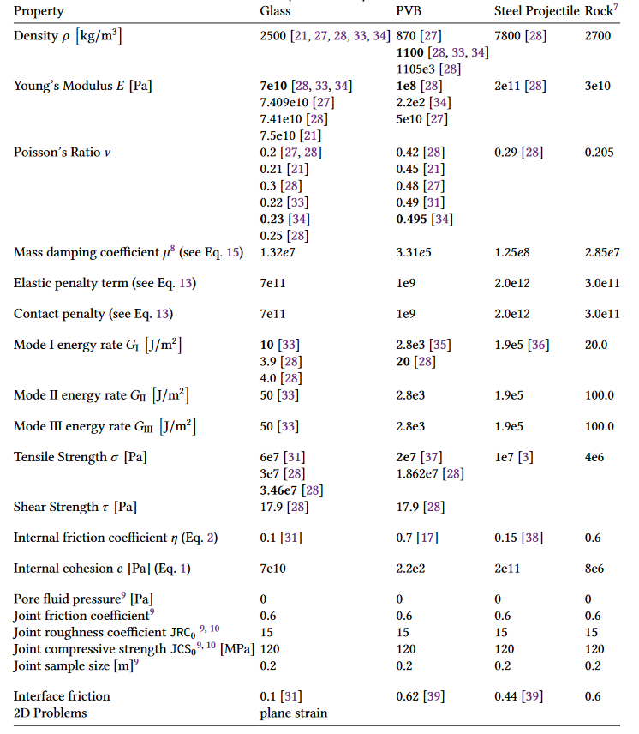
Material Parameters

