Slide 1
Elementary Algorithm to generate VTK output files A FEMDEM application Michael Trapp 01627245

Slide 2
Workflow FEMDEM
Program
Output
GiD
y input file
Pre-Processor
Computation
Yf
ym files
Post-Processor
M2vtu
M2vtu_crack
vtu files
vtu files
Paraview
→Complicated

Slide 3
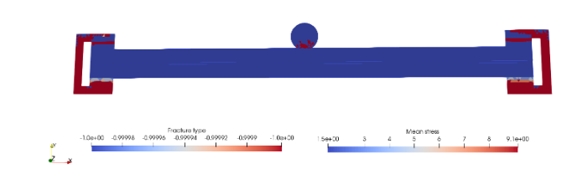
Simulation
Failure!
GID
Yf

Slide 4
Fix error
No GiD code available
[Alternative software]
Y Code
Runs on OS ↔ Fails on Travis
Problem: VTK 5.8
Remove VTK dependency
Not locally debuggable
debug

Slide 5
New Workflow
Old Workflow
GiD
y input file
GiD
y input file
Yf
Y2D = Yf
+
algorithm
ym files
vtu files
M2vtu
M2vtu_crack
vtu files
vtu files
Paraview
Paraview
→ Simple, local

Slide 6
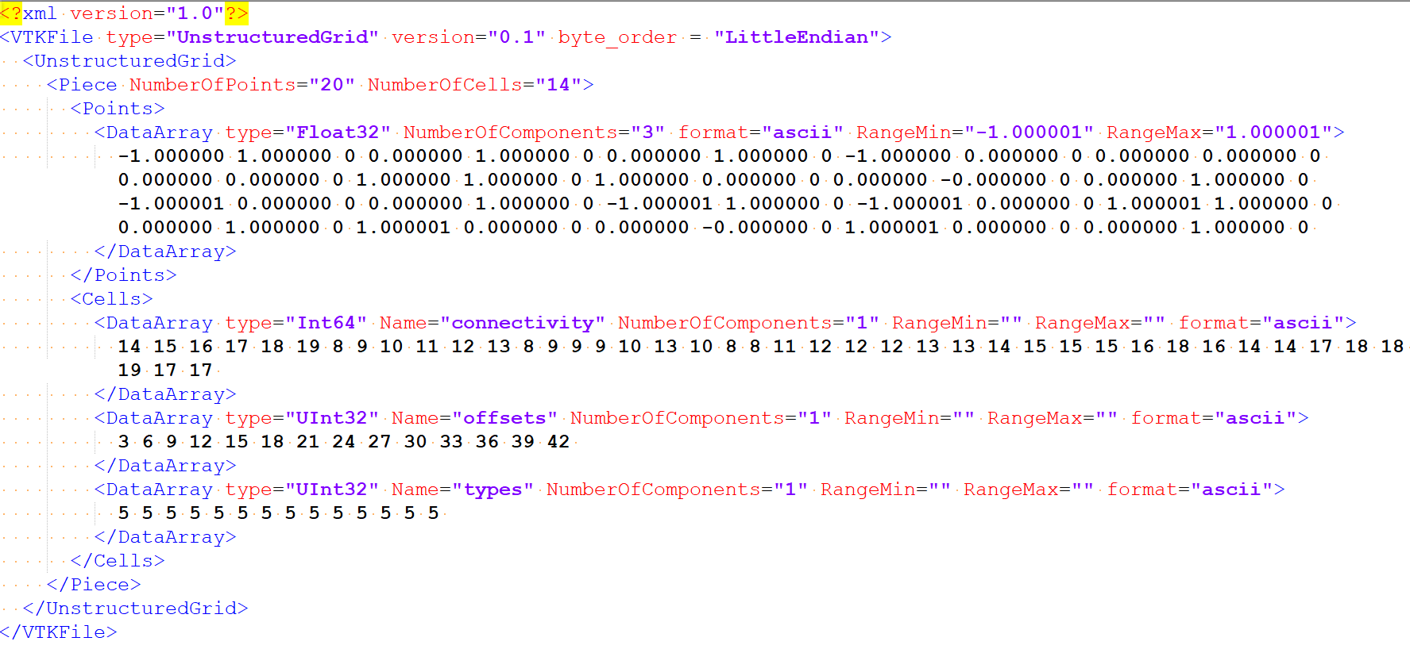
VTK XML Inline ASCII

Slide 7
Decimal ascii works. Why b64?
Previous output was b64 encoded
Additional Features: Appendable, Compressable
Data modification/loss in transit unlikely
No delimiter collision
Basic characters
Embeddable code
(Insecure) way to obscure secrets

Slide 8
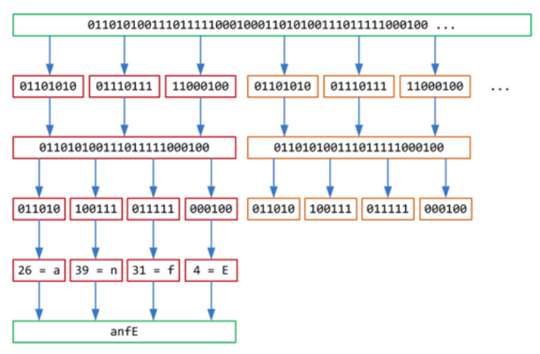

B64 encoding scheme
double loop
malloc/memcpy
?
bitshift
array indexing
output

Slide 9
B64 encoding implementation
3 x 8 bit
1
0
0
1
1
0
1
1
1
0
1
1
0
0
1
1
1
1
>> 2
1
0
0
1
1
0
1
&
1
1
1
1
1
1
1
0
0
1
1
0
1
1
>> 4
0
0
0
0
1
0
1
1
2
&
1
1
&
1
1
1
1
<< 4
1
1
|
1
0
1
1
4 x 6 bit
1
0
0
1
1
0
1
1
1
0
1
1
1

Slide 10
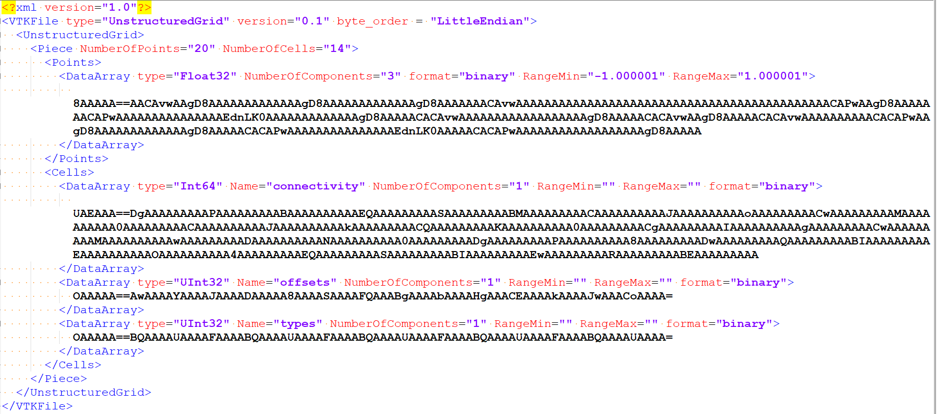
VTK XML Inline

Slide 11
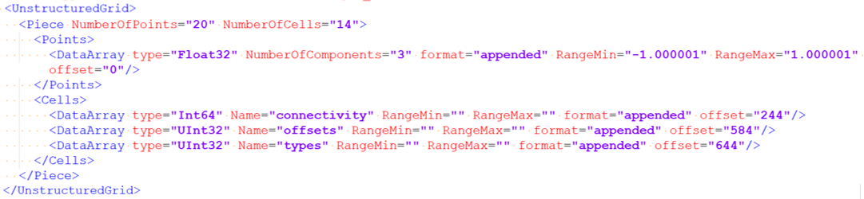
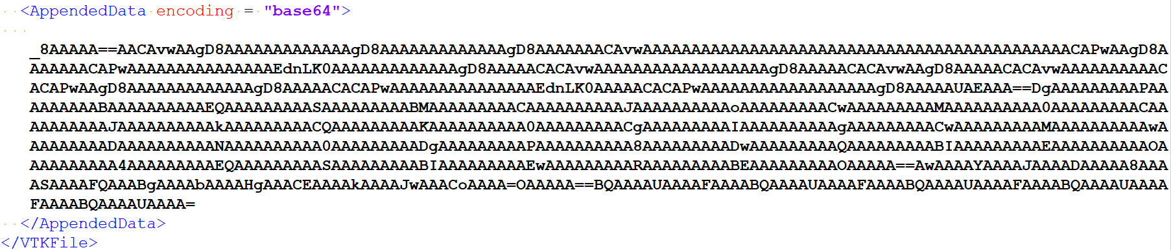
VTK XML Appended B64

Slide 12
Future Research
Make Code Debuggable
Alternative Pre-processor
Debug Code
More Features
Pass Travis Tests
(Realistic) Simulations
New Material Laws
Joint Elements between Different Materials
Large Scale HPC

Slide 13
Project Reflection
Confusing Setup
Difficulties
RCS
Requirements?
Documentation?
“Wrong” Research
Gdb
Novel algorithm

