Slide 1
Implementing integrated machine learning strategies to accelerate high accuracy fracture growth simulators
John Walding
Supervisor: Dr. Adriana Paluszny Rodriguez

Slide 2
Agenda
Motivation
Introduction
Background: SIF
Problem Specification
Implementation
Testing Strategy
Results
Conclusion
Future Developments

Slide 3
Motivation
Fracture Simulation is of great importance to many fields
Hydraulic Fracturing
Mineral Extraction
Medical Osteology
FDEMs are very accurate but can be slow
Is it possible to improve time efficiency without loss of accuracy?

Slide 4
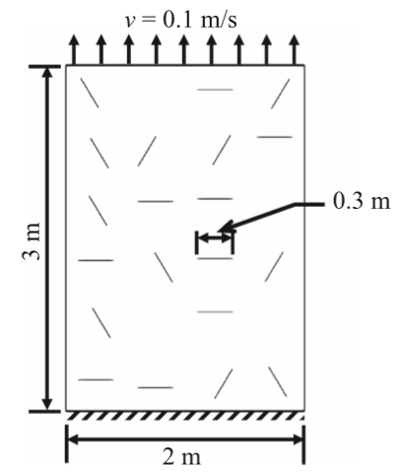
Introduction
ML has been applied to fracture problems before
Can be effective for certain criteria
Often limited by:
Restricted dimensionality
Graph theoretic approach
Not currently applicable to real world problems
Source: (Hunter, et al., 2019)

Slide 5
Introduction
Avoid aforementioned limitations by accelerating an FDEM
Calculation of SIF required before fracture tip evolution
SIF computation requires solution of several PDEs – computationally complex
Fracture tip evolution is well understood and simple by comparison
Is it possible to predict the SIF without the preceding computation?

Slide 6
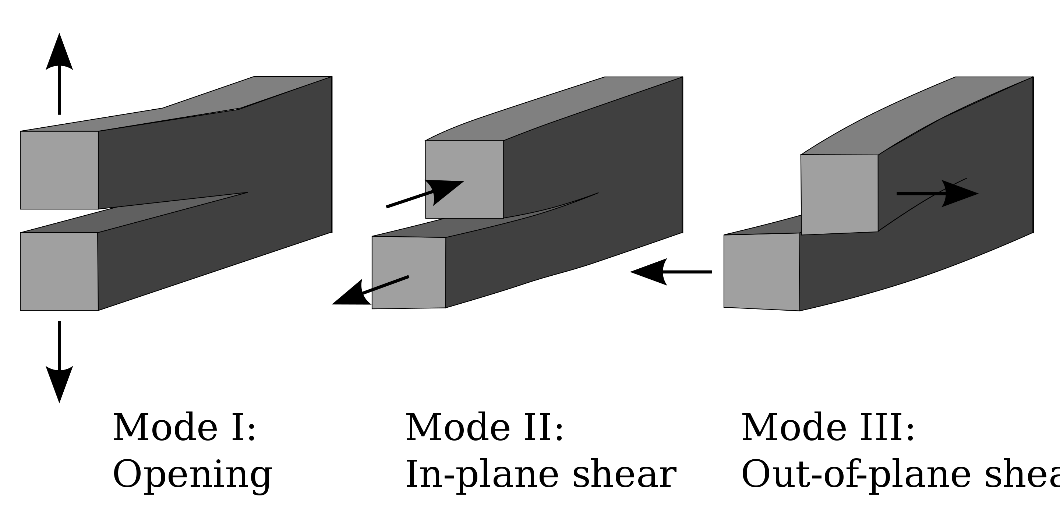

Background: SIF
Most important quantity for this project is Stress Intensity Factor (SIF)
The SIF is a theoretical construct that encodes the stress state at a tip
SIF has three elements:
$K_{I}$ - opening damage – positive definite
$K_{II}$ - in-plane shearing
$K_{III}$ - out-of-plane shearing
$K_{I}$ is often dominant, $K_{II}$ and $K_{III}$ are harder to predict

Slide 7
Problem Specification
Two factors relevant to an accelerator:
Time efficiency
Accuracy
For an ML method, time efficiency applies to training and execution
Training time of diminished importance
Execution time almost guaranteed to be superior to current algorithm
Therefore primary objective is accuracy retention

Slide 8
Problem Specification
This is a regression problem
Fracture tip evolution is determined by the current configuration
Therefore configuration history information is not necessary
Inter-fracture geometric data is important for interactions
Data is gathered from runs of the Imperial College Geomechanics Toolkit (ICGT)

Slide 9
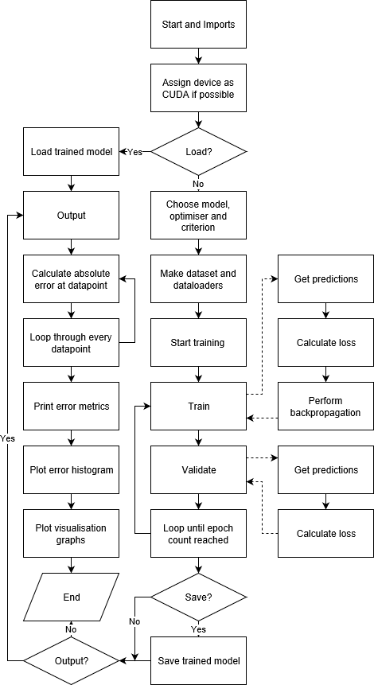
Implementation
Feed forward neural network selected
Python implementation – chosen for ML libraries
PyTorch used for the ML aspects
Little attention given to hyperparameters at this stage
Input data formatted as a CSV
Data split as 80:10:10 for training : validation : testing

Slide 10
Testing Strategy
Testing strategy designed for hyperparameter optimisation
Optimal configuration infeasible to ascertain
Heuristic approach taken
Hyperparameters tested in order of expected significance
Order investigated with preliminary testing
Will not result in optimal configuration, but adequate
Hyperparameters tested are:
Feature set
Model architecture
Optimiser
Criterion function
Activation function
Further hyperparameters left as defaults

Slide 11
Testing Conclusions
Feature Set: position vector, old SIF, angle
Architecture: see diagram
Optimiser: Adam
Criterion Function: L1Loss
Activation Function: LeakyReLU
n=7
n=25
n=200
n=100
n=50
n=1

Slide 12
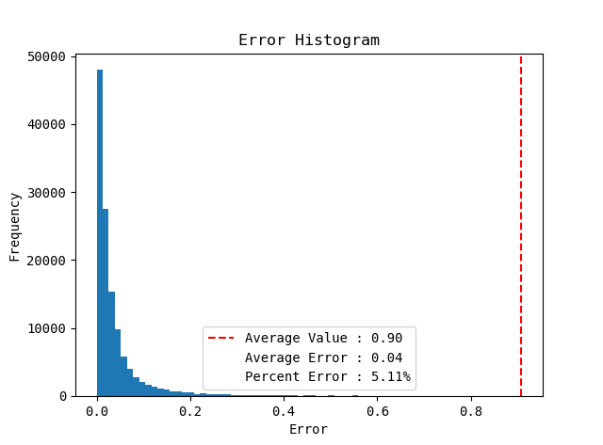
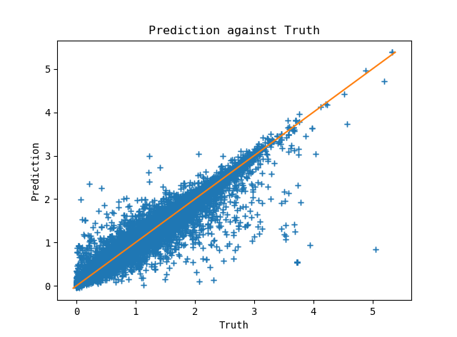
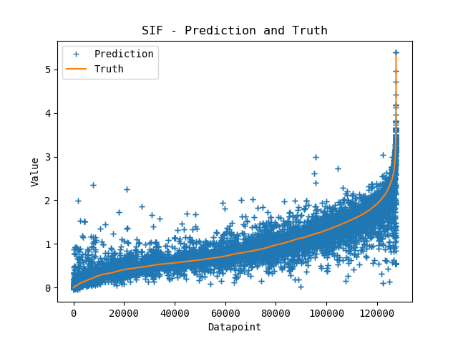

Results - $K_{I}$

Slide 13
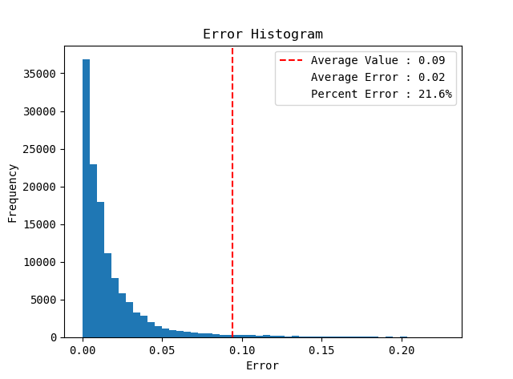
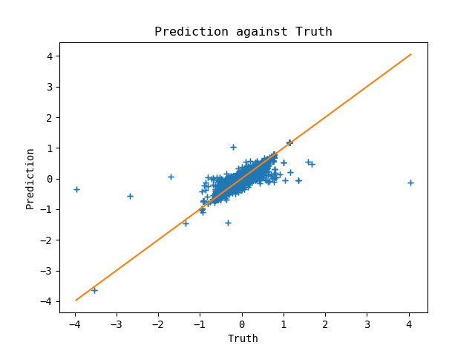
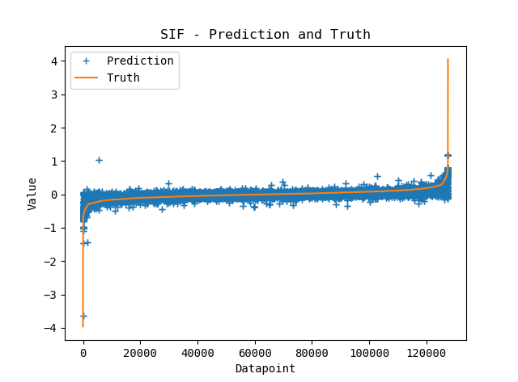

Results - $K_{II}$

Slide 14
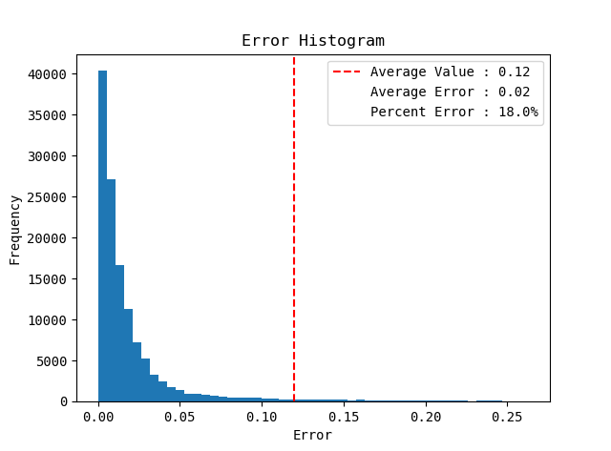
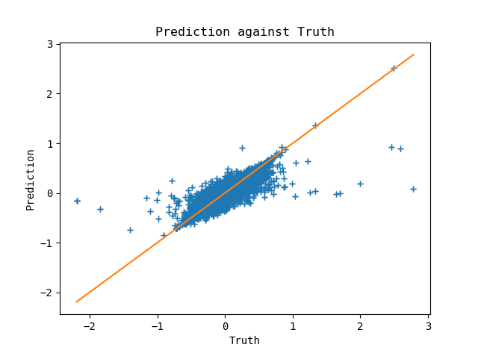
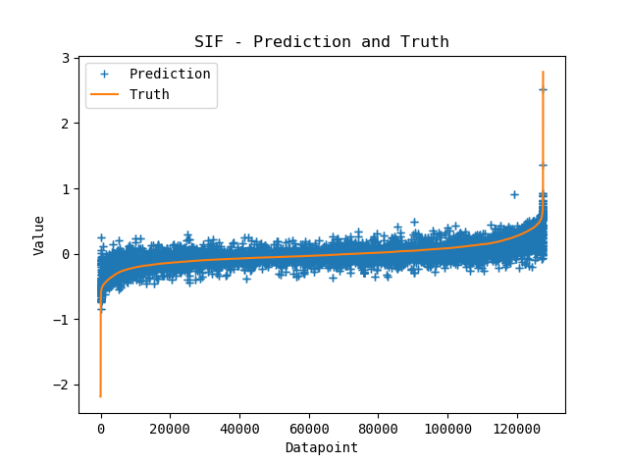

Results - $K_{III}$

Slide 15

Conclusions
ML acceleration of an FDEM is viable
$K_{I}$ easier to predict than $K_{II}$ and $K_{III}$
Further inter-fracture geometric data must be incorporated into feature set
Outputs currently returned with insufficient accuracy for immediate practical implementation

Slide 16
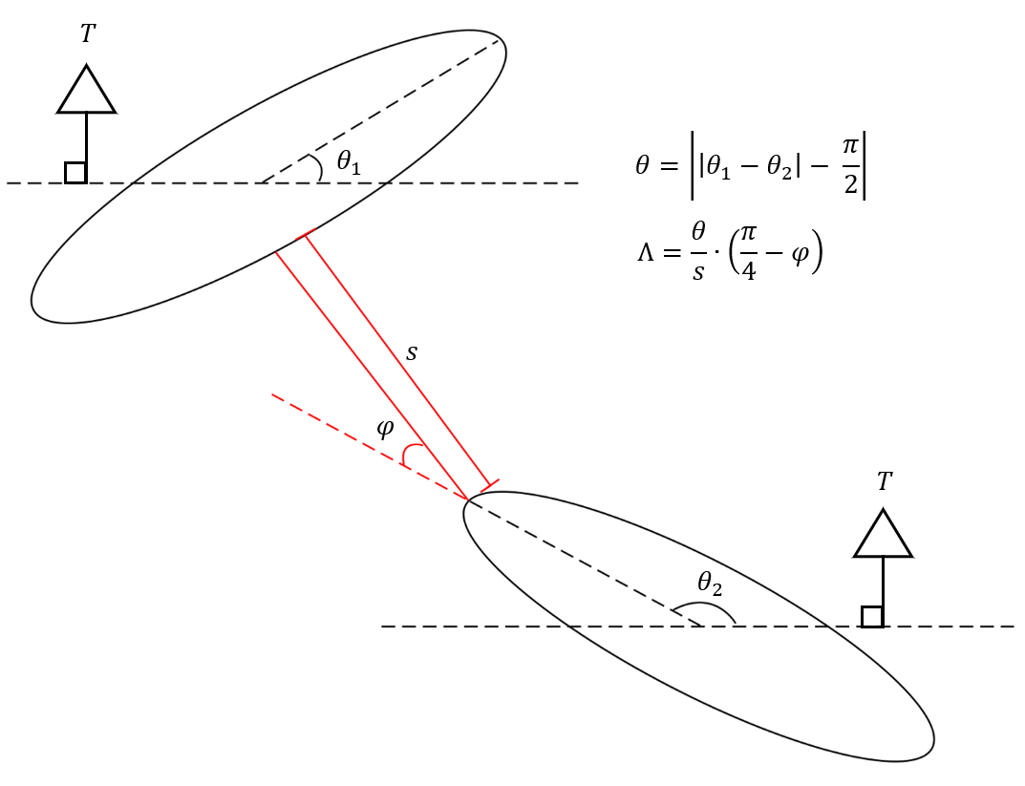
Future Developments
Increased dataset size
Improved hyperparameter optimisation scheme
Addition of fracture interaction index – see diagram
Implementation of binary measure for fracture interaction

Slide 17
Thank you for your attention Any questions?

