Slide 1
Parallelization of iSALE-2D Using OpenMP
ACSE-9 IRP Final Presentation
09/09/2019
Thesis for the MSc in Applied Computational Science and Engineering
Xianzheng Li
CID : 01611306
Notes:
My name is Xianzheng Li.

Slide 2
Outline
1
Introduction
Profiling
Code Refactoring
Serial Code Performance
Parallelization Strategy
Parallelization Performance
Further Developments

Slide 3
Introduction
2
360
Finite Difference
Rectangular Mesh
Explicit Time Step
Lagrangian + Advection
# of Vertical Cells
0
# of Horizontal Cells
280
Notes:
iSALE (impact-SALE) is a well-established shock physics code (written in Fortran
95) that has been developed and used for more than two decades to simulate impact
cratering.
This project involved the parallelization of the iSALE code which is used to solve the
compressible Navier-Stokes equations and the mass and internal energy equations.
The iSALE solution algorithm is an arbitrary Lagrangian-Eulerian finite difference
method on a structured rectangular mesh.
Each timestep
involves an explicit Lagrangian step that updates the nodal velocities.
the nodal positions can be updated to deform the mesh, if a Lagrangian
solution is desired; alternatively, an Eulerian ‘advection’ step can be invoked to
transfer momentum and all cell quantities between cells on the fixed mesh, based
on the overlap volumes between the deformed Lagrangian mesh and the original
fixed mesh.

Slide 4
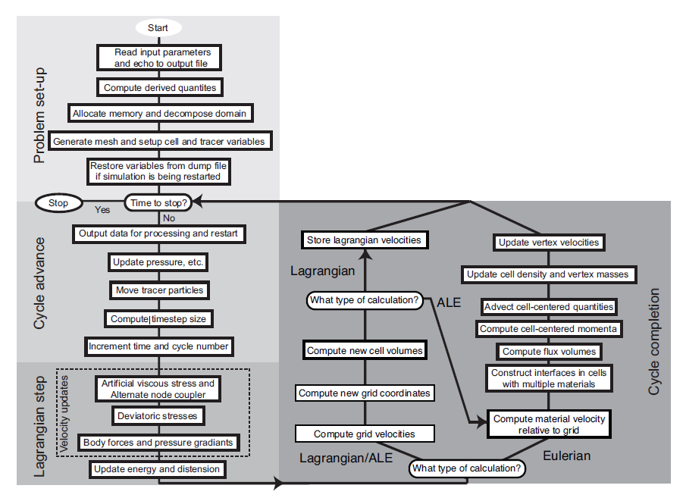
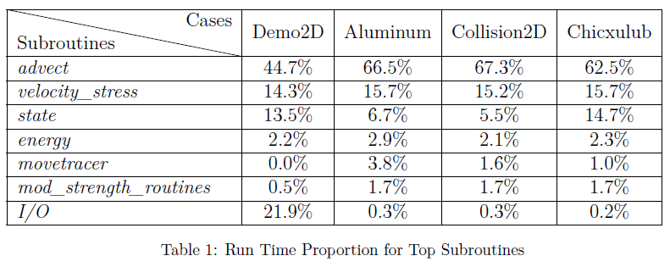
Profiling
3
Lagrangian
Advection
Intel VTune Amplifier Results

Slide 5
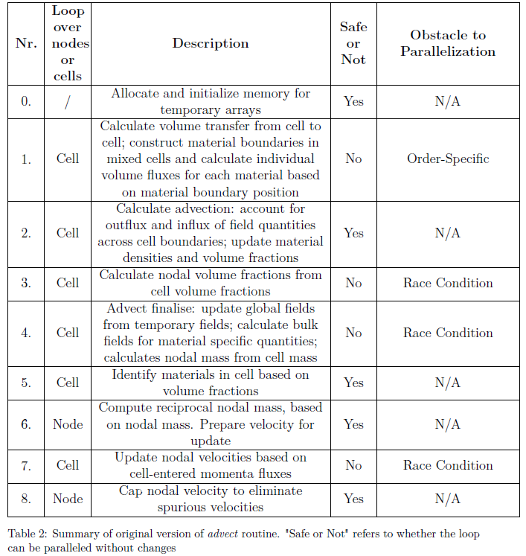
4
8 Loops
Contained Subroutines
Order – Specific Problem
Race Condition
Original Code Structure

Slide 6
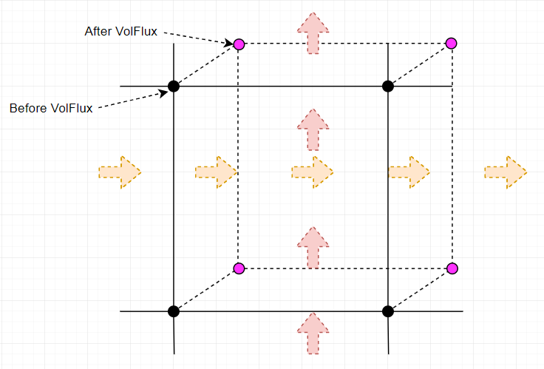
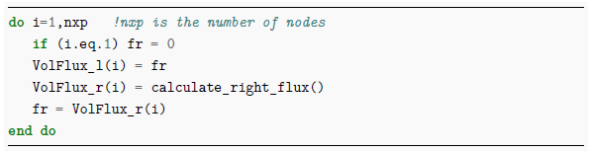
Order Specific Problem – VolFlux
5
Visual Illustration
Pseudo Code
Notes:
VolFlux loops is used to calculate volume transfer from cell to cell in specific order
However, once adding the parallelization to this, each
thread will process one node, and the data can not be guaranteed to
pass in the specific order because the processing time of each thread will
be varied.

Slide 7
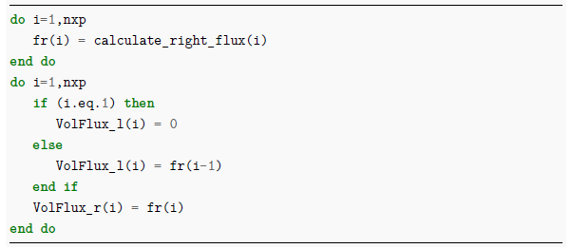
Order Specific Problem
6
Pseudo Code
Separated fr and VolFlux Calculation
Update fr First
Easy to Parallel the Most Expensive Part

Slide 8
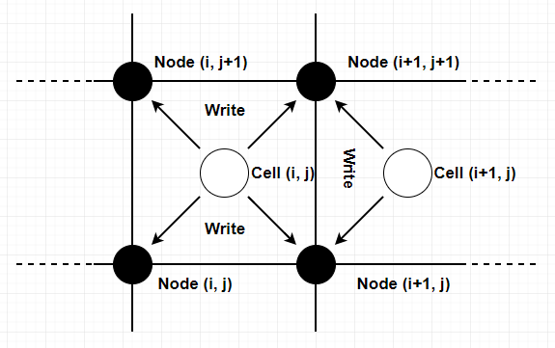
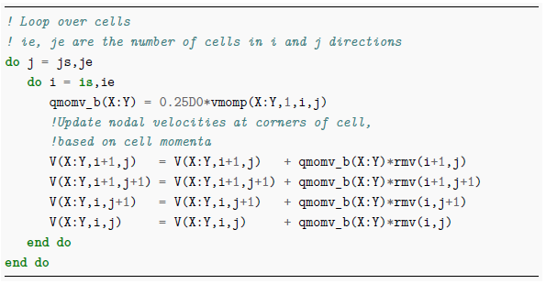
Race Condition
7
Visual Illustration
Pseudo Code

Slide 9
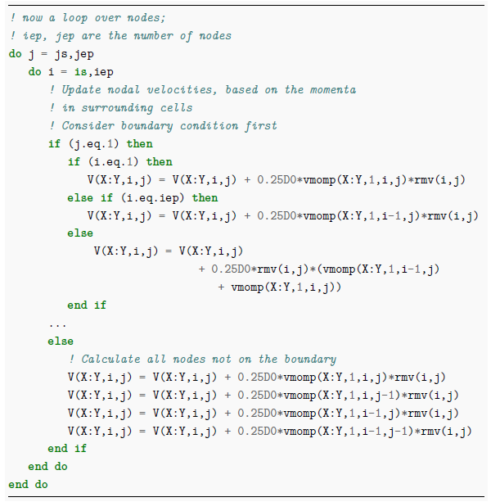
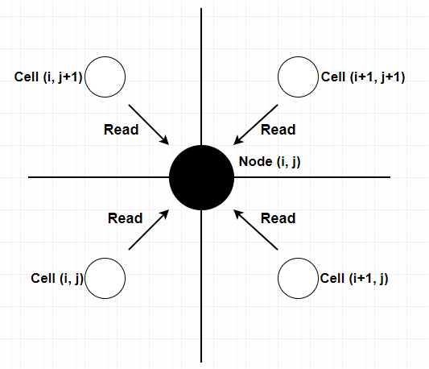
Race Condition
8
Visual Illustration
Pseudo Code

Slide 10
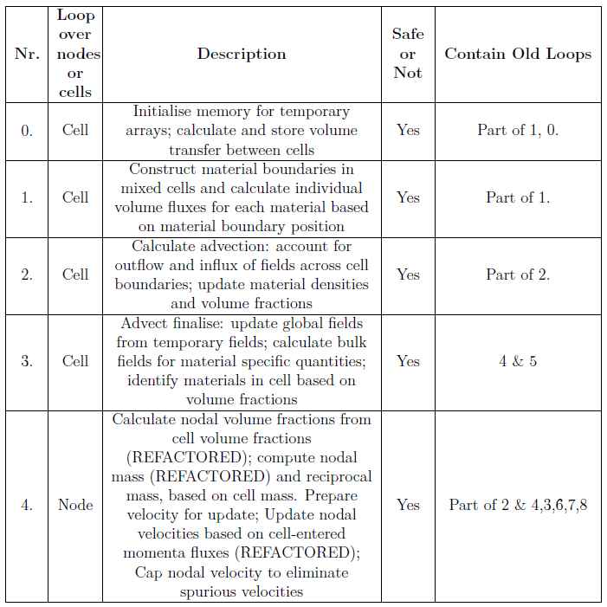
9
5 Loops
Remove Obstacles
Loop Merging
Initialization
Latest Code Structure

Slide 11
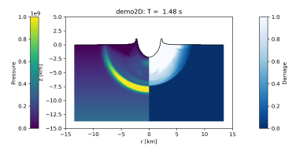
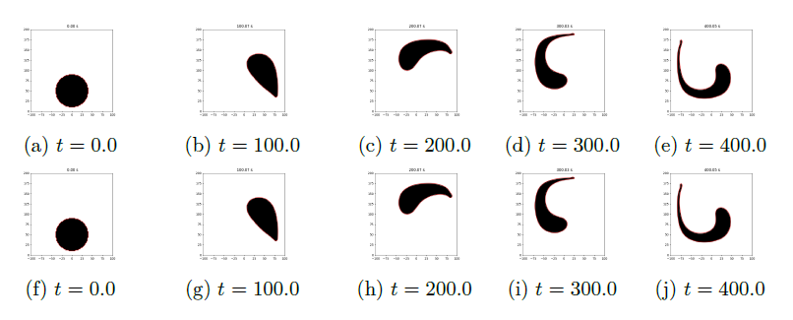
Verification – Subroutine Advect
10
Rotating Test
Impact Simulation Test
Before
Before
After
After
Notes:
After all code re-factoring and loop merging, the first priority was to test the
functionality of the subroutine advect, to ensure the changed code could produce
same results. This test imposes a fixed rotational (vortex) velocity field that advects a circle of material
around.
The purpose of this test is to compare the results of a simple impact simulation after 100 time
steps with those of a previously calculated reference simulation, to see whether the simulation results using the new code give identical
results to the previous code version.
Visualization output(double check)
The best way to reduce the error
is to re-define the test file. Thus, after full consideration, the benchmark file was
replaced with the new test results.

Slide 12
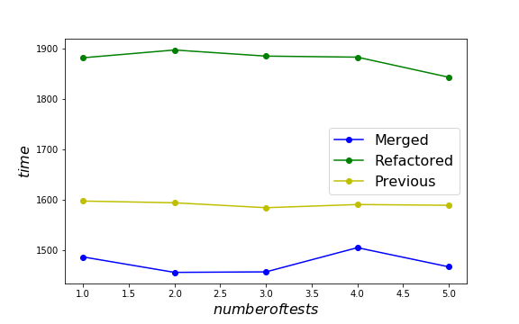
Serial Code Performance
11
Collision 2D Sample Case
Three Different Versions
Old Version
Refactored with Removing Obstacles
Loop Merged
Serial Code without Any Parallelization
Notes:
To ensure the accuracy of the run time, each version of the code ran five times
and the running time were recorded. The figure 9 shows that after re-factoring
the loops, the run time increased, which was reasonable because
the code re-factoring introduced more conditional cases inside loops to deal with
boundary cases. After merging 8 loops into 5, the run time of the code was shorter
than the original code, which indicated that reducing the number of loops will
improve the efficiency of the code. Therefore an unexpected benefit of preparing
the code for parallel processing was a speedup up the serial code.

Slide 13
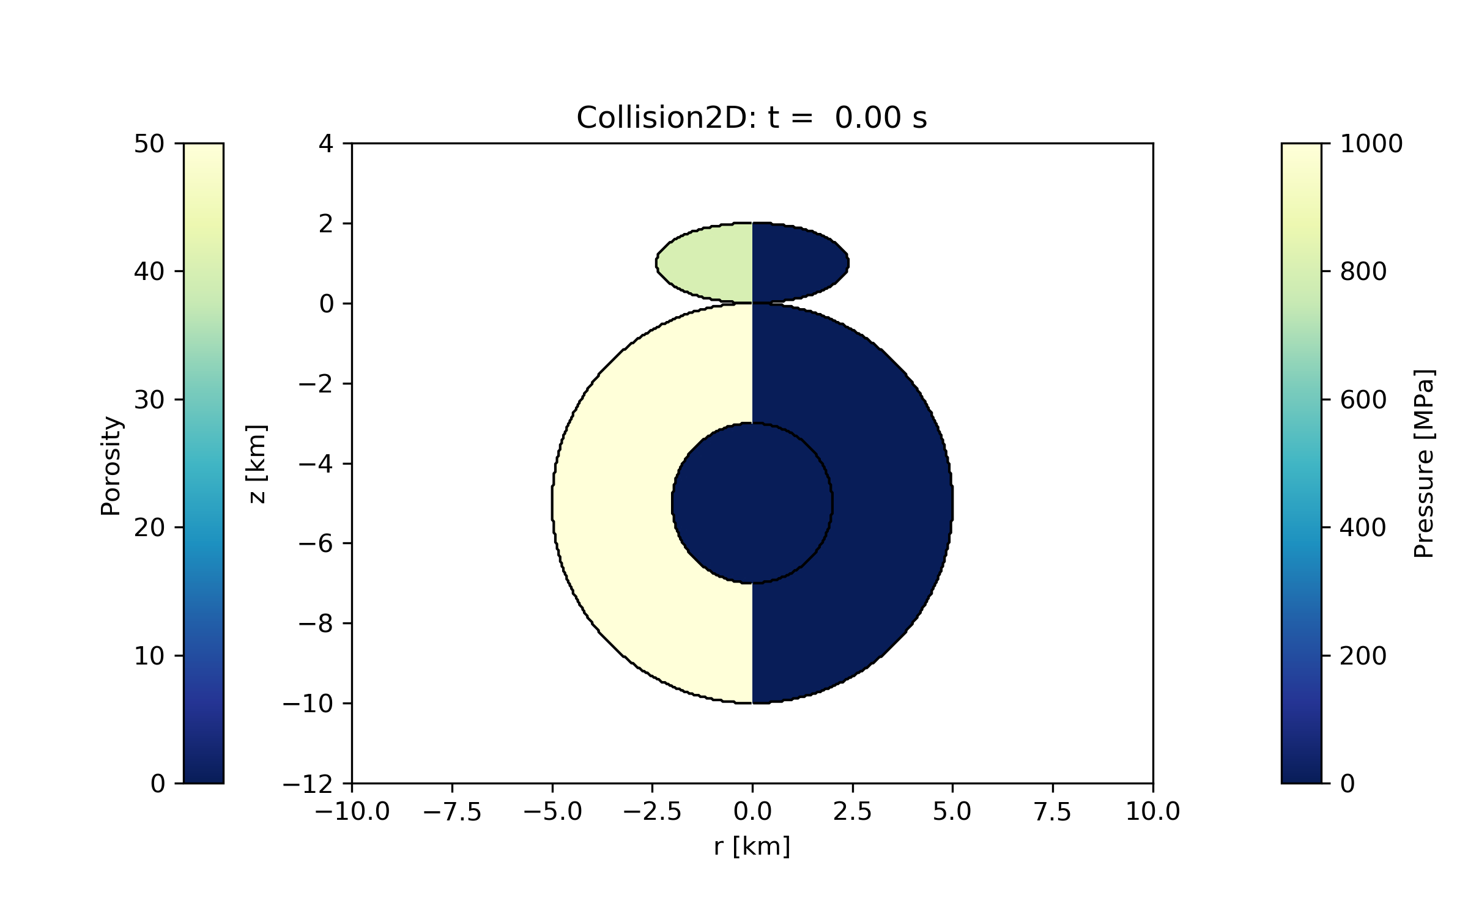
Parallelization Strategy
12
360
OpenMP Parallelization
Example of 4 Threads
Workload Balance
OMP PARALLEL DO (static)
# of Vertical Cells
# 1
# 2
# 3
# 4
0
# of Horizontal Cells
280

Slide 14
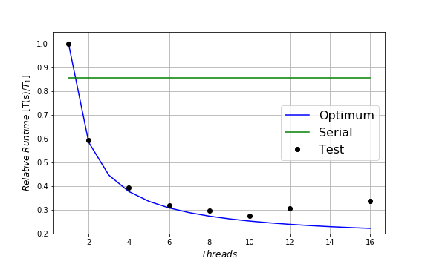
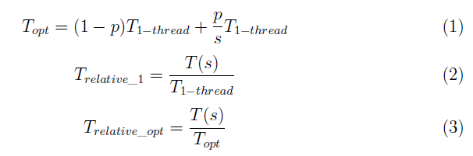
Parallelization Performance
13
Theoretical Optimum Run Time - Amdahl’s Law
Collision 2D Performance, p = 0.83
Notes:
The fraction of the execution time of the
task that would benefit from the improvement of the subroutine advect is denoted
by p. The one concerning the part that would not benefit from it is therefore 1-p
The reason for the longer run time and poor performance with 12 and 16
threads is the hardware issue. The workstation for this project used Intel(R)
Xeon(R) Gold 5118 CPU @ 2.30GHz, with 12 cores, and 24 threads because of
hyper-threading. Therefore, when the allocated threads reached or beyond the
physical limitation of the hardware, the communication would be messed up, and
the efficiency of the parallelization would fall down and become unstable. Although
the the omp_affinity issue was recognized and fixed, the limitation of the
hardware was still the point for longer run time with more than 12 threads. Another
potential reason is that the current mesh size was too small and 16 threads
were too many; the threads’ scheduling time was more than the running time.
With a higher resolution, which means larger mesh size, the performance of tests
with 12 and 16 threads would improve further.

Slide 15
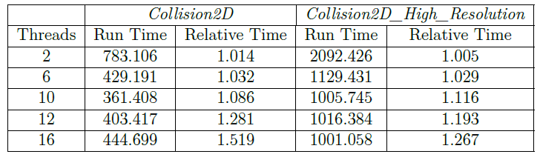
Performance – Higher Resolution
14
Run Time and Relative Run Time
Collision 2D Sample Case
Normal and Double Resolution
Parallelization with Different # of Threads

Slide 16
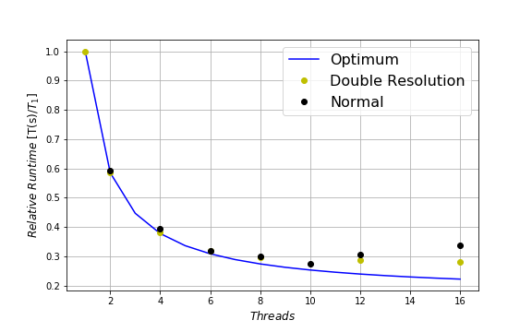
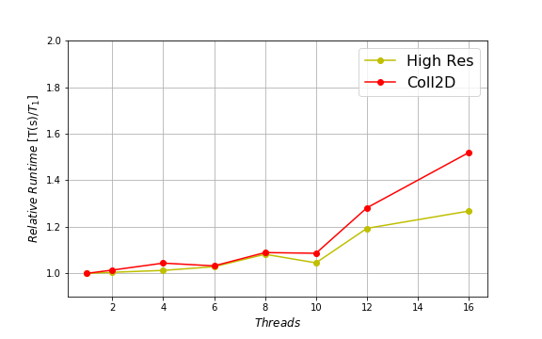
Performance – Higher Resolution
15
Double Resolution Performance
Normalized Performance

Slide 17
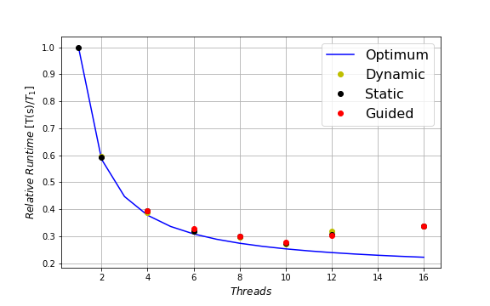
OpenMP Scheduling Methods Investigation
16
Test with Different Scheduling Methods
Static. Dynamic. Guided
Different Chunk Size
Even Workload Balance ?
Optimal Chunk Size ?
Notes:
As introduced earlier, each thread had equal work sections when the static
type applied. One disadvantage of the static type is when the workload
were not balanced for different sections, some threads would finish the work
quicker than the others, and cause significant idle time. The dynamic and
guided type would allocate the threads which finished the work section with
a new one. The idle time would be reduced, then improve the efficiency
of parallelization. The results in figure 13 show the relative run time of
static, dynamic and guided are similar, which potentially indicated that the
workload are balanced. Then, no matter which type was used, the run time
would be stable and similar.
The second potential reason is, the chunk size should be re-considered. Due
to the time limitation, the tests for different chunk size were not substantial.
Only two different chunk sizes were tested for dynamic, and one for guided.
Find the optimal chunk size may cause a significant improvement of the
parallelization performance.

Slide 18
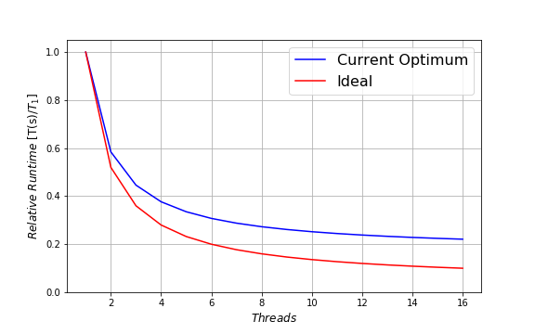
Further Investigation
17
65 % ~ 70 % of total code benefited from OpenMP currently
Have possibility to make further improvement
95 % of total code benefited from OpenMP
Will reduce 90 % of the total serial run time
Notes:
This brings me to the end of my todays presentation.

Slide 19
Questions?

Slide 20
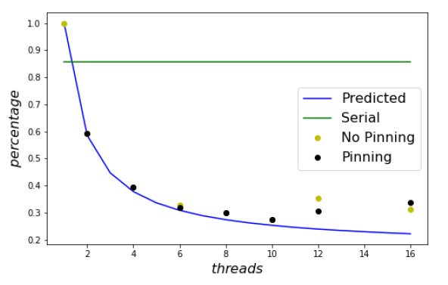
OMP_PINNING

Slide 21
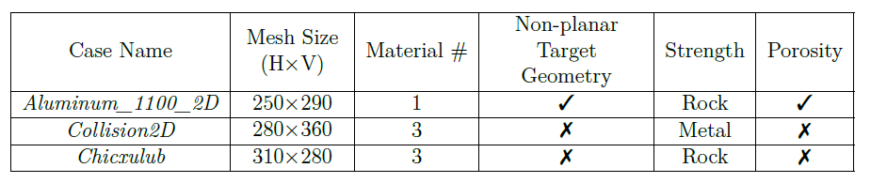
Information for Three Cases
Notes:
The Collision2D has the largest mesh size with three material. It also involves
a non-planar problem geometry with the most mixed cells in any calculation and
a porous material model.

Slide 22
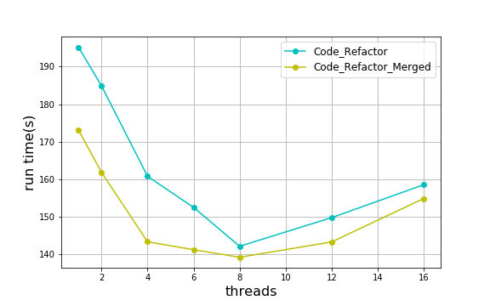
Loop Merging

Slide 23
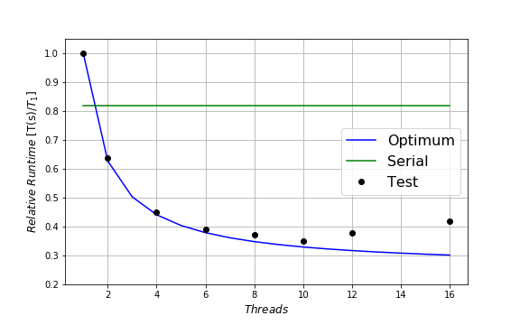
Chicxulub

Slide 24
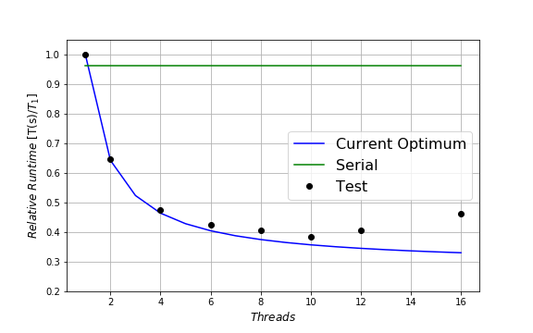
Aluminum_1100_2D

Slide 25
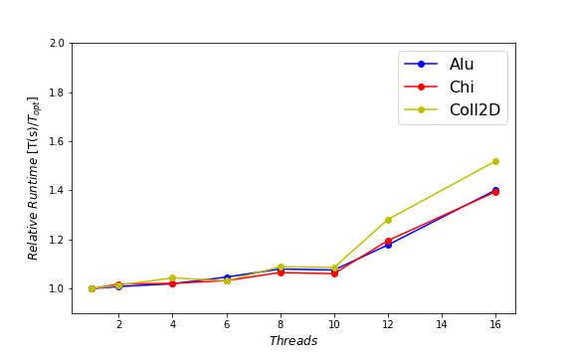
Normalized

Slide 26
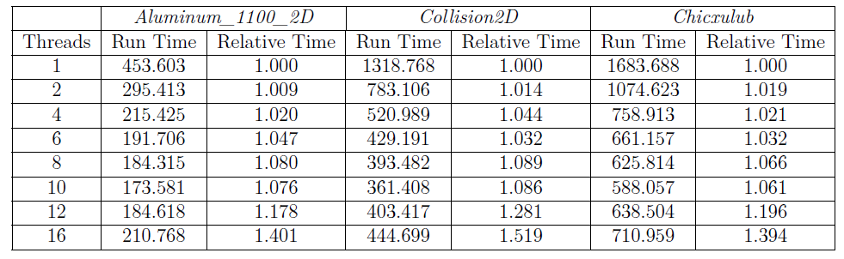
Run Time and Relative Run Time for Three Cases

Slide 27
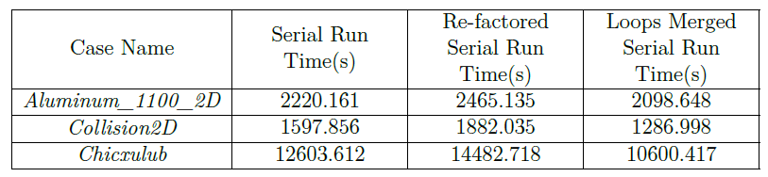
Run Time for Three Cases

Slide 28
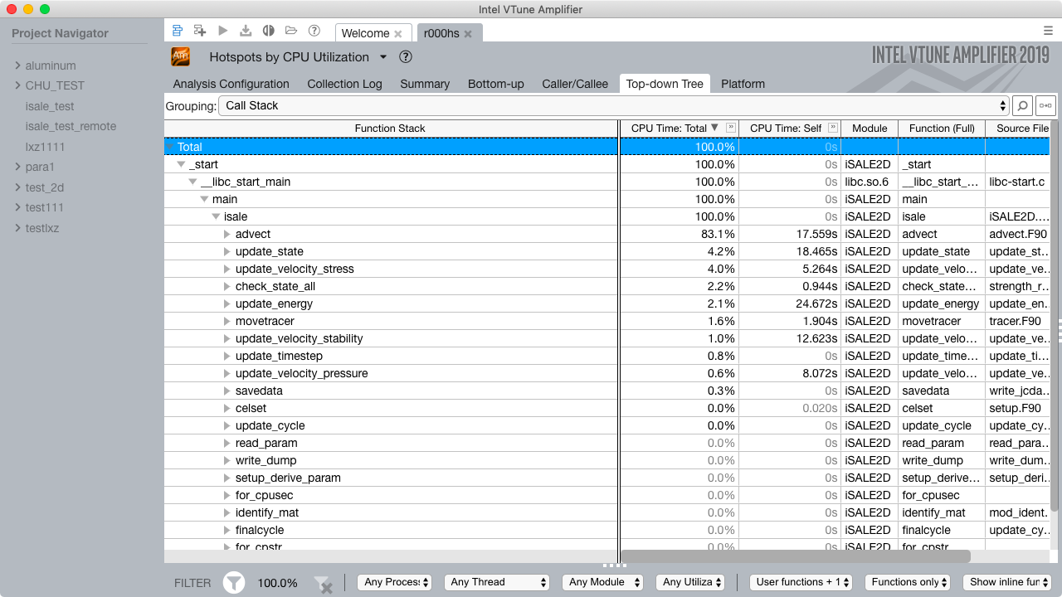
Vtune Amplifier UI

Slide 29
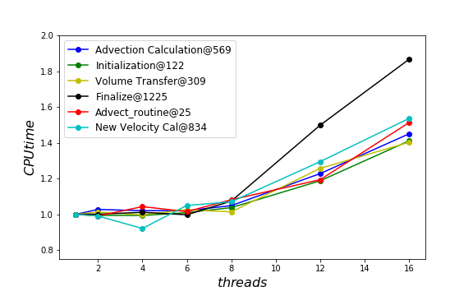
Parallelization Sections

