Slide 1


2.1 An Introduction to Metabolic Modeling
Expanding the Horizon for Anaerobic Digestion Modeling
Matthew Scarborough, PE, Ph.D
Department of Civil and Environmental Engineering
University of Vermont
June 19, 2022

Slide 2

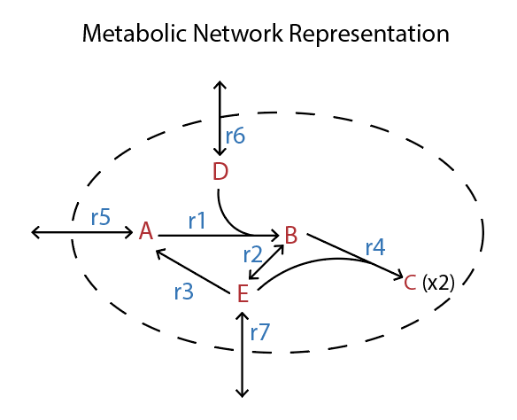
This presentation will introduce you to metabolic modeling theory and implementation
Describe what metabolic models can and cannot do
Explain how to model a metabolic network with constraint-based approaches
Dissect a 3-guild metabolic model of anaerobic digestion
Notes:
Example title: This study determined how FeCl3 dosing to secondary sludge impacted biogas production

Slide 3
What can metabolic modeling do?
Metabolic models can…
…directly model the yield (e.g., Y_{OHO})
…account for changes in metabolism under different conditions
…be built based on DNA of organisms
…account for multiple rate limiting metabolic steps
…incorporate reaction-level thermodynamic (and other) constraints
Notes:
Example title: An anaerobic dynamic membrane bioreactor was designed for simultaneous chain elongation and filtration

Slide 4
What are the limitations?
Metabolic models cannot…
…accurately estimate growth without understanding maintenance energy requirements
… accurately estimate rates without enzyme-level kinetic information
… be built based on DNA of organisms without significant manual curation
… predict decay rates
Notes:
Example title: An anaerobic dynamic membrane bioreactor was designed for simultaneous chain elongation and filtration

Slide 5
How to model a metabolic network with constraint-based approaches
Reconstruct the metabolic network
Make a list of metabolites
Make a list of reactions
Make a stoichiometric matrix
Set constraints
Set objective function
Solve the model
Notes:
Example title: An anaerobic dynamic membrane bioreactor was designed for simultaneous chain elongation and filtration

Slide 6
1. Reconstruct the metabolic network

Slide 7

2. Make a list of metabolites

Slide 8
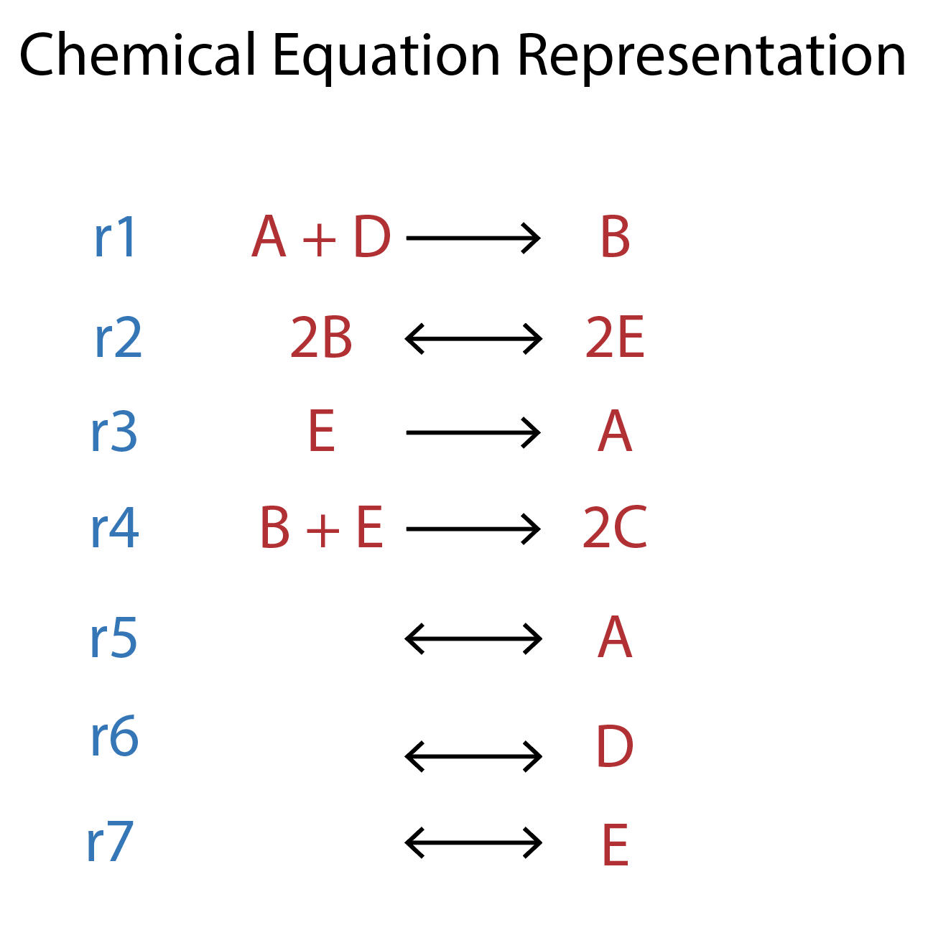
3. Make a list of reactions

Slide 9
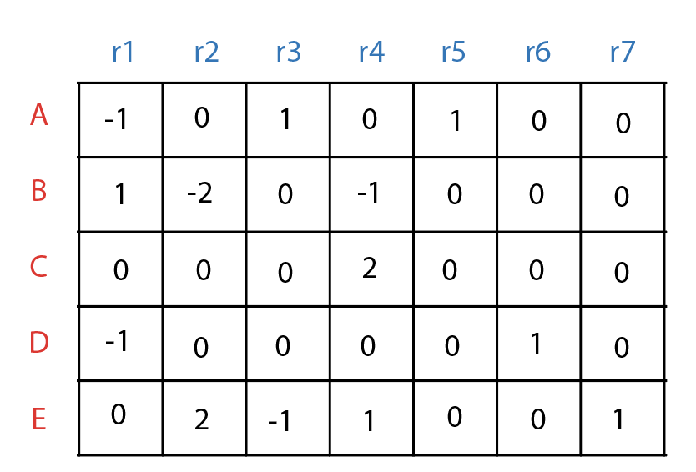
4. Make a stoichiometric matrix

Slide 10
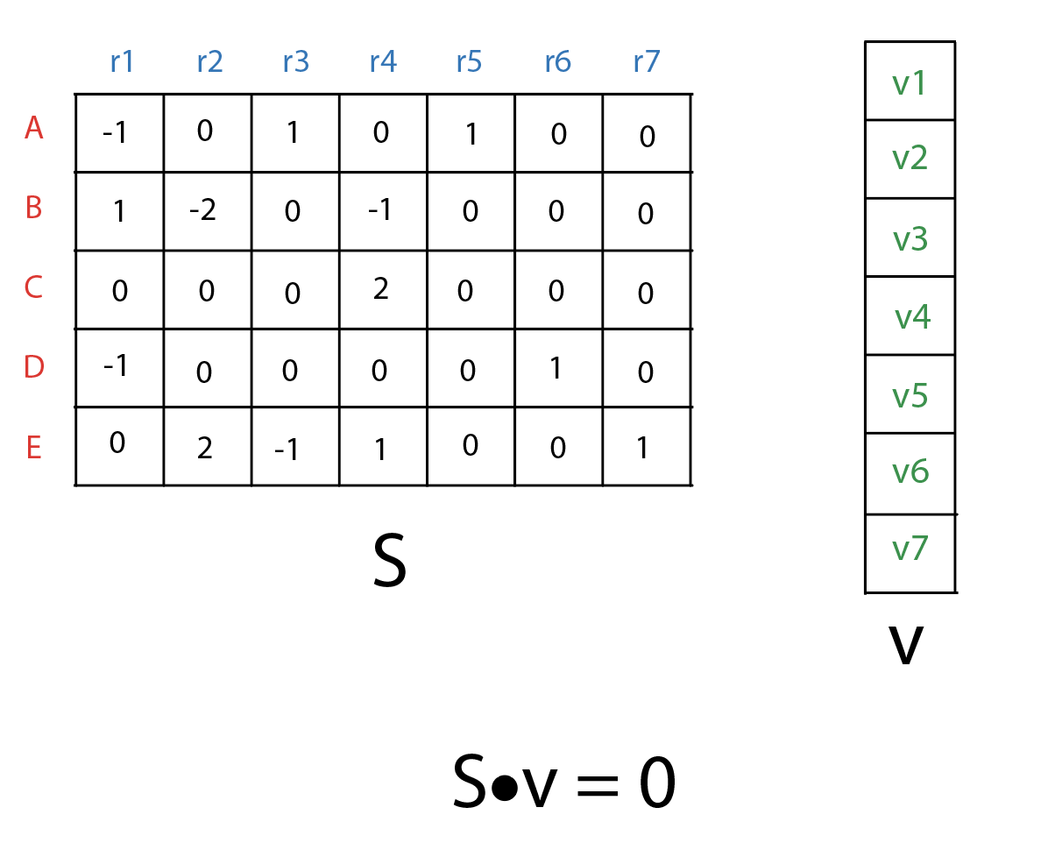
5. Set constraints

Slide 11
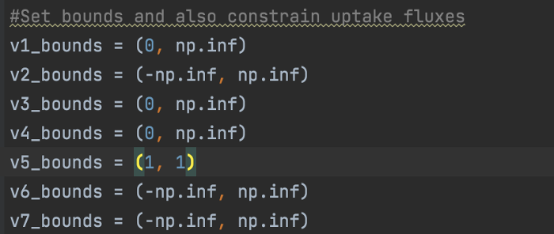
5. Set constraints

Slide 12
6. Set the objective function

Slide 13
6. Set the objective function

Slide 14
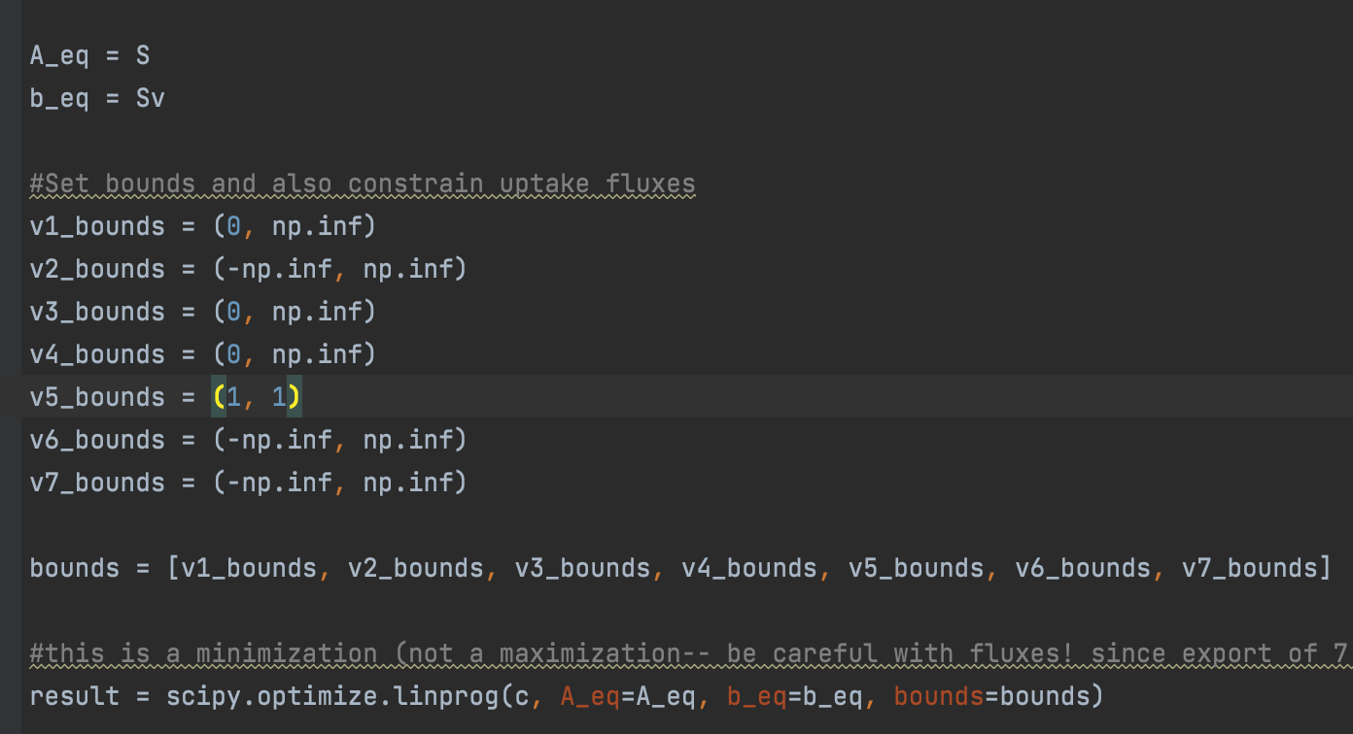
7. Solve the model

Slide 15
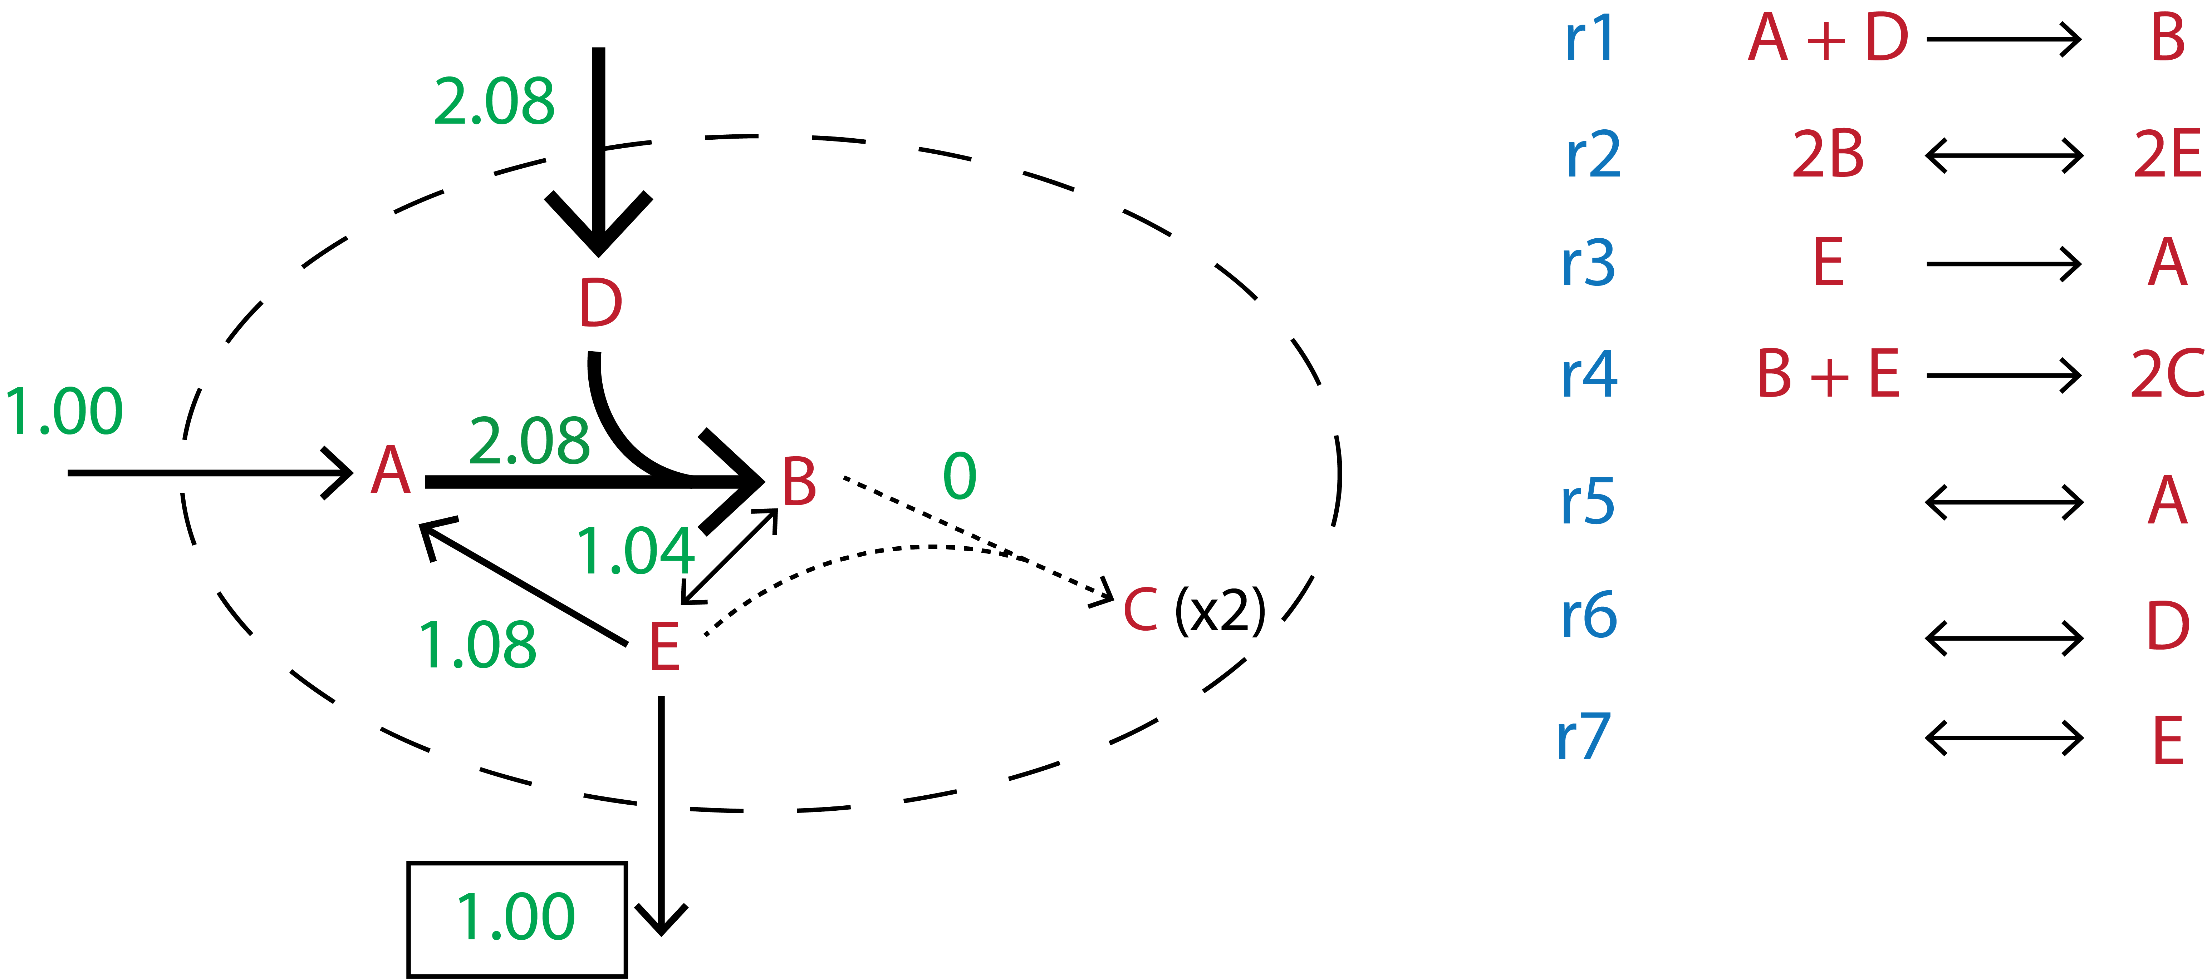
Flux Balance Analysis (FBA)
Standard units are [mmol gDCW⁻¹ hr⁻¹]

Slide 16
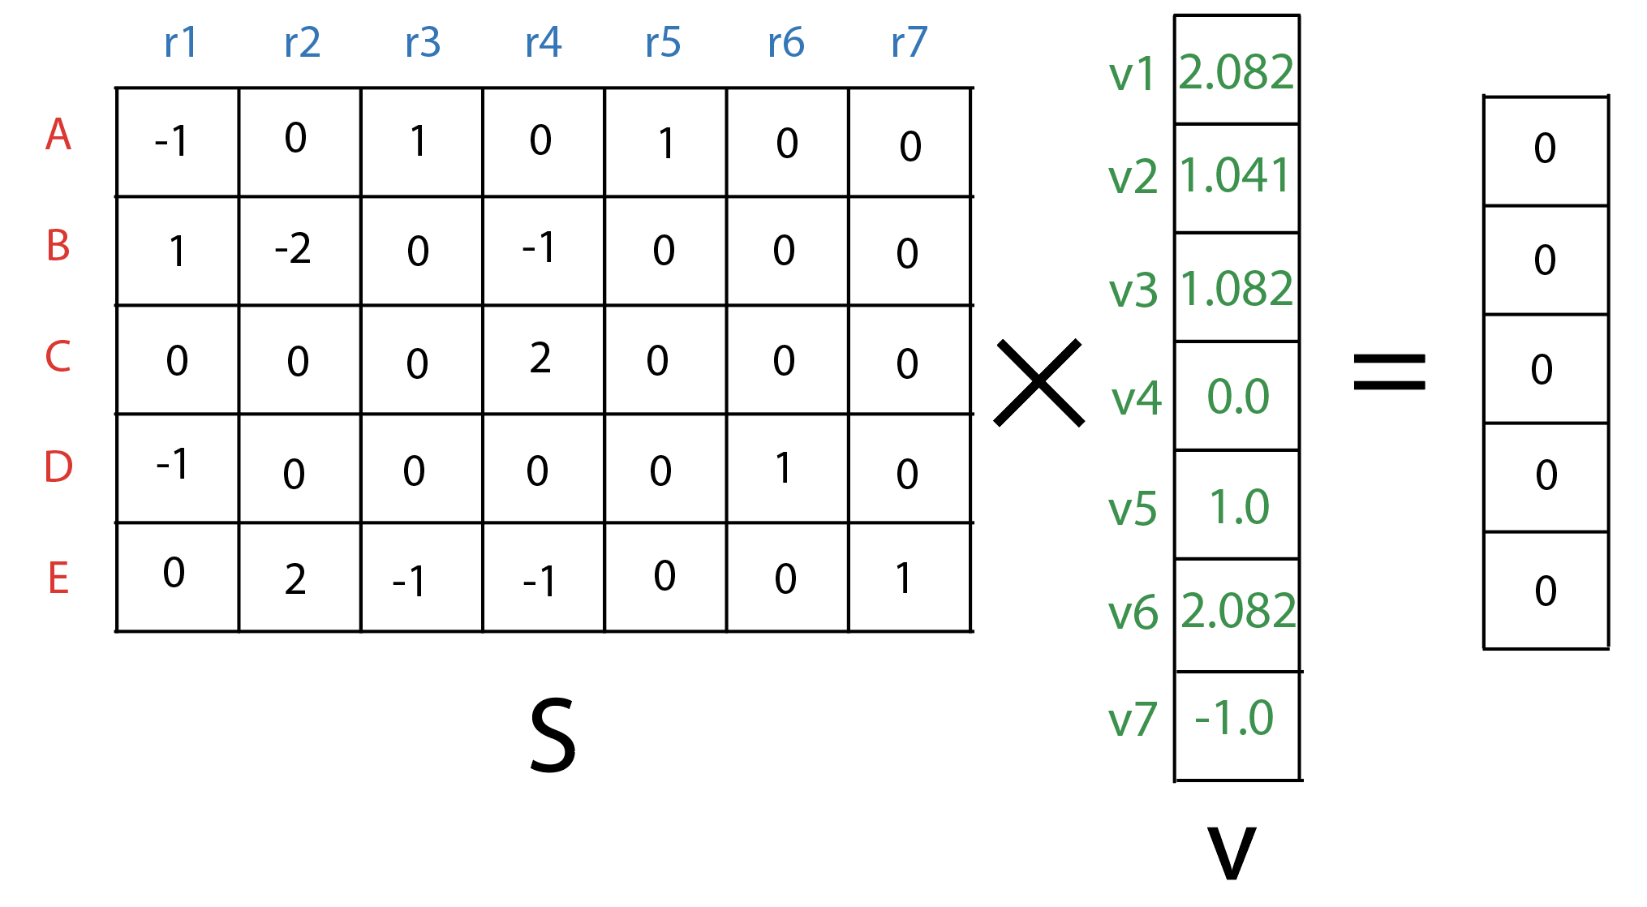
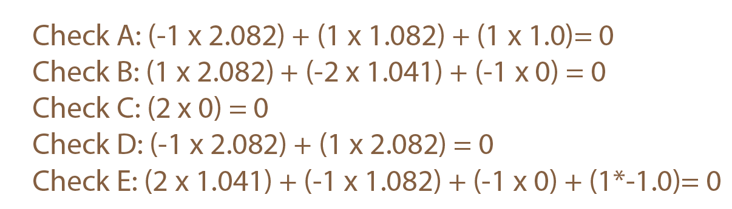
Checking the solution

Slide 17
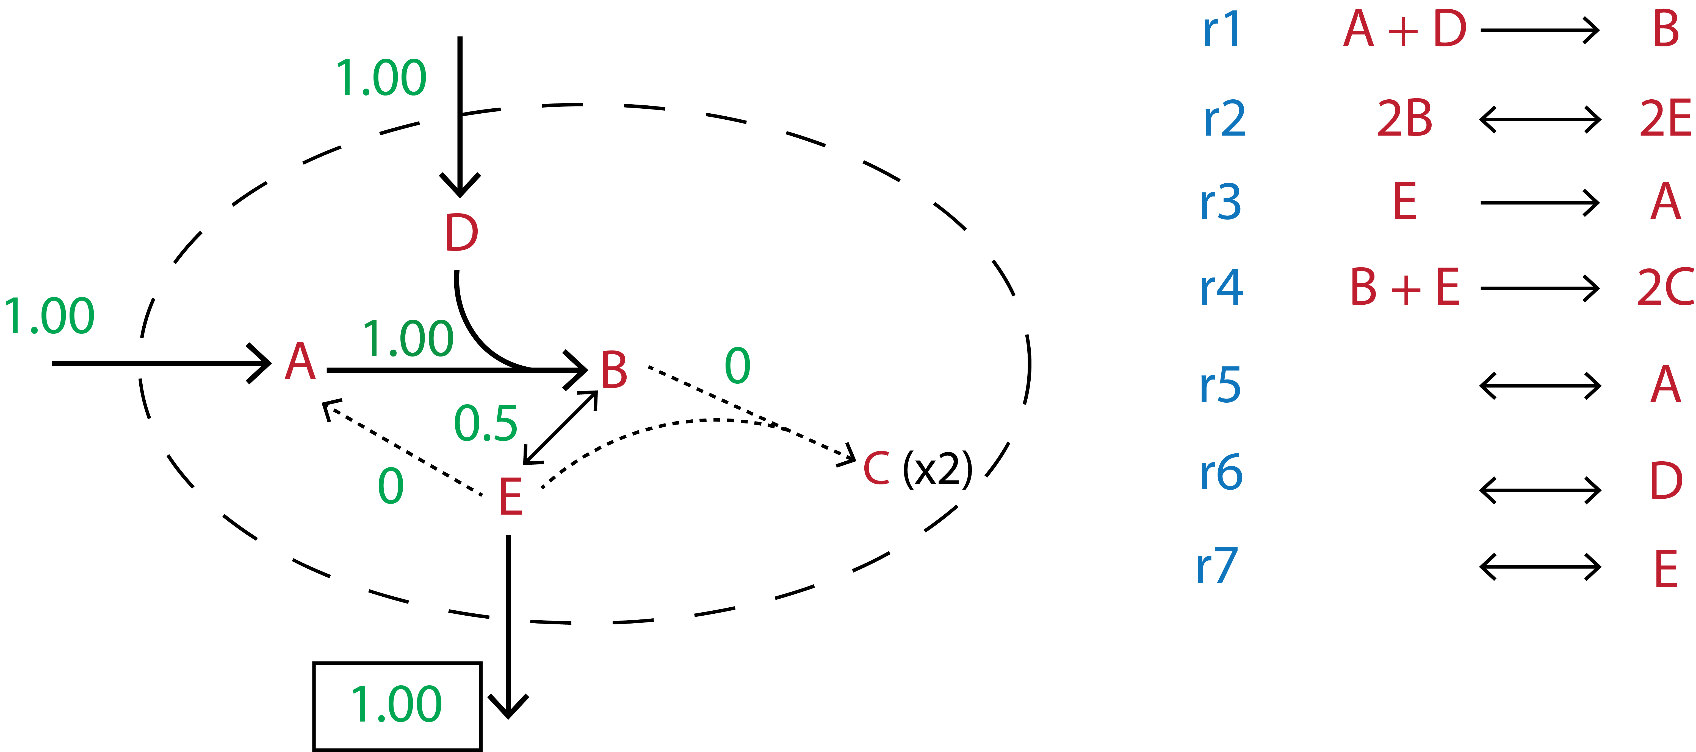
Parsimonious Flux Balance Analysis (pFBA)

Slide 18
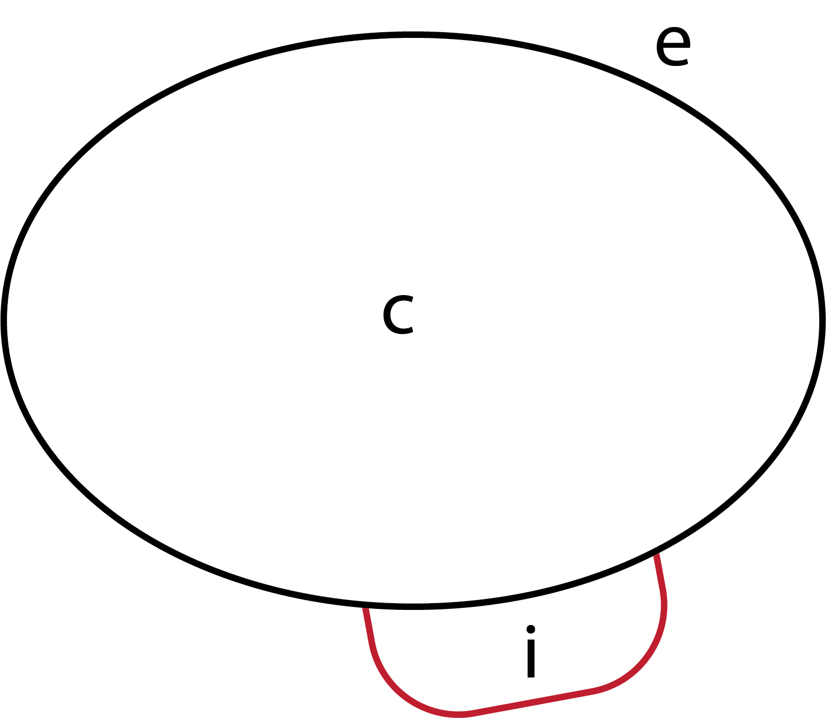
Compartmentalization of reactions
e = extracellular space
c = cytoplasm
i = ion-motive force
Notes:
Example title: This study determined how FeCl3 dosing to secondary sludge impacted biogas production

Slide 19
Genome Scale Models
https://sbrg.ucsd.edu/InSilicoOrganisms/OtherOrganisms

Slide 20
Example of full biomass equation (iRSP1140)
48.8795598256 ATP + 0.817579349929507 L-Alanyl-tRNA(Ala) + 0.430368015578729 L-Arginyl-tRNA(Arg) + 0.142057409042004 L-Asparaginyl-tRNA(Asn) + 0.333864881166228 L-Aspartyl-tRNA(Asp) + 0.071328403696196 L-Cysteinyl-tRNA(Cys) + 0.16003935955365 L-Glutamyl-tRNA(Glu) + 0.400398098059319 Glutaminyl-tRNA(Gln) + 0.552645279057922 Glycyl-tRNA(Gly) + 0.136063425538122 L-Histidyl-tRNA(His) + 0.29010880158789 L-Isoleucyl-tRNA(Ile) + 0.550247685656369 L-Leucyl-tRNA(Leu) + 0.16663274140792 L-Lysyl-tRNA(Lys) + 0.158241164502485 L-Methionyl-tRNA(Met) + 0.203795439131989 L-Phenylalanyl-tRNA(Phe) + 0.323675109209629 L-Prolyl-tRNA(Pro) + 0.27332564777702 L-Seryl-tRNA(Ser) + 0.312885938902641 L-Threonyl-tRNA(Thr) + 0.0629368267907612 L-Tryptophanyl-tRNA(Trp) + 0.120479068428029 L-Tyrosyl-tRNA(Tyr) + 0.451946356192704 L-Valyl-tRNA(Val) + 0.093471857028361 GTP + 0.0907387617936135 CTP + 0.0437295237559583 UTP + 0.0185403408113183 dATP + 0.0185642947400151 dGTP + 0.0411528495010915 dCTP + 0.0414882045028466 dTTP + 0.027400 Peptidoglycan + 0.00834 LPS + 0.077027 Phosphatidylethanolamine + 0.086655 Phosphatidylglycerol + 0.038513 Phosphatidylcholine + 0.002407 Cardiolipin + 0.024071 Sulfoquinovosyldiacylglycerol + 0.0000676933681191807 Spheroidenone + 0.002140 NAD + 0.00005 NADH + 0.000129 NADP + 0.000398 NADPH + 0.000003 Succinyl-CoA + 0.00005 Acetyl-CoA + 0.000059 CoA + 0.00001 FAD + 0.049752 5-Methyltetrahydrofolate + 0.000995 AMP + 0.002990 D-Glucose 1-phosphate + 0.034830 Putrescine + 0.006970 Spermidine + 0.000059 S-Adenosyl-L-methionine + 0.000059 Thiamindiphosphate + 0.000059 Pyridoxalphosphate + 0.000059 HemeO + 0.000059 Riboflavin + 0.000059 di-trans,poly-cis-Undecaprenyldiphosphate + 0.000059 ubiquinol + 0.000059 Glutathione + 0.000059 Biotinyl-5'-AMP => 48.8340638966 ADP + 48.8340638966 Orthophosphate + 48.8340638966 H2O + 48.8340638966 H+ + 0.284470 Diphosphate + 0.817579349929507 tRNA(Ala) + 0.430368015578729 tRNA(Arg) + 0.142057409042004 tRNA(Asn) + 0.333864881166228 tRNA(Asp) + 0.071328403696196 tRNA(Cys) + 0.16003935955365 tRNA(Glu) + 0.400398098059319 tRNA(Gln) + 0.552645279057922 tRNA(Gly) + 0.136063425538122 tRNA(His) + 0.29010880158789 tRNA(Ile) + 0.550247685656369 tRNA(Leu) + 0.16663274140792 tRNA(Lys) + 0.158241164502485 tRNA(Met) + 0.203795439131989 tRNA(Phe) + 0.323675109209629 tRNA(Pro) + 0.27332564777702 tRNA(Ser) + 0.312885938902641 tRNA(Thr) + 0.0629368267907612 tRNA(Trp) + 0.120479068428029 tRNA(Tyr) + 0.451946356192704 tRNA(Val) + Biomass

Slide 21
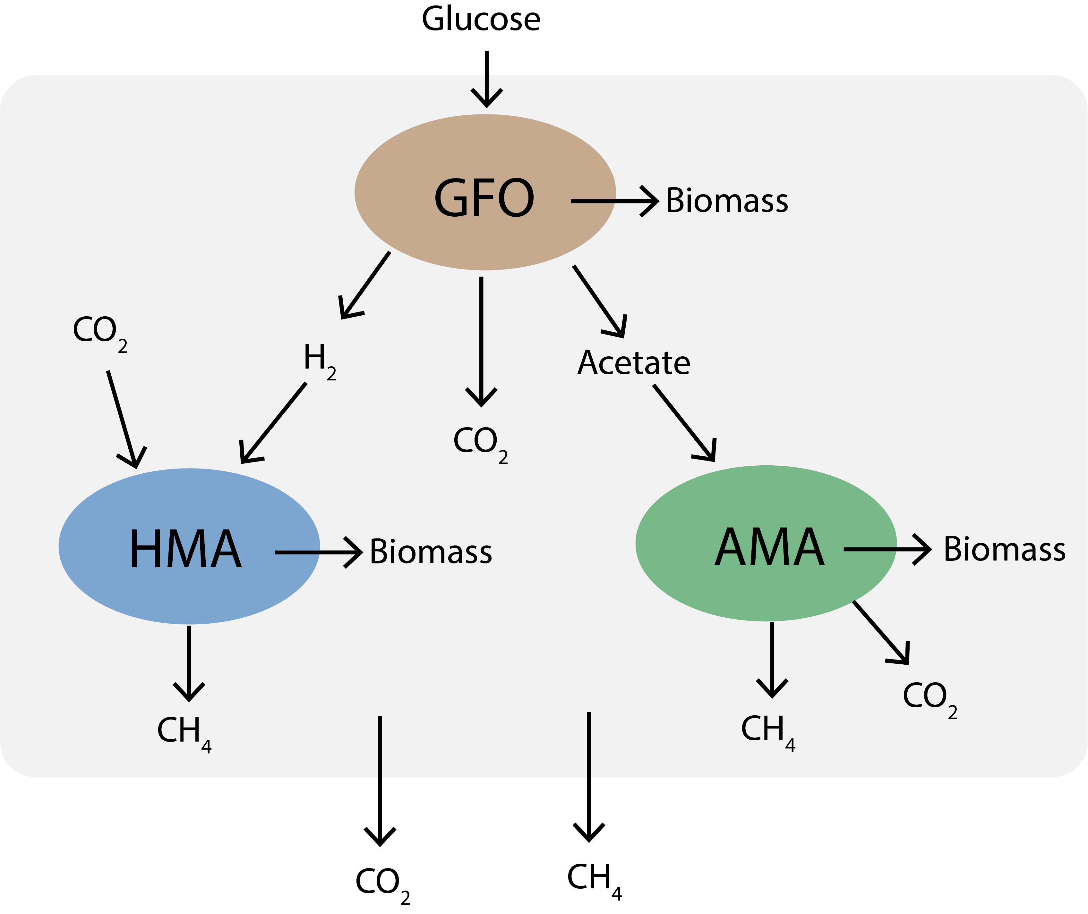
Introduction to the 3 guild AD mode
Notes:
Example title: This study determined how FeCl3 dosing to secondary sludge impacted biogas production

Slide 22
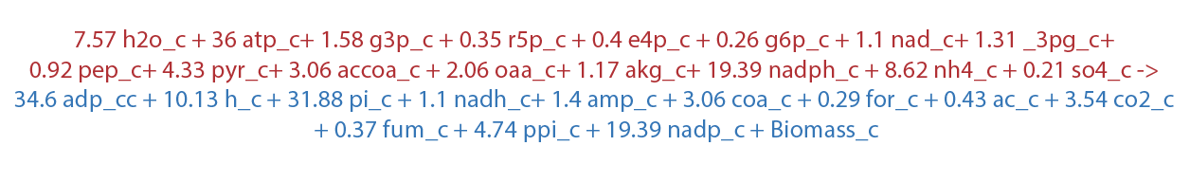


The objective function: maximize biomass production
A simplified biomass equation:
$$1 mmol Biomass=1 g DCW:$$
$$v=\left[\frac{mmol}{g DCW hr}\right]=\frac{1}{hr}=μ$$
Notes:
Example title: This study determined how FeCl3 dosing to secondary sludge impacted biogas production

Slide 23
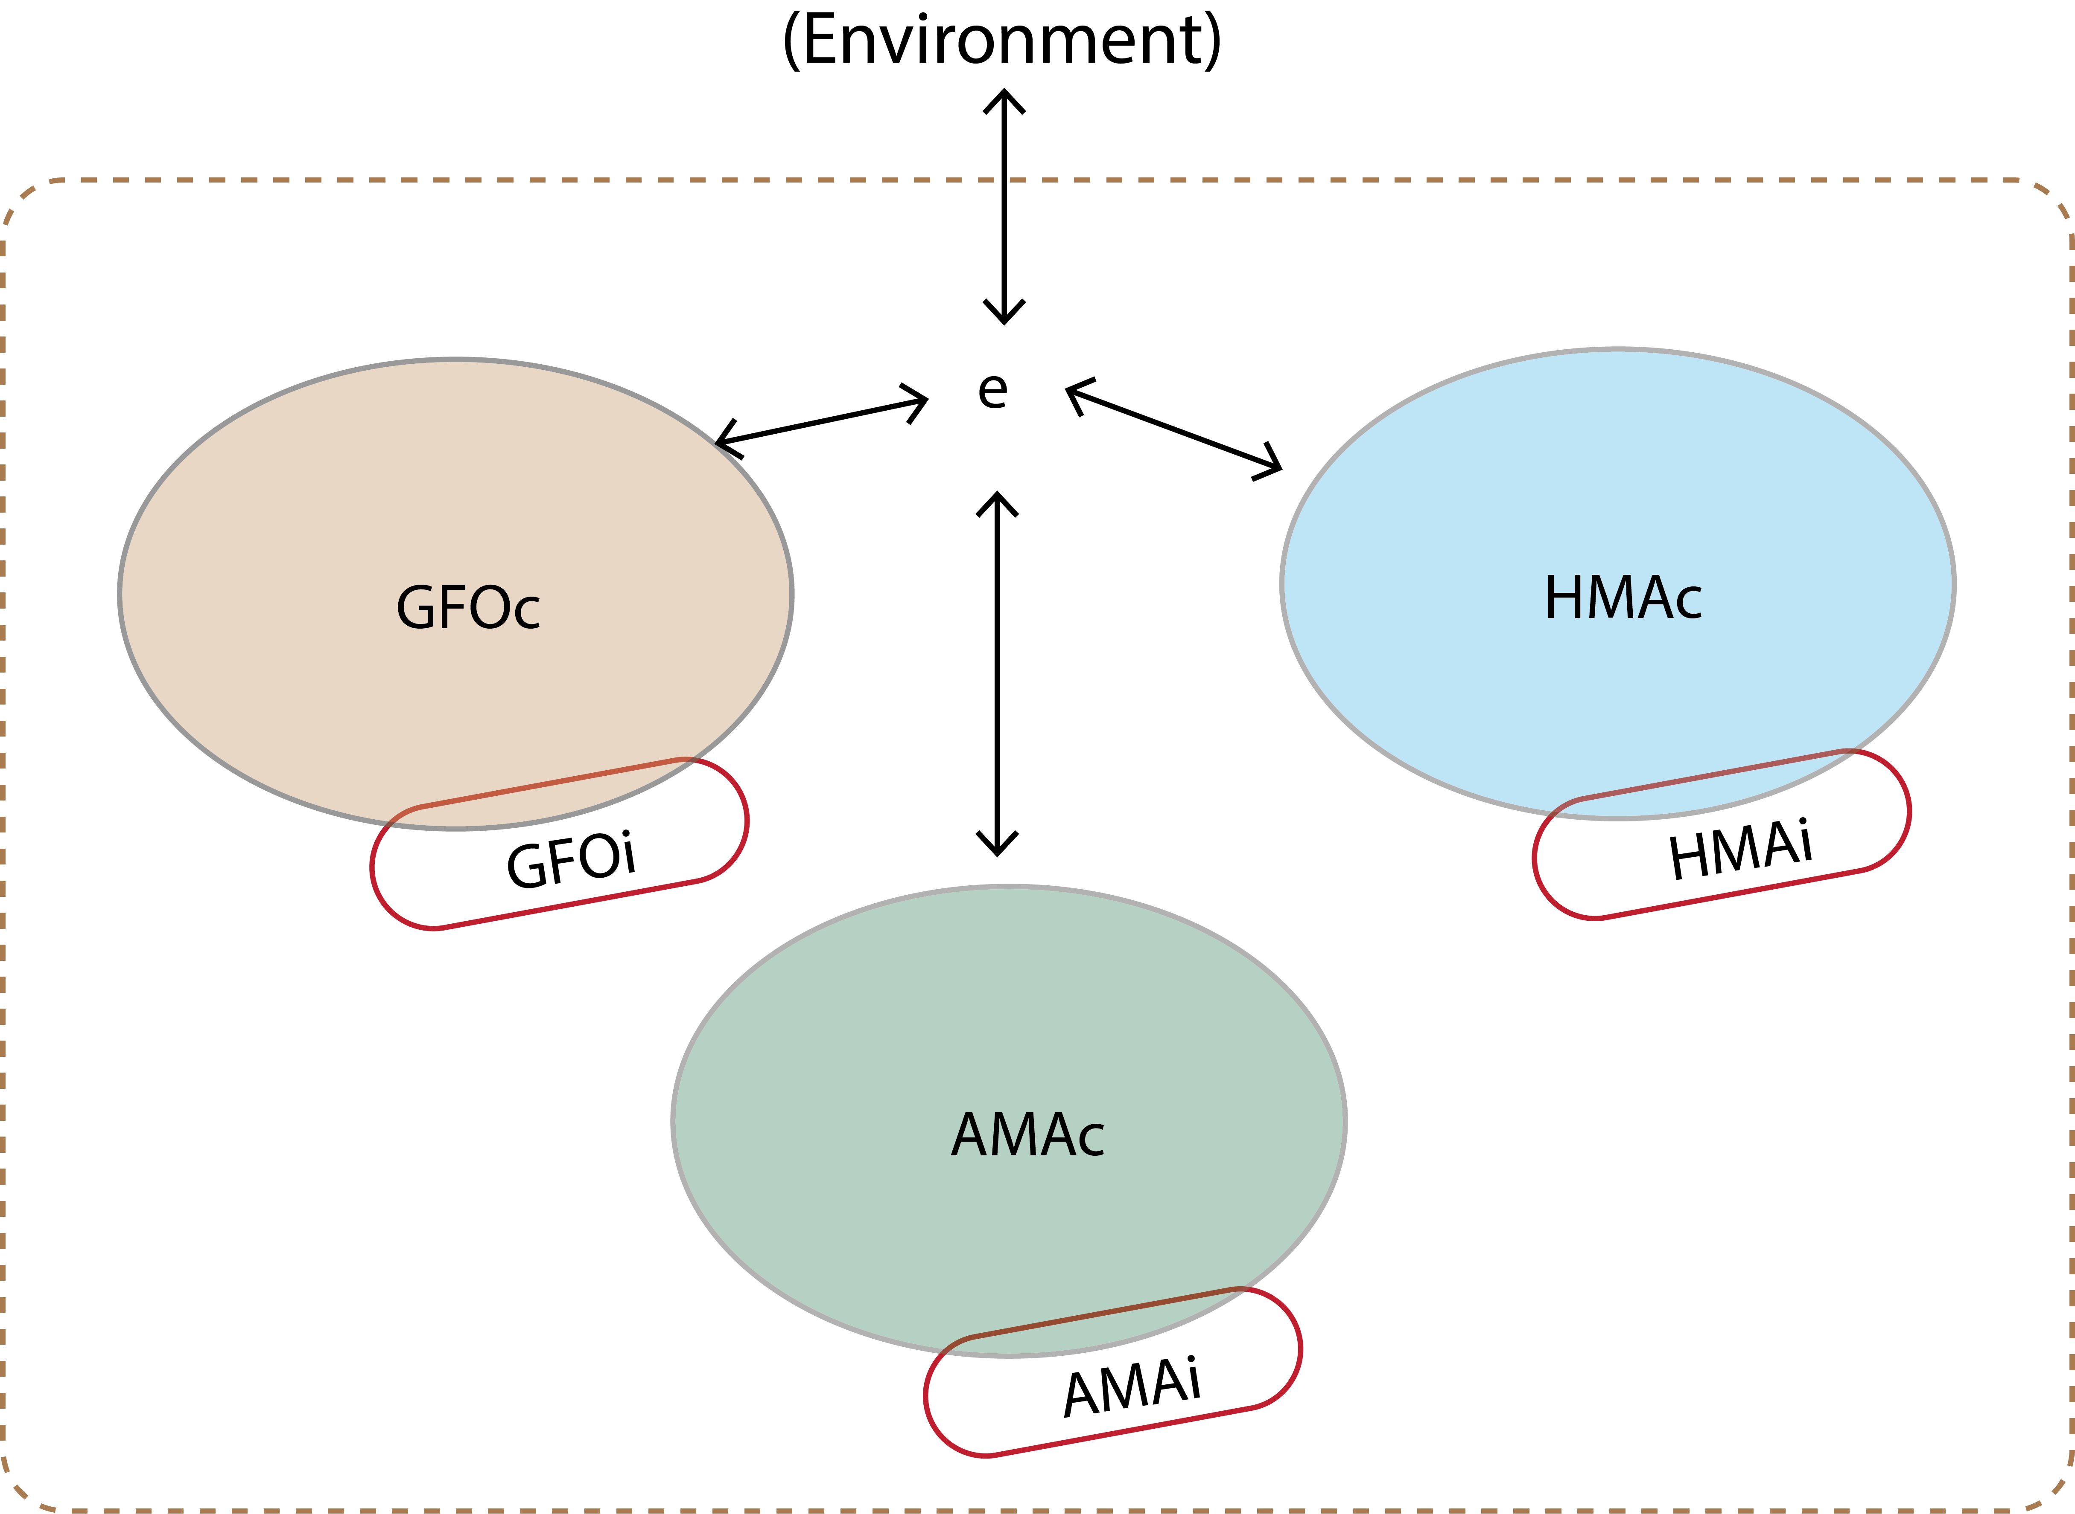
Compartmentalization of reactions
Notes:
Example title: This study determined how FeCl3 dosing to secondary sludge impacted biogas production

Slide 24
Hands-on modeling after lunch!
AD 3-guild model:
7 compartments
197 reactions
205 metabolites
Questions?

