Slide 1
RentIt Marketplace
Local Peer-to-Peer Rental Platform

Slide 2
The Problem
• Underutilization of Assets: High-value items (tools, gear) sit idle in homes most of the year.
• Financial Burden: Consumers bear high costs purchasing items they only need once or twice.
• Lack of Local Connection: Hard to find a structured way to borrow items securely from neighbors.
• Environmental Waste: Constantly buying single-use items contributes heavily to landfill waste.

Slide 3
Our Solution
• A localized Peer-to-Peer Marketplace connecting neighbors to share resources.
• Completely free-to-use platform facilitating direct, in-person item exchanges.
• Secure digital booking requests allowing owners to review renter profiles before accepting.
• Integrated review and rating system ensuring accountability and community trust.

Slide 4
Project Objectives
• To build a fully functional MERN stack application tailored for local communities.
• To create a clean, responsive UI that makes browsing and listing items effortless.
• To implement robust user authentication to protect user identities and data.
• To establish a reliable database architecture for managing users, items, and bookings.

Slide 5
Target Demographics
• Local Item Owners: People wanting to help their community while monetizing unused items offline.
• Cost-Conscious Renters: Individuals needing short-term access to tools without buying them.
• Students & Freelancers: Demographics requiring temporary access to specialized equipment.
• Eco-conscious Citizens: Groups actively participating in the circular economy to reduce waste.

Slide 6
Core Platform Features
• JWT-Secured Authorization (Login/Registration).
• Dynamic Item Listings with image support and detailed descriptions.
• Interactive Owner and Renter Dashboards to track booking requests.
• Search functionality to discover items by category.
• Direct offline transaction model—no hidden fees or integrated payment hurdles.

Slide 7
System Architecture
Frontend (React/Vite)
Client UI, React Router, Custom CSS
REST API (Node/Express)
Controllers, Auth Middleware, Routing
Database (MongoDB)
NoSQL, Mongoose Schemas, Local/Atlas

Slide 8
Technology Stack
• Frontend: React.js (Vite), React Router DOM, Custom Vanilla CSS.
• Backend: Node.js, Express.js REST API.
• Database: MongoDB, Mongoose Object Data Modeling.
• Security: JSON Web Tokens (JWT) for sessions, bcryptjs for password hashing.

Slide 9
Database Schema Design
• Users Collection: Stores credentials, names, and contact information.
• Items Collection: Stores item details, daily rates, and references the Owner's ID.
• Bookings Collection: Links Renters to Items, tracking dates and Request Status (Pending/Approved).
• Reviews Collection: Allows users to leave feedback tied to specific items and users.

Slide 10
Workflow & Lifecycle
User Registration & Login
Owner Lists Item (Price/Detail)
Renter Searches & Discovers
Renter Submits Booking Request
In-Person Handover & Offline Payment
Platform Rating & Reviews

Slide 11
Core Modules
• Authentication Module: Secure onboarding and session management.
• Item Management Module: CRUD operations for owners to manage their local inventory.
• Discovery Module: Browsing interface allowing renters to view available items.
• Booking Module: System to request dates and for owners to approve/reject requests.

Slide 12
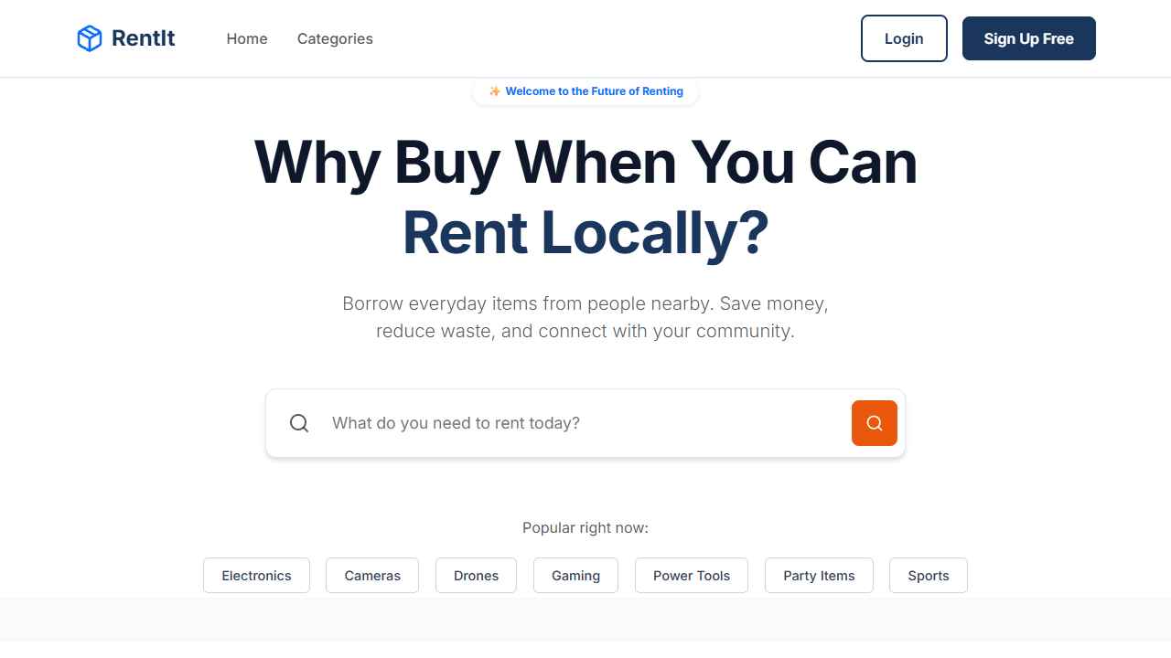
User Interface: Landing Page
Vibrant landing page highlighting featured assets available in the community.

Slide 13
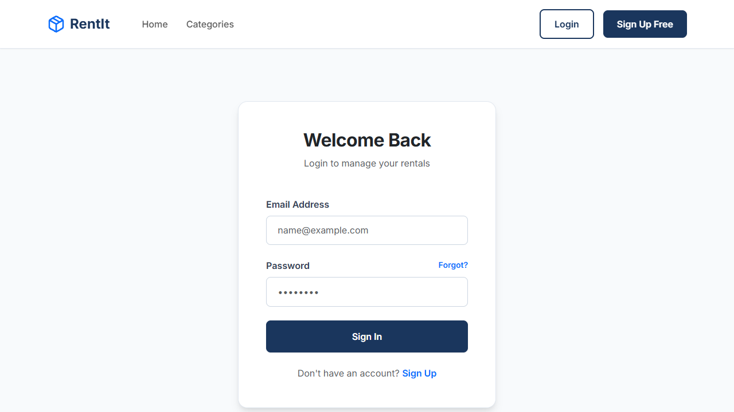
User Interface: Authentication
Secure login portal with field validation.

Slide 14
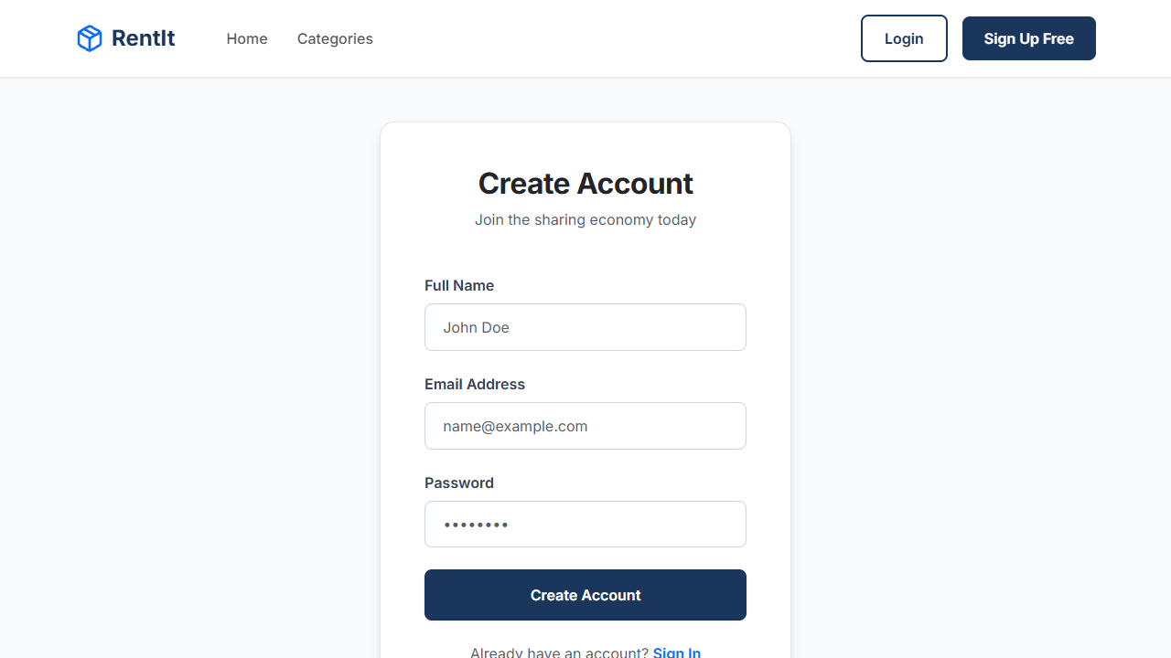
User Interface: Registration
Streamlined user onboarding flow.

Slide 15
Platform & Revenue Model
• Zero-Commission Community Platform: RentIt is built as a free utility for local neighborhoods.
• No Online Payments: All financial transactions are handled offline, directly between users.
• No App Earnings: The platform takes 0% commission, maximizing value for the community.
• Value Proposition: Success is measured by community engagement and resource sharing, not direct profit.

Slide 16
Platform Advantages
• Frictionless Onboarding: No need to link credit cards or bank accounts to join.
• Direct Community Building: Encourages face-to-face interactions during handovers.
• 100% Free: Owners keep all the money they make; renters pay no service fees.
• Sustainable Impact: Actively promotes the global circular economy by reducing mass production.

Slide 17
Technical Challenges & Solutions
• Challenge: Securing user routes. Solution: Implemented custom JWT verification middleware.
• Challenge: Managing relational data in NoSQL. Solution: Used Mongoose populate() for Bookings.
• Challenge: Handling dates accurately. Solution: Normalized start and end dates in the Booking schema.
• Challenge: Password Security. Solution: Integrated bcrypt to hash passwords before database insertion.

Slide 18
Future Scope
• In-App Messaging: Adding Socket.io to allow users to chat and coordinate handovers.
• Location Services: Integrating Google Maps API to search items strictly by neighborhood radius.
• Optional Premium Features: Potential future introduction of promoted listings for power-users.
• Online Payment Gateway: Future integration of Stripe for users who prefer digital escrow.

Slide 19
Conclusion
• RentIt successfully proves the technical viability of a modern P2P marketplace.
• By removing online payment friction, it fosters direct community trust and interaction.
• The MERN stack facilitated rapid, full-stack iteration without performance bottlenecks.
• The platform stands as a complete, secure, and robust foundation for local sharing economies.

Slide 20
Thank You
Opening the floor for Questions

