Slide 1
RentIt
Rent Anything Locally - Major Project Presentation

Slide 2
The Problem
Underutilization of goods: People buy expensive items they rarely use (e.g. tools, camping gear).
High cost of ownership: Purchasing items for one-time or occasional use is financially inefficient.
Lack of trust: Hard to find a reliable and secure platform to rent items from strangers locally.
Environmental impact: Overconsumption leads to more waste and carbon emissions.

Slide 3
Our Solution
A peer-to-peer rental marketplace connecting owners and renters in local communities.
Provides a platform for users to list their underutilized items for rent.
Offers a secure booking system for users to safely rent items they need temporarily.
Built-in rating and review system to establish trust among community members.

Slide 4
Objectives
To develop a fully functional, scalable web application for peer-to-peer renting.
To create a seamless and intuitive user experience for both owners and renters.
To implement a secure authentication and authorization mechanism.
To promote a circular economy and reduce wasteful consumption.

Slide 5
Target Users
Item Owners: Individuals looking to monetize their infrequently used assets.
Renters: People needing temporary access to items without the cost of ownership.
Students & Professionals: Need temporary items for projects, events, or short-term stays.
Local Communities: Promoting sharing and collaboration within neighborhoods.

Slide 6
Key Features
User Authentication & Profiles (JWT-based).
Dynamic Item Listings with high-quality images and descriptions.
Real-time Search and Filtering (by category, price, location).
Secure Booking & Reservation System.
Responsive, Glassmorphism UI (Vite + React).

Slide 7
System Architecture
Client-Server Model: Separation of frontend and backend layers.
Frontend: React SPA communicating with backend via REST APIs.
Backend: Node.js/Express server handling logic and authentication.
Database: MongoDB (NoSQL) for flexible document-based data storage.
Cloud/Hosting: Vercel for frontend deployment (ready for integration).

Slide 8
Technology Stack
Frontend: React.js, Vite, Vanilla CSS / Bootstrap.
Backend: Node.js, Express.js.
Database: MongoDB, Mongoose ORM.
Authentication: JSON Web Tokens (JWT).
Other Tools: Git/GitHub, Postman (for API testing), Puppeteer (for testing/automation).

Slide 9
Database Design
Users Collection: Stores user details, hashed passwords, contact info.
Items Collection: Stores item details, pricing, owner ID reference, status.
Bookings Collection: Links User (renter) and Item, stores dates, total price, and status.
Reviews Collection: Stores feedback, rating, linked to User and Item.

Slide 10
Workflow
1. User registers and logs in.
2. Owner adds an item listing with details and pricing.
3. Renter browses or searches for available items.
4. Renter selects dates and submits a booking request.
5. Owner approves/rejects the booking.
6. Item is rented, and post-rental reviews are submitted.

Slide 11
User Modules
Authentication Module: Login, Register, Logout.
Dashboard Module: Manage personal listings, view incoming/outgoing bookings.
Search & Discovery Module: Browse items, filter by categories.
Booking Module: Handle reservations and date selection.

Slide 12
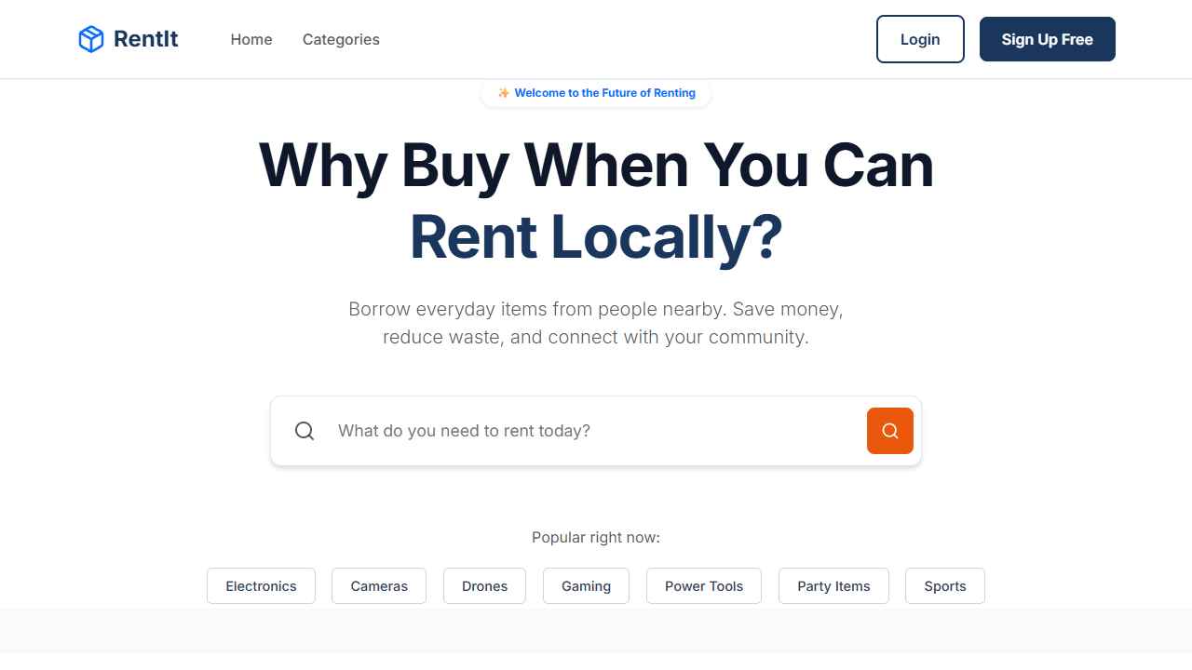
Application Screens: Home Page

Slide 13
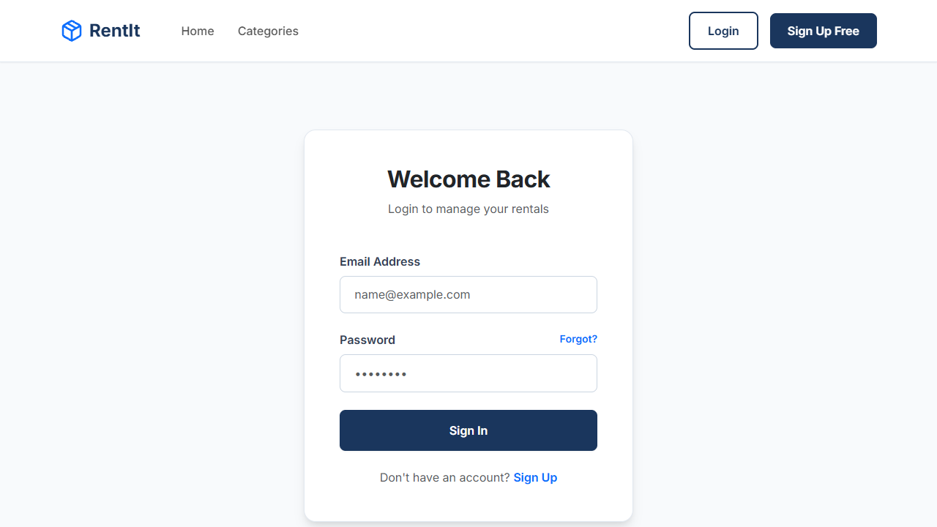
Application Screens: Login Page

Slide 14
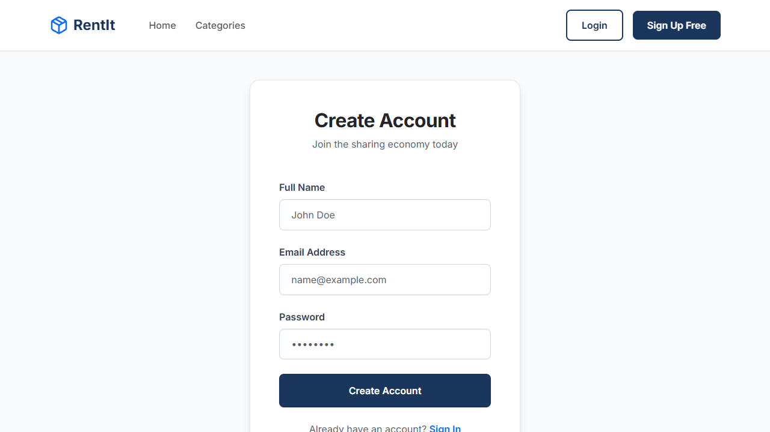
Application Screens: Register Page

Slide 15
Revenue Model
Commission Fee: Platform takes a small percentage (e.g., 5-10%) from each successful rental transaction.
Premium Listings: Owners can pay to feature their items at the top of search results.
Insurance Options: Optional damage protection fees for high-value items.
Subscription Plans: For power users/businesses listing bulk items.

Slide 16
Advantages
Cost-effective for renters compared to buying.
Income generation for item owners.
Promotes sustainability and reduces environmental waste.
Builds local community connections through peer-to-peer sharing.
Highly scalable and accessible web platform.

Slide 17
Challenges & Solutions
Challenge: Building Trust. Solution: Implement a robust rating/review system and user verification.
Challenge: State Management. Solution: Use React hooks and Context API for predictable state.
Challenge: Responsive UI. Solution: Adopted a mobile-first design approach using modern CSS.
Challenge: Secure Data. Solution: Implemented bcrypt for passwords and JWT for session management.

Slide 18
Future Scope
Integration of a Payment Gateway (e.g., Stripe) for seamless transactions.
Real-time Chat feature between owners and renters using Socket.io.
AI-powered recommendations based on user browsing history.
Mobile Application development (React Native) for iOS and Android.
ID verification system for enhanced security.

Slide 19
Conclusion
RentIt successfully demonstrates a modern, scalable P2P rental platform.
It solves real-world problems related to overconsumption and underutilization.
The MERN stack provides the perfect balance of performance and rapid development.
The project lays a strong foundation for a full-fledged commercial product.

Slide 20
Thank You
Any Questions?

