Slide 1
RentIt
"Why Buy When You Can Rent?"
A Secure Peer-to-Peer Rental Marketplace
Major Project Presentation

Slide 2
The Problem: Idle Assets
Underutilized Equipment
People purchase expensive items (DSLRs, power tools, tents) for one-time use. These valuable assets sit idle in homes for the majority of their lifespan.
High Costs for Renters
Others need these items temporarily but cannot afford to buy them new. Existing rental shops are expensive, limited in stock, and lack peer-to-peer trust.

Slide 3
Our Solution: RentIt
For Owners
List idle assets seamlessly. Review requests, approve renters, and generate passive income safely.
For Renters
Search categories, request bookings, and access necessary items temporarily at a fraction of retail cost.

Slide 4
Target Audience
• Students: Need cameras, projectors, or event gear cheaply.
• Freelancers: Photographers needing specialized lenses.
• Travelers: Needing camping tents for a weekend.
• Homeowners: Occasional DIYers needing power tools.
A hyper-local marketplace catering to short-term community needs.

Slide 5
Architecture & Stack
• Frontend UI: React.js (Vercel Edge Network)
• Backend API: Node.js & Express (Vercel Serverless)
• Database: MongoDB Atlas (Cloud Cluster)
• Storage: Cloudinary (Image Hosting)
• Security: JWT & Bcrypt Hashing
• Styling: Custom CSS (Glassmorphism)

Slide 6
Database Schema
• Users: Stores names, emails, encrypted passwords, and user IDs.
• Items: Asset title, price, description, images, and Owner ID ref.
• Bookings: Start/End dates, status (Pending/Approved), Renter & Item references.

Slide 7
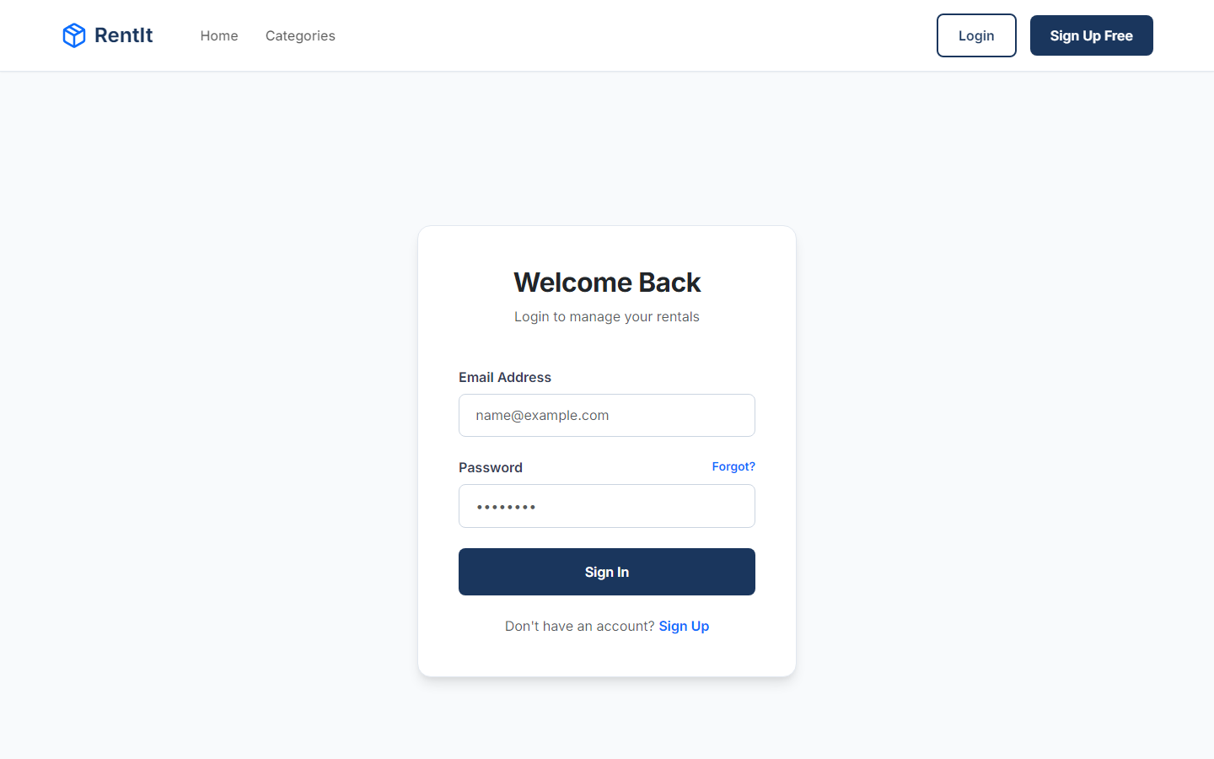
1. Secure Login
Users (both renters and owners) authenticate using encrypted credentials. A JWT token is stored securely to maintain the session.

Slide 8
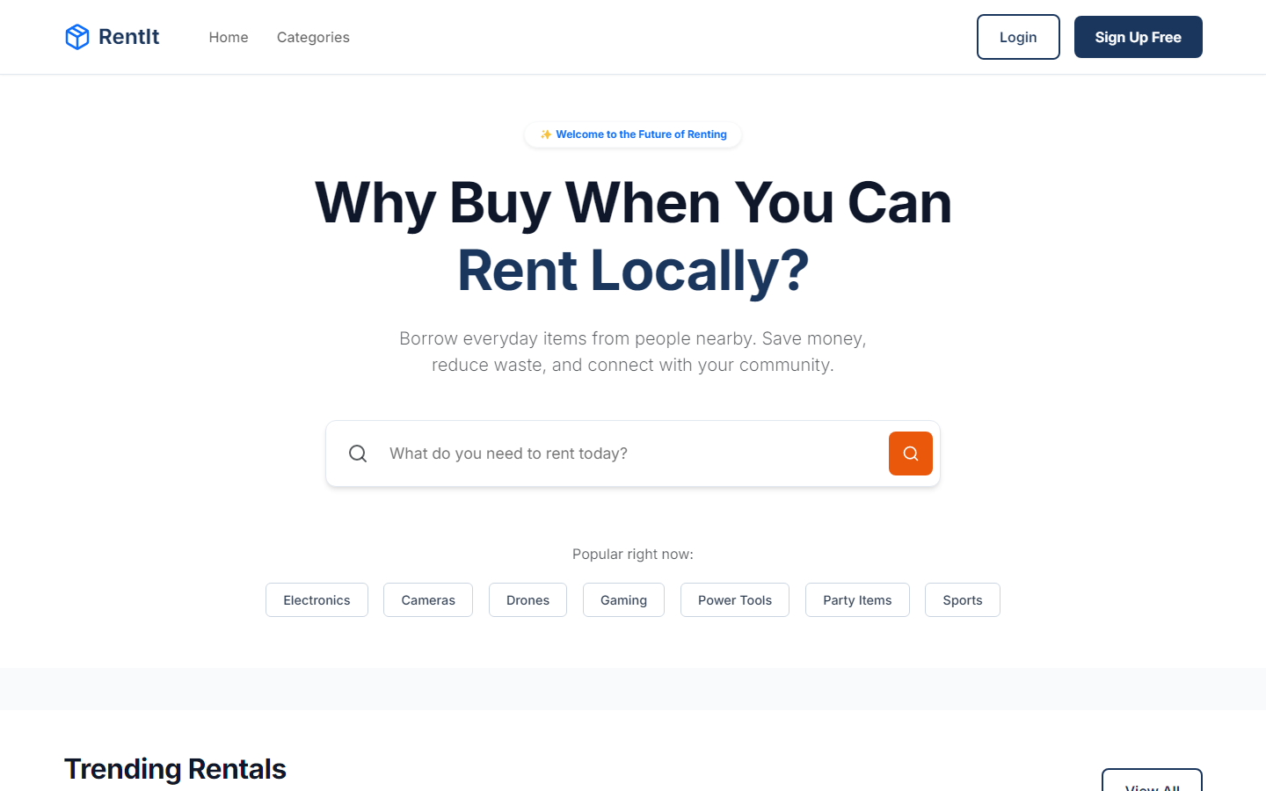
2. Item Discovery
The React frontend displays available items dynamically. Users can browse pricing, locations, and high-quality images.

Slide 9
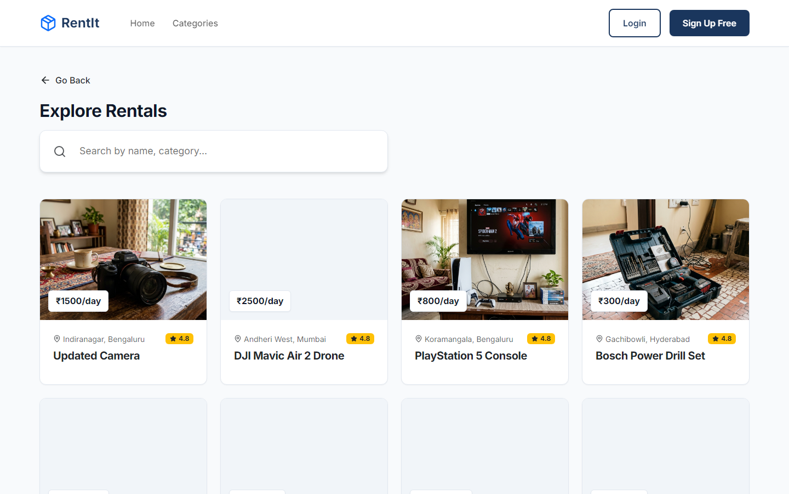
3. Search & Filters
Renters can narrow down inventory quickly using search terms (e.g. "tents") or category filters, syncing with URL parameters.

Slide 10
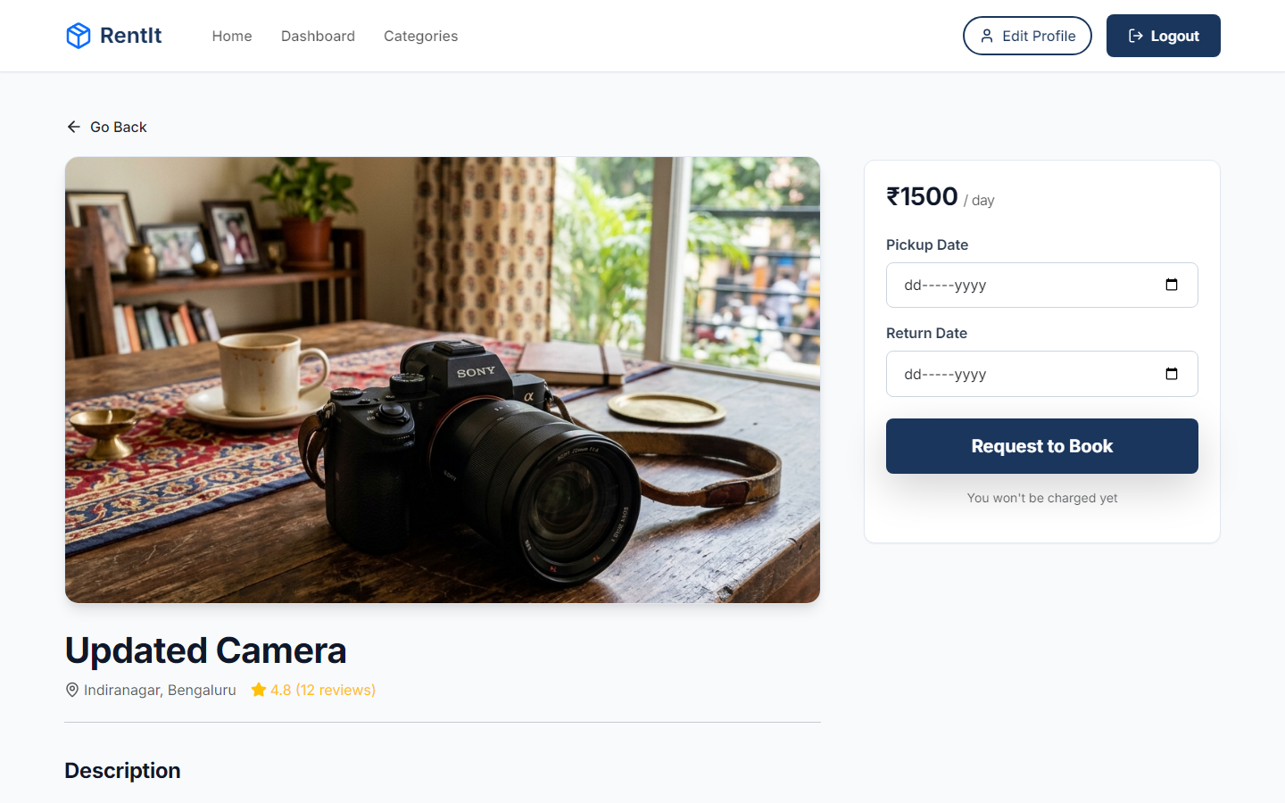
4. Item Details
Clicking on an item reveals in-depth information, descriptions, user reviews, and the form required to request a booking.

Slide 11
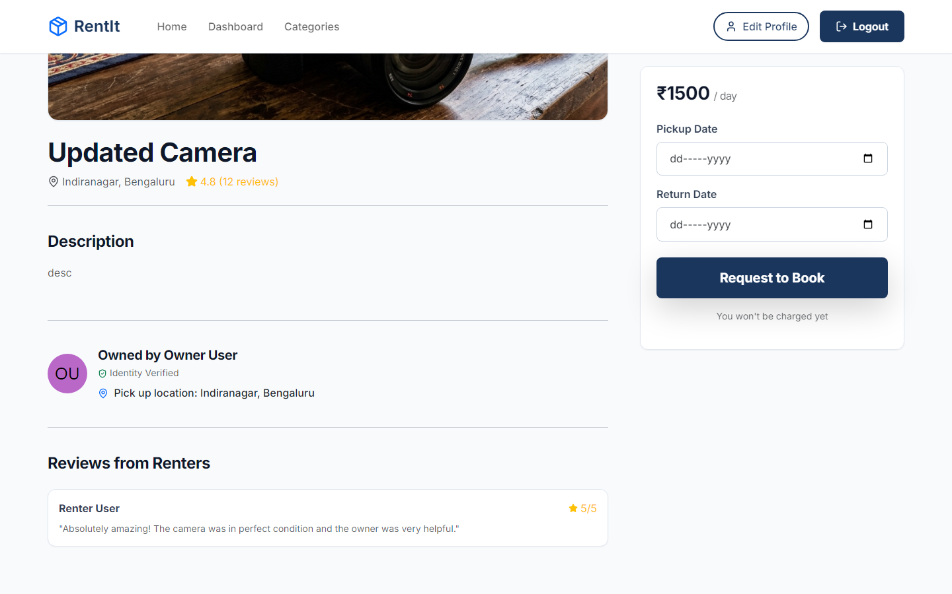
5. Creating a Request
Renters easily select their desired rental dates on the calendar and submit a booking request securely to the item's owner.

Slide 12
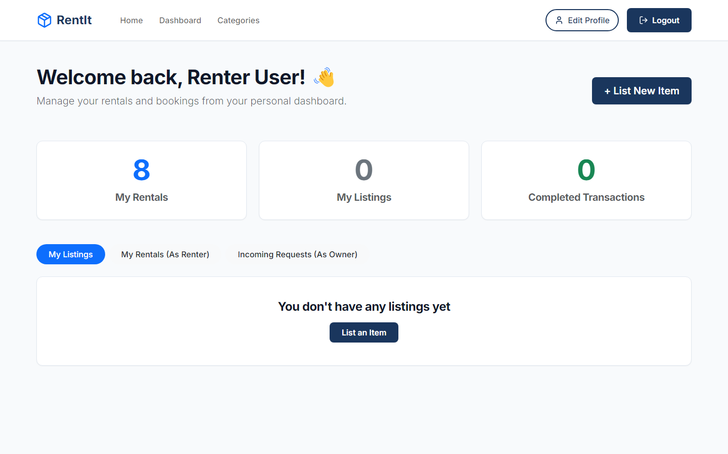
6. Renter Dashboard
Renters can track all their active and pending rental requests, cancel bookings, and leave reviews upon completion.

Slide 13
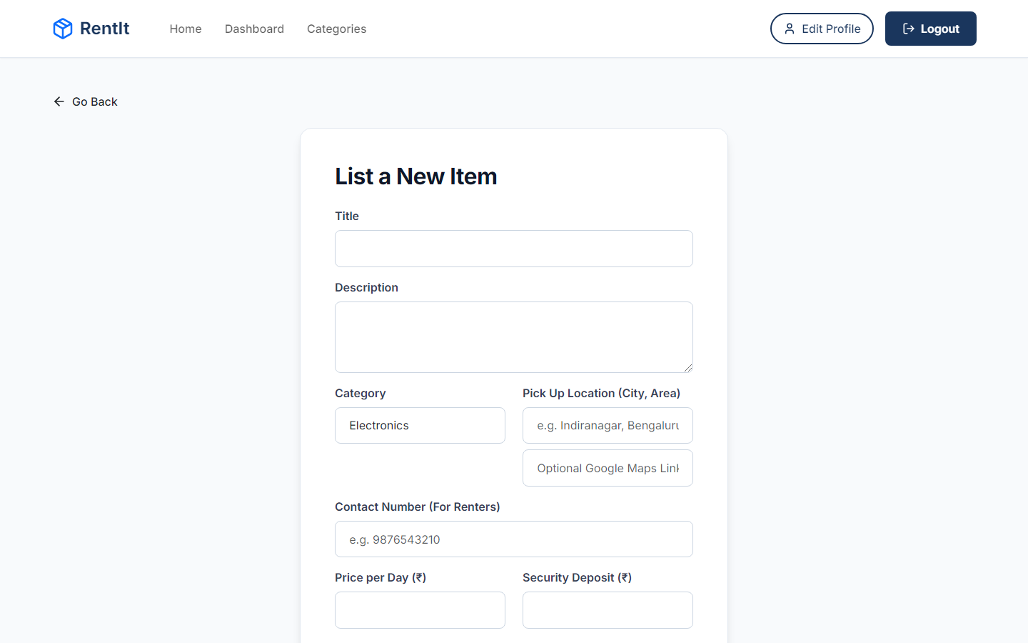
7. Creating a Listing
Owners utilize a clean, responsive form to add new assets. Data is validated on the client side, and images are pushed directly to Cloudinary.

Slide 14
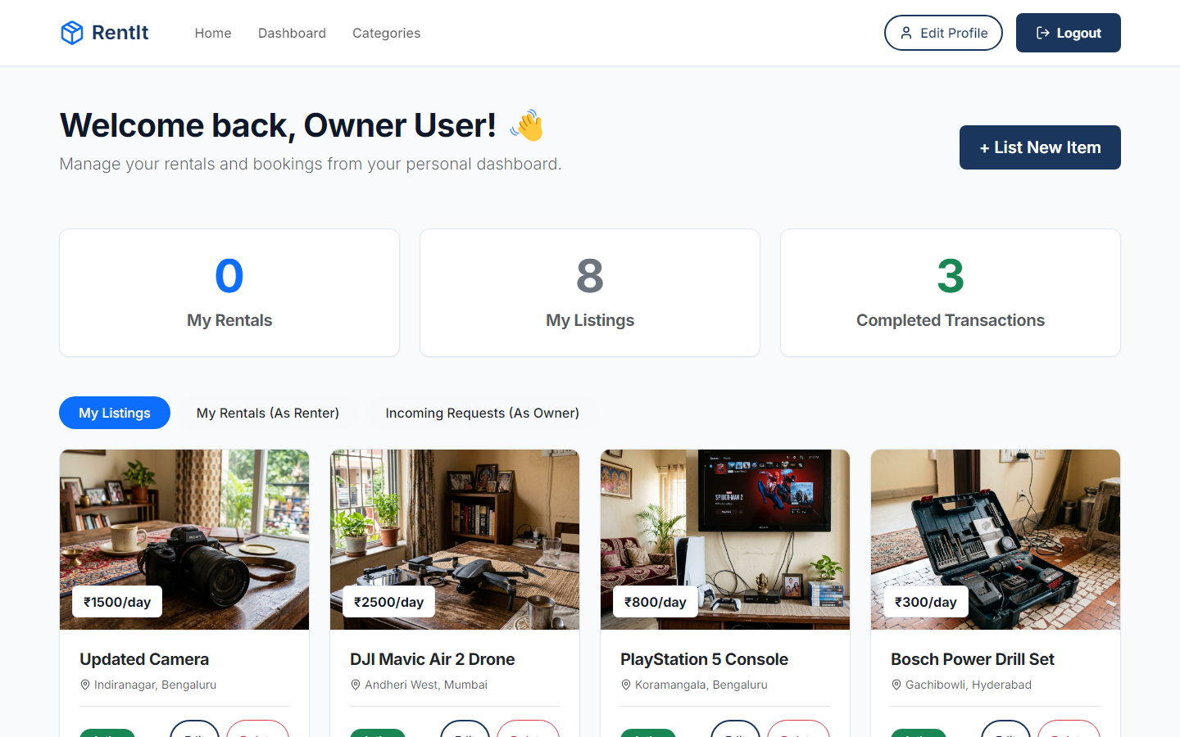
8. Owner Dashboard
The centralized hub. Owners can track active listings and instantly approve or reject incoming booking requests from renters.

Slide 15
Thank You
Empowering local communities through sustainable sharing.
Live Platform: https://rentit-marketplace.vercel.app
Source Code: https://github.com/mscharan1810/RentIt

