Slide 1
RentIt Marketplace
Next-Generation P2P Rental Platform

Slide 2
The Problem
• Underutilization of Assets: High-value items (tools, gear) sit idle 90% of the time.
• Financial Inefficiency: Consumers bear high ownership costs for single-use purposes.
• Trust Deficit: Existing local marketplaces lack verification, reliable reviews, and secure booking.
• Environmental Impact: Rampant consumerism contributes heavily to global carbon footprints.

Slide 3
Our Solution
• Unified P2P Marketplace: A centralized ecosystem connecting local owners and renters.
• Secure & Verified: Built-in authentication and transaction security protocols.
• Dynamic Asset Monetization: Allows individuals to passively earn from idle assets.
• Community-Driven Trust: Transparent rating and review infrastructure.

Slide 4
Project Objectives
• Architect a highly scalable MERN stack web application with robust APIs.
• Deliver a seamless, premium, glassmorphism-inspired User Interface.
• Implement fail-safe JWT authentication and secure routing.
• Establish a scalable NoSQL database schema for complex relational entities.

Slide 5
Target Demographics
• Asset Owners: Individuals seeking secondary income streams.
• Cost-Conscious Renters: Users needing premium tools/gear without premium costs.
• Students & Freelancers: Demographics requiring short-term access to specialized equipment.
• Eco-conscious Communities: Groups actively participating in the circular economy.

Slide 6
Core Platform Features
• JWT-Secured Authorization & Role-based Access.
• Real-time Inventory Search with Multi-parameter Filtering.
• Interactive Owner Dashboards for Revenue & Booking Management.
• Responsive, Mobile-First UI Architecture.
• Integrated Image Processing & Cloud Storage Handling.

Slide 7
System Architecture
Frontend (React/Vite)
Client UI, Responsive Views, State Mgmt
RESTful API (Node/Express)
Controllers, Auth Middleware, Routing
Database (MongoDB Atlas)
NoSQL, Mongoose Schemas, Cloud DB

Slide 8
Enterprise Technology Stack
• Frontend Layer: React.js (Vite), React Router DOM, Custom Vanilla CSS.
• Backend Layer: Node.js, Express.js HTTP Server.
• Database Layer: MongoDB (Atlas Cluster), Mongoose Object Data Modeling.
• Security & Auth: JSON Web Tokens (JWT), bcryptjs for cryptographic hashing.
• Deployment Strategy: Vercel (Frontend edge network), Render (Backend services).

Slide 9
Database Schema Design
• Users: Schema mapping authentication credentials, profiles, and transactional history.
• Items: Indexed schema containing pricing algorithms, availability status, and owner references.
• Bookings: Relational mapping between Users and Items with temporal state management.
• Reviews: Feedback schema aggregated for user/item trust scoring.

Slide 10
Workflow & Lifecycle
User Registration & Verification
List Item (Set Price/Dates)
Search & Match (Renters Find Items)
Secure Booking & Payment
Rental Period & Return
Rating & Reviews

Slide 11
Core Modules
• Identity Management: Secure onboarding, JWT lifecycle, profile management.
• Asset Management: CRUD operations for item listings, dynamic state updates.
• Discovery Engine: Optimized search, category filtering, availability checks.
• Transaction Processing: Booking initiation, lifecycle tracking, approval matrix.

Slide 12
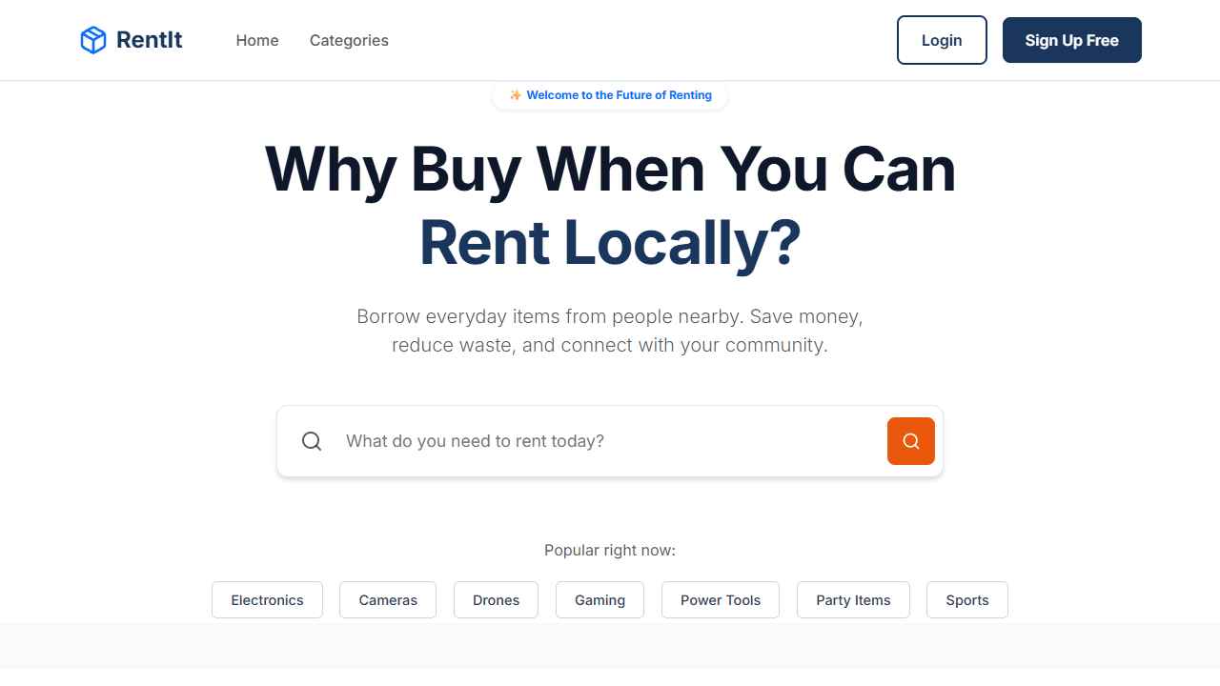
User Interface: Landing Page
Vibrant, glassmorphism-inspired landing page highlighting featured assets.

Slide 13
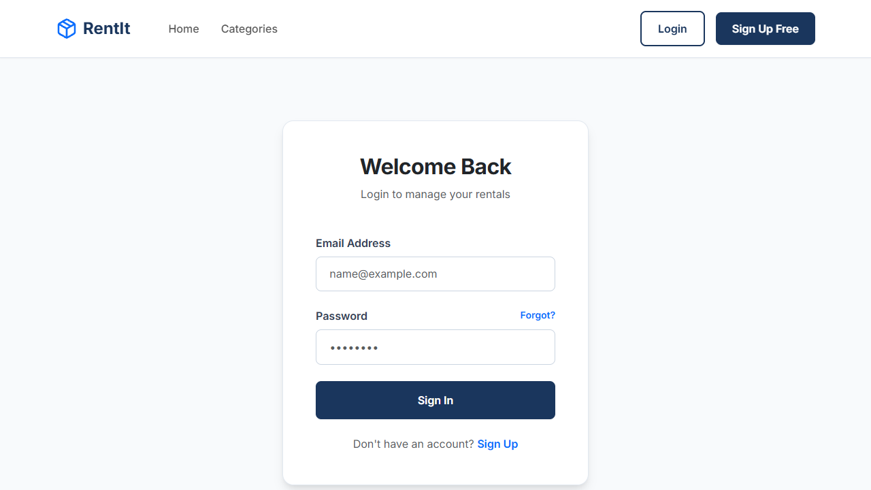
User Interface: Authentication
Secure login portal with field validation and immediate error handling.

Slide 14
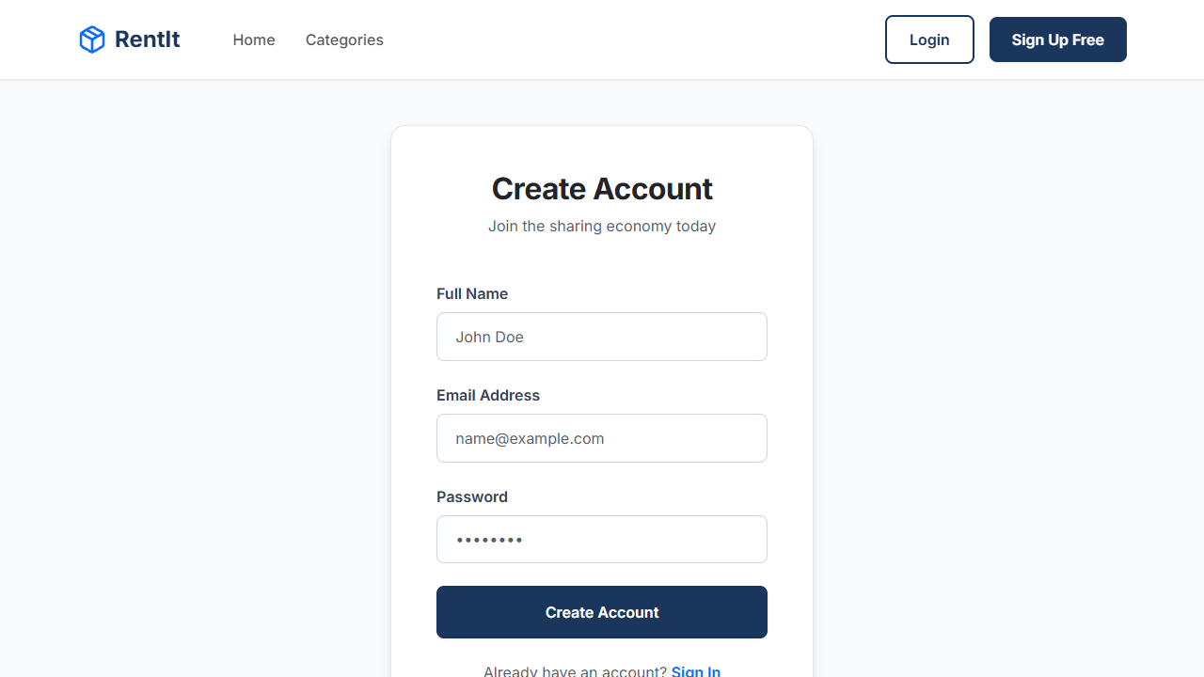
User Interface: Registration
Streamlined user onboarding flow.

Slide 15
Strategic Revenue Model
• Transaction Commission: 8% platform fee on all successfully completed rentals.
• Promoted Listings: Tiered micro-transactions for owners to boost item visibility.
• Premium Subscriptions: 'Pro' tier for businesses listing 50+ items.
• Damage Protection: Optional insurance markup at checkout.

Slide 16
Platform Advantages
• Economic Efficiency: Unlocks capital tied up in idle personal assets.
• Rapid Scalability: Component-driven frontend and decoupled backend APIs.
• Superior UX/UI: Premium visual aesthetics driving higher user retention.
• Sustainable Impact: Actively promotes the global circular economy.

Slide 17
Technical Challenges & Resolutions
• State Synchronization: Implemented React Context for global state predictability.
• Secure Token Storage: Shifted JWTs to HttpOnly cookies for XSS mitigation.
• Responsive Data Tables: Designed mobile-first CSS grids for complex owner dashboards.
• Asynchronous Validations: Utilized Mongoose middleware for pre-save data integrity.

Slide 18
Future Roadmap
• Payment Gateway Integration (Stripe/PayPal) for automated fund escrow.
• Real-time WebSocket Chat (Socket.io) for instant owner-renter communication.
• AI-Driven Recommendations: Suggesting items based on behavioral clustering.
• Cross-Platform Mobile Application using React Native.

Slide 19
Conclusion
• RentIt successfully proves the technical viability of a modern P2P marketplace.
• The MERN stack facilitated rapid, full-stack iteration without performance bottlenecks.
• The platform is enterprise-ready, scalable, and visually competitive.
• Foundation is fully prepared for cloud deployment and commercial launch.

Slide 20
Thank You
Opening the floor for Questions

