Slide 1
RentIt Marketplace
A Secure Peer-to-Peer Rental Platform
Major Project Presentation

Slide 2
Problem Statement
Many individuals purchase expensive items (like DSLRs, tents, or tools) for one-time use.
These valuable assets sit idle in homes for the majority of their lifespan.
Meanwhile, other people need these items temporarily but cannot afford to buy them new.
There is a lack of a centralized, secure platform to connect local owners with renters.

Slide 3
Our Solution: RentIt
RentIt is a full-stack MERN web application that facilitates secure peer-to-peer rentals.
Owners can list their idle assets on the platform to generate passive income.
Renters can search, filter, and request bookings for items they need temporarily.
The platform manages the workflow from booking request to owner approval and final reviews.

Slide 4
Core Features
Authentication & Security
• JWT-based user login and registration
• Protected API routes
Item Management (CRUD)
• Owners can upload item details and images
• Edit and delete functionality for active listings
Booking Workflow
• Renters select dates and submit requests
• Owners approve or reject requests
• Renters can cancel pending bookings
Feedback System
• Renters leave ratings and reviews after use

Slide 5
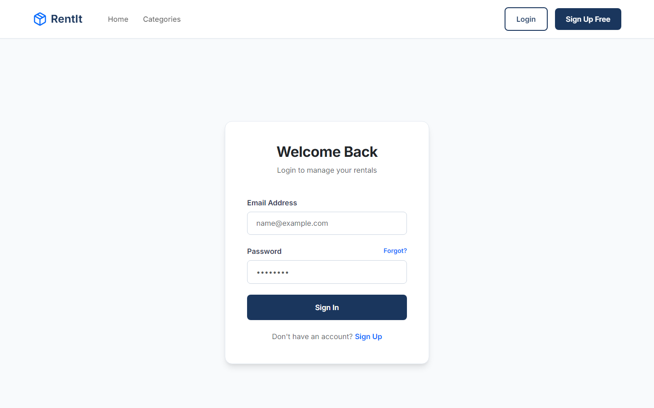
Platform UI: User Authentication
Secure JWT-based authentication system.
Separates users securely via encrypted passwords.
Responsive glassmorphism design for optimal user experience.

Slide 6
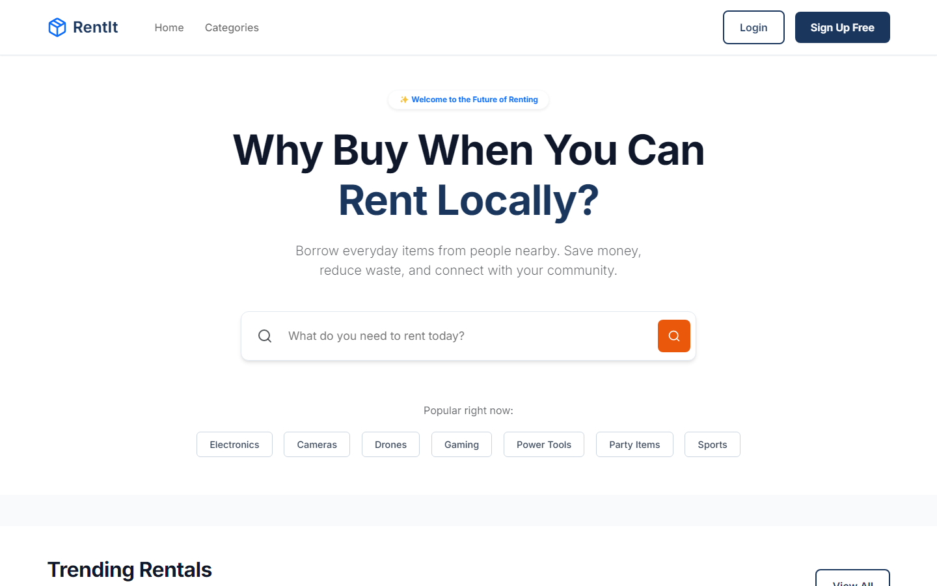
Platform UI: Discovery & Browsing
Dynamic React frontend.
Users can filter items by category.
Responsive grid layout displaying item images, prices, and locations.

Slide 7
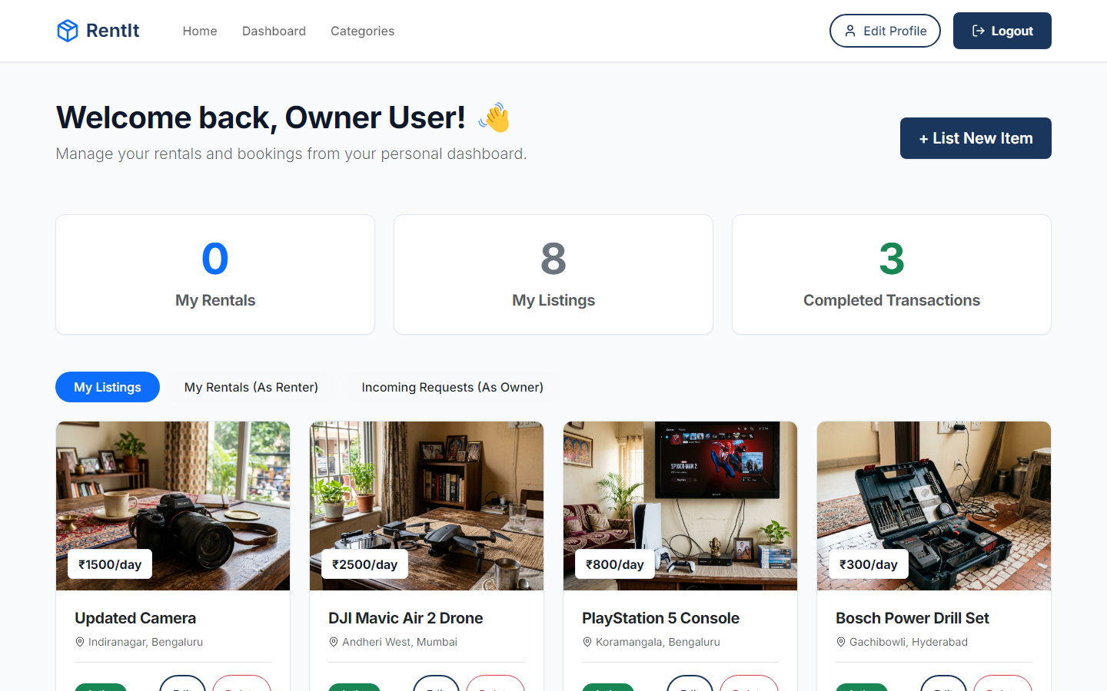
Platform UI: Owner Dashboard
Centralized dashboard for managing assets.
View incoming booking requests from renters.
One-click 'Approve' or 'Reject' actions linked directly to the database.

Slide 8
Technology Stack (MERN)
Frontend: React.js, React Router, Axios, CSS (Glassmorphism UI)
Backend: Node.js, Express.js
Database: MongoDB Atlas (Cloud NoSQL Database), Mongoose ODM
Storage: Cloudinary API (Secure Image Hosting)
Security: JSON Web Tokens (JWT), Bcrypt Password Hashing
Deployment: Vercel (Hosting for both Client and Serverless API)

Slide 9
Architecture & Deployment
The application relies on a decoupled Client-Server architecture.
The React SPA communicates with the Express backend via RESTful APIs.
All data is persistently stored in MongoDB Atlas, replacing local databases.
To handle Vercel's Serverless environment, the backend API is configured to export the Express app directly.
Environment variables secure the MongoDB URI and JWT secrets in production.

Slide 10
Thank You
RentIt: Empowering communities through peer-to-peer sharing.
Live Demo: https://rentit-marketplace.vercel.app
GitHub: https://github.com/mscharan1810/RentIt

