Slide 1
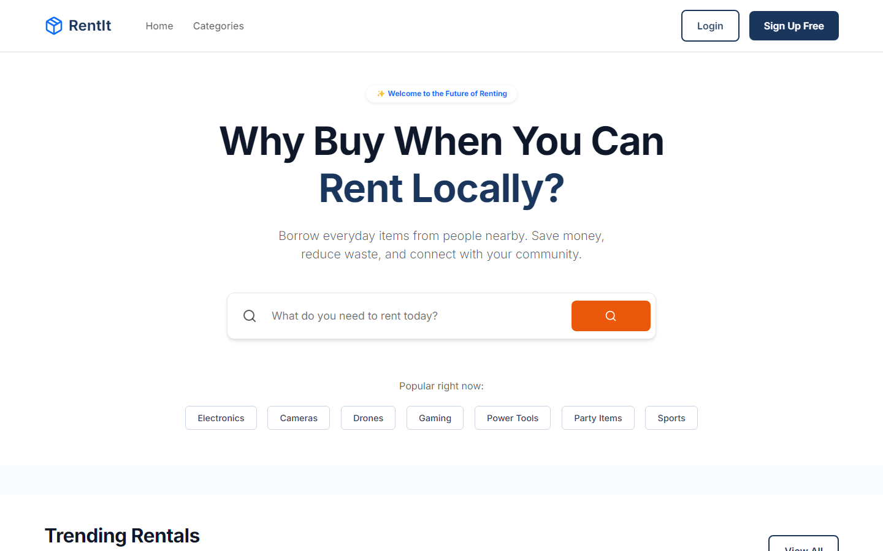
RentIt
"Why Buy When You Can Rent?"
A Secure Peer-to-Peer Rental Marketplace

Slide 2
Why RentIt?
• Millions of valuable products remain unused in homes.
• People often buy expensive products for one-time use.
• Renting saves money for consumers.
• Owners earn passive income on idle assets.
• RentIt connects both sides seamlessly.

Slide 3
The Problem
Expensive items are purchased but rarely used.
Idle Assets
DSLR Cameras, Projectors, Camping Tents, Power Tools, Gaming Consoles, Speakers sit unused.
Fragmented Market
Finding trustworthy local rentals is difficult and lacks a unified platform.
The Opportunity
Idle Assets + Temporary Needs = Massive Rental Opportunity

Slide 4
Our Solution
Owner
Lists item
• A platform that allows users to securely rent products from nearby owners.
• Owners generate passive income easily.
• Renters save money instead of buying.
• Promotes a sustainable, sharing-driven community.
RentIt Platform
Secures transaction
Renter
Enjoys item affordably

Slide 5
Business Objectives
• Reduce unnecessary retail purchases.
• Help owners monetize their unused assets.
• Build a trusted, verified rental marketplace.
• Promote sustainable and eco-friendly consumption.
• Deliver a secure, seamless user experience.

Slide 6
Target Audience
Students
Freelancers
Photographers
Event Organizers
Small Businesses
Homeowners
Travelers
Content Creators

Slide 7
Core Features
• Secure Login
• Item Listing
• Booking Calendar
• Wishlist
• Ratings & Reviews
• Search & Filters
• Owner Dashboard
• Booking History
• Notifications
• QR Pickup
• Admin Dashboard

Slide 8
System Architecture
React Frontend
Node.js API
Express Server
MongoDB Database
Cloudinary Storage
Authentication

Slide 9
Technology Stack
React
UI
Node.js
Runtime
Express
Backend
MongoDB
Database
JWT
Security
Cloudinary
Media
Vercel
Client
Render
API

Slide 10
Database Entity Relationships
Robust NoSQL Document Structure
Users
Collection
Items
Collection
Bookings
Collection
Reviews
Collection
Payments
Collection
Categories
Collection

Slide 11
The User Journey
Step 1
Register
Step 2
Browse Items
Step 3
View Details
Step 4
Book Item
Step 5
Pay Deposit
Step 6
Pickup
Step 7
Return
Step 8
Review

Slide 12
Platform Modules
Renter
Browse Catalog Search & Filter Request Booking Pay Deposit Leave Review
Owner
List New Item Manage Inventory Approve Requests Confirm Returns Rate Renters
Admin
User Management Dispute Resolution Platform Analytics Content Moderation Category Control

Slide 13
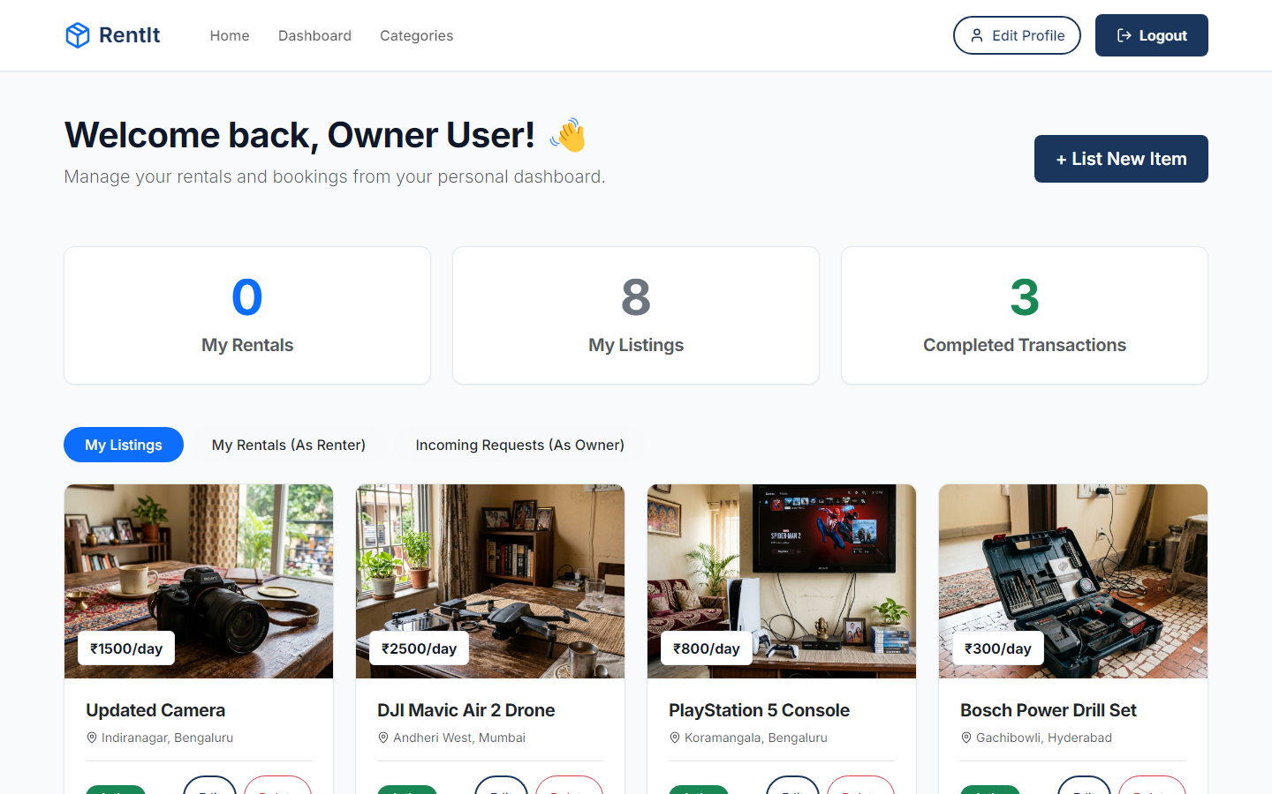
Application UI
Modern, Responsive, and Intuitive Design
Home Page
Owner Dashboard

Slide 14
Market Opportunity
The Booming Sharing Economy
• The global sharing economy is experiencing exponential growth.
• Consumers increasingly prefer accessing over owning.
Lower Costs
For Renters
Utilization
Of Idle Assets
Sustainability
Eco-friendly
Passive Income
For Owners

Slide 15
Competitive Advantage
Features
Rent Online Booking Calendar Verified Reviews Secure Payments Owner Dashboard Rental History Availability
OLX
Yes No No No No No No
Local Shops
No No No No No Yes No
RentIt
Yes Yes Yes Yes Yes Yes Yes

Slide 16
Revenue Streams
Platform Commission
Featured Listings
Premium Sellers
Business Accounts
Delivery Charges
Damage Protection
Advertisement Space

Slide 17
Business Model Canvas
Key Partners
Strategic focus area
Key Activities
Strategic focus area
Value Proposition
Strategic focus area
Customer Segments
Strategic focus area
Revenue Streams
Strategic focus area
Cost Structure
Strategic focus area
Channels
Strategic focus area
Customer Relationships
Strategic focus area

Slide 18
Platform Advantages
Passive Income
Affordable Rentals
Secure Marketplace
Community Sharing
Reduced Waste
Sustainability
Easy Booking
Scalable Business

Slide 19
Technical Challenges Overcome
• Ensuring real-time availability to prevent double-bookings.
• Managing large image uploads securely without slowing down the platform.
• Building a seamless, intuitive dashboard for both renters and owners.
• Implementing a secure, state-based authentication system.
• Designing a scalable database to handle future growth.

Slide 20
Future Roadmap
Phase 1
Mobile App
Phase 2
GPS Nearby Rentals
Phase 3
Digital Agreements
Phase 4
Live Chat
Phase 5
Multi-language
Phase 6
Delivery Integration
Phase 7
Insurance
Phase 8
Business Rentals

Slide 21
Conclusion
RentIt transforms unused products into earning opportunities while making expensive products affordable through secure peer-to-peer rentals. It promotes sustainability, affordability, and community-driven sharing with strong startup potential.

Slide 22
Thank You
Live Demo: https://rentit-marketplace.vercel.app GitHub: https://github.com/mscharan1810/RentIt Contact: owner@example.in

