Slide 1

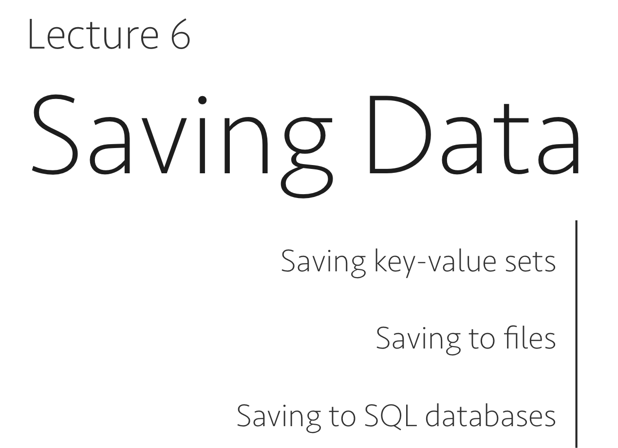
Lecture 6
CSC 431 – Mobile Application development

Slide 2
Saving Data
Most Android apps need to save data, even if only to save information about the app state during onPause() so the user's progress is not lost
Most non-trivial apps also need to save user settings, and some apps must manage large amounts of information in files and databases
This can be done using:
Saving key-value pairs of simple data types in a shared preferences file
Saving arbitrary files in Android's file system
Using databases managed by SQLite or MySQL

Slide 3
1
Saving key-value sets using sharedPreferences

Slide 4
SharedPreferences
If you have a relatively small collection of key-values that you'd like to save, you should use the SharedPreferences APIs.
A SharedPreferences object points to a file containing key-value pairs and provides simple methods to read and write them.
Each SharedPreferences file is managed by the framework and can be private or shared.
i
Note: The SharedPreferences APIs are only for reading and writing key-value pairs and you should not confuse them with the Preference APIs, which help you build a user interface for your app settings (although they use SharedPreferences as their implementation to save the app settings).

Slide 5
sharedPreferences (example)
KEY | VALUE
highscore | 200
highquality | TRUE
loggedin | 1

Slide 6
Creating and accessing
You can create a new shared preference file or access an existing one by calling one of two methods:
getSharedPreferences()
Use this if you need multiple shared preference files identified by name, which you specify with the first parameter. You can call this from any Context in your app.
getPreferences()
Use this from an Activity if you need to use only one shared preference file for the activity. Because this retrieves a default shared preference file that belongs to the activity, you don't need to supply a name.

Slide 7
Examples
Option 1
If we want more than 1 file, we need to access/create using some String name of our choice
SharedPreferences sharedPref =
getSharedPreferences(“myfile”, Context.MODE_PRIVATE);
Option 2
If we just want 1 file, then there is no need for a name, just the mode
SharedPreferences sharedPref = getPreferences(Context.MODE_PRIVATE);

Slide 8
How to write to sharedPreferences?
To write to a shared preferences file, create a SharedPreferences.Editor by calling edit() on your SharedPreferences
Pass the keys and values you want to write with methods such as putInt() and putString()
Then call commit() to save the changes

Slide 9
Writing to sharedPreferences Example
SharedPreferences mypref= getPreferences(Context.MODE_PRIVATE);
SharedPreferences.Editor e = mypref.edit();
e.putInt(“highscore”, 400);
e.commit();

Slide 10
Read from SharedPreferences
To retrieve values from a shared preferences file, call methods such as getInt() and getString(), providing the key for the value you want, and optionally a default value to return if the key isn't present.
SharedPreferences sharedPref = getPreferences(Context.MODE_PRIVATE);
int defaultValue = 100; //example
int highScore = sharedPref.getInt(“highscore”, defaultValue);

Slide 11
Example
public void saveoption(View view){
SharedPreferences mypref = getPreferences(Context.MODE_PRIVATE);
SharedPreferences.Editor e = mypref.edit();
RadioButton r0 = (RadioButton) findViewById(R.id.radio0);
//RadioButton r1 = (RadioButton) findViewById(R.id.radio1);
if(r0.isChecked()){
e.putString("choice", "option 0");
}
else { e.putString("choice", "option 1");}
e.commit();
}

Slide 12
Accessing the sharedpreference file from different activities.
Same as before but assign a name for it

Slide 13
Lab session
Topics covered:
sharedPreferences
Floating button
SnackBar
Action Bar (from a previous chapter)

Slide 14
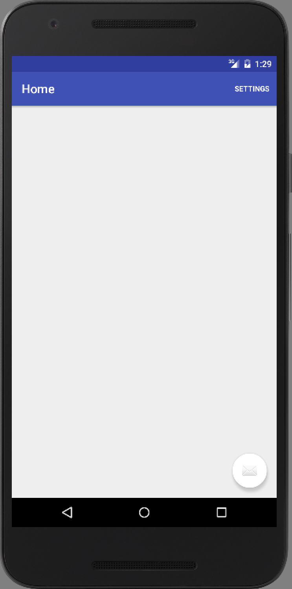
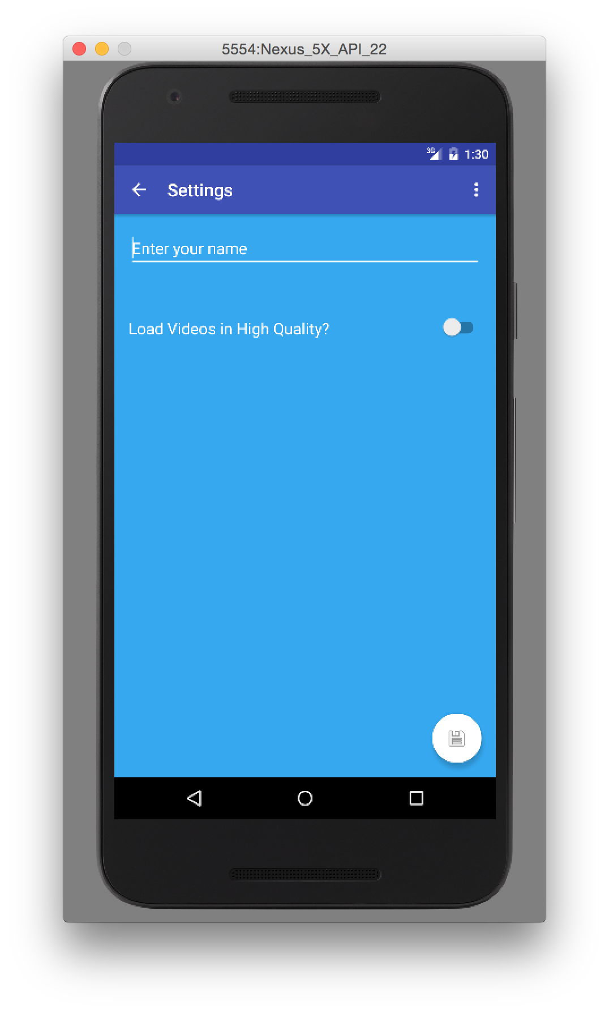
Exercise
2 activities:

Slide 15
Exercise
2 activities:
MainActivity is empty but has an action bar containing “settings”
When we press on settings, we go to the Settings Activity containing an EditText and a switch and a floating button containing an icon for saving.
When we press on save, the values are saved.

Slide 16
Exercise continues
Each time we go to the settings activity, the PREVIOUSLY saved values should be loaded.
Of course the user can change them again and save.
Also note that if you exit the app and enter again, the valued should be still saved.
Extra care should be taken if we are going to the Settings activity for the FIRST time.

Slide 17
solution
The solution will be 2 parts. Each having several parts.
PART 1: Main activity.
Part 1.1 add the “settings” item to the action bar
Part 1.2 Program it to take me to the SettingsActivity when clicked. (you need to modify the onOptionsItemSelected())

Slide 18
PART 1.1 solution
Add the settings to the action bar in the xml file in the MENU folder. (you will find it added by default but let’s make it ALWAYS instead of NEVER).
<menu xmlns:android="http://schemas.android.com/apk/res/android" xmlns:app="http://schemas.android.com/apk/res-auto" xmlns:tools="http://schemas.android.com/tools" tools:context=".Main2Activity"> <item android:id="@+id/mySettings" android:title="@string/action_settings" android:orderInCategory="100" app:showAsAction="always" /> </menu>

Slide 19
Part 1.2 solution
@Override public boolean onOptionsItemSelected(MenuItem item) { int id = item.getItemId(); if (id == R.id.mySettings) { Intent i = new Intent(this, SettingsActivity.class); startActivity(i); return true; } return super.onOptionsItemSelected(item); }

Slide 20
That’s all we need to do in the main activity ☺
Let’s see part 2.

Slide 21
Part 2: the Settings Activity
Part 2.1 design it in XML
Part 2.2 Java:
2.2.A) inside onCreate, try to read the sharedPref file and extract the values and set the editText and the switch accordingly. Be careful, it might be the first time you enter and nothing is saved yet.
2.2.B) Program the floating button in a way that when clicked, the 2 values are extracted from the layout, and saved into the sharedPref file. Also make the snackbar appear to tell the user that save was successful. (Snackbar is like toast but more advanced)

Slide 22
2.1 XML of the main
Remember there are 2 files!
One is main and one is content.
The floating button is in the main and the rest in the content.
In the main, change this in the floating button
<android.support.design.widget.FloatingActionButton android:id="@+id/fab" android:layout_width="wrap_content" android:layout_height="wrap_content" android:layout_gravity="bottom|end" android:layout_margin="@dimen/fab_margin" android:src="@android:drawable/ic_menu_save" app:backgroundTint="#ffffff”/>

Slide 23
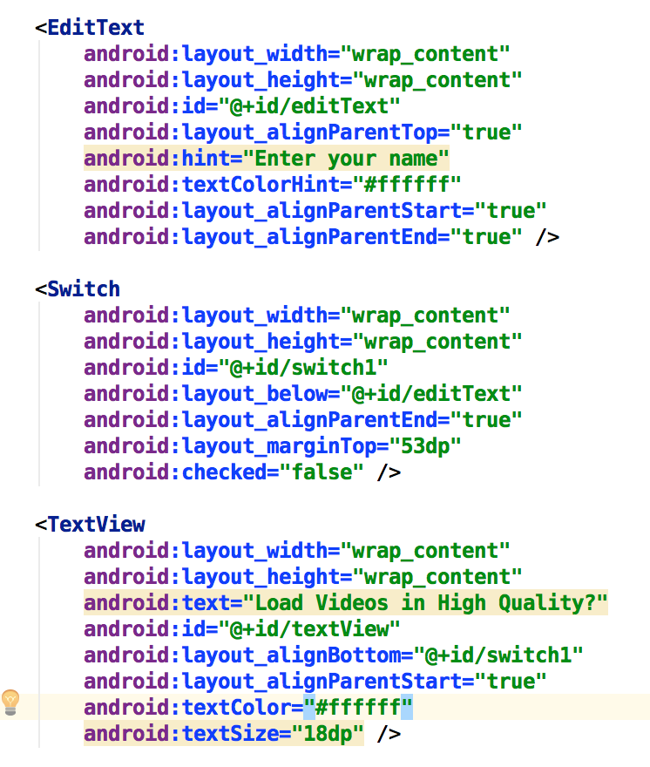
2.1 XML of the content

Slide 24
JAVA part 2.2.A (displaying part)
Remember: we need to read values from sharedPref and display them.
Assume that we will name the sharedpref file “Settings”, the name of the user “user_name” and the switch boolean value as “high_quality”

Slide 25
2.2.A (solution)
protected void onCreate(Bundle savedInstanceState) { // … leave any code as is. // add this to make the back arrow appear on the screen getSupportActionBar().setDisplayHomeAsUpEnabled(true); // grab the elements from the layout e = findViewById(R.id.editText); // e is global edittext s = findViewById(R.id.switch1); // s is global switch
// grab shared pref SharedPreferences display_sp = getSharedPreferences("settings",Context.MODE_PRIVATE); name = display_sp.getString("user_name",null);
// null is default value in case user_name is not created yet. choice = display_sp.getBoolean("high_quality",false);
//false is default in case high_quality cannot be found. if (name!=null) { e.setText(name);} s.setChecked(choice);

Slide 26
2.2.B Programming the floating button
Btw, we are still inside onCreate ☺
FloatingActionButton fab = findViewById(R.id.fab); fab.setOnClickListener(new View.OnClickListener() { @Override public void onClick(View view) { // open shared pref SharedPreferences sp = getSharedPreferences("settings", Context.MODE_PRIVATE); // read values from user name = e.getText().toString(); choice = s.isChecked();

Slide 27
2.2.B Programming the floating button
Continuing:
// create editor SharedPreferences.Editor myEditor = sp.edit(); // save values myEditor.putBoolean("high_quality",choice); myEditor.putString("user_name",name); // commit myEditor.commit(); // show snackbar to tell user everything is saved. Snackbar.make(view, "Save Successful", Snackbar.LENGTH_LONG).show(); } }); } // on create ends here

Slide 28
Lab session SharedPref
settings
save
0
John Smith
1
John smith
You choice is 0

