Slide 1
Red & White Wine:
Predicting Quality
Max Schemitsch, DATA 440L 200

Slide 2

The Dataset
Obtained from Kaggle
Originally available from UCI Machine Learning Repository
Paulo Cortez, University of Minho (Portugal)

Slide 3
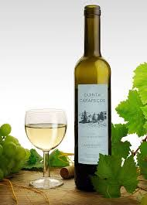
About the Data
Contains information about both red & white wines
Portuguese “Vinho Verde” wine
Does not include sensory characteristics
Grape type, wine brand, price, etc
Each wine is given a quality score, from 0 to 10
However, the no wine was given scores 0, 1, 2, or 10

Slide 4
Data Attributes
Fixed Acidity: Most acids involved with wine (do not evaporate readily)
Volatile Acidity: Acetic Acid, which can lead to unpleasant vinegar taste
Citric Acid: Usually in small quantities, can add freshness to wine
Residual Sugar: Amount of sugar remaining after fermentation
Chlorides: Amount of salt in the wine

Slide 5
Data Attributes (cont)
Free Sulfur Dioxide: Free form SO2 , prevents microbial growth and oxidation
Total Sulfur Dioxide: Both free form SO2 and bound SO2
Density: Can be close to water depending on alcohol and sugar content
pH: How acidic or basic the wine is from 0 to 14 (usually 3-4)
Sulphates: Wine additive that contributes to SO2 levels (antioxidant)
Alcohol: Percent alcohol content of the wine

Slide 6
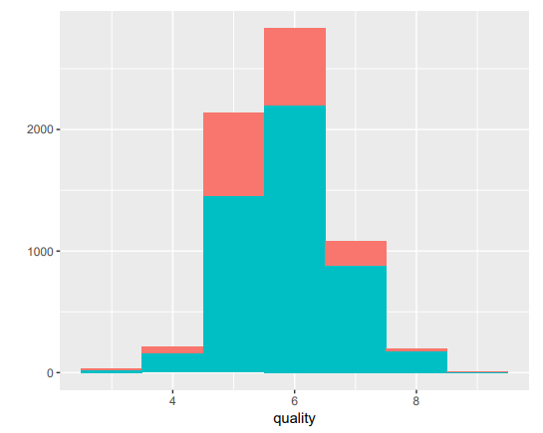
Normality

Slide 7

Data Tool of Choice

Slide 8
Choice of Methods
Multiple Linear Regression - showcase weaknesses (correlation problems)
k-Nearest Neighbors - strengths in categorizing
Random Forest - decision trees

Slide 9
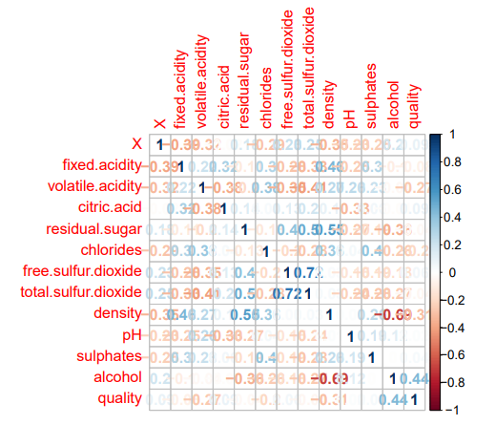
Correlation Matrix

Slide 10
Prominent Correlations for Quality
Alcohol (0.44)
Density (-0.31)
Volatile Acidity (-0.27)

Slide 11
Linear Regression
Model 1: All Variables - Adjusted R-square Value = 0.2909
Model 2: Alcohol - Adjusted R-square Value = 0.1973
Model 3: Alcohol, Volatile Acidity, Density - Adjusted R-square Value = 0.267
Best model with 4 variables?
Model 4: Alcohol, Volatile Acidity, Density, Sulphates - Adjusted R-square Value = 0.27
Cross Validation also confirms Model 4 as the best

Slide 12
k-Nearest Neighbors
Split data into groups: - 3,4 = “Poor” - 5, 6 = “Average” - 7, 8, 9 = “Good”
Use all variables
K-values: 1, 5, 20, 40, 60, 80

Slide 13
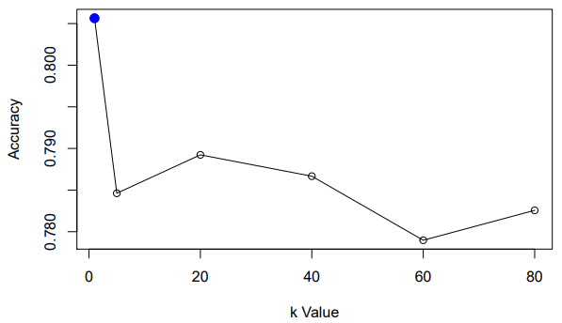

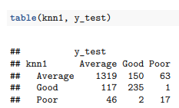
Graph of Accuracies

Slide 14
Conclusions? (What about Random Forest?)
It’s my last thing to do
Might show that decision trees could be useful for something like this
Otherwise, KNN looks much better in terms of categorizing
Wine is great
Pablo please don’t be mad at me for using R

Slide 15
Image References
https://upload.wikimedia.org/wikipedia/commons/1/11/Alvarinho_Vinho_Verde_Quinta_de_Carape%C3%A7os.jpg
https://cdn-images-1.medium.com/max/1200/0*ftOal7fKVCNtJr4N.png

