Slide 1
ENGI 301 Morse Code Decode Project Proposal
02/16/2024
Mina Schepmann

Slide 2
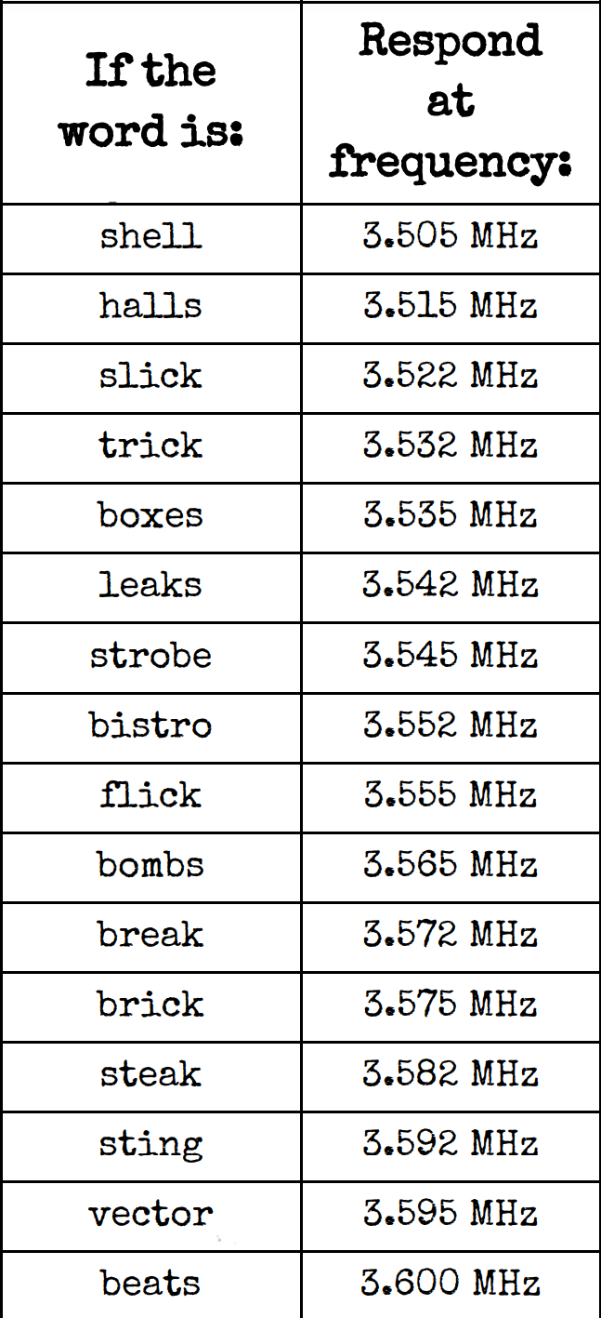
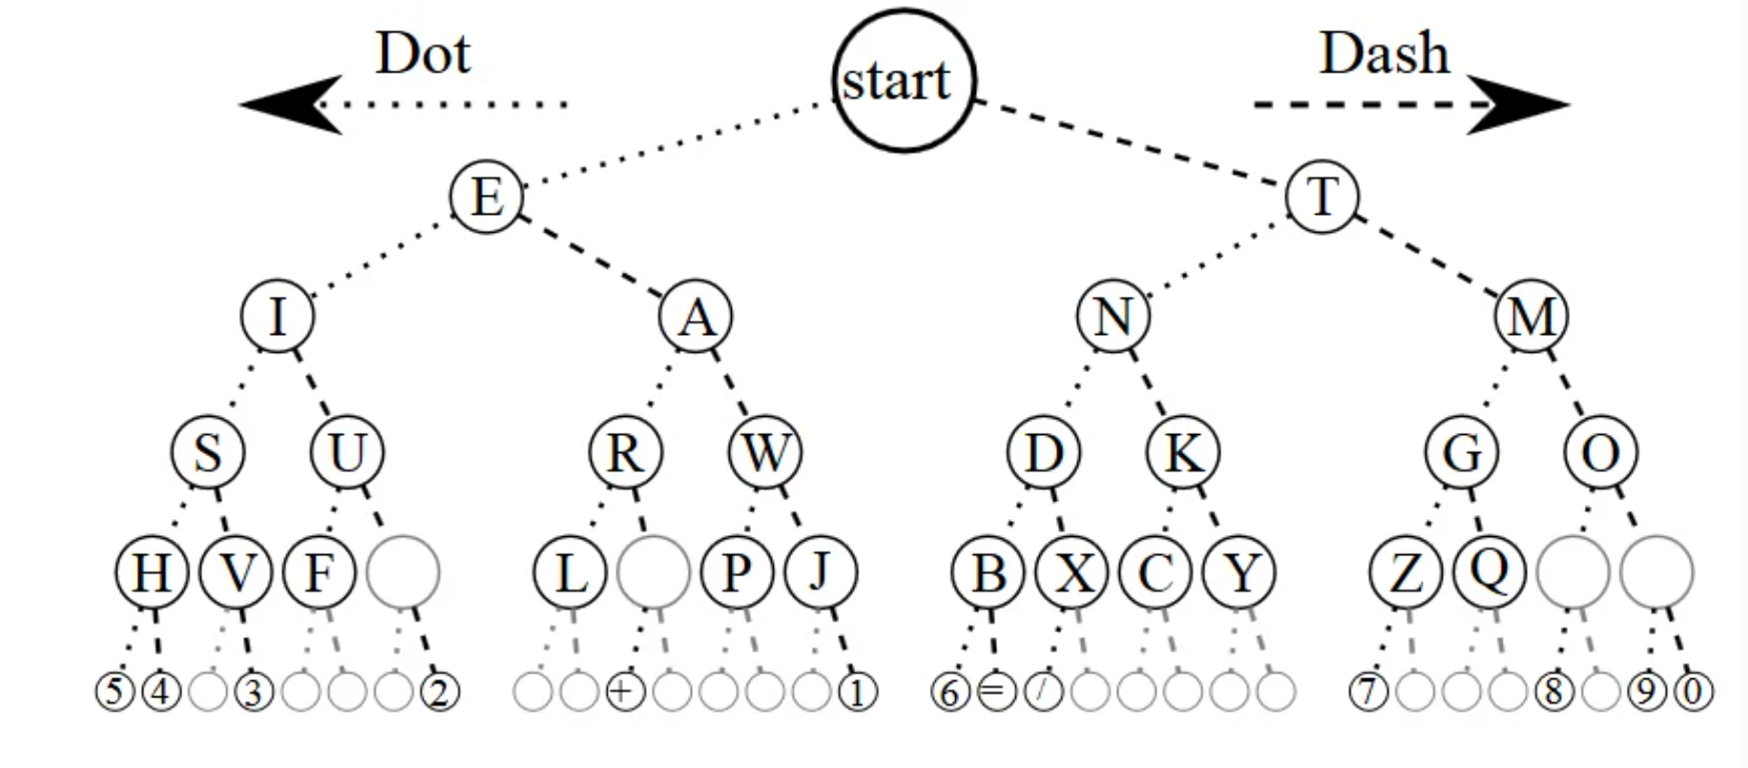
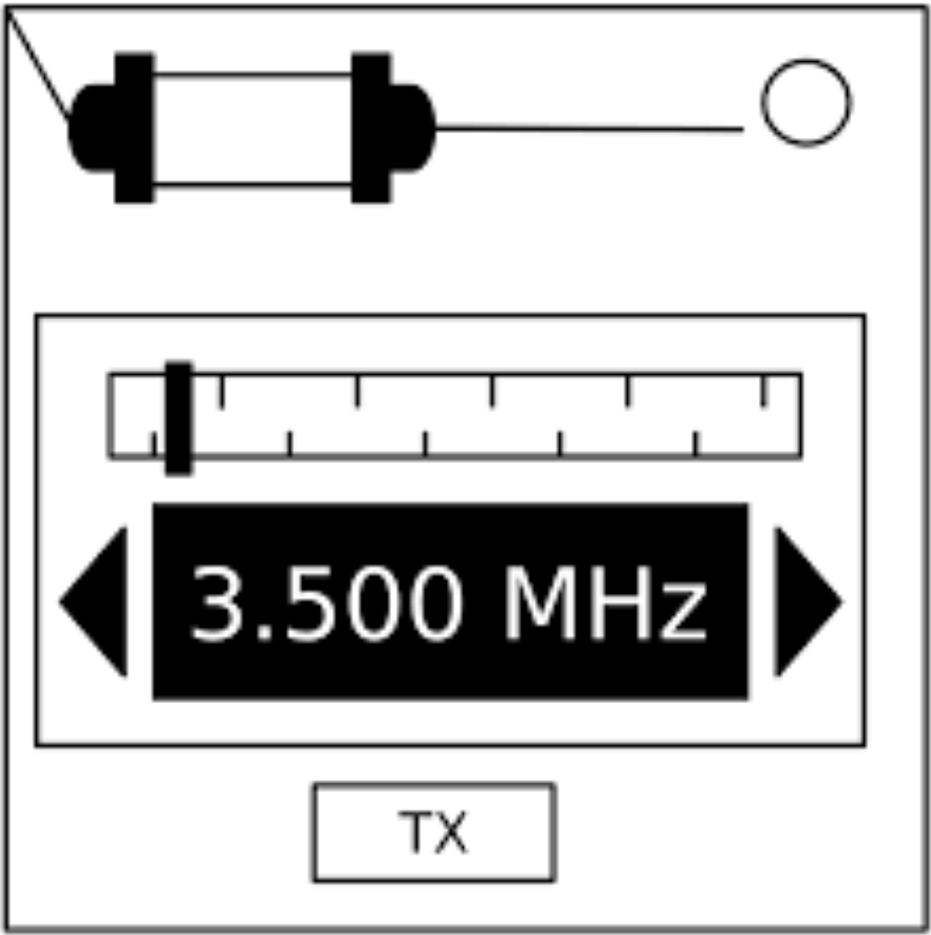
Background Information
Schepmann Family Game Night
Fun, Interactive Game
Teaches Morse Code
Notes:
Over winter break, I rediscovered a game with my friends that my family and I would play on Friday nights for a little while when we were little. The game is called Keep Talking and Nobody Explodes and the object of the game is to defuse a bomb. The catch is that only one person can see the bomb, while everyone else is looking at the bomb defusal manual. The person who can see the bomb cannot see the bomb defusal manual. The game is timed, the bombs get harder, and there are different modules that all have different ways to defuse them. One of them is a game where you have to watch a blinking light and decipher what it is in morse code and then enter a corresponding frequency to defuse that module. I love this game and thought it would be cool to bring it to life, while also having an educational aspect to it of learning morse code.

Slide 3
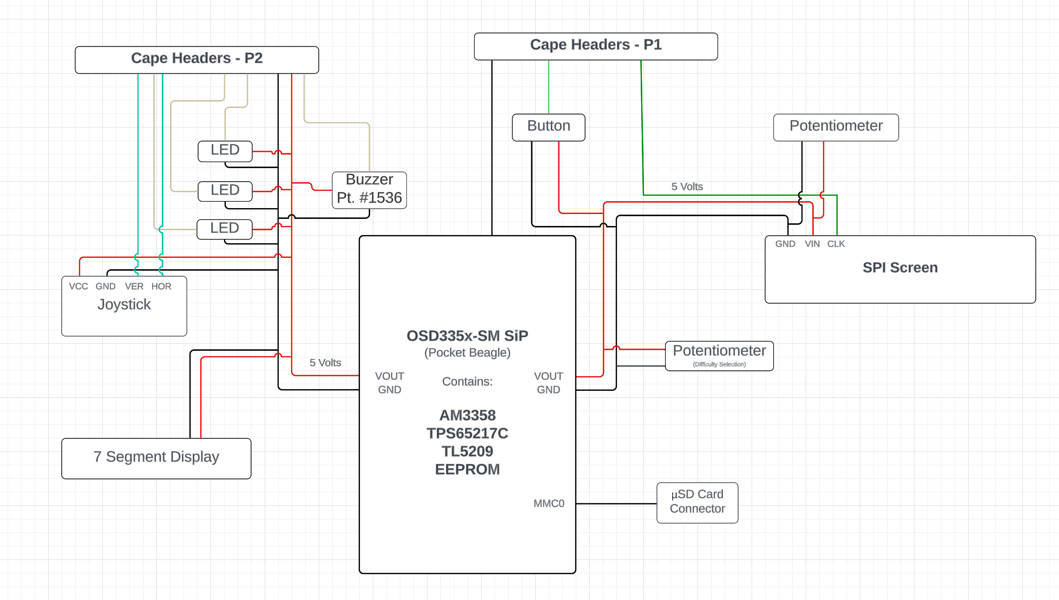
System Block Diagram
https://lucid.app/documents#/documents?folder_id=home

Slide 4
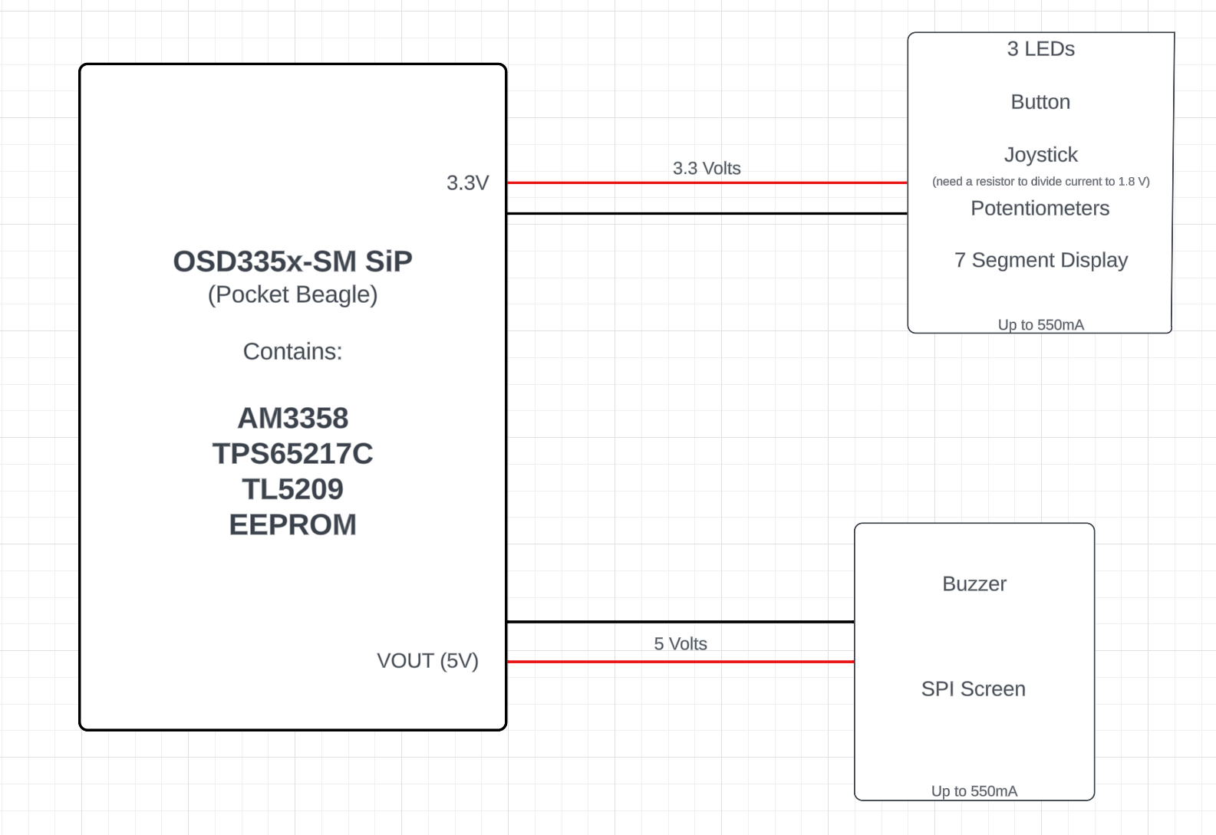
Power Block Diagram
https://lucid.app/documents#/documents?folder_id=home

Slide 5
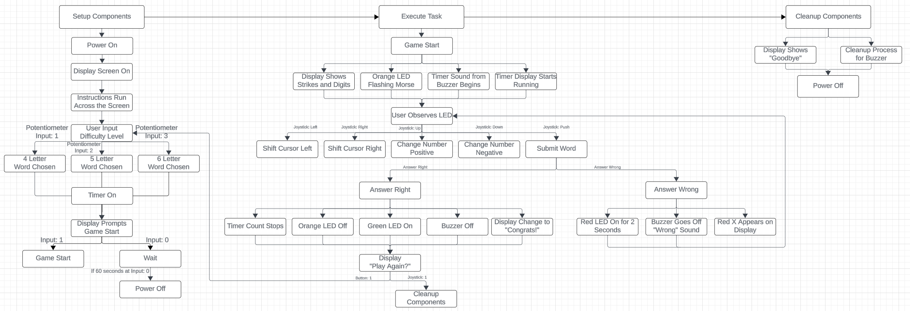
Software Block Diagram

Slide 6
Components / Budget
Component | ENGI301 to Buy? | Cost
SPI Screen (https://www.adafruit.com/product/1770) | Yes | $29.95
5V Passive Buzzer (https://www.adafruit.com/product/1536) | Yes | $0.95
1 Joystick (https://www.amazon.com) | Yes | $1.33
1 7 Segment Display (https://www.adafruit.com/product/1002) | Yes | $9.95
1 Button | No | N/A
1 Green LED | No | N/A
1 Red LED | No | N/A
1 Orange LED | No | N/A
2 Potentiometers | No | N/A
TOTAL |  | $42.18

