Slide 1
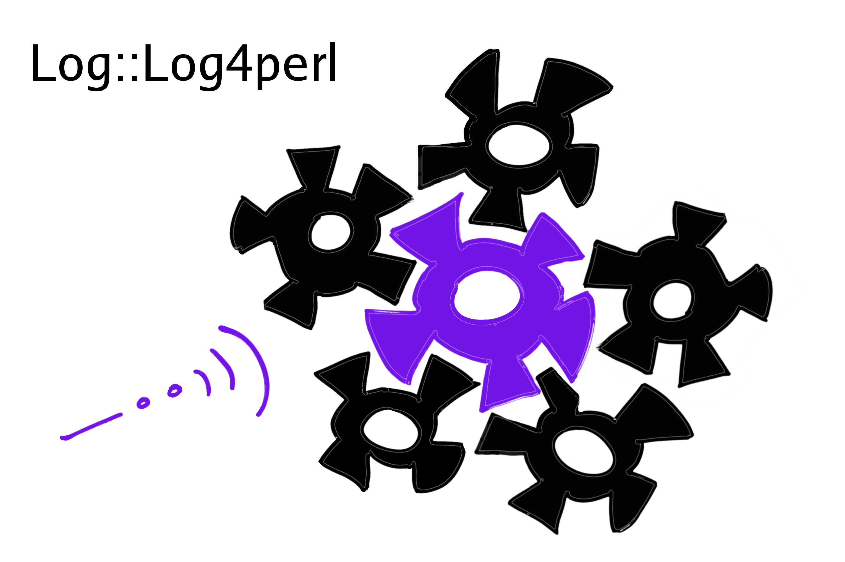
Log4perl
Mike Schilli, Yahoo!
OSCON, 07/24/2008

Slide 2
Logging – why?
Debug during development
Go back in time and figure out what happened.
Measure performance
Trace activity on live systems

Slide 3
Why Log4perl and not one of the 20 Logging modules on CPAN?
No CPAN dependencies
Easy to use, but scales with complexity
Unique Features
Notes:
rite of passage, template system
no cpan deps: easy adoption to become standard

Slide 4
Log::Log4perl Availability
cpan> install Log::Log4perl
  (Only requires core modules)
Included in major Linux distros
  sudo apt-get install liblog-log4perl
Requires Perl 5.00503 or better
Windows: ppm package available in ActiveState archives or from log4perl.com
Notes:
windows: cpan smoke testers

Slide 5
Use Log4perl as a Remote Control to your System.

Slide 6
Log::Log4perl Remote Controls
Levels
Loggers
Layouts
Appenders

Slide 7
Log::Log4perl Remote Controls
Levels
Log/Suppress Priority/Level
Loggers
Locate it in the system
Layouts
Format it
Appenders
Write it out

Slide 8
Log::Log4perl Remote Controls
Levels
DEBUG “Starting up”;
ERROR “Cannot open $file”;
Loggers
Turn logging on in main or Net::Amazon
Layouts
“Starting up” =>
2007-06-21 07:30:33 Foo.pm-123 Starting up
Appenders
Log File
…
Database

Slide 9
Sounds complicated?
Actually, it’s easy …

Slide 10
Easy Log4perl
#!/usr/bin/perl –w
use strict;
use Log::Log4perl qw(:easy);
DEBUG “Starting up”;

Slide 11
Don’t like macros?
Use get_logger()
#!/usr/bin/perl –w
use strict;
use Log::Log4perl qw(get_logger);
my $logger = get_logger();
$logger->debug(“Starting up”);

Slide 12
Like it clean? Use Moose!
package Ferrari;
use Moose;
with “MooseX::Log::Log4perl”;
sub drive {
my($self) = @_;
$self->log->debug(“Wroom!!”);
}

Slide 13
Easy Log4perl
#!/usr/bin/perl –w
use strict;
use Log::Log4perl qw(:easy);
DEBUG “Starting up”;
Notes:
cpan modules: users are not even aware they’re using l4p

Slide 14
Easy Log4perl
$ ./hello
$

Slide 15
Easy Log4perl
#!/usr/bin/perl –w
use strict;
use Log::Log4perl qw(:easy);
Log::Log4perl->easy_init( $DEBUG );
DEBUG “Starting up”;

Slide 16
Easy Log4perl
$ ./hello
2008/07/08 18:37:12 Starting up
$
Notes:
timestamp, newline

Slide 17
Easy Log4perl
#!/usr/bin/perl –w
use strict;
use Log::Log4perl qw(:easy);
Log::Log4perl->easy_init( $DEBUG );
DEBUG “Starting up”;
# … something happens
ERROR “Horrible error!”;

Slide 18
Easy Log4perl
$ ./hello
2008/07/08 18:37:12 Starting up
2008/07/08 18:37:12 Horrible error!
$

Slide 19
Easy Log4perl
#!/usr/bin/perl –w
use strict;
use Log::Log4perl qw(:easy);
Log::Log4perl->easy_init( $ERROR );
DEBUG “Starting up”;
ERROR “Horrible error!”;

Slide 20
Easy Log4perl
$ ./hello
2008/07/08 18:37:12 Horrible error!
$

Slide 21
Remote Control #1: Levels

Slide 22
You get the concept:
FATAL
ERROR
WARNING
INFO
DEBUG
TRACE
FATAL
ERROR
WARNING
INFO
DEBUG
TRACE
Message
Priority
Log Level
Configured

Slide 23
Chatty configuration
FATAL
ERROR
WARNING
INFO
DEBUG
TRACE
TRACE
Message
Priority
Log Level
Configured

Slide 24
Silent configuration
FATAL
ERROR
WARNING
INFO
DEBUG
TRACE
ERROR
Message
Priority
Log Level
Configured

Slide 25
Log Levels
Choose them wisely
  TRACE(“$bytes bytes transferred”);
  DEBUG(“HTTP get OK”);
  INFO(“Starting up”);
  WARN(“HTTP get failed, retrying”);
  ERROR(“Out of retries!”);
  FATAL(“Panic! Shutting down.”);
Notes:
Questions?

Slide 26
Remote Control #2: Layouts

Slide 27
Location-Awareness
Log4perl’s Loggers are aware of their location:
package Foo;
use Log::Log4perl qw(:easy);
sub foo {
DEBUG “Starting up”;
}

Slide 28
Location-Awareness
package Foo;
use Log::Log4perl qw(:easy);
sub foo {
DEBUG “Starting up”;
}
$ ./hello
2008/07/13 19:32:39 Starting up

Slide 29
Location-Awareness
package Foo;
use Log::Log4perl qw(:easy);
sub foo {
DEBUG “Starting up”;
}
$ ./hello
637 Foo::foo ./Foo.pm-4> Starting up

Slide 30
Location-Awareness
package main;
use Log::Log4perl (:easy);
Log::Log4perl->easy_init({
level => $DEBUG,
layout => “%r %M %F-%L> %m%n”,
});
Foo::foo(); # unchanged!
$ ./hello
637 Foo::foo ./Foo.pm-4> Starting up

Slide 31
Configuration Files
If this becomes unwieldy:
Log::Log4perl->easy_init({
level => $DEBUG,
layout => “%r %M %F-%L>%m%n”,
});

Slide 32
Configuration Files
#l4p.conf
l4p.logger = DEBUG, Screen
l4p.appender.Screen = Log::Log4perl::Appender::Screen
l4p.appender.Screen.Layout = PatternLayout
l4p.appender.Screen.Layout.ConversionPattern = \
%r %M %F-%L> %m%n
Log::Log4perl->init( “l4p.conf” );

Slide 33
Advantages of Config Files
Can be edited
  indepentently of the script
  while the script runs
  by people without access to the code
Notes:
Questions?

Slide 34
Remote Control #3: Categories (Loggers)

Slide 35
Turn on Logging Everywhere
Script
l4p.logger = DEBUG, Screen
Modules

Slide 36
Using Categories
Script
l4p.logger.Net.Amazon = \
DEBUG, Screen
Modules
Net::Amazon

Slide 37
Using Categories
main
Script
l4p.logger.main = \
DEBUG, Screen
Modules
Net::Amazon

Slide 38
Using Categories
main
Script
l4p.logger.main = DEBUG, Screen
l4p.logger.Net.Amazon = \
DEBUG, Screen
Modules
Net::Amazon

Slide 39
Categories
#l4p.conf
l4p.logger.main = DEBUG, Screen
l4p.logger.Net.Amazon = DEBUG, Screen
l4p.appender.Screen = Log::Log4perl::Appender::Screen
l4p.appender.Screen.Layout = PatternLayout
l4p.appender.Screen.Layout.ConversionPattern = \
%r %M %F-%L> %m%n
main
Net::Amazon

Slide 40
Category Inheritance
#l4p.conf
l4p.logger.Net = DEBUG, Screen
l4p.appender.Screen = Log::Log4perl::Appender::Screen
l4p.appender.Screen.Layout = PatternLayout
l4p.appender.Screen.Layout.ConversionPattern = \
%r %M %F-%L> %m%n
main
Net::Google
Net::Amazon

Slide 41
Remote Control #5: Appenders

Slide 42
Root Logger
#l4p.conf
l4p.logger = DEBUG, Screen
l4p.appender.Screen = Log::Log4perl::Appender::Screen
l4p.appender.Screen.Layout = PatternLayout
l4p.appender.Screen.Layout.ConversionPattern = \
%r %M %F-%L> %m%n
main
Net::Google
Net::Amazon
Notes:
Question?

Slide 43
Multiple Appenders
#l4p.conf
l4p.logger.main = DEBUG, Screen
l4p.logger.Net.Amazon = DEBUG, File
l4p.appender.Screen = Log::Log4perl::Appender::Screen
l4p.appender.Screen.Layout = SimpleLayout
l4p.appender.File = Log::Log4perl::Appender::File
l4p.appender.File.filename = /var/log/myapp.log
l4p.appender.File.Layout = PatternLayout
l4p.appender.File.Layout.ConversionPattern = \
%r %M %F-%L> %m%n
Screen
main
File
Net::Amazon

Slide 44
Multiple Appenders
(different log levels)
#l4p.conf
l4p.logger.main = DEBUG, Screen
l4p.logger.Net.Amazon = ERROR, File
l4p.appender.Screen = Log::Log4perl::Appender::Screen
l4p.appender.Screen.Layout = SimpleLayout
l4p.appender.File = Log::Log4perl::Appender::File
l4p.appender.File.filename = /var/log/myapp.log
l4p.appender.File.Layout = PatternLayout
l4p.appender.File.Layout.ConversionPattern = \
%r %M %F-%L> %m%n
Screen
main
File
Net::Amazon

Slide 45
Multiple Appenders
#l4p.conf
l4p.logger.main = DEBUG, Screen, File
l4p.appender.Screen = Log::Log4perl::Appender::Screen
l4p.appender.Screen.Layout = SimpleLayout
l4p.appender.File = Log::Log4perl::Appender::File
l4p.appender.File.filename = /var/log/myapp.log
l4p.appender.File.Layout = PatternLayout
l4p.appender.File.Layout.ConversionPattern = \
%r %M %F-%L> %m%n
Screen
main
File
Net::Amazon

Slide 46
Log4perl Flow
Application sends a log message (Category, Priority)
Log4perl Configuration decides go/no go, based on Category and Priority
?
Layout
Appender
Appender
Appender

Slide 47
Log4perl and Log4j
Log::Log4perl ports Log4j to Perl
Log4j: de facto Java logging standard, by Ceki Gülcü
  Latest development: ‘logback’
http://logging.apache.org/log4j
Log::Log4perl adds perlisms demanded by users

Slide 48
Log4perl History
0.01 release 2002
Current release 1.17 (07/2008)
Authors: Mike Schilli, Kevin Goess
Used by major banks, target.com, fedex.com, Yahoo!, Google, …
Several CPAN modules support it (e.g. Catalyst, Net::Amazon, …)
Every major Linux distro has it (Ubuntu, Suse, Fedora …)

Slide 49
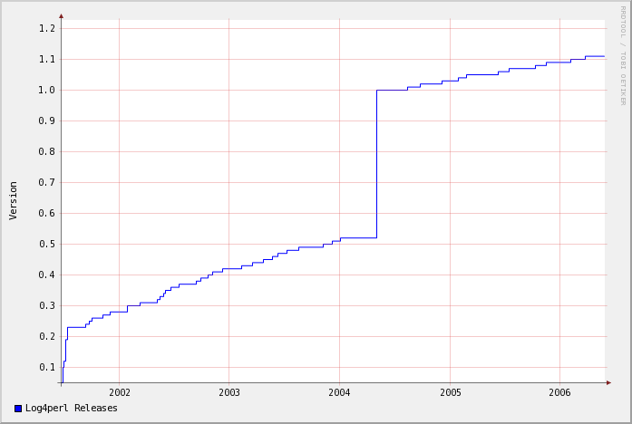
Log4perl Release History

Slide 50
Design Goals
Easy to use in small scripts
Scales easily with growing architecture
Log4perl-enabled CPAN modules can be used with and without Log4perl initialization
Optimized for Speed
Open Architecture, extensible

Slide 51
Combine Remote Controls
Write code once, and L4p-enabled scripts/modules can be used
  with any logging configuration you desire
  by changing loggers, appenders and layouts independently
  similar to dtrace probes
No need to change your source code to change the logging behavior

Slide 52
Init and Watch
Log::Log4perl->init(“l4p.conf”);
Log::Log4perl->init(\$conf_string);
Log::Log4perl->init_and_watch(“l4p.conf”, 30);
Log::Log4perl->init_and_watch(“l4p.conf”, ‘HUP’ );

Slide 53
Demo

Slide 54
Appenders
Appenders are output sinks
Get called if a message passes category and level hurdles

Slide 55
Appenders
Log::Log4perl::Appender::Screen Log::Log4perl::Appender::File Log::Log4perl::Appender::Socket Log::Log4perl::Appender::DBI Log::Log4perl::Appender::Synchronized Log::Log4perl::Appender::RRDs
Log::Dispatch provides even more:

Slide 56
Log::Dispatch Appenders
Log::Dispatch::ApacheLog Log::Dispatch::DBI, Log::Dispatch::Email, Log::Dispatch::Email::MIMELite Log::Dispatch::File Log::Dispatch::FileRotate Log::Dispatch::Screen Log::Dispatch::Syslog, Log::Dispatch::Tk

Slide 57
Example: Rotating Log File Appender
Keep 5 days of logfiles, then delete:
log4perl.category = WARN, Logfile
log4perl.appender.Logfile = Log::Dispatch::FileRotate
log4perl.appender.Logfile.filename = test.log
log4perl.appender.Logfile.max = 5
log4perl.appender.Logfile.DatePattern = yyyy-MM-dd
log4perl.appender.Logfile.TZ = PST
log4perl.appender.Logfile.layout = \
Log::Log4perl::Layout::SimpleLayout

Slide 58
Rotating Files
Rotating File Appender:
  Log::Dispatch::FileRotate
  Single request pays for rotation
  Rotation runs as particular user
External Rotators (e.g. newsyslog):
  recreate flag makes sure file appender adjusts
  recreate_check_interval saves on stat() calls

Slide 59
Layouts
SimpleLayout
$log->debug(“Sending Mail”);
DEBUG – Sending Mail
log4perl.appender.Screen = \
Log::Log4perl::Appender::Screen
log4perl.appender.Screen.layout = SimpleLayout

Slide 60
Layouts
PatternLayout
$log->debug(“Sending Mail”);
2004/10/17 18:47:25 l4ptest.pl:25> Sending Mail
log4perl.appender.Logfile.layout = \
Log::Log4perl::Layout::PatternLayout
log4perl.appender.Logfile.layout.ConversionPattern = \
%d %F{1}:%L> %m %n

Slide 61
Layouts
PatternLayout
%T stack trace
%c Category of the logging event.
%C Fully qualified package (or class) name of the caller
%d Current date in yyyy/MM/dd hh:mm:ss format
%F File where the logging event occurred
%H Hostname
%l calling method + file + line
%L Line number within the file where the log statement was issued
%m The message to be logged
%M Method or function where the logging request was issued
%n Newline (OS-independent)
%p Priority of the logging event
%P pid of the current process
%r Number of milliseconds elapsed from program start
%x The elements of the NDC stack
%X{key} The entry 'key' of the MDC
%% A literal percent (%) sign

Slide 62
Layouts
Still not enough? Write your own:
log4perl.PatternLayout.cspec.U = sub { return "UID $<" }
…
log4perl.appender.Logfile.layout = \
Log::Log4perl::Layout::PatternLayout
log4perl.appender.Logfile.layout.ConversionPattern = \
%d %U> %m %n

Slide 63
Speed

Slide 64
Benchmarks
1M/sec suppressed calls
50k/sec logged messages (memory appender)
No degradation with subcategories

Slide 65
Avoid Wasting Cycles
for (@super_long_array) {
$logger->debug("Element: $_\n");
}
if($logger->is_debug()) {
for (@super_long_array) {
$logger->debug("Element: $_\n");
}
}

Slide 66
Dirty Tricks

Slide 67
Resurrect in a Single File
The :resurrect target uncomments lines starting with ###l4p:
  use Log4perl qw(:easy :resurrect);
  sub foo {
  # …
  ###l4p DEBUG “foo was here”;
  }

Slide 68
Resurrect L4p in all Modules
The Log::Log4perl::Resurrector touches all subsequently loaded modules (experimental!):
  use Log4perl qw(:easy);
  use Log::Log4perl::Resurrector;
  use Foo::Bar;
  # Deploy a module without requiring L4p at all!
  package Foo::Bar;
  ###l4p use Log4perl qw(:easy);
  sub foo {
  ###l4p DEBUG “This will be resurrected!”;
  }

Slide 69
The Future

Slide 70
Wouldn’t it be nice …
… if all modules on CPAN had a standard logging interface?

Slide 71
Log4perl-enable a CPAN Module
package Foo;
sub foo {
# … do something
}
1;

Slide 72
Log4perl-enable a CPAN Module
package Foo;
use Log::Log4perl qw(:easy);
sub foo {
# … do something
DEBUG “Fooing $bar”;
}
1;

Slide 73
… and voila, your CPAN module has a built-in remote.

Slide 74
Be Open
Let other people debug your module in a standard way.

Slide 75
Q & A
Q & A

Slide 76
Thank You!
Log::Log4perl Project Page (includes slides of this talk):
http:/log4perl.com
Email me:
Mike Schilli cpan@perlmeister.com

