Slide 1
Continuously integrating Perl projects with Vagrant
Mike Schilli, Venkat Venkataraju
Yahoo!
YAPC 2013, Austin, TX
06/04/2013

Slide 2
Summary
Unit Tests vs. Integration
Infrastructure as Code
What’s Vagrant?
Provisioning Tools (Puppet, Chef, Salt)
Example and Demo

Slide 3
Unit Tests
$ perl Makefile.PL
$ make
$ make test
t/Unit.t .. ok
t/Live.t .. skipped: only with LIVE
All tests successful.
Files=2, Tests=2, 0 wallclock secs ( 0.03 usr 0.01 sys + 0.03 cusr 0.00 csys = 0.07 CPU)
Result: PASS

Slide 4
Unit Test Limitations
“Works for me” syndrome
Tied to development box setup
But what about …
A different OS?
Interaction with a database?
Other people’s code?

Slide 5
CI Pipeline
Staging
…
Dev
Integration

Slide 6
CI Pipeline
Staging
…
Dev
Integration

Slide 7
Integration Tests
Full application stack installed
Integrate early, integrate often, integrate continuously
Problem: Can’t configure your devbox for many different project environments

Slide 8
What you need to integrate with
New supporting package releases
Other people’s code
Config changes
Services
External Systems

Slide 9
Virtual Machines
Easy to spin up on many platforms to set up integration environments
But setting up the application stack
is manual work
needs to be documented
slows down potential contributors

Slide 10
Infrastructure as Code
Store machine setup in source control
One-command spin-up
Creates VM
Provisions VM based on checked-in file
Packages
Configuration files
Start Services
Create user account

Slide 11
Infrastructure as code - why?
Restore Infrastructure from scratch after catastrophic incidents
The New Guy doesn’t need to read documentation to get started
Get a working development environment back right away after coming back to a project

Slide 12

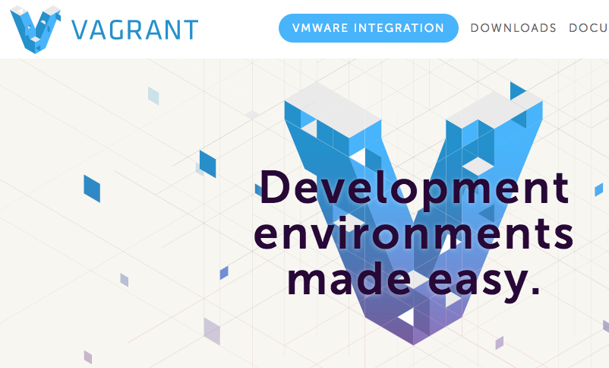
VirtualBox and Vagrant
+

Slide 13
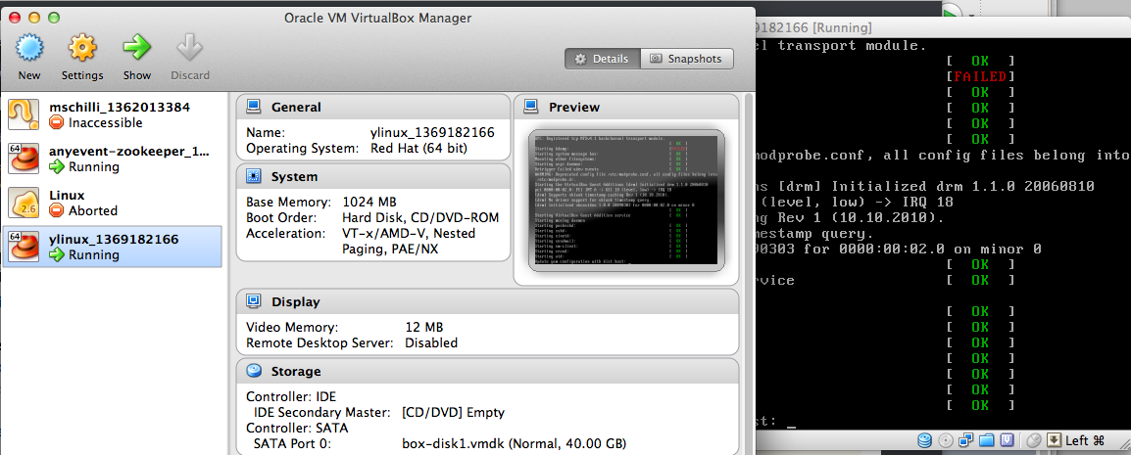
On top of VirtualBox

Slide 14
$ vagrant up

Slide 15
Vagrantfile

Slide 16
Vagrantfile
Vagrant::Config.run do |config|
config.vm.box = "ubuntu2"
config.vm.box_url = "http://files.vagrantup.com/precise64.box"
end

Slide 17
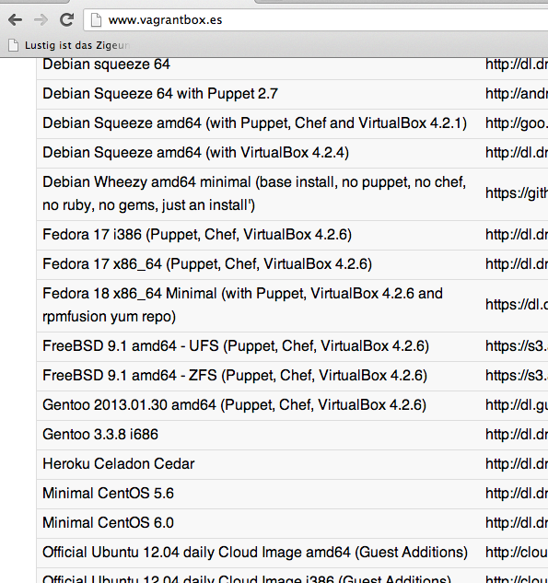
Vagrant Boxes For Download

Slide 18
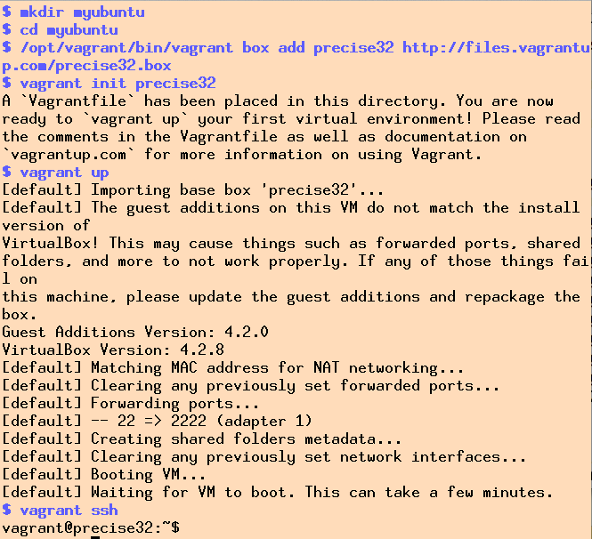
Box Install

Slide 19
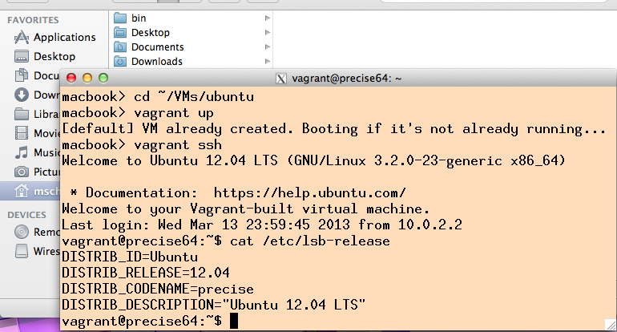
Vagrant: Remote-controls VirtualBox

Slide 20
Magic Mount
/vagrant in the VM maps to the start directory on the host system.

Slide 21
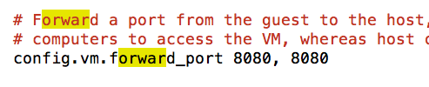
Networking – Simple

Slide 22
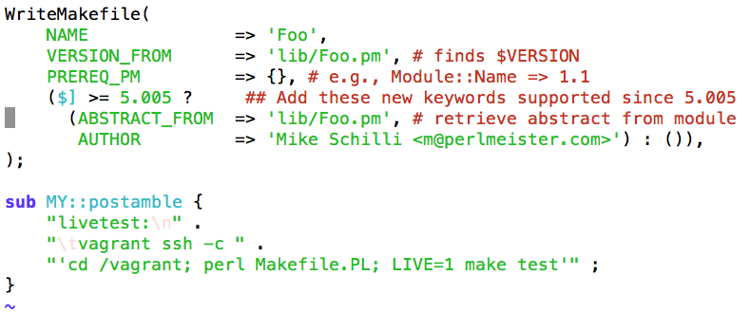
Integration Tests

Slide 23
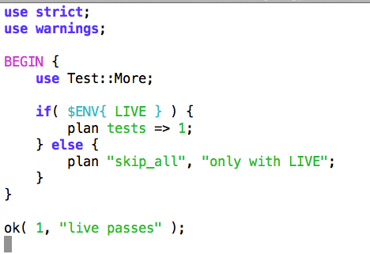
Integration Test Suite

Slide 24
Unit Test
$ make test
t/Unit.t .. ok
t/Live.t .. skipped: only with LIVE
All tests successful.

Slide 25
Live Test
$ make livetest
vagrant ssh –c ‘cd /vagrant; perl Makefile.PL; make test’

Slide 26
Live Test
$ make livetest
vagrant ssh –c ‘cd /vagrant; …’
t/Live.t .. ok
t/Unit.t .. ok
$ cd /vagrant
$ perl Makefile.PL
$ LIVE=1 make test
…

Slide 27
Infrastructure As Code

Slide 28
Cleanup

Slide 29
Provisioning Tools
Tool | Client | Server | Config Format
Puppet (Puppet Labs) | puppet-agent | Puppet master | DSL
Chef (Opscode) | chef-client & knife | Chef solo, server or hosted | Ruby
Salt Stack (saltstack.com) | Salt minion | Salt server | Python + YAML
…

Slide 30
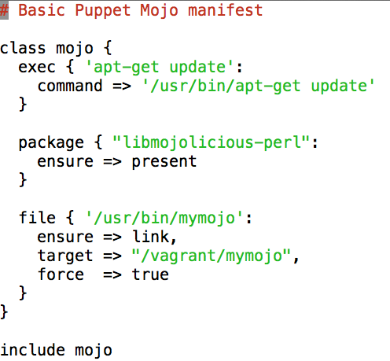
Provisioning with Puppet

Slide 31
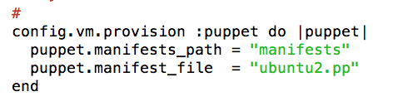
Provisioning with Puppet

Slide 32
Provisioning with Puppet

Slide 33
Chef, cookbooks and recipes
Chef - Infrastructure automation framework
Cookbooks/Recipe - Abstract definition for installing package(s) and configuring them
Recipes contain resource primitives that enable us to define any workflow

Slide 34
Little more about resources
package "name" do
action :install
end
execute "Starting service" do
command "svc -u /service/name"
end
cookbook_file "/path/to/file" do
source "/path/to/source/file"
end

Slide 35
Test kitchen
Integration test harness for Chef
Abstracts creation and provisioning of VMs
Manage multiple VMs
Easy to write YAML file
Beta software

Slide 36
Kitchen config (.kitchen.yml)
---
driver_plugin: vagrant
driver_config:
require_chef_omnibus: true
platforms:
- name: centos-6.4
driver_config:
box: opscode-centos-6.4
suites:
- name: default
run_list:
- "recipe[yapc2013-cookbook::default]"
attributes: {}

Slide 37
Test Kitchen (cont.)
Supports
kitchen create - creates VMs
kitchen converge - provisions VMs
kitchen verify - runs test suite
kitchen destroy - deletes VMs

Slide 38
Bats
Bash automated testing system
TAP compliant test framework written in Bash
Can test any scripts or programs that run in Bash shell

Slide 39
Simple Bats test suite
#!/usr/bin/env bats
@test "Running make test" {
make -C /path/to/Makefile/ test
}

Slide 40
Demo
Creates "centos-6.4" virtual machine
Installs "perl"
Installs cpan modules "Plack" and "Dancer"
Runs verification tests

Slide 41
References
Slides: https://github.com/mschilli/yapc2013
Demo code: https://github.com/mschilli/yapc2013/tree/master/yapc2013-cookbook
Michael Hütterman, “DevOps for Developers”, 2012
Stephen Nelson-Smith, “Test-driven Infrastructure with Chef”, 2011
Puppetlabs.com
Saltstack.com
http://www.opscode.com/chef/
Facebook & Chef Talk: http://www.youtube.com/watch?v=SYZ2GzYAw_Q
Chef Docs: http://docs.opscode.com/
Test-Kitchen: https://github.com/opscode/test-kitchen
Bash automated testing system: https://github.com/sstephenson/bats

Slide 42
The End
Q&A

