Slide 1
RNN Stock Predictions
Michael Schmidlin
Mid-term presentation
4/7/23

Slide 2
Overview
The task at hand
RNN, LSTM, GRU background info
Data Source and Collection
Model Creation & Model Training
Model Results
Hyperparameter Tuning
Final Results & Conclusions

Slide 3
The task at hand
Our goal is to predict stock price by using only using historical stock data. (Not data from other sources)
This implies that we will be able to find patterns in the stock data in order to generate future prices.
This project was completed using PyTorch tools but similar tools exist in TensorFlow.

Slide 4
RNN, LSTM, GRU
Recurrent Neural Network – a type of artificial neural network designed to process sequential data.
Long Short-Term Memory – a type of RNN which is designed to address vanishing and exploding gradients which are the main issue of RNN.
Gated Recurrent Unit – a type of RNN which is meant to deliver the same accuracy as RNN just with better performance due to it’s fewer parameters.
RNN type models are very good at predicting the next step in a sequence. Examples of that:
Time series (i.e stock data)
Text completion
Music/Audio generation
Video Analysis

Slide 5
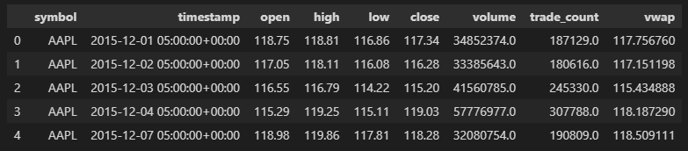
Data Source and Collection
Data was collected using a custom wrapper around Alpaca-py. Alpaca is an online brokerage with free sign-up.
Stock data for Apple and Microsoft is used from 2015 to 2023 with a daily value for the following features:
open: Open price of a stock on a particular day
high: Highest price of a stock on a particular day
low: lowest price of a stock on a particular day
close: last price of a stock on a particular day
volume: how many shares were traded on a particular day
The data was min max scaled.
DataFrame head:

Slide 6


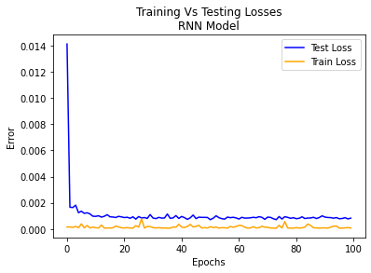
Model Creation & Model Training
The models were created using PyTorch’s built in RNN, LSTM, and GRU neural net layers. I have used those in a custom PyTorch model implementation.
Model Training is similar for RNN, LSTM, and GRU. We need a PyTorch loss function and optimizer.
After training for 100 epochs this is what the losses looked like:
It’s clear the model is done
learning by 100 Epochs.

Slide 7
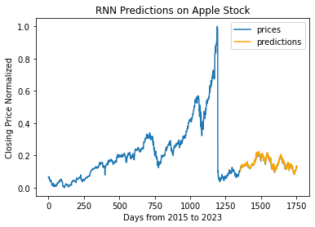
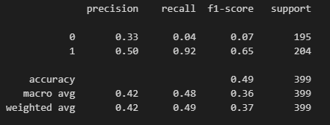
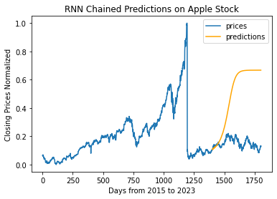
Model Results
BAM! Looks like we’re going to millionaires! 😁(these types of plots are everywhere online)
Let’s take a closer look though because this seems too good to be true. Let’s look at how well the model can predict just going up and down (classification)
Now our model is not looking so good with an accuracy of 49% (coin flip).
Let’s also take a look at “chained prediction”. Feed the model previous predictions rather than stock data.

Slide 8
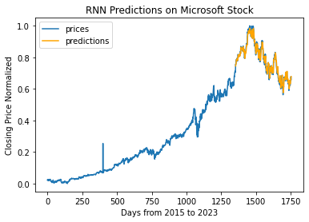
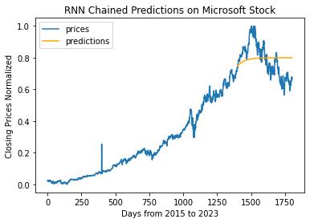
Hyperparamter Tuning
Spoiler Alert!! None of these things make the model any more viable. We’ll briefly discuss each though and what it means/does.
Use 5 input features (open, high, low, close, and volume) to try and improve performance. One of these features might help us see the future better.
Increase number of RNN Layers. This increases model complexity and ability to learn.
Increase hidden size. Also increases model complexity by increasing number of model parameters.
Predict a different stock (maybe Apple stock is the only one that is not predictable. (50% accuracy)

Slide 9
Final Results & Conclusions
We were not able to predict stock price or even whether it will go up or down (not going to be millionaires after all 😢)
It is most likely not possible to predict stock price solely based on past stock prices no matter what model is used.
Why? Stock data is driven by an infinite number of factors ranging from global trends individual company policies. Moreover, stock price is driven by supply and demand which is influenced by human emotion and irrational decision making.

Slide 11
Backup slides

Slide 12
