Slide 1
Continuous Integration with the Open Build Service
Christian Bruckmayer & Manuel Schnitzer

Slide 2





SCM
Code
Appliance
IMAGE
2.
4.
Appliance
Binaries
(rpm, deb)
Code
1.
3.
5.
PACKAGE
YES
NO
Notes:
1) So continuous integration means to integrate your changes several times a day with the upstream code shared by all developers!
2) Every coode should trigger a build for your package
3) BuildService ships the binaries
4) You want to test your package within a full distribution

Slide 3



Slide 4





010011
Notes:
- What does the build service
- It takes care of producing binaries in an automatic, consistent and reproducible way.
- Which means it automatically builds a new package on every source change
- It automatically triggers a rebuild of your package if source files change
- It builds cross distributions which means you can build for Leap, Tumbleweed etc
- But also for Fedora etc
- It supports different build formats like debian or fedora

Slide 5

SUBMIT
FORK
FIX
Notes:
Furthermore it encourages people to collaborate.
- Think of it a little bit like a github for packages, so you face a bug in a package: just fork it, fix it and submit it back like you would do it on Github.

Slide 6
SCM
Code
Appliance
IMAGE
2.
Appliance
Binaries
(rpm, deb)
Code
1.
PACKAGE
YES
NO

Slide 7
Applications:Popular
OFFICE
GIMP
Firefox

Slide 8
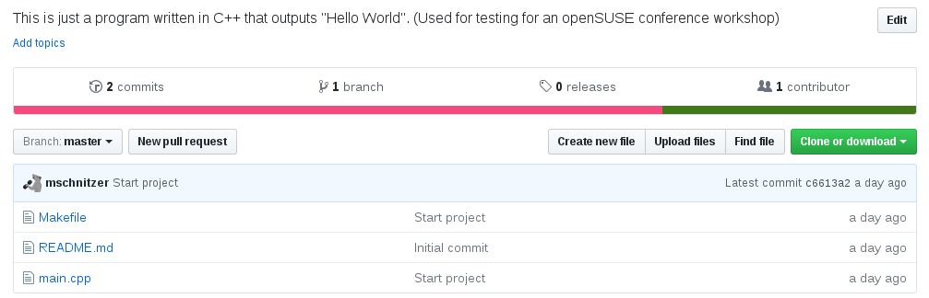

Slide 9
SCM
Source Code
Notes:
- Wont talk about the first point
- You all use git and know how this works
- How do we get our sources into the buildservice?

Slide 10
<services>
<service name="tar_scm">
<param name="url">
git://github.com/user/repo.git
</param>
<param name="scm">git</param>
</service>
<service name="set_version">
<param name="basename">hello-osc</param>
</service>
</services>
Notes:
tar_scm:
- versionformat
- versionprefix
- revision (branch / commit)
There are other services like:
- source service
- kiwi import service
- set version service
- recompress

Slide 11
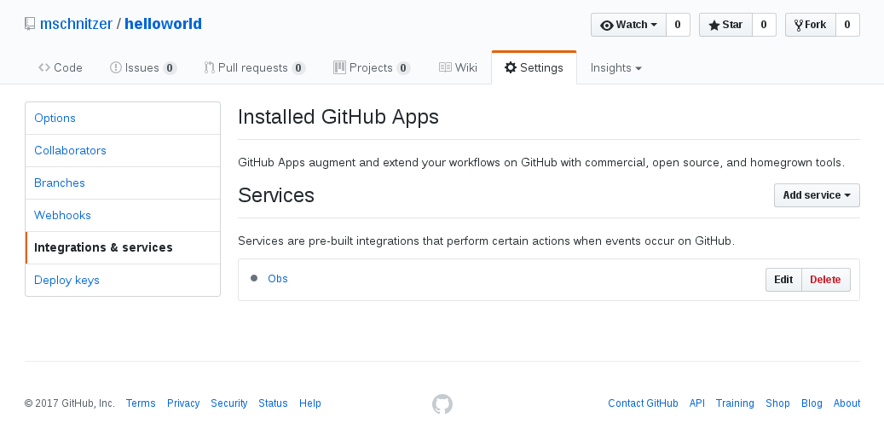

Slide 12

"This image shows a cut kiwifruit" by Luc Viatour is licensed under CC BY 2.5

Slide 13
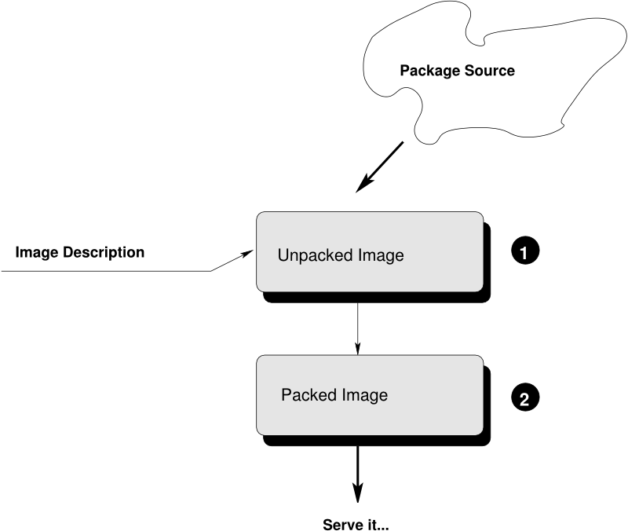

Slide 14
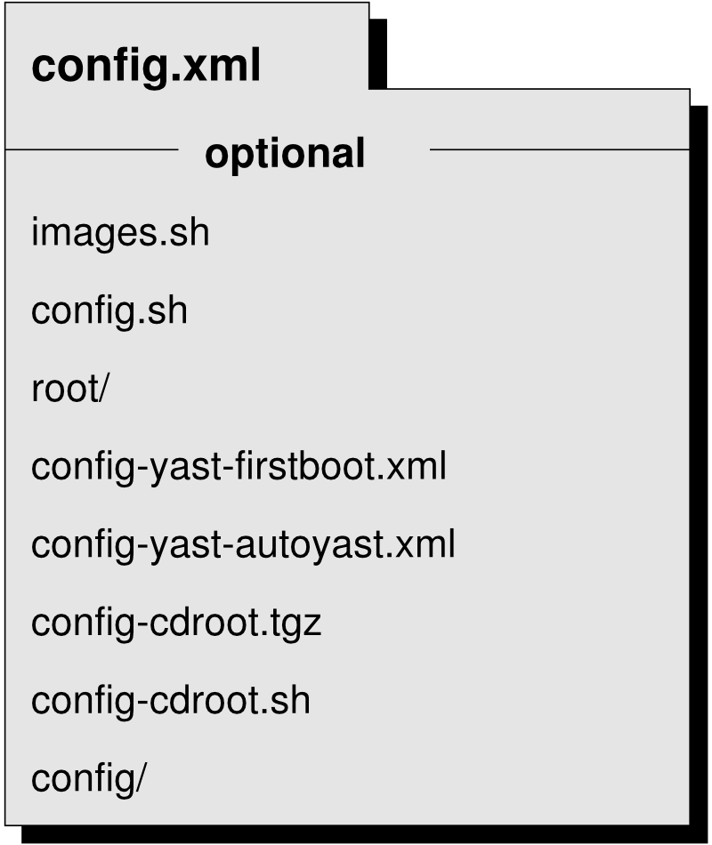

Slide 15

Import

Slide 16
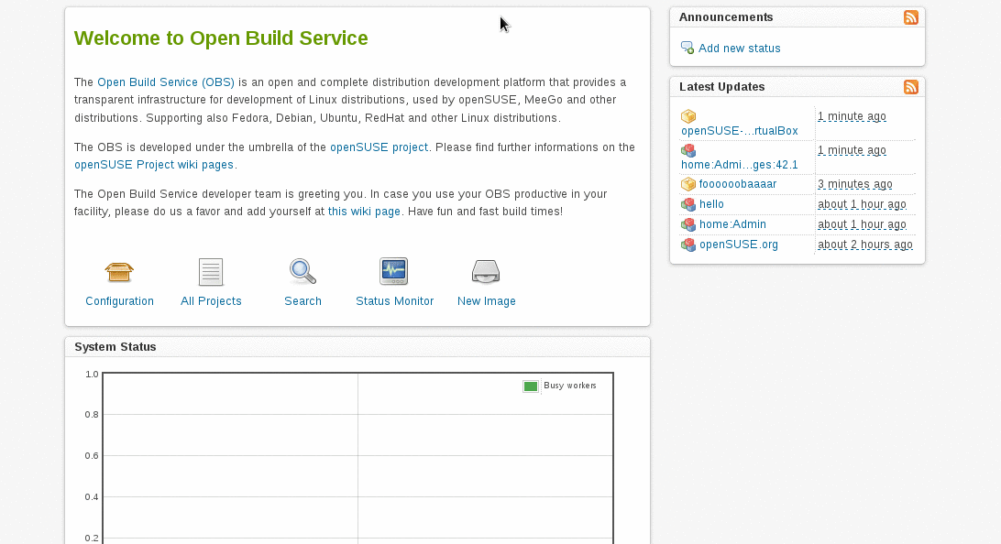

Slide 17
SCM
Code
Appliance
IMAGE
2.
4.
Appliance
Binaries
(rpm, deb)
Code
1.
3.
5.
PACKAGE
YES
NO

Slide 18
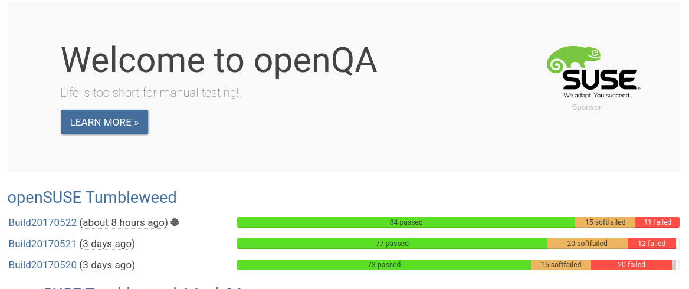

Slide 19
Hands On

Slide 20


Slide 21
https://github.com/mschnitzer/workshop-obs-ci

Slide 22
What next

Slide 23
TODO: links etc

Slide 24
Other OBS Talks @ oSC17
FRIDAY
  11:00 Galerie – osc2: The modern osc by Marco
  12:00 Main Hall – Open Build Service Roadmap by David & Moises
  12:15 Galerie – Repoducible builds in openSUSE by Bernhard
  15:00 Seminarium 2 - Continuous Integration with the Open Build Service by Manuel & Chris
  16:30 Galerie – SUSE Package Hub by Wolfgang

Slide 25
Other OBS Talks @ oSC17
SATURDAY
  11:30 Galerie – OBS numbers by Ana
  11:45 Main Hall – YaST: from the repository to the distributions by Ancor
  12:00 Galerie – Make packaging software a breeze by Björn
  12:30 Seminarium 1 - OBS <B AppImage by Simon & Adrian
  13:00 Seminarium 2 – AppImage Workshop by Simon & Adrian
  13:45 Seminarium 1 – Get packages into Package Hub by Wolfgang
  16:15 Main Hall - Take me to Leap by Axel

Slide 26
Other OBS Talks @ oSC17
SUNDAY
  13:00 Seminarium 1 – Packaging workshop by Simon
  14:00 Seminarium 2 – reproducible builds discussion by Bernhard

