Slide 1
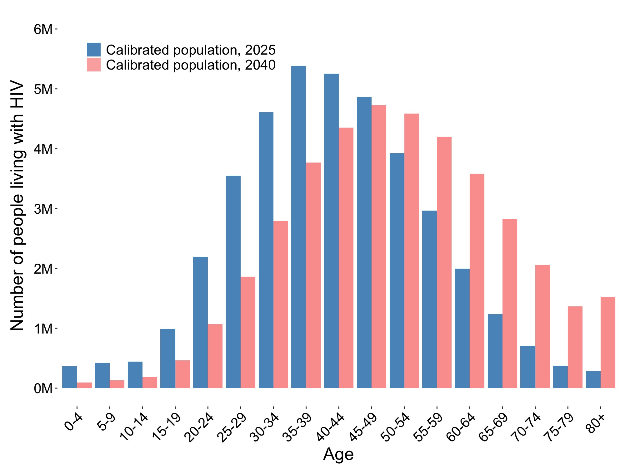
Median age, 2025: 41
Median age, 2040: 50
Year | Median Age | Total population living with HIV | Proportion over 50
2025 | 41 | 39M | 31%
2040 | 50 | 41M | 51%

Slide 2
Median age, 2025: 41
Median age, 2040: 50
Year | Median Age | Proportion over 50
2025 | 41 | 31%
2040 | 50 | 51%

