Slide 1
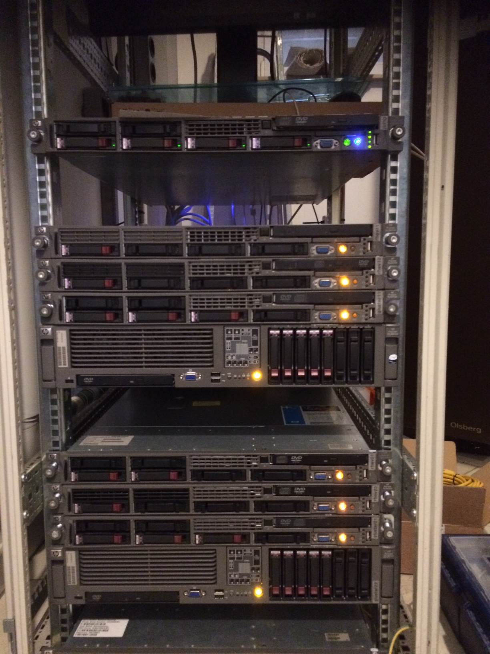
jump
rhev11
DC “left”
rhev12
gluster11
gluster12
rhev21
DC “right”
rhev22
gluster21
gluster22

