Slide 1
SSWD – Project Presentation
Kevin O’ Dea – 2884995
Anthony Pigott – 2872730

Slide 2
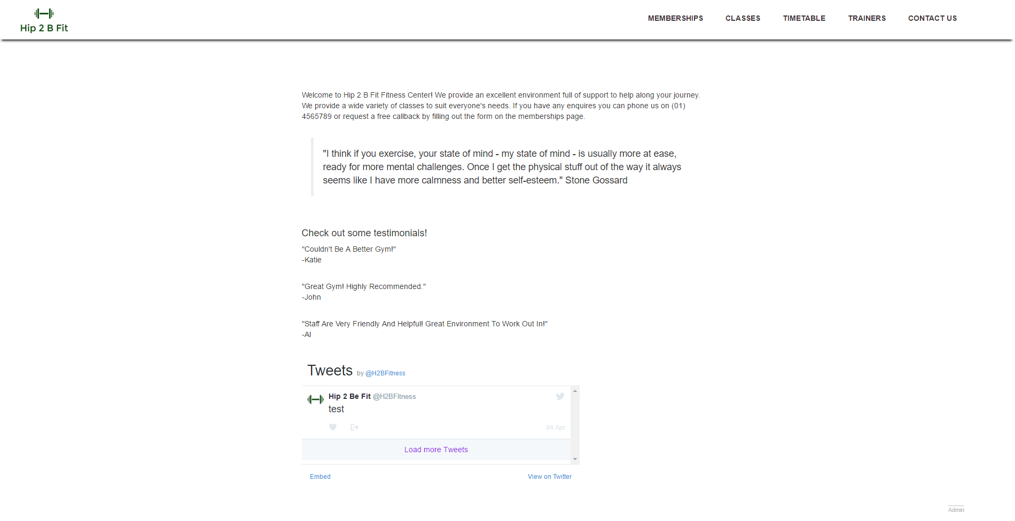
Visual Design – Home page

Slide 3
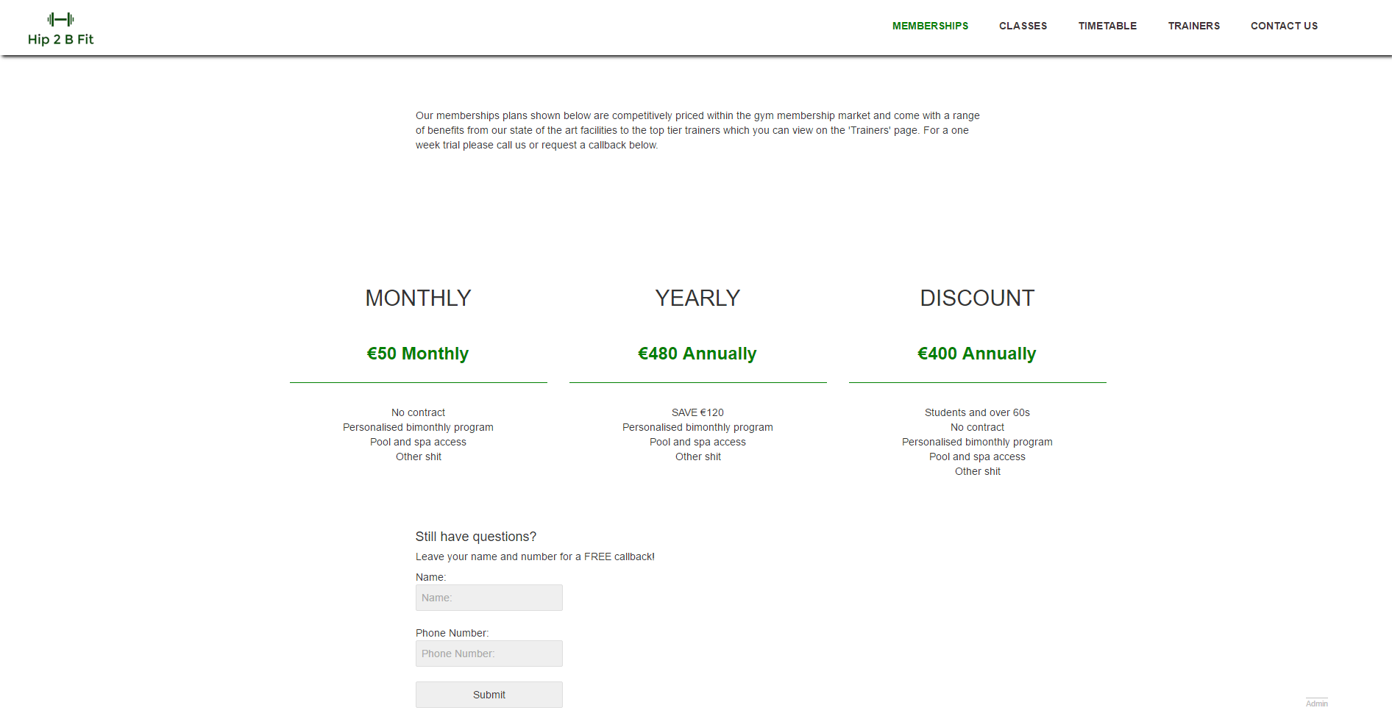
Visual Design – Membership page

Slide 4
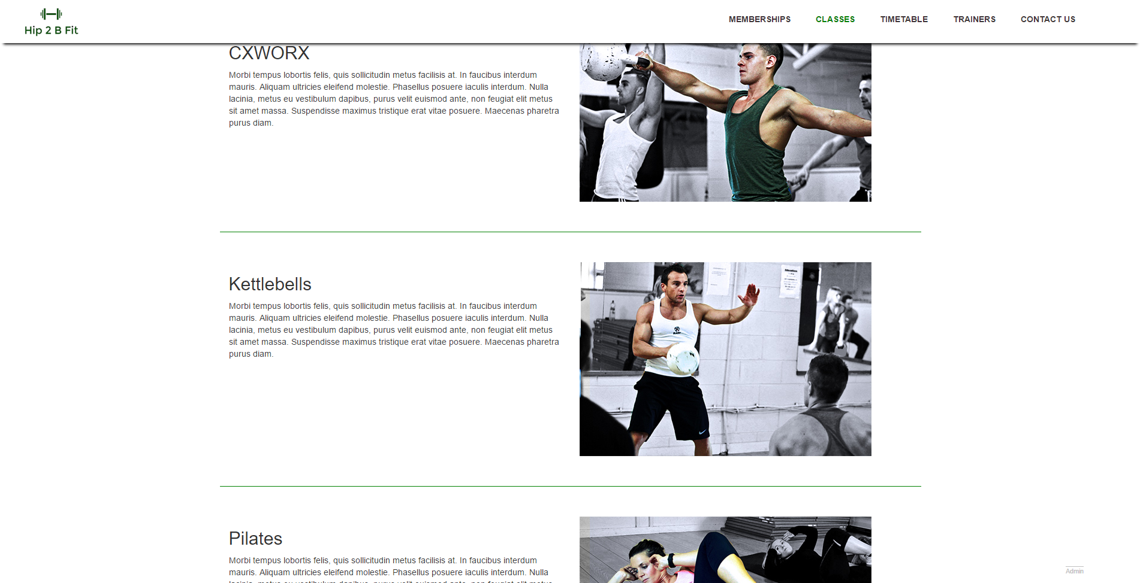
Visual Design – Classes page

Slide 5
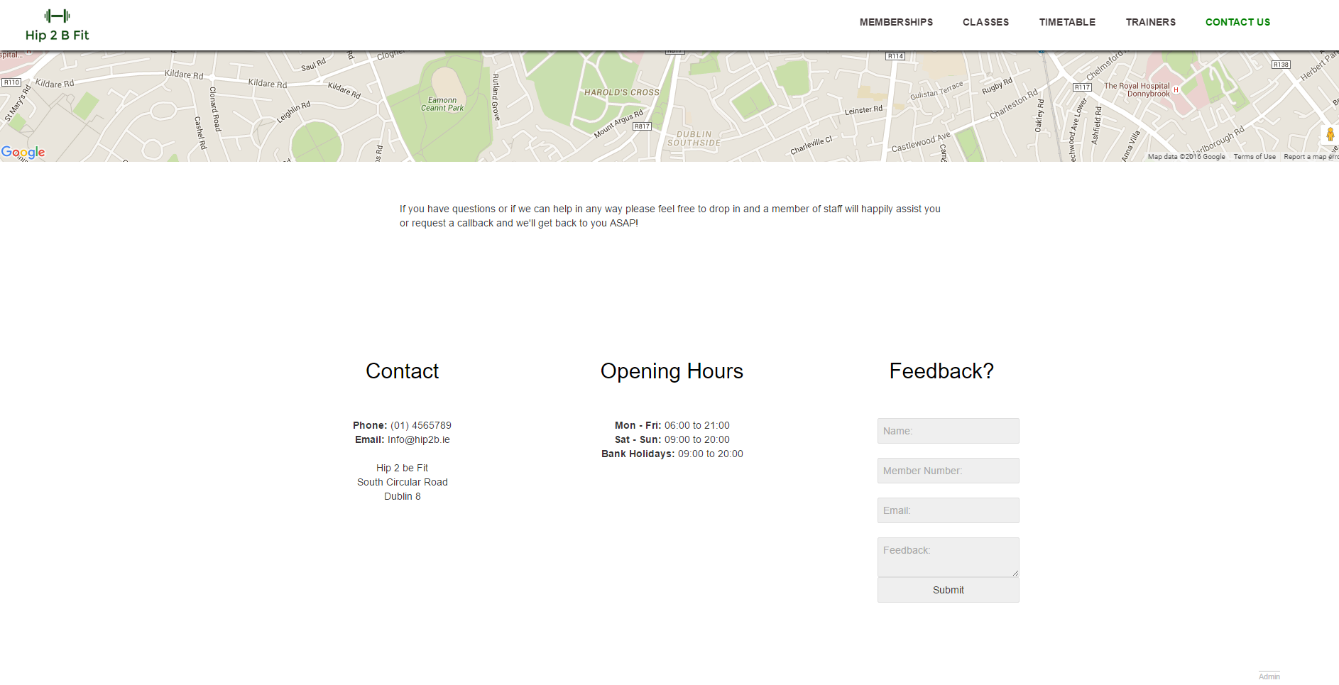
Visual Design – Feedback page

Slide 6
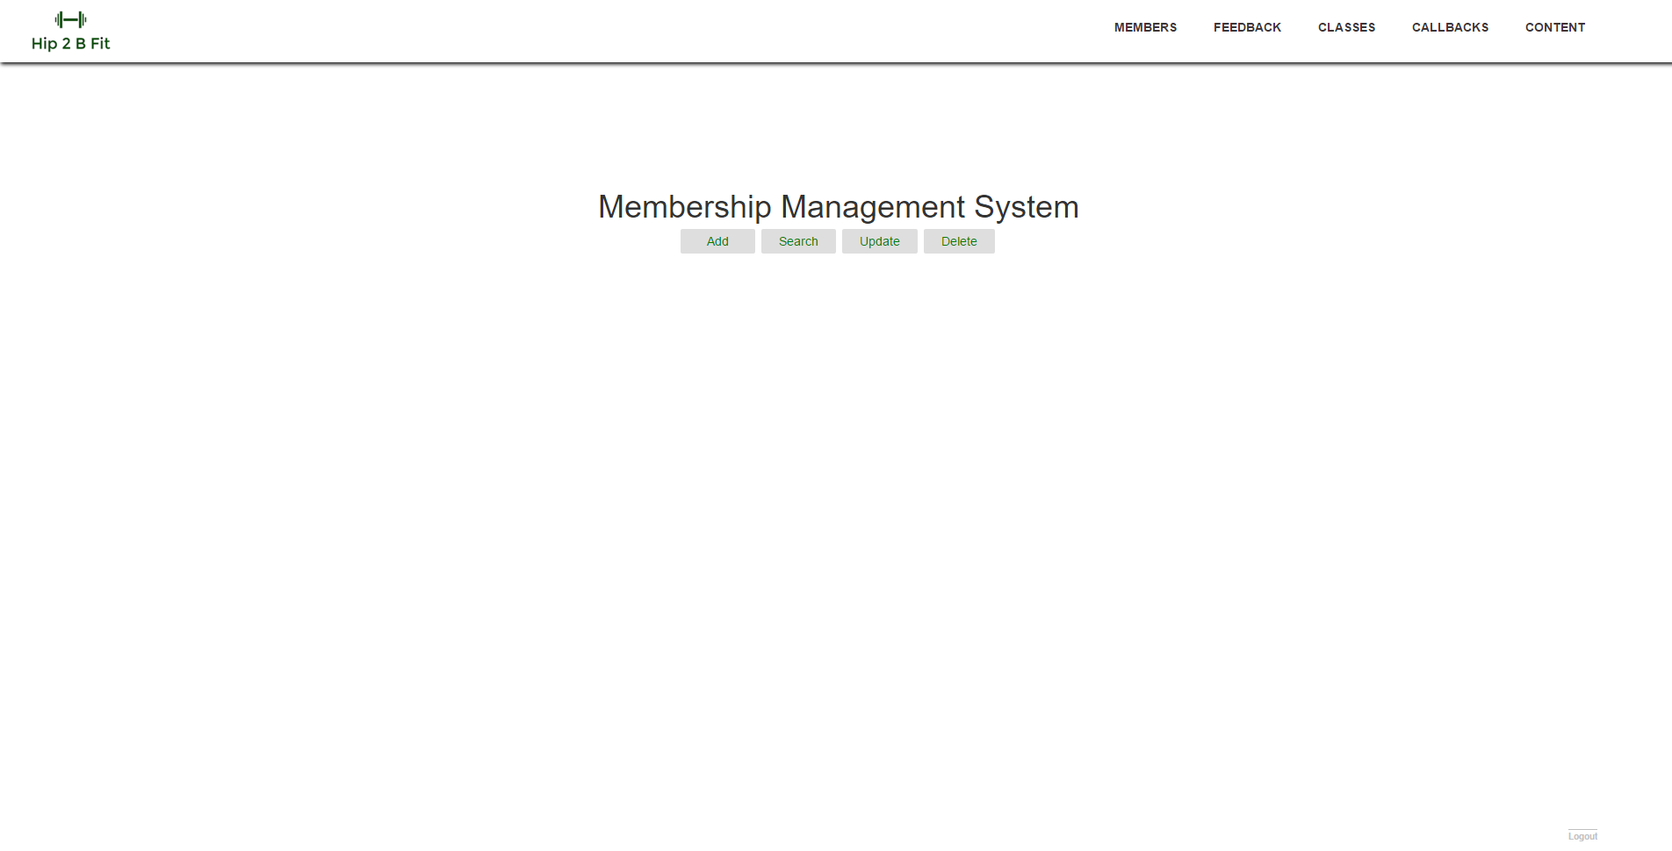
Visual Design – Administration

Slide 7
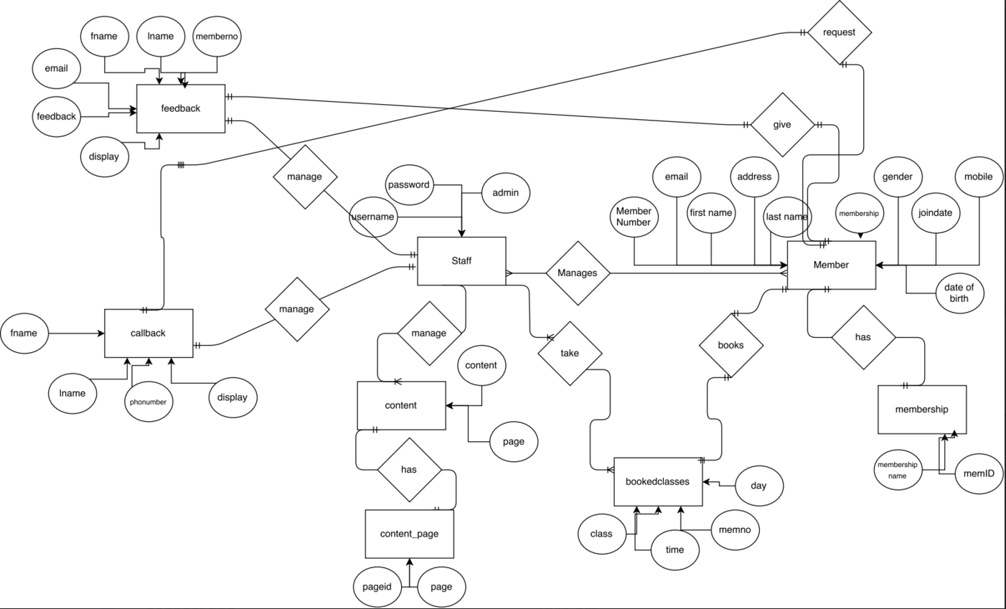
Database Design – ERD

Slide 8
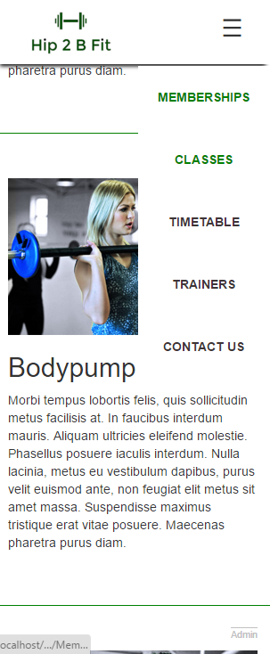
Extra Features
The whole site is responsive and mobile
Navigation becomes a dropdown menu
All images and text are responsive

Slide 9
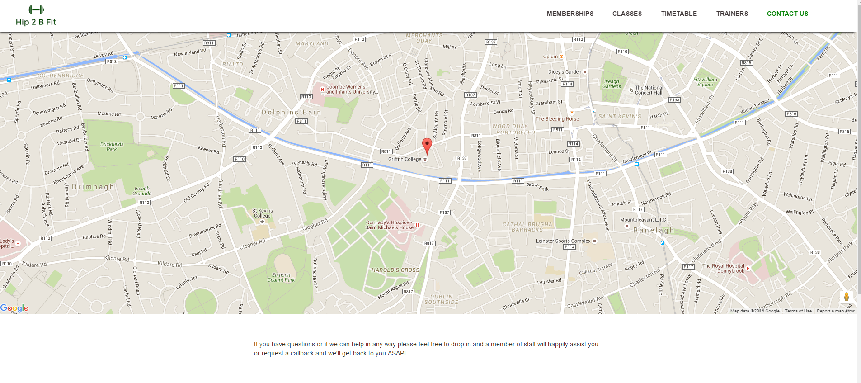
Extra Features
Google map built in

