Slide 1
IBC-grass
Individual-based community model of grasslands

Slide 2
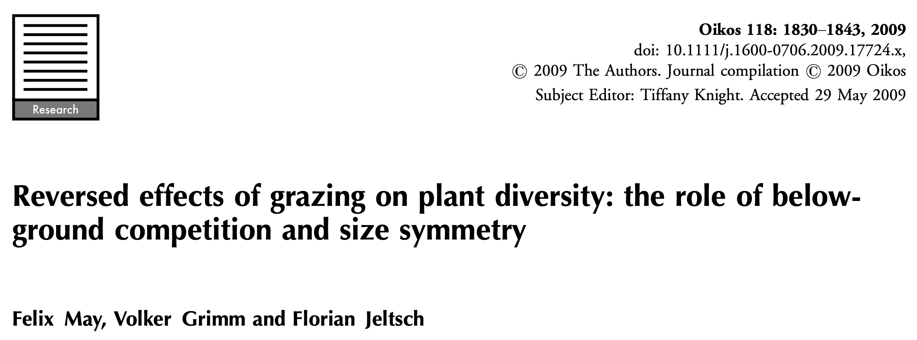
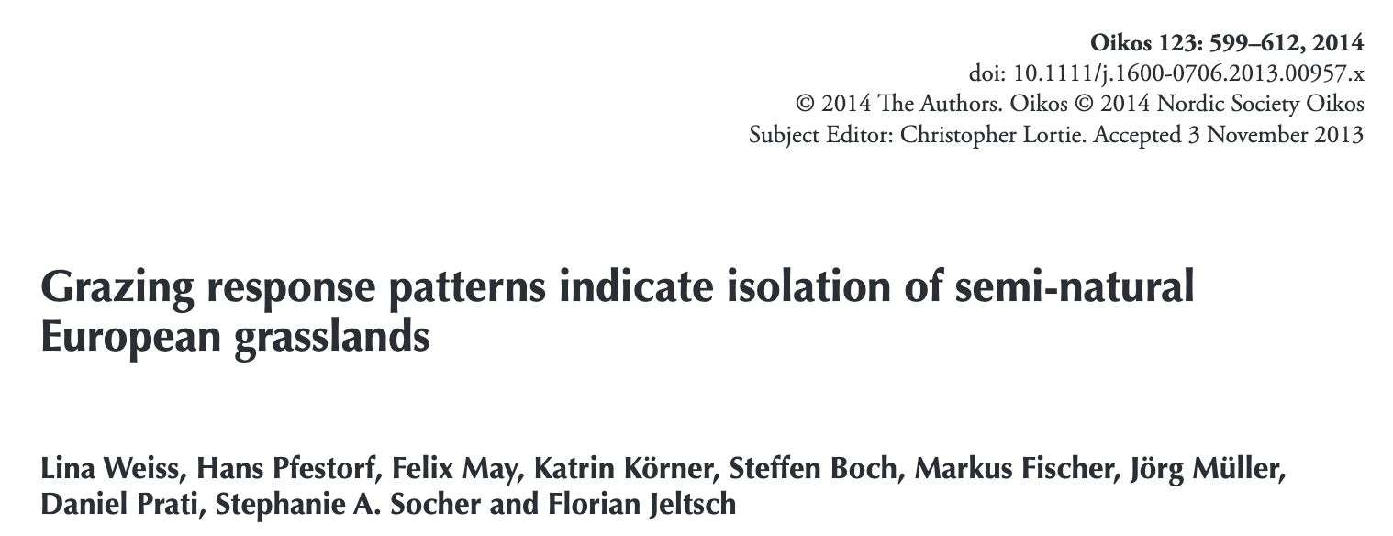
Brief history
Original model published in May et al. 2009
Tested with empirically-derived PFTs by Weiss et al. 2014
Since then, used on many topics around grassland assembly:
Herbicides
Succession after grazing abandonment
Intraspecific trait variation
Belowground herbivory
Eutrophication

Slide 3
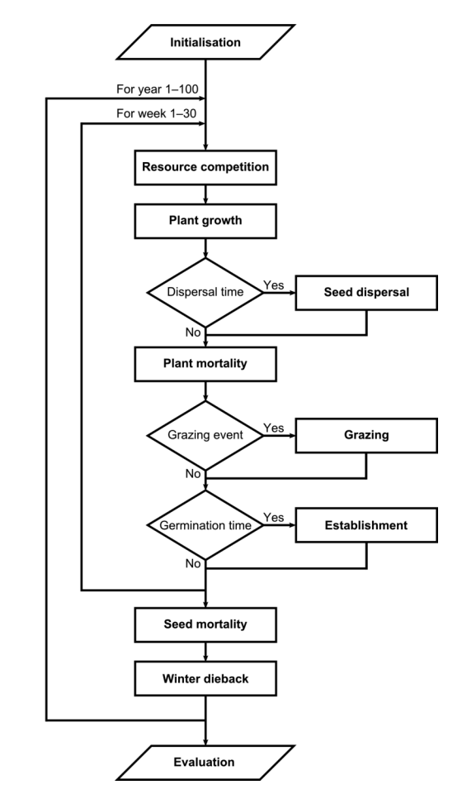
Model structure
2 sq. m. grid space
Above- and belowground compartments, cells hold resources
Plant functional types (PFTs) are defined by four traits axes (adopted from Weiher et al. 1999)
Growth form (rosette, erect)
Maximum size — seed mass
Competitive ability — stress tolerance
SLA — palatability for grazing
A plant is defined by its trait values and above- and belowground biomass
Weiher, E. et al. 1999. Challenging Theophrastus: a common core list of plant traits for functional ecology. - J. Veg. Sci. 10: 609-620.
Notes:
Shoot competition is proportional to maximal resource utilization, biomass, and growth form
Root competition is proportional to maximal resource utilization and biomass

Slide 4
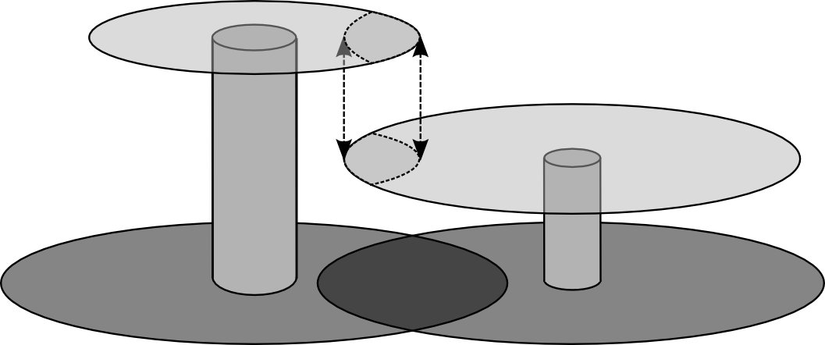
Model structure, cont.
Plant competition is modelled through a zone of influence (ZOI) approach
This premise is an extension of Weiner et al. (2001)
Two-layer ZOI
Asymmetric shoot competition
(Biomass and growth form)
Symmetric root competition
(Only biomass)
Plant growth depends on the total resources it collects
Resource uptake depends on the size of the ZOI and its competitive ability
Sigmoidal in the absence of competition
Grazing events
Palatability is correlated to SLA, erect growth form, and aboveground biomass
Many other extensions also exist
Weiner, J. et al. 2001. The effects of density, spatial pattern, and competitive symmetry on size variation in simulated plant populations. – American Naturalist 158: 438-450.
Notes:
Shoot competition is proportional to maximal resource utilization, biomass, and growth form
Root competition is proportional to maximal resource utilization and biomass

Slide 5
Coexistence mechanisms
Fitness differences emerge from the trade-offs for a given environment, and depend on resource availability/grazing
Trait trade-offs are not stabilizing
But time to exclusion will depend on the fitness differences (i.e. insufficient time for exclusion)
Long-term coexistence, however, arises through negative density dependence (phenomenological)
When a plant is surrounded by conspecifics, its competitive ability is dampened by the square root of the number of neighbors
I can run the simulation with variable exogenous resources over time (but I haven’t tested this)

Slide 6
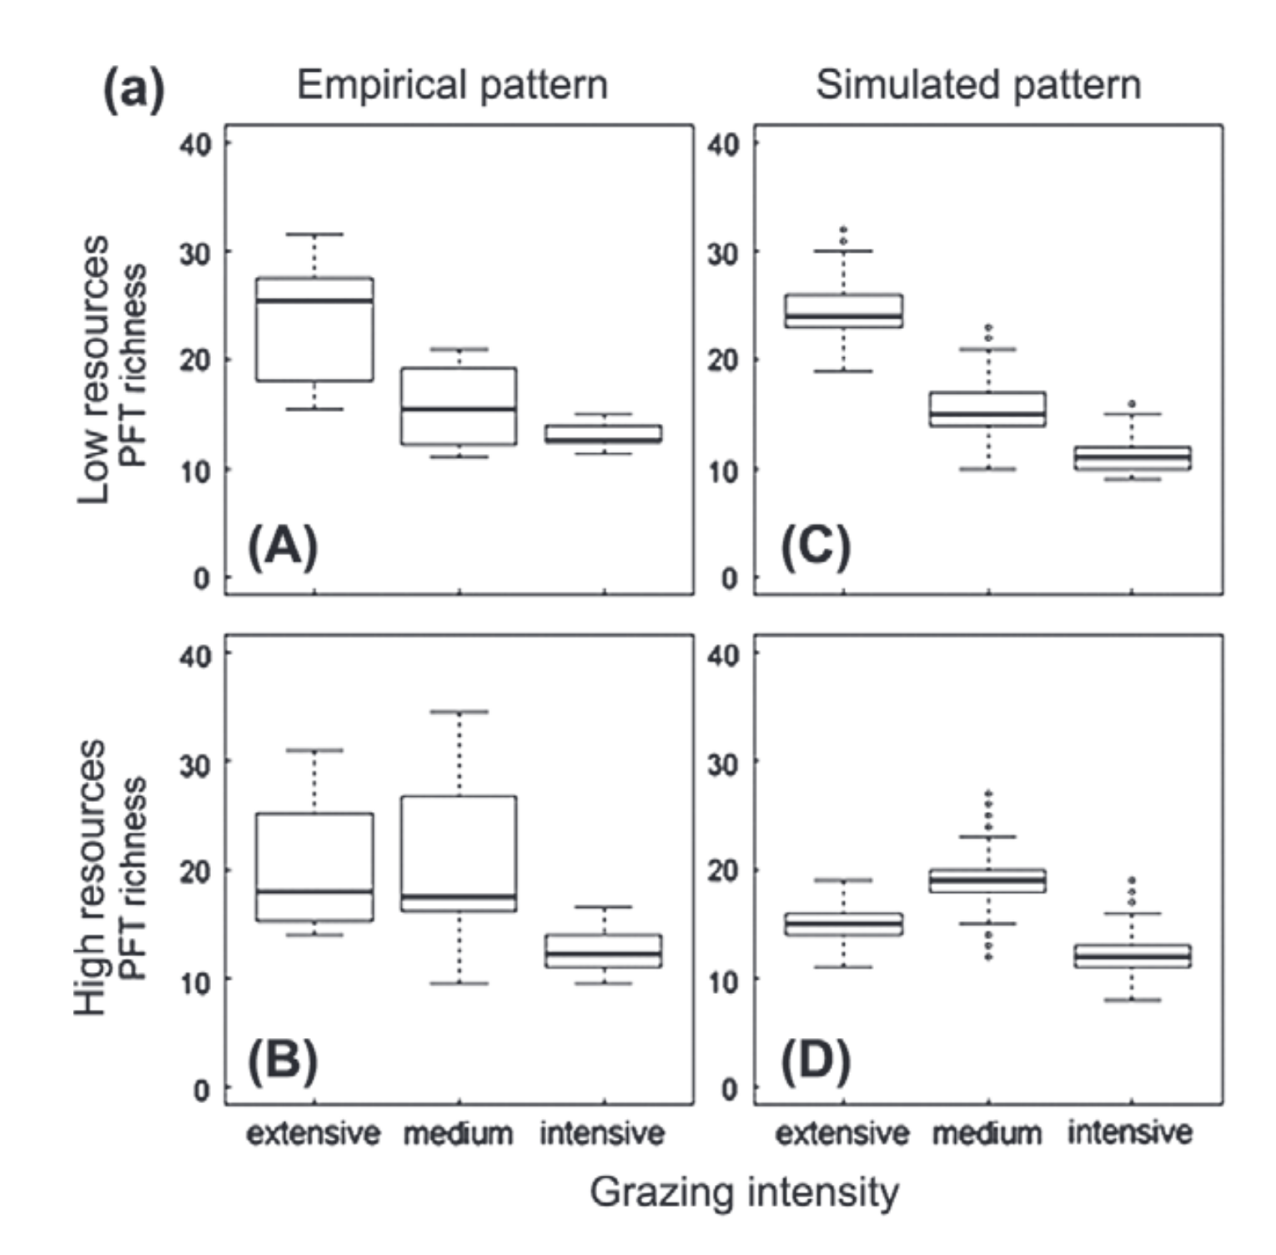
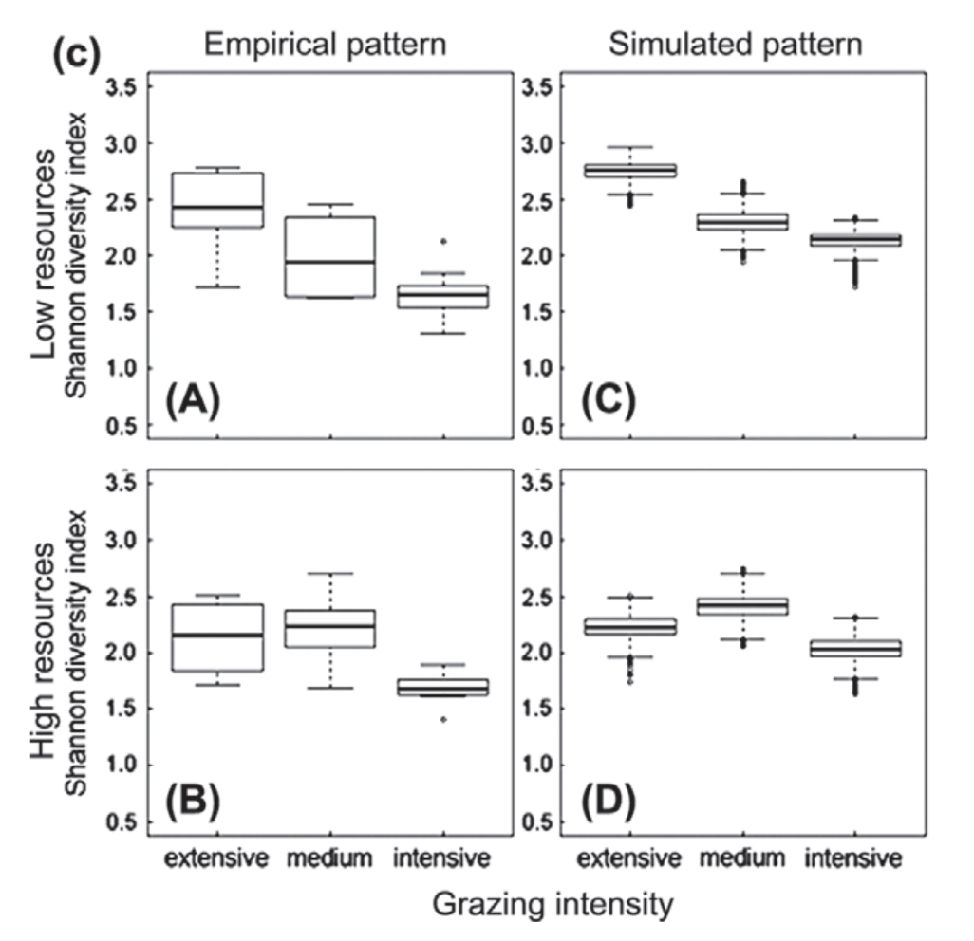
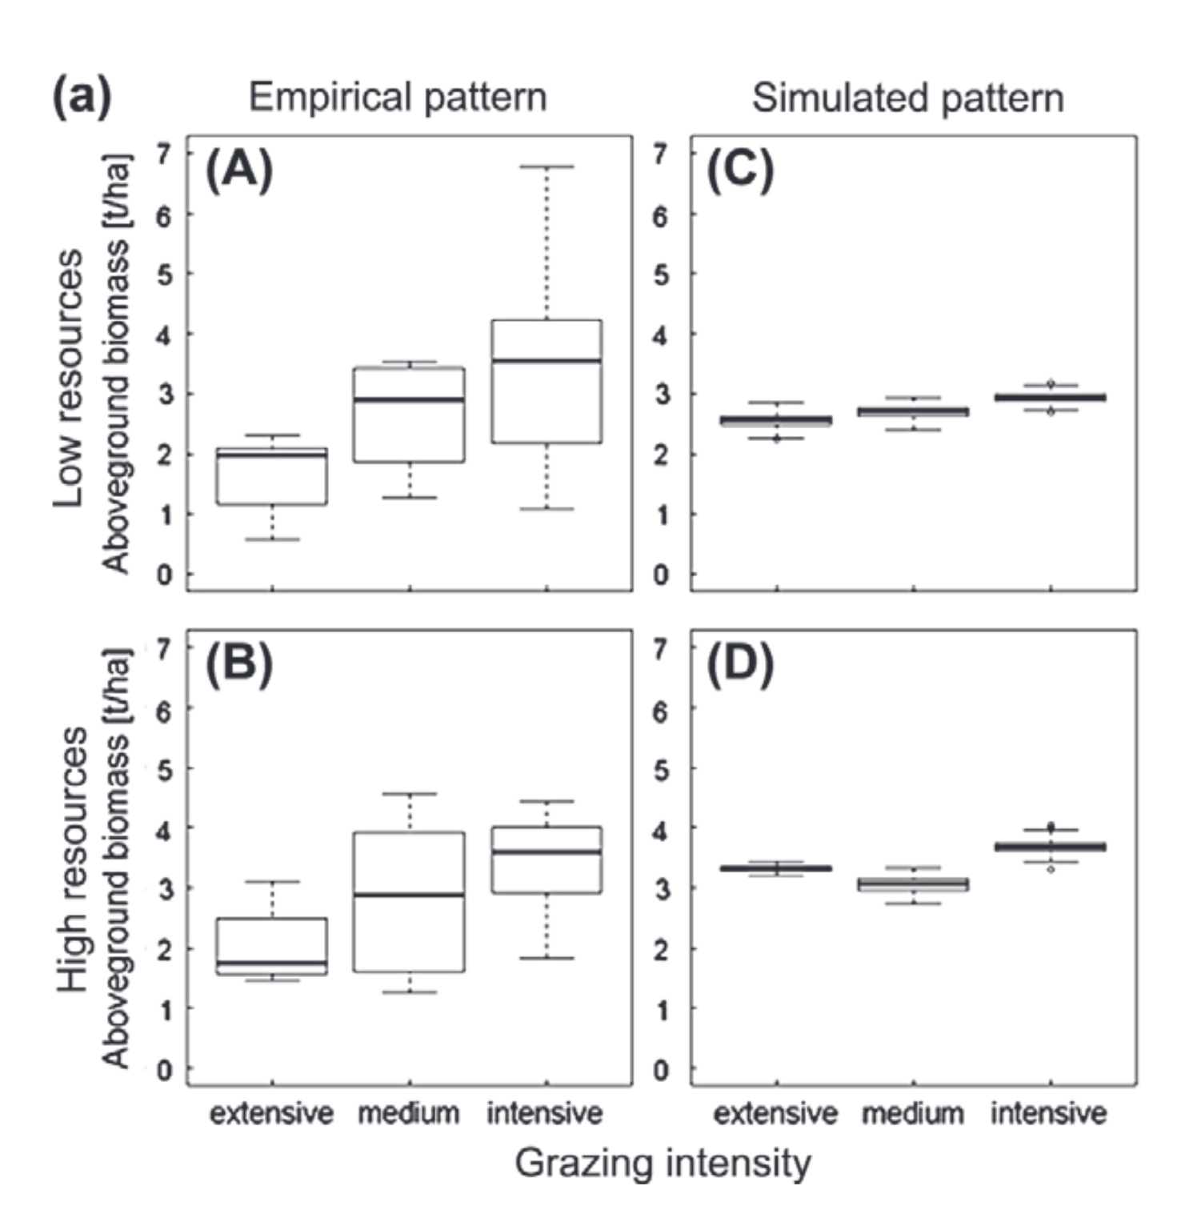
Parameterization & validation
Lina Weiss used traits from databases and classified them into PFTs (~86 grassland species)
She did not further calibrate the model
To Biodiversity Exploratories data, she compared:
Richness
Shannon diversity
Aboveground biomass
Trait composition
For traits, simulated communities corresponded in all traits or 3/4 of the traits most of the time with the real communities.
There were specific “problem spots,” however, like low resource, intensive grazing, of which 32% of the PFTs only shared two traits.

