Slide 1

DEEP REINFORCEMENT LEARNING
High-Dimensional Humanoid
Locomotion Control
using Proximal Policy Optimization (PPO)
Rida Saeed | MSCSF25M017 | M.Sc. Computer Science
PUCIT, University of the Punjab, Lahore | Supervised by: Dr. Nazar Ameen Khan
MuJoCo Humanoid-v4
15M Timesteps
12 Parallel Workers
Stable-Baselines3 + PyTorch
Notes:
Title slide. Introduce yourself, your supervisor, and the core challenge: teaching a humanoid to walk purely from reward signals.
1

Slide 2
PROJECT OVERVIEW
What We Built & Why It Matters
01
02
03
The Challenge
Our Approach
Key Outcome
Humanoid locomotion is one of the hardest problems in DRL — 17 joint DoFs, continuous torques, strict balance constraints, and no motion capture data.
PPO with parallelized VecEnv workers, observation & reward normalization, and a composite reward driving forward speed, posture, and efficiency.
After 15M timesteps on CPU, the agent learned stable, coordinated bipedal walking with natural gait patterns and consistent balance recovery.
Notes:
Explain why this problem is hard and what distinguishes this approach from naive attempts.
2

Slide 3
ENVIRONMENT
MuJoCo Humanoid-v4
17
Joint Configuration — 17 DoF Total
Body Segment
Joints
Function
Rotational DoF
Abdomen
3
Torso stabilization
376
Hips
6
Stride generation
Knees
2
Leg extension
Obs. Dimensions
Ankles
4
Foot balance
17
Shoulders
4
Arm swing
Action Dims
Elbows
2
Arm articulation
Notes:
Describe Humanoid-v4 as a physics benchmark. Emphasize the difficulty of 17 joint coordination.
3

Slide 4
REWARD FUNCTION
Shaping Intelligent Behavior
R_total = R_forward + R_healthy − C_control − C_impact
+
Forward Reward
+
Healthy Reward
Rewards positive velocity along the x-axis. Primary locomotion driver — the agent is incentivized to move forward continuously.
Survival bonus awarded every timestep the humanoid maintains a valid upright posture within predefined height bounds.
−
Control Cost
−
Impact Cost
Penalizes large actuator torques. Encourages smooth, energy-efficient motion over jittery, high-effort movements.
Penalizes large ground-contact forces. Discourages unstable footfalls and promotes gentle, stable foot placement.
Notes:
Walk through each reward component. Emphasize the balance between positive signals and cost penalties.
4

Slide 5
ALGORITHM
Proximal Policy Optimization (PPO)
Why PPO?
Hyperparameters
✓ Clipped surrogate objective prevents destructive policy updates
Learning Rate
1e-4
✓ Native support for continuous action spaces (torque control)
n_steps
1024
Batch Size
256
✓ Strong baseline on locomotion benchmarks
Epochs / Update
10
✓ Balanced exploration vs. exploitation via entropy control
Gamma (γ)
0.99
✓ Compatible with parallelized VecEnv workers
GAE Lambda (λ)
0.95
✓ Memory-efficient on CPU hardware
Clip Range (ε)
0.10
Grad Norm Max
0.50
Notes:
Explain the clipping mechanism intuitively: it limits how far the policy can change in one update.
5

Slide 6
TRAINING PIPELINE
Parallelized Training Architecture
01
Initialize VecEnv
02
VecNormalize Wrapper
03
Rollout Collection
Launch 12 parallel Humanoid-v4 workers using make_vec_env
Wrap with observation & reward normalization (clip_obs=10)
Each worker collects n_steps=1024 transitions per update cycle
04
GAE Advantage
05
PPO Update
06
Checkpoint & Eval
Generalized Advantage Estimation (λ=0.95) over all workers
10 epochs of mini-batch gradient updates with clipped objective
Save weights + VecNormalize stats; evaluate policy performance
Notes:
Explain why 12 parallel environments helps: more diverse experience per wall-clock second.
6

Slide 7
CODE
Agent.py — Training Script
Agent.py
Design Decisions
# Initialize 12 parallel environments
vectorized_system = make_vec_env(
VecNormalize
"Humanoid-v4", n_envs=12)
Stabilizes gradient flow; clip_obs=10 prevents outlier obs from dominating.
# Wrap with normalization
normalized_env = VecNormalize(
vectorized_system, norm_obs=True,
MlpPolicy
norm_reward=True, clip_obs=10.0)
Fully connected layers handle high-dimensional obs without spatial assumptions.
# Build PPO agent
agent_model = PPO(
policy="MlpPolicy",
CPU Device
env=normalized_env,
MuJoCo simulation is CPU-bound; PPO on CPU avoids GPU transfer overhead.
learning_rate=1e-4,
n_steps=1024, batch_size=256)
# Train for 15M timesteps
Checkpointing
agent_model.learn(
Saves both weights and env stats (pkl) for faithful policy reconstruction.
total_timesteps=15_000_000)
Notes:
Walk through the training script section by section. Highlight the VecNormalize and checkpoint saving.
7

Slide 8
CODE
visual.py — Evaluation & Video Recording
visual.py
Evaluation Pipeline
# Load saved normalization stats
normalized_env = VecNormalize.load(
1
Load env normalization stats (training=False)
"saved_weights/env_stats.pkl",
vectorized_env)
normalized_env.training = False
normalized_env.norm_reward = False
2
Load saved PPO model weights
# Load trained model
model = PPO.load(
"saved_weights/humanoid_policy.zip",
Run deterministic policy for 1500 steps
env=normalized_env)
3
# Simulate and capture frames
for step in range(1500):
Capture rgb_array frames each step
action, _ = model.predict(obs,
4
deterministic=True)
frame = base_env.render()
imageio.mimsave(video_path, frames, fps=30)
5
Compile frames → MP4 at 30 FPS
Notes:
Key point: training=False and norm_reward=False ensures the eval env matches training distribution without leaking reward normalization.
8

Slide 9
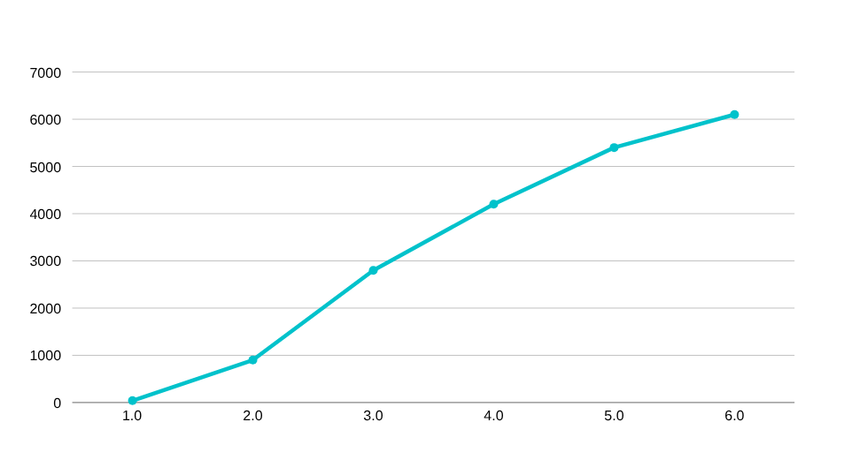
RESULTS
What the Agent Learned
15M
12×
~30s
Timesteps Trained
Parallel Workers
Stable Walk Duration
Achieved Behaviors
Reward Progression
✓ Stable upright posture maintained
✓ Continuous forward locomotion
✓ Coordinated lower-body movement
✓ Improved balance recovery
✓ Smooth, natural walking trajectory
✓ Reduced actuator effort (control cost minimized)
Notes:
Highlight the most impressive results. Mention that the agent went from random flailing to stable walking.
9

Slide 10
TECH STACK
Technologies & Frameworks
PY
MU
GY
ST
Python
MuJoCo
Gymnasium
Stable-Baselines3
Core language
Physics engine
Environment API
RL algorithms
PY
NU
TE
IM
PyTorch
NumPy
TensorBoard
imageio
Neural networks
Numerics
Visualization
Video export
Notes:
Briefly describe the role of each technology. Emphasize that all components are open-source.
10

Slide 11
CONCLUSION
Key Takeaways
PPO is Effective
Parallelization Matters
Proximal Policy Optimization reliably solves high-dimensional continuous control — stable updates and strong sample efficiency make it ideal for humanoid locomotion.
12 parallel workers dramatically reduce wall-clock training time by diversifying experience collection and improving batch quality.
Normalization is Critical
Reward Shaping Works
VecNormalize stabilizes training by preventing large observation or reward values from destabilizing gradient updates.
Composite rewards balancing speed, health, and efficiency guide the agent naturally toward stable, coordinated walking behavior.
Notes:
Summarize the project outcome and what you would explore next: curriculum learning, sim-to-real, SAC comparison.
11

Slide 12
Thank You
Questions & Discussion
Rida Saeed · MSCSF25M017
M.Sc. Computer Science · PUCIT, University of the Punjab, Lahore
Supervised by Dr. Nazar Ameen Khan · Assistant Professor, PUCIT
GitHub: github.com/<MSCSF25M017-Rida Saeed>/<https://github.com/mscsf25m017-web/High-Dimensional-Humanoid-Locomotion-control-using-PPO>
Notes:
12

