Slide 1

Why node.js ?
“Node's goal is to provide an easy way to build scalable Network programs”

Slide 2
About Node.js……
• Created by Ryan Dahl in 2009
• Development && maintenance sponsored by Joyent
• Licence MIT
• Last release : 0.10.31
• Based on Google V8 Engine
• +99 000 packages

Slide 3
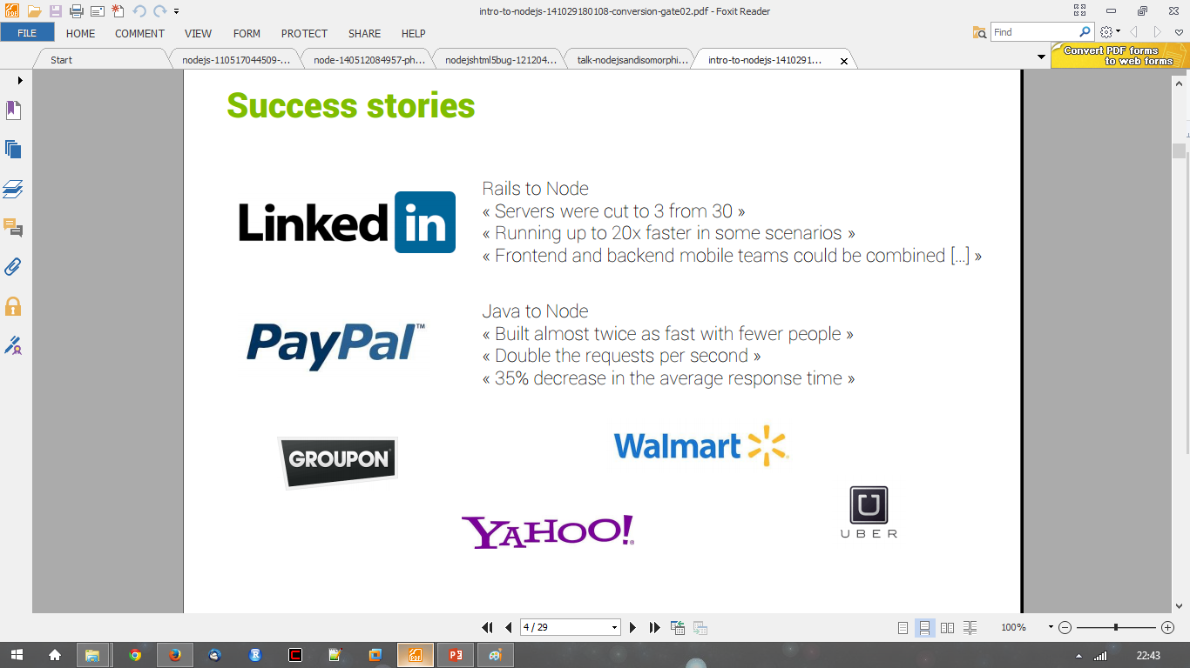
Success Stories…..

Slide 4
Node.js is not……
● Another Web framework
● For beginner
● Multi-thread

Slide 5
Development for the Web….
Traditional desktop applications have a user interface wired up with background logic
  user interfaces are based on Windows Forms, Jswing, WPF, Gtk, Qt, etc. and dependant on operating system
On the web user interfaces are standardized
  HTML for markup
  CSS for style
  JavaScript for dynamic content
In the past proprietary technologies existed on the web, e.g. Adobe Flash, ActiveX
  They are slowly dying
Data is generated on the server, transferred to the client and displayed by the browser
Server Side technologies include PHP, JSP, ASP.net, Rails, Djanog, and yes, also node.js

Slide 6
REST……
● REST = REpresentational State Transfer
● Not new technology
● Architectural style for client-server

Slide 7
Goals of REST……..
● General interface
● Scalability of component interface
● Reduce latency
● Encapsulate legacy system

Slide 8
HTTP Method……
● GET
● POST
● PUT
● DELETE

Slide 9
HTTP Method with CRUD…..
● POST => Create
● GET => Read
● PUT => Update
● DELETE => Delete

Slide 10
Why node.js ?
● Non Blocking I/O
● V8 Javascript Engine
● Single Thread with Event Loop
● 40,025 modules
● Windows, Linux, Mac
● 1 Language for Frontend and Backend
● Active community

Slide 11
What is node.js?
« A platform built on Chrome's JavaScript runtime for easily building fast, scalable network applications. » http://nodejs.org/
Asynchronous i/o framework
Core in c++ on top of v8
Rest of it in javascript
Swiss army knife for network Related stuffs
Can handle thousands of Concurrent connections with Minimal overhead (cpu/memory) on a single process
It’s NOT a web framework, and it’s also NOT a language

Slide 12
Why javascript ?!!!
Friendly callbacks
Ubiquitous
No I/o Primitives
One language to RULE them all
JavaScript is well known for client-side scripts running inside the browser
node.js is JavaScript running on the server-side
SSJS -> Server-Side JavaScript
  Use a language you know
  Use the same language for client side and server side

Slide 13
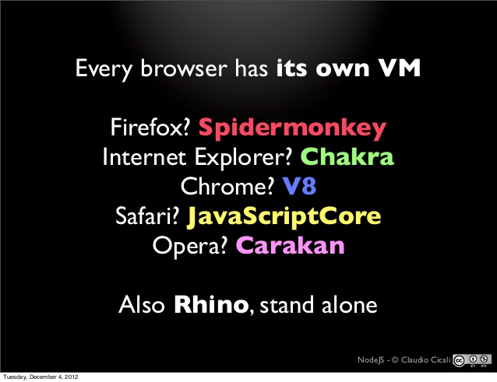
JavaScript Engines……

Slide 14
The idea behind node.js….
  Perform asynchronous processing on single thread instead of classical multithread processing, minimize overhead & latency, maximize scalability
  Scale horizontally instead of vertically
  Ideal for applications that serve a lot of requests but dont use/need lots of computational power per request
  Not so ideal for heavy calculations, e.g. massive parallel computing
  Also: Less problems with concurrency

Slide 15
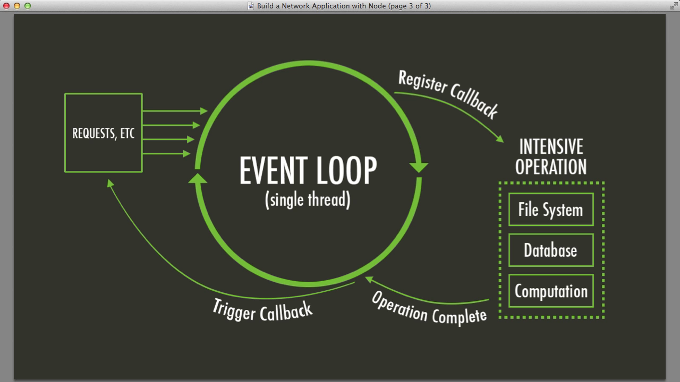
Node.js Event Loop
There are a couple of implications of this apparently very simple and basic model
  Avoid synchronous code at all costs because it blocks the event loop
  Which means: callbacks, callbacks, and more callbacks

Slide 16
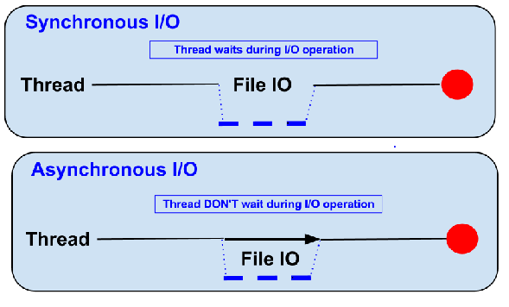
Blocking vs Non-Blocking……
Example :: Read data from file and show data

Slide 17
Blocking…..
● Read data from file
● Show data
● Do other tasks
var data = fs.readFileSync( “test.txt” );
console.log( data );
console.log( “Do other tasks” );

Slide 18
Non-Blocking……
Callback
● Read data from file
When read data completed, show data
● Do other tasks
fs.readFile( “test.txt”, function( err, data ) {
console.log(data);
});

Slide 19
When to use it ?
• Chat/Messaging
• Real-time Applications
• Intelligent Proxies
• High Concurrency Applications
• Communication Hubs
• Coordinators

Slide 20
Node.js for….
● Web application
● Websocket server
● Ad server
● Proxy server
● Streaming server
● Fast file upload client
● Any Real-time data apps
● Anything with high I/O

Slide 21
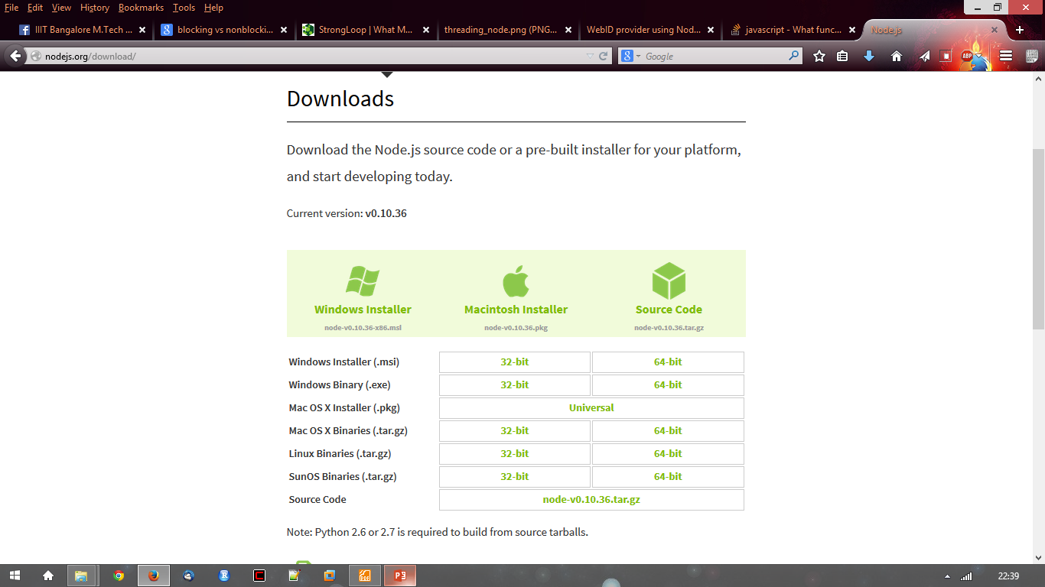
Getting Started…..
http://nodejs.org/ and Download tar.gz
Extract to any directory
$ ./configure && make install

Slide 22
File package.json…..
Project informations
• Name
• Version
• Dependencies
• Licence
• Main file
Etc...

Slide 23
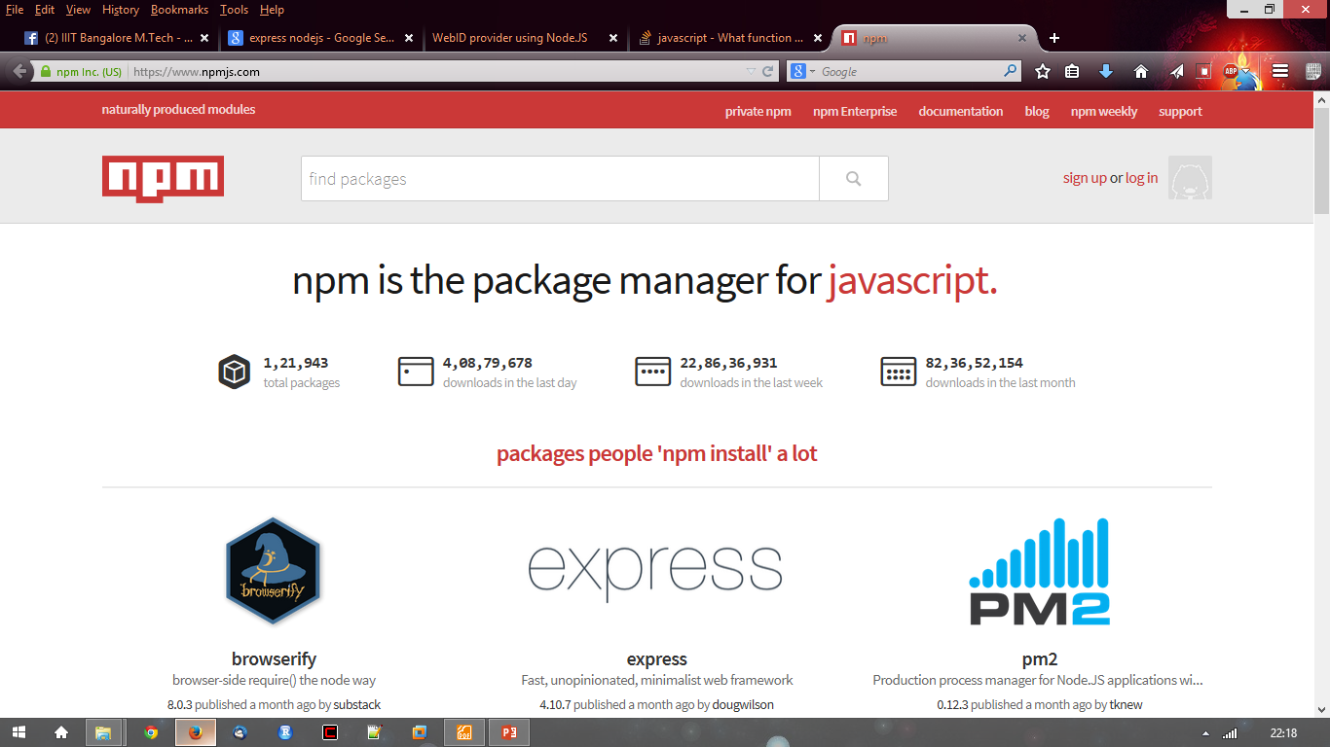
Node.js Modules…..
● https://npmjs.org/
● # of modules = 1,21,943

Slide 24
Install module…..
$npm install <module name>

Slide 25
Using module…..
var http = require(‘http’);
var fs = require(‘fs’);
var express = require(‘express’);

Slide 26
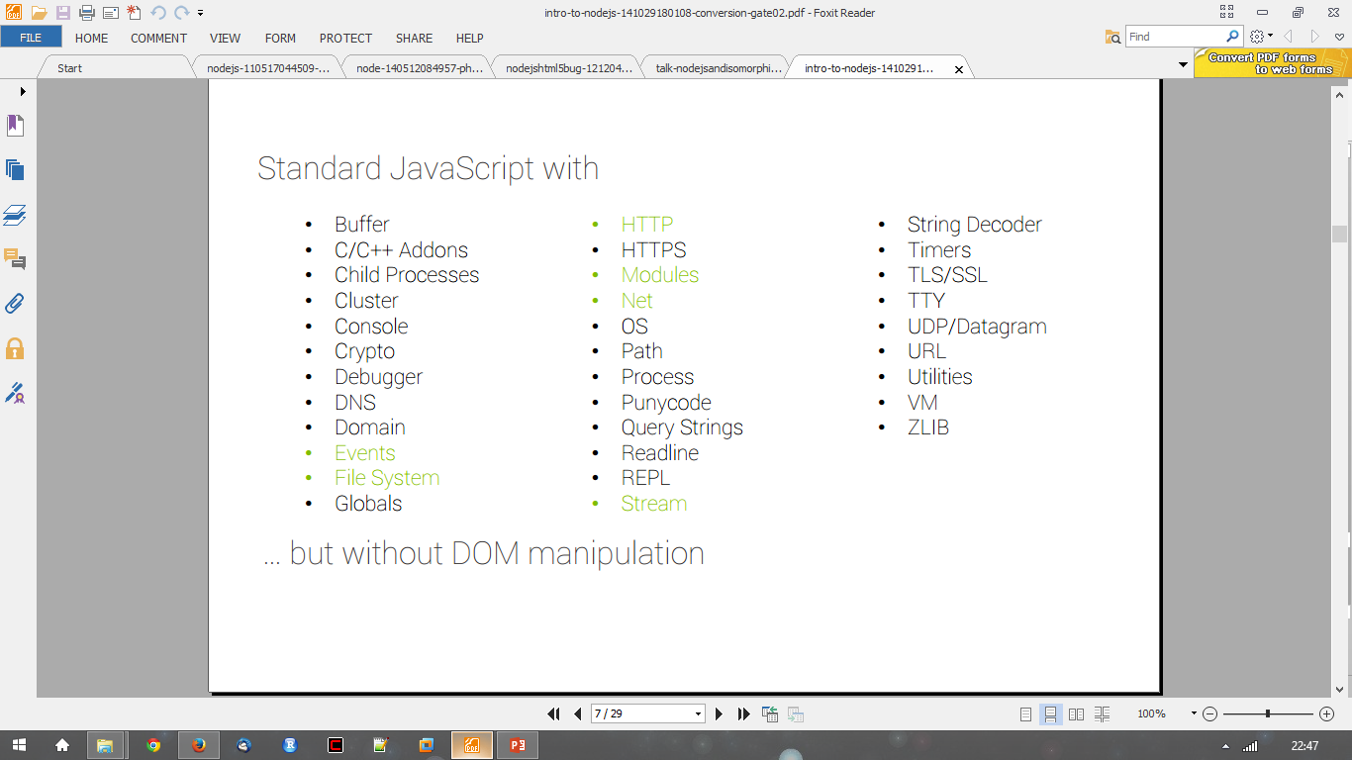
In NodeJS

