Slide 1
CUSTOMER CHURN PREDICTION
Predicting and Preventing Customer Loss with Machine Learning
Data science Project • Done By : Solomon Moses

Slide 2
Project Objectives
1
Understand the Data
Explore the Telco customer base and identify which attributes relate to churn.
2
Clean & Prepare
Handle missing values, type issues, and encode features without leaking the target.
3
Test & Select Features
Use statistical testing to keep only features that matter.
4
Build & Compare Models
Train five classifiers and evaluate them on consistent, fair metrics.
5
Deploy & Recommend
Ship the best model as an interactive tool and recommend retention action.
2

Slide 3
The Dataset
7,043
21
26.5%
5
Customers
Features used
Churn rate
Models compared
Source: IBM Telco Customer Churn dataset (extended, 33 raw columns)
Removed before modeling: geographic fields (constant or overly granular), and Churn Score / CLTV / Churn Reason / Churn Label — all derived from or duplicating the churn outcome itself, which would leak the answer into the model.
Remaining features cover demographics, account details (tenure, contract, billing), and subscribed services (phone, internet, streaming, security add-ons).
3

Slide 4
Data Cleaning
Total Charges type fix
11 blank entries coerced to numeric and filled with 0 — all were brand-new customers with 0 months tenure, so this is correct, not missing data.
Duplicate check
Verified CustomerID uniqueness — zero duplicate records found.
Categorical consistency
Stripped whitespace and confirmed every categorical column's values were clean, with no typos or stray characters.
Missing values
No further missing values remained after the Total Charges fix.
4

Slide 5
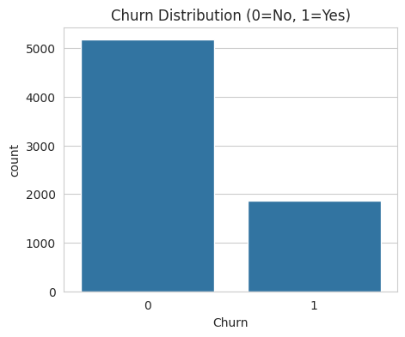
Who's Churning?
26.5% of customers churned
A moderately imbalanced target — meaning accuracy alone is a misleading metric, and recall/precision matter more when judging models.
Strongest numeric signal: Tenure
Correlation with churn: -0.35. Customers who stay longer are steadily less likely to leave — loyalty compounds.
5

Slide 6
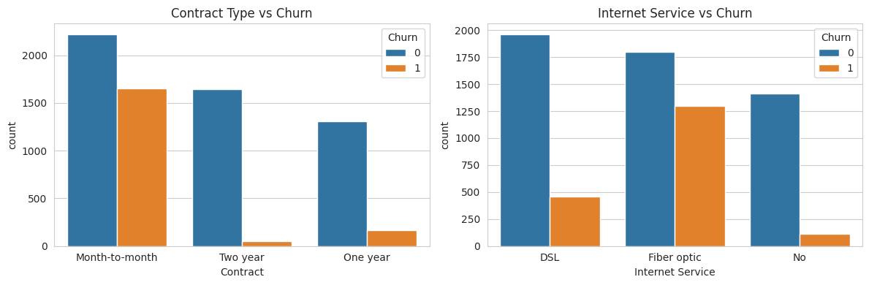
Key Churn Drivers: Contract & Internet
Month-to-month customers and Fiber optic subscribers churn at far higher rates — likely reflecting lower switching costs and higher price points respectively.
6

Slide 7
Statistical Significance Testing
Chi-Square tests of independence were run for every categorical feature against Churn (H₀: feature is independent of churn; reject if p < 0.05).
Feature | Chi² | p-value | Result
Contract | 1184.60 | <0.0001 | Significant
Online Security | 850.00 | <0.0001 | Significant
Tech Support | 828.20 | <0.0001 | Significant
Internet Service | 732.31 | <0.0001 | Significant
Payment Method | 648.14 | <0.0001 | Significant
Gender | 0.48 | 0.4866 | Not significant
Phone Service | 0.92 | 0.3388 | Not significant
Gender and Phone Service were dropped from modeling — statistically no relationship to churn.
7

Slide 8
Feature Selection & Preparation
1
Train/test split first
80/20 stratified split performed BEFORE any encoding or scaling, to prevent test-set information leaking into preprocessing.
2
One-hot encoding
Multi-category fields encoded with drop_first=True; test set columns aligned to train set columns.
3
Binary mapping
Yes/No and Male/Female fields mapped directly to 0/1.
4
Drop insignificant features
Gender and Phone Service removed per Chi-Square results, leaving 28 encoded predictors.
8

Slide 9
Model Comparison
9

Slide 10
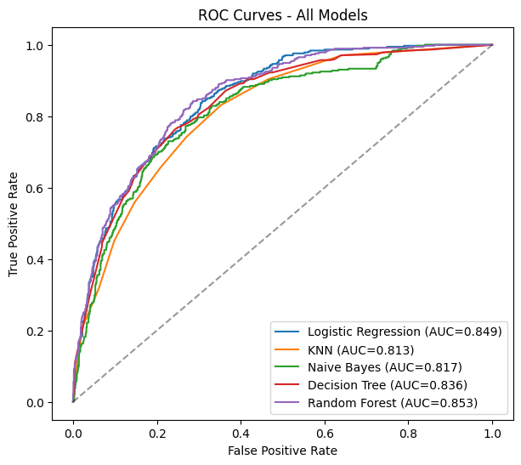
Best Model: Random Forest
ROC-AUC: 0.853
Highest of all five models tested.
Accuracy
80.8%
Precision
68.4%
Recall
51.6%
F1-score
58.8%
Trade-off worth noting: Naive Bayes achieves 85% recall (best at catching actual churners) despite lower overall accuracy — a candidate if minimizing missed churners matters more than precision.
10

Slide 11
Deployment: Streamlit App
📉
Takes raw, human-readable inputs (contract type, services, charges)
Customer Churn Predictor
Reproduces the exact training-time encoding pipeline internally
Interactive web app — enter a customer profile, get an instant churn probability and risk band.
Outputs churn probability, prediction, and a risk-based recommendation
Built with Streamlit; deployable to Streamlit Community Cloud
11

Slide 12
Recommendations & Conclusion
Target month-to-month customers
Offer incentives to shift them onto annual contracts, which show much lower churn.
Watch new & fiber customers closely
Early tenure and Fiber optic service are the highest-risk segments — early intervention pays off most.
Promote add-on services
Online Security and Tech Support subscribers churn far less; bundling them may improve retention.
Operationalize the model
Score the active customer base weekly with the Streamlit app to flag at-risk accounts for outreach.
12

