Slide 1

Covid-19 Daily Statistics Dashboard
Matthew Decaro, Rice University
March 16, 2022

Slide 2
Covid-19 Dataset
• Data collected by 'Our World in Data' (owid).
• Scraped from several sources:
• Specialized institutions (WHO, JHU, ...)
• International agencies (UN, World Bank, ...)
• Government sources (US Department of Health & Human Services)
• >150K rows of data, updated daily.
• Confirmed Covid cases, deaths, vaccinations and more for >200 countries.
1

Slide 3
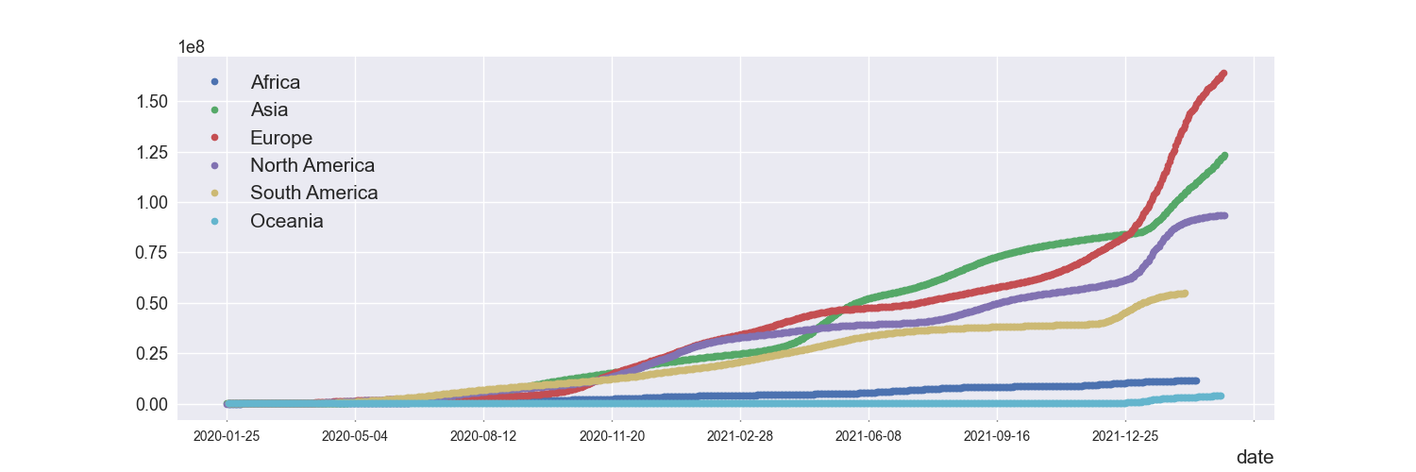
Total Covid-19 Cases by Continent
2

Slide 4
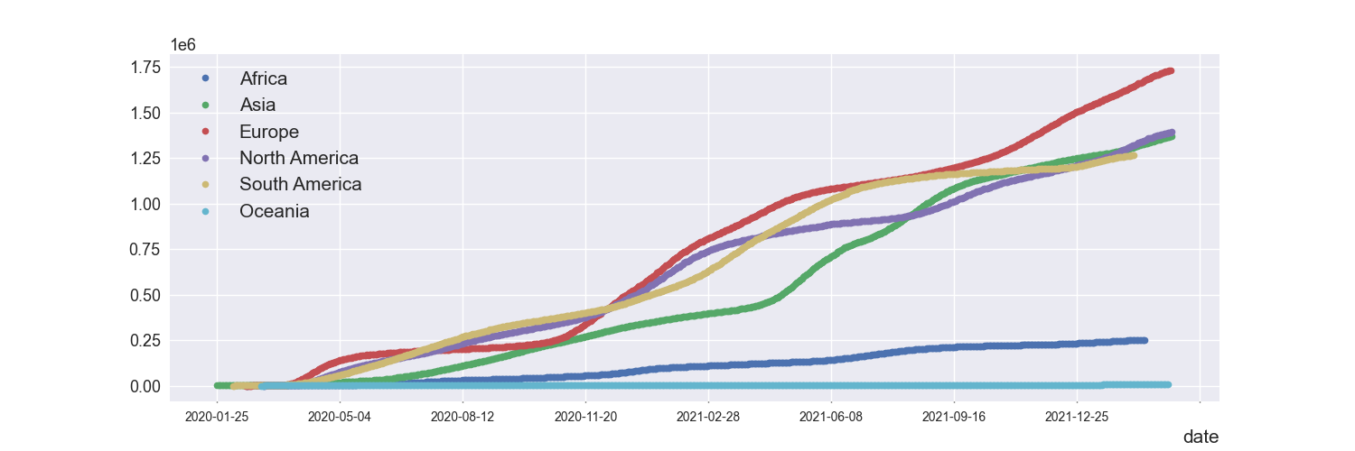
Total Covid-19 Deaths by Continent
3

Slide 5
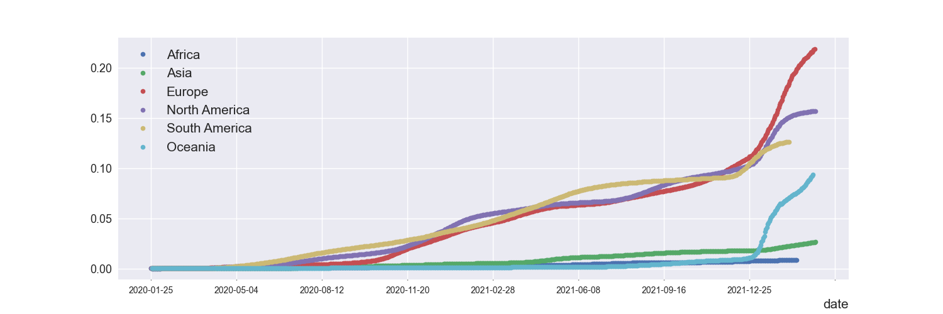
Covid-19 cases per capita per continent
4

Slide 6
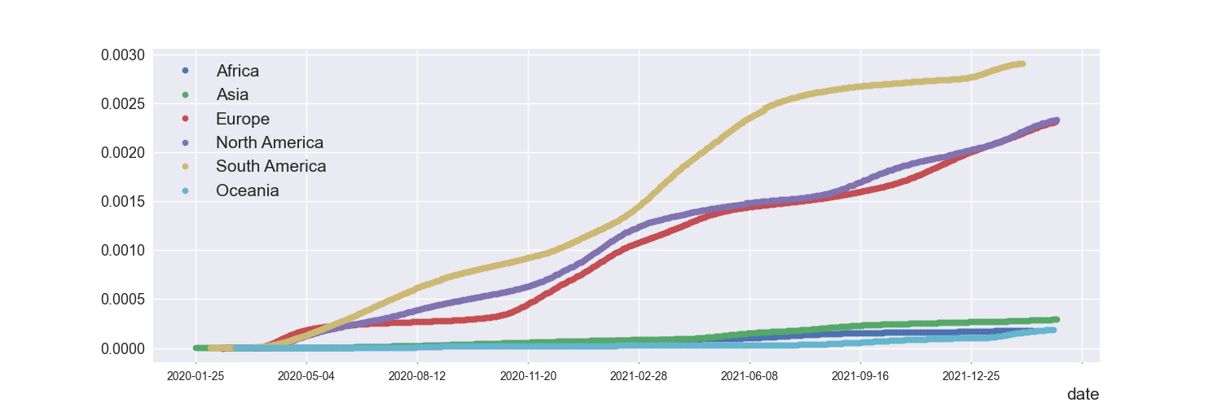
Covid-19 deaths per capita per continent
5

Slide 7
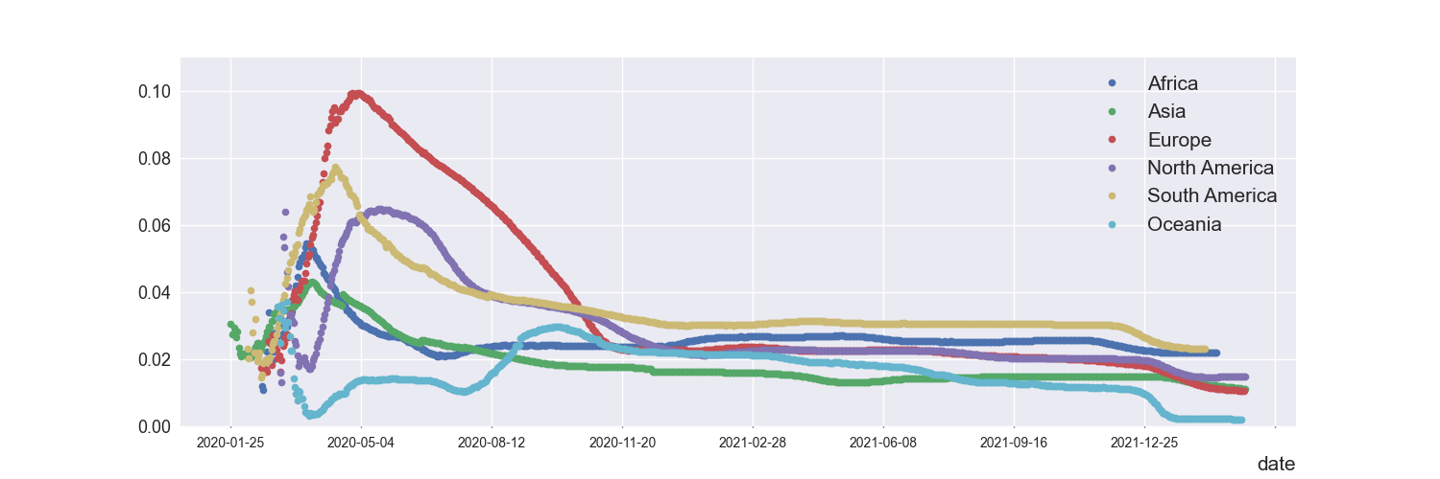
Total Covid-19 Deaths/Cases per continent
6

Slide 8
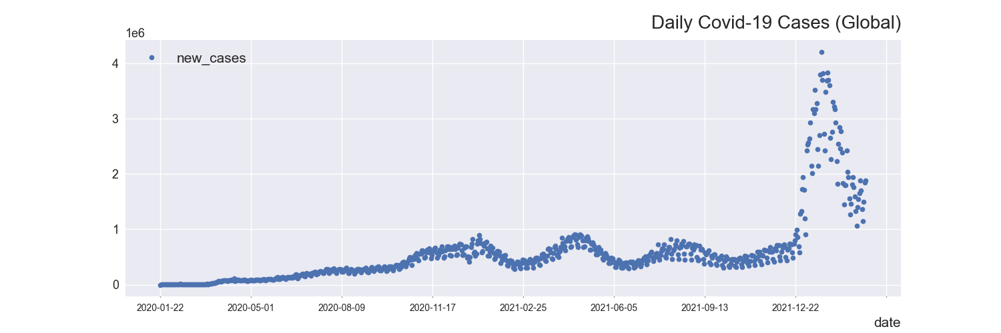
Daily Global Covid-19 Cases
7

Slide 9
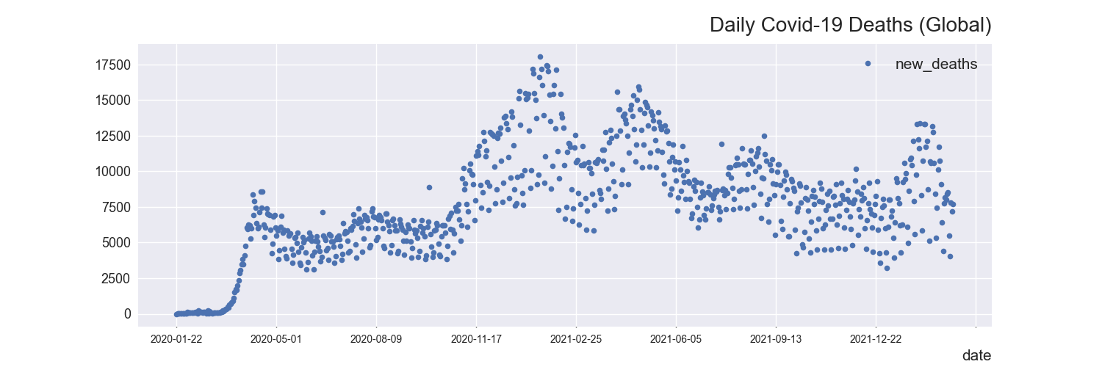
Daily Global Covid-19 Deaths
8

Slide 10
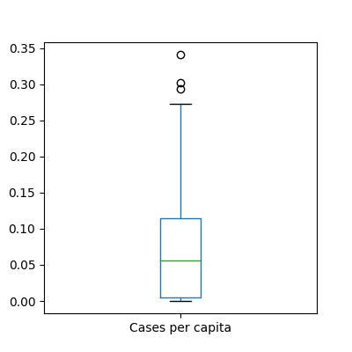
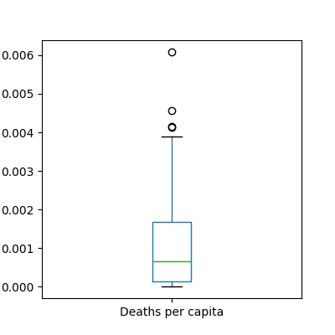
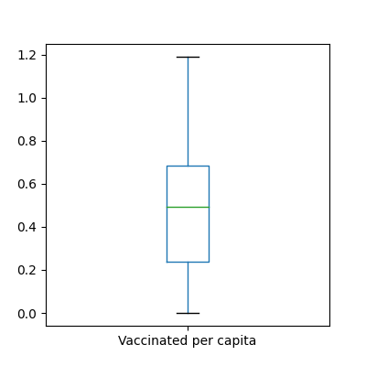
Cases, Deaths, and Vaccinations per capita per country
9

Slide 11
Daily Covid-19 Cases by Continent
(Africa, Asia, Europe, North America, South America, Oceania)
10

Slide 12
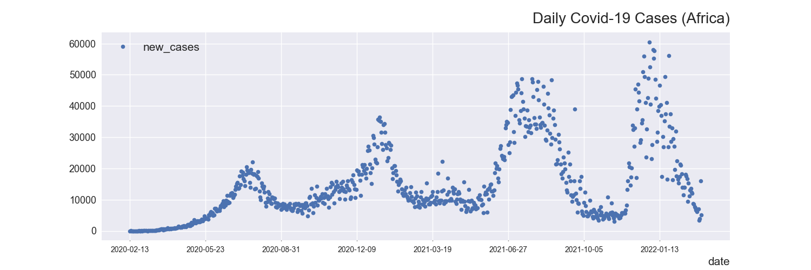
Daily Covid-19 Cases in Africa
11

Slide 13
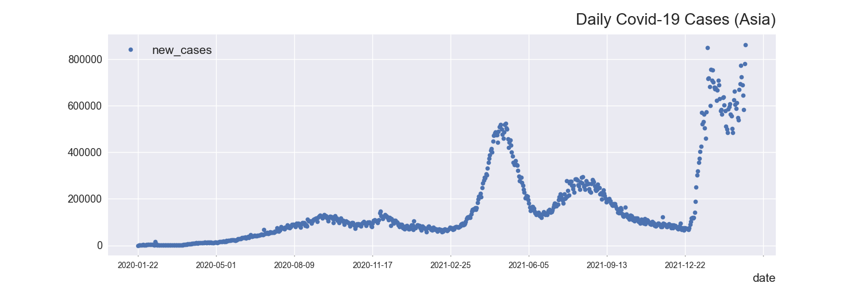
Daily Covid-19 Cases in Asia
12

Slide 14
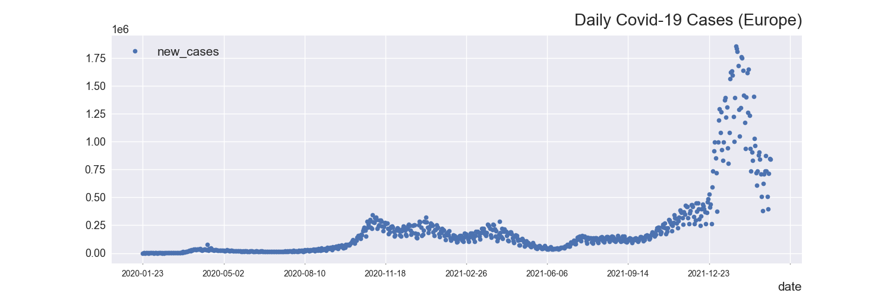
Daily Covid-19 Cases in Europe
13

Slide 15
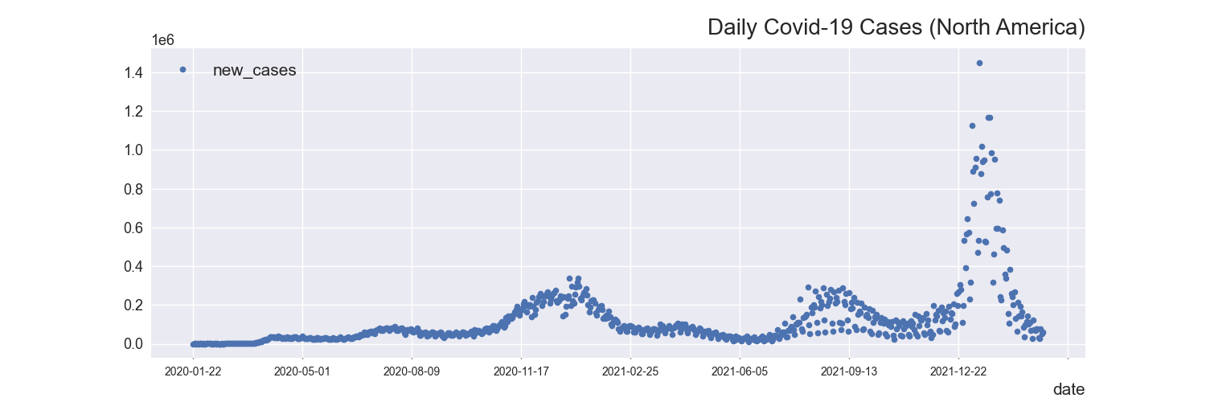
Daily Covid-19 Cases in North America
14

Slide 16
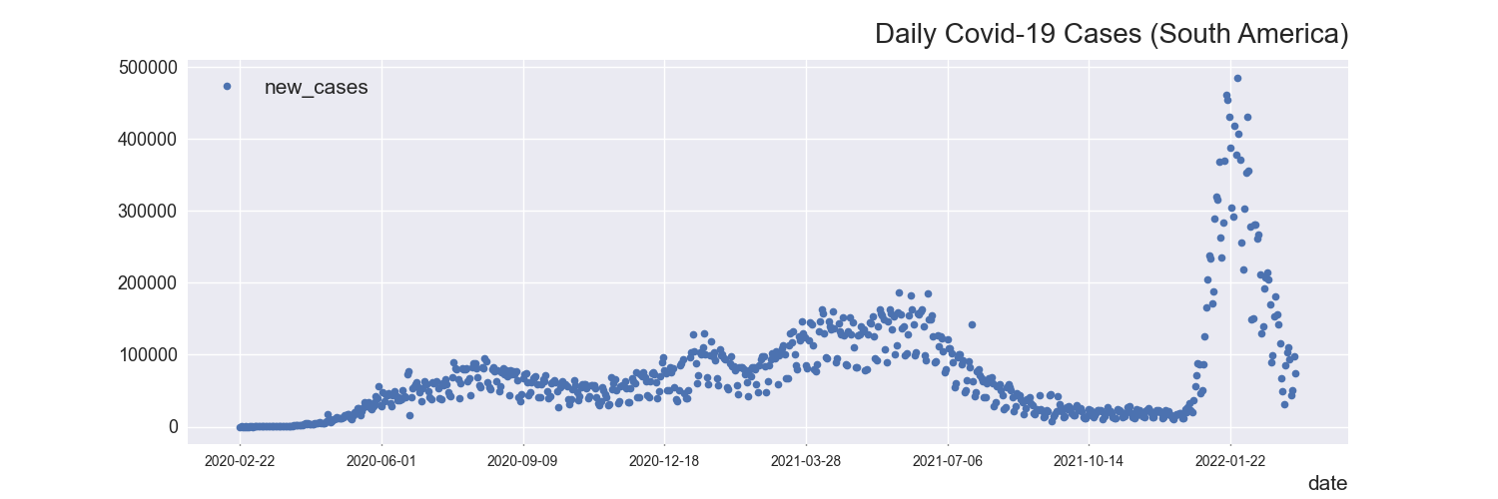
Daily Covid-19 Cases in South America
15

Slide 17
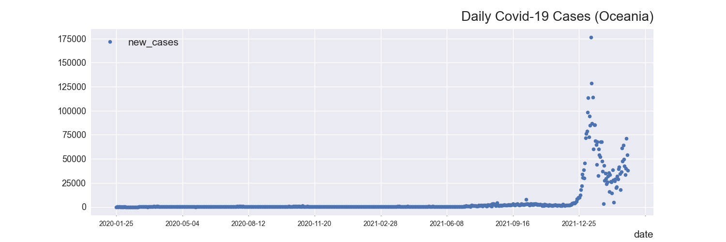
Daily Covid-19 Cases in Oceania
16

Slide 18
Daily Covid-19 Deaths by Continent
(Africa, Asia, Europe, North America, South America, Oceania)
17

Slide 19
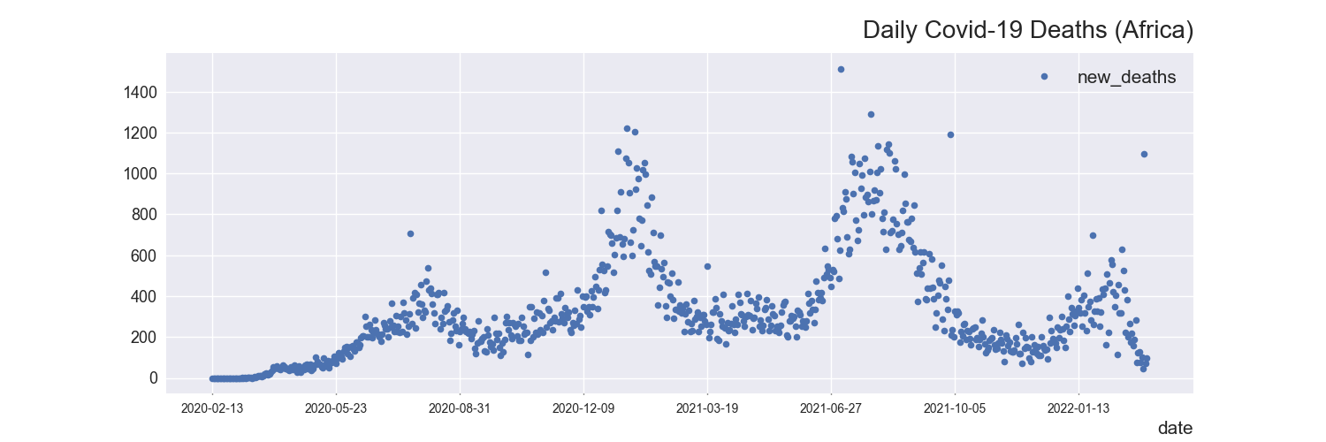
Daily Covid-19 Deaths in Africa
18

Slide 20
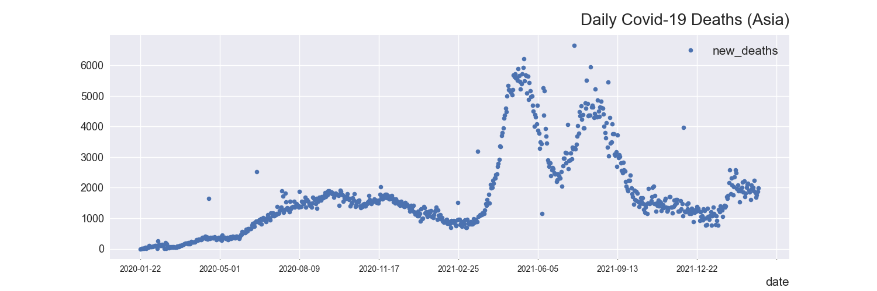
Daily Covid-19 Deaths in Asia
19

Slide 21
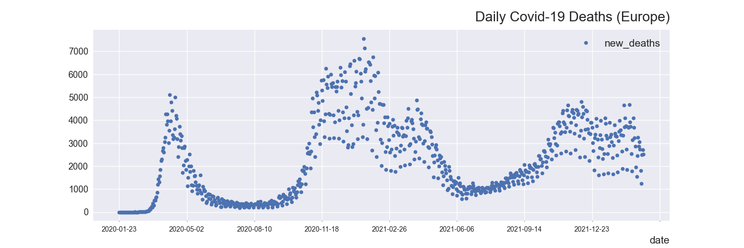
Daily Covid-19 Deaths in Europe
20

Slide 22
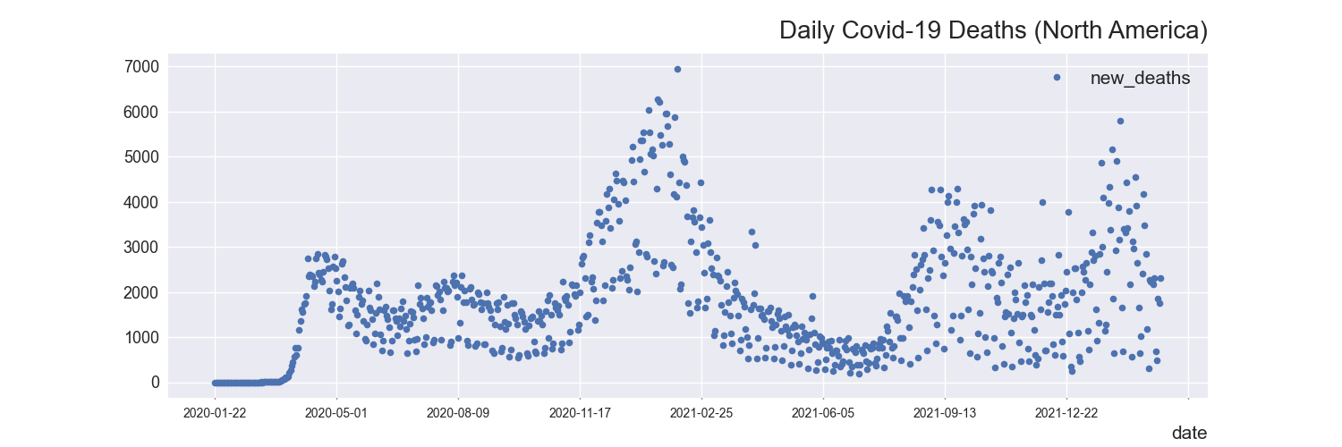
Daily Covid-19 Deaths in North America
21

Slide 23
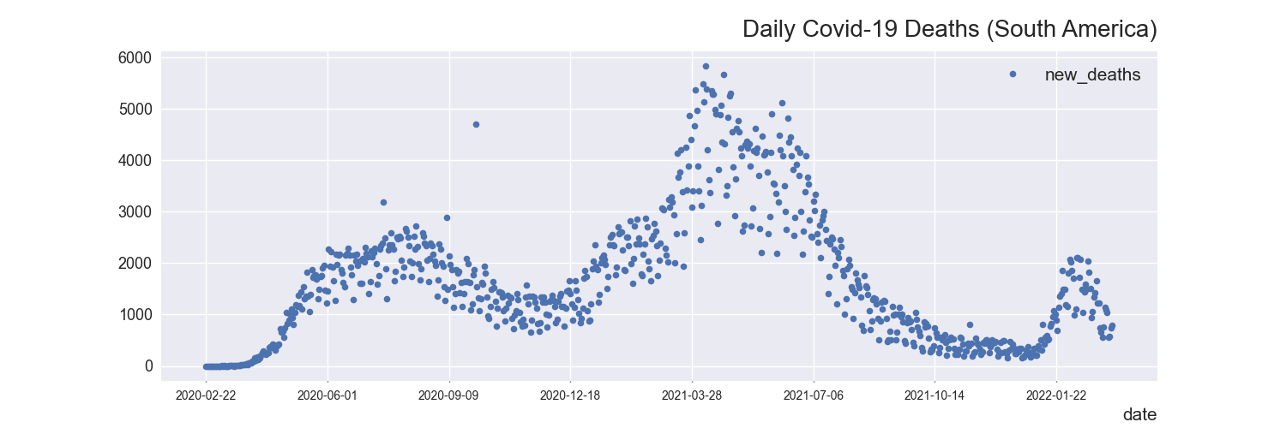
Daily Covid-19 Deaths in South America
22

Slide 24
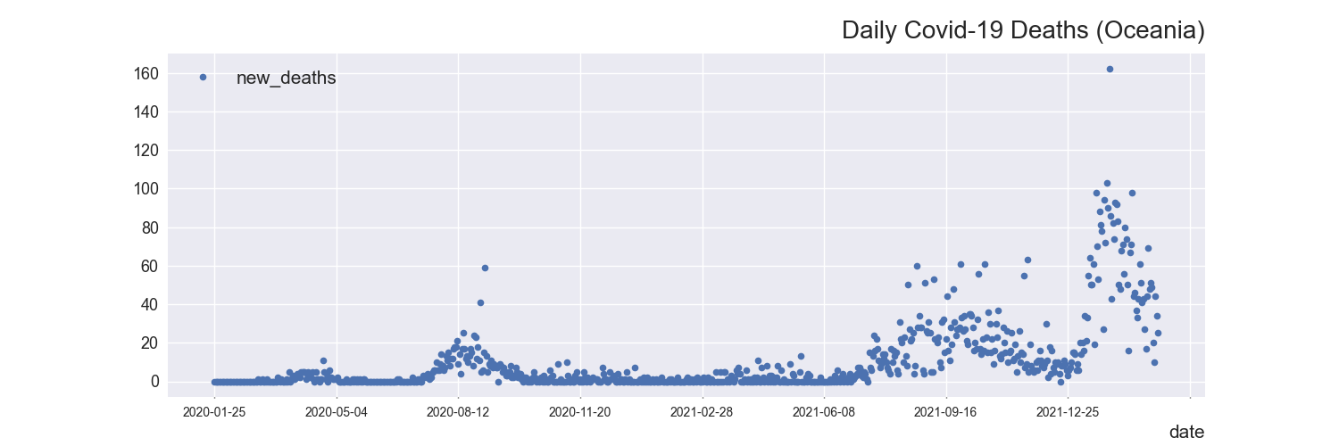
Daily Covid-19 Deaths in Oceania
23

