Slide 1
TRAVEL DATA ANALYSIS
BY:
PRAYAG SINGH(3331)
MANDEEP SINGH(3323)
PAWAN KUMAR(3329)

Slide 2
INTRODUCTION
Today travel providers have vast amount (petabytes) of data on every step that their customers take during their travel booking cycle. But the main challenge they face is converting this data into value for customers. The right solution can open up immense opportunities for all – the customers, the travel providers and the solution providers.
In this manuscript, we are trying to elaborate travel and tourism counts data to identify different places where the trend of visiting is increasing throughout the years. So that less focus would be on these places to overcome the less visiting trend. In order to do this, we have proposed a framework to analyze travel and tourism time series data that uses both data mining and traditional statistical techniques.

Slide 3
HOW DATA IS GENERATED?
Browsing through travel service provider‘s website, traversing through OTA sites, clicking on ads on social media sites like facebook, pinterest, using marketing promotions by travel service providers, using travel search sites, online searching and travel blogs and publications
Calling up the travel providers‘ call centers, browsing OTA sites, surfing websites of travel service providers, reading other travelers‘ experiences on social media sites and blogs, surfing through travel review sites such as TripAdvisor, seeing pictures and videos

Slide 4
OUR SYSTEM
Our application finds out top 20 travelled destinations and least 20 travelled destinations from a large data set, and by using these results we can take appropriate measures for a city which is least travelled as well as maintaining the current reputation of top 20 travelled destinations.

Slide 5
APPROACH
DATA MINING: We will use dataset to optimize the frequency of the travelled destinations. This is achieved through R Studio.
ANALYSIS: Extract data using Pig tool and analyze it using R programming.

Slide 6
VALUE GENERATED FROM DATA(BENEFITS)
Past behaviors: “We see that you like an aisle seat with extra leg space. Book a seat on our economy plus class which has extra leg space and also get 30% off on selection of aisle seat.”
Identifying most valuable customers: The major chunk of value from harnessing big data analytics can be derived by identifying the most profitable customers. Marketing efforts can be directed to capture their attention, the offers can be better suited to their needs, and efforts can be made to drive loyalty. This is more important keeping in mind the fact that cost of new acquisition is higher than the cost of retention.
Targeted marketing.

Slide 7
VALUE GENERATED FROM DATA(BENEFITS)
A link from the association to the hotel booking page with a discount code is standard, so you’ll know the names of people booking, why they’re staying with you, and that their interests involve a love of music and its performance.
Depending upon the transaction process you might know about the train, plane or automobile they took, their party size suggesting business or family intentions, and any upgrades they might have purchased.
While hotels have been an example, there are similar benefits for everyone in the travel industry. Trains, planes and automobiles can consider integrating themselves into an entire journey, not just the points of transportation they supply.

Slide 8
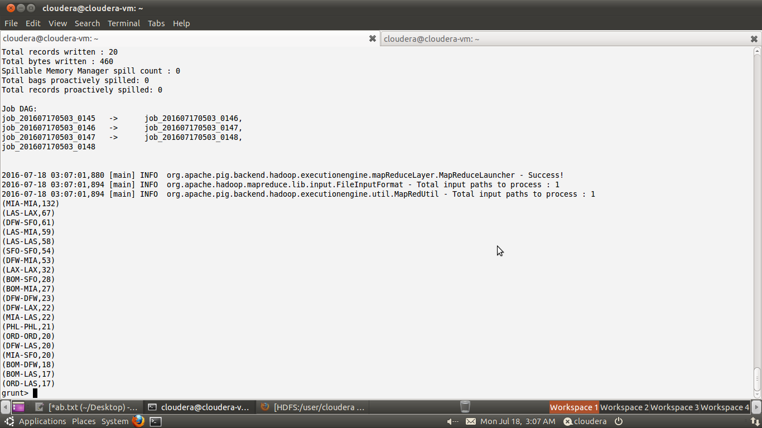
TOP 20 TRAVELLED DESTINATIONS

Slide 9
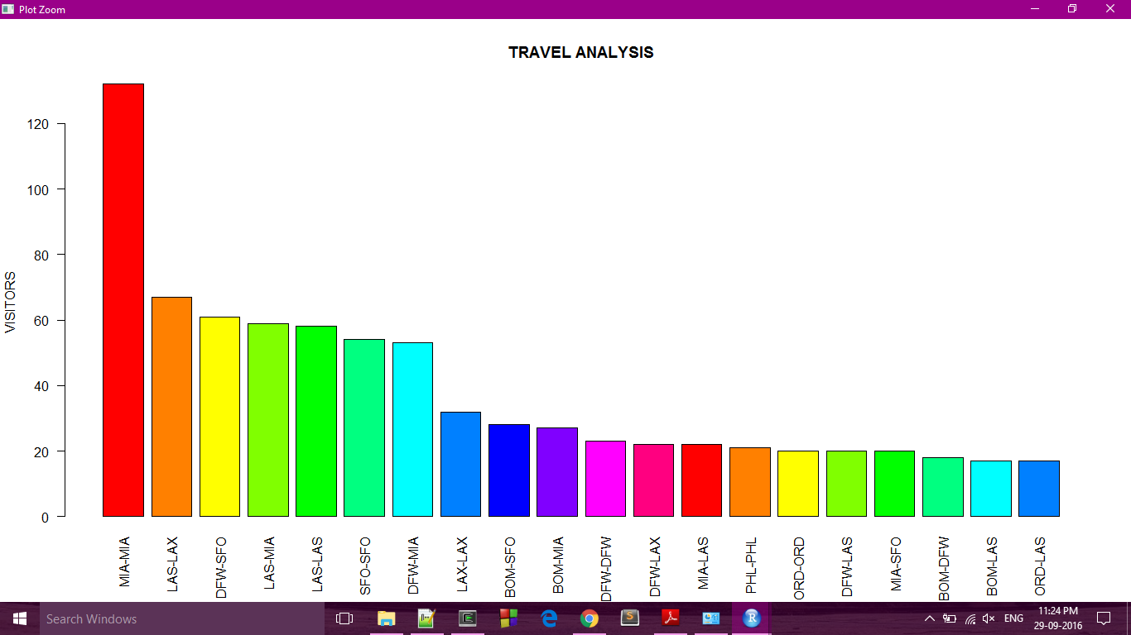

Slide 10
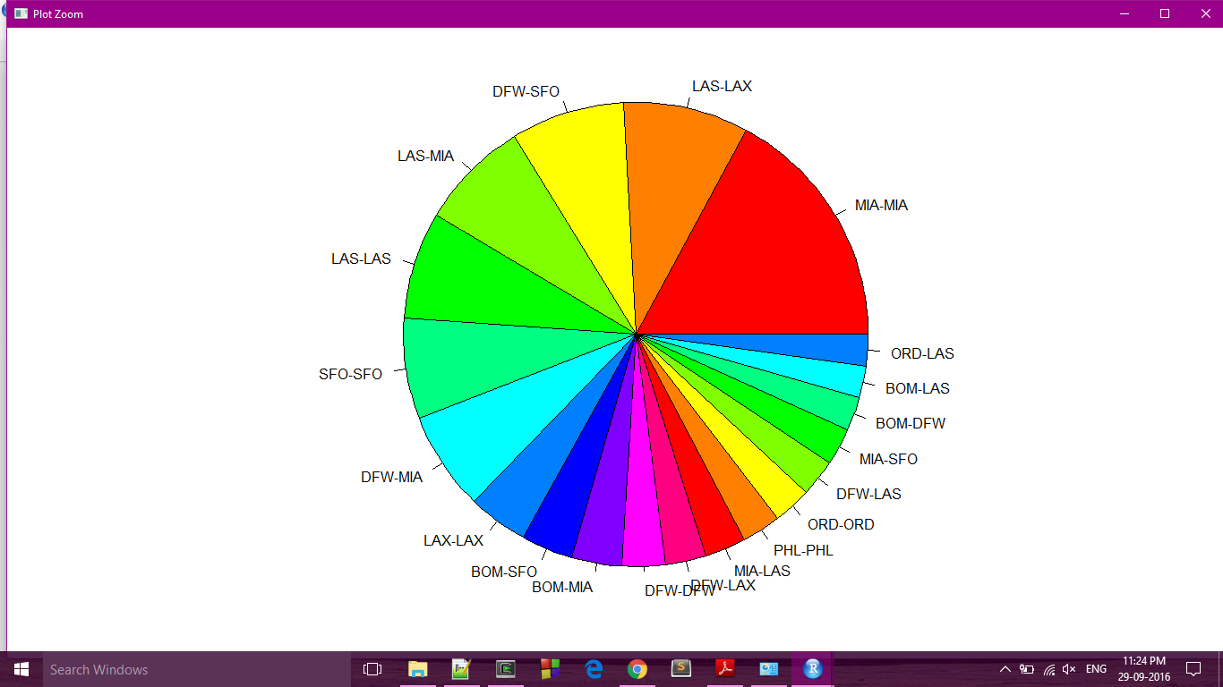

Slide 11
THANK YOU

