Slide 1
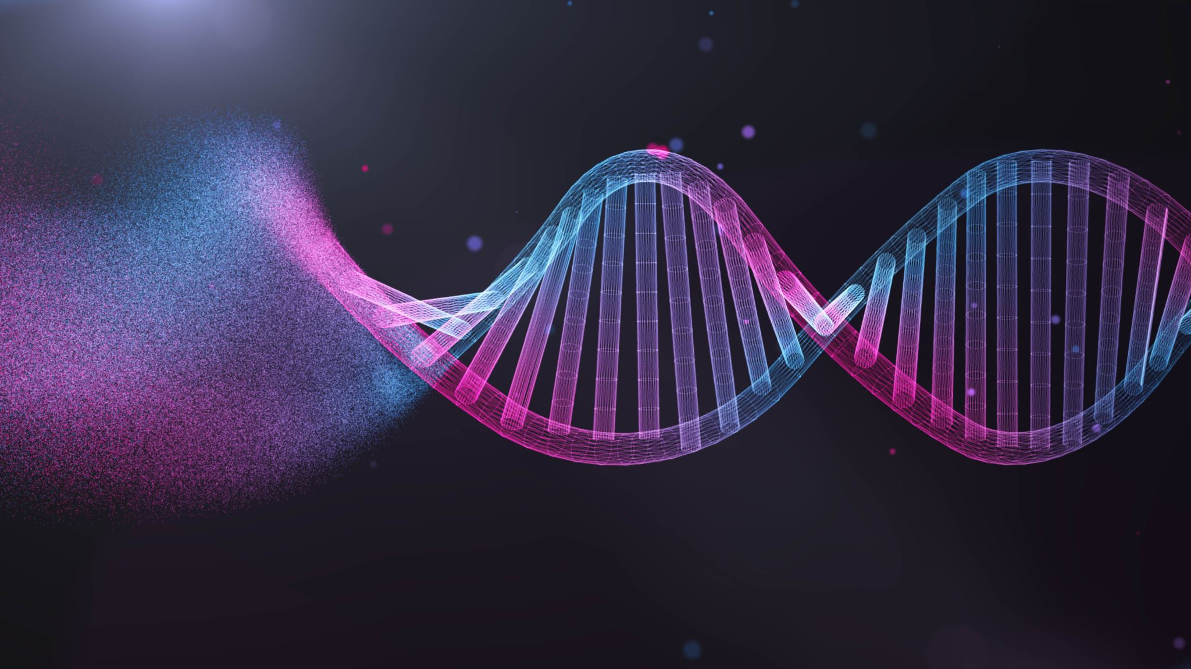
DNA CLUSTERING USING VARIOUS FEATURES

Slide 2
Introduction
Process of grouping similar DNA sequences together based on their shared characteristics.
Identify groups of sequences that are more similar to each other than to those in other groups.
To identify patterns and insights that can inform fields such as evolutionary biology, medicine, and biotechnology.

Slide 3
Proposed Model:
Data Preprocessing( Kmers )
FCGR of DNA and its mimics
Convolutional neural net
Input: 4 FCGR images for each DNA
Output: 3 clusters
Testing the model
ARI as Evaluation metric
Testing the model.
Dataset Gathering
Data preprocessing
Feature detection
Classifying the features
3D reconstruction

Slide 4
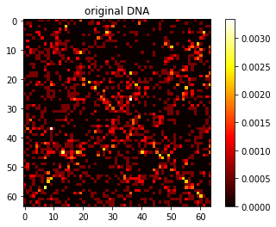
DNA Pre-processing:
DNA sequences into K Mers counts
FREQUENCY CHAOS REPRESENTATION OF DNA SEQUENCES WITH RESOLUTION K = 6
FCGR images for DNA and its mimics(transversion, transition mutations, transversion and transition mutation)
L1 Normalization on FCGR image

Slide 5
Dataset:
35000 DNA sequencies Approx.
Total 6 taxa ( Bacteria, Dog, Fungi, Human, Plant, Rattus)
6 clusters as output
DNA cluster | Cluster label | No of DNA in Dataset
human | 1 | 9999
plant | 2 | 76
Bacteria | 3 | 9542
Rattus | 4 | 3542
fungi | 5 | 9998
Dog | 6 | 3990

Slide 6
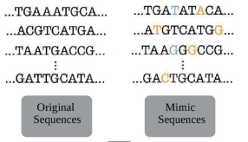
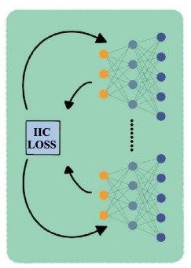
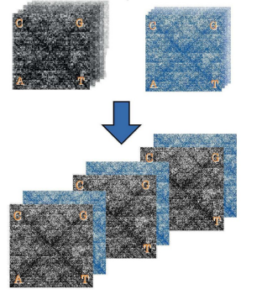

ARCHITECTURE:

Slide 7
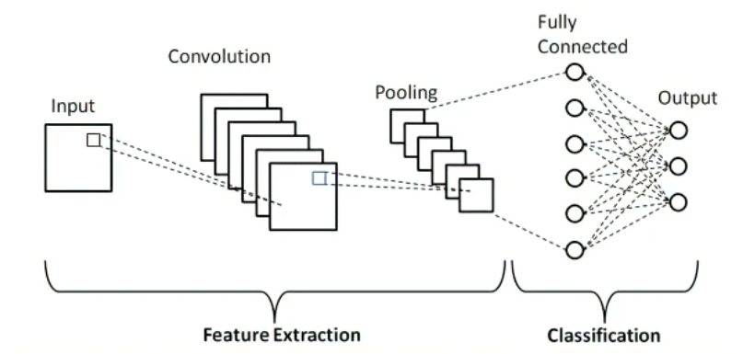
ARCHITECTURE:
ADAM OPTIMIZER.
Input to CNN: image of 2 bands:
FCGR of original DNA
FCGR of 3 mimics DNA
LOSS FUNCTION: loss according to IIC.
Dropout to avoid overfitting
Convolution layer to extract important features from FCGR image
SoftMax to get probability of assigning to each cluster

Slide 8
Evaluation:
Popular evaluation metric for clustering is ARI
Adjusted Rand Index
Upgrade to Rand Index

Slide 9
Literature Review
Author and year | Title | Methodology | Limitations
Pablo Milla Arias, Fatemeh AlipourI, Kathleen A. HillI , Lila Kari, 2022 | DeLUCS: Deep learning for unsupervised clustering of DNA sequences[1] | Frequency Chaos game Representation of DNA Mimic DNA generation Information invariant clustering CNN and Rand index as metric | As it is clustering approaches, having different cluster of irregular size is problematic It is unsupervised clustering so less better than supervised one
Raphael Petegrosso, Zhuliu Li, Rui Kuang,2019 | Machine learning and statistical methods for clustering single-cell RNA-sequencing data[2] | Hierarchical Clustering Partitioning-based clustering Density-based clustering | Evaluates clustering algorithms based on a single dataset. Does not compare the computational efficiency .
Lailil Muflikhah, Widodo,Wayan Firdaus Mahmudy, Solimun ,2019 | DNA Sequence of Hepatitis B Virus Clustering Using Hierarchical k-Means Algorithm[3] | Using hierarchical k-means clustering algorithm for clustering DNA sequences | Unable to handle noise Limited flexibility (Fixed number of clusters)
E. Kiruba Nesamalar1, J. Satheesh Kumar2, T. Amudha3 ,2021 | Influence of an efficient Hierarchical Clustering Algorithm in analyzing Cancer affected DNA Dataset[4] | Using hierarchical, k-means and k-medoids for cancer affected DNA sequences | Difficulty in determining the optimal number of clusters. Sensitivity to noise

Slide 10
Reference
https://pubmed.ncbi.nlm.nih.gov/35061715/ [1]
https://pubmed.ncbi.nlm.nih.gov/31243426 / [2]
https://ieeexplore.ieee.org/document/9117565 [3]
https://iopscience.iop.org/article/10.1088/1742-6596/1998/1/012030 [4]
https://academic.oup.com/bib/article/21/1/1/5098604 [5]

Slide 11
Thank you.

