Slide 1
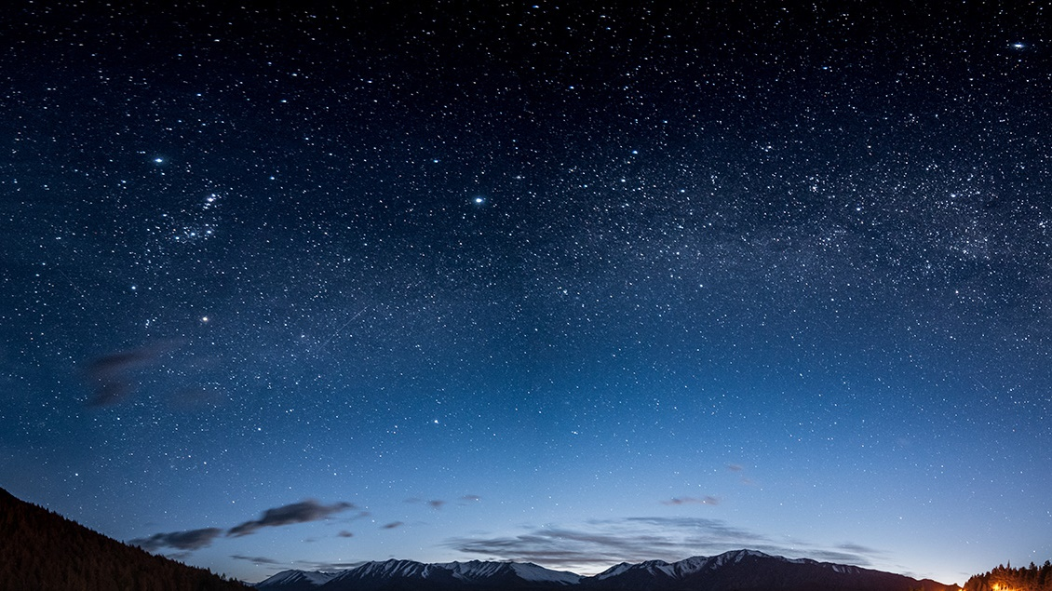
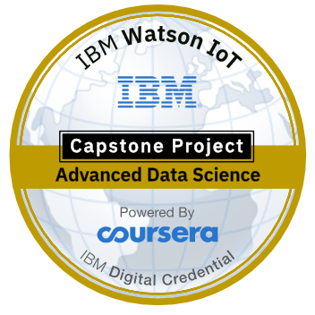
Chennai Attractions Recommender System
IBM- Applied Data Science Capstone project
By
Dhinakar Babu

Slide 2
Introduction
Chennai, on the Bay of Bengal in eastern India, is the capital of the state of Tamil Nadu. The city is home to Fort St. George, built in 1644 and now a museum showcasing the city’s roots as a British military garrison and East India Company trading outpost, when it was called Madras. Religious sites include Kapaleeshwarar Temple, adorned with carved and painted gods, and St. Mary’s, a 17th-century Anglican church.
For tourists or new comers it is difficult to get to know about the nearby attractions. The diversity of the places available is reflective of the social and economic diversity of Chennai. Temples, Malls, Shopping sites are all very popular in the city. Chennai can also be called a Tourist favourites because of its vast variety of attractions and with a touch of Tamil Nadu’s uniqueness and tradition.
We have to build recommender system which recommends tourist travel locations based on his nearby venues. Recommended engine is built on an observation that tourist always try to explore places which are nearby first. We will be using location data to get best spots in neighborhood. For getting location data we will use Foursquare API.

Slide 3
Problem Statement
Recommending nearby attractions to the users based on their preference and tastes, we would help customers to find their mst related attractions in the nearby areas. This helps the prblem of finding and exploring inappropriate places

Slide 4
Business Questions
How many types of attractions are available ?
Which is the most nearest to me with good rating ?
How many "similar" places are available near by me ?
What types of places are present in a particular area ?
Where are the similar places present based on a preference to particular food ?
How do different places rank with respect to my preferences ?

Slide 5
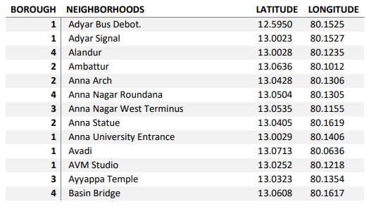
Data
Geographical coordinates(latitude and longitude) to find our where exactly it is located. To access location of a attractions, its Latitude and Longitude is to be known so that we can point at its coordinates and create a map displaying all the attractions with its labels respectively.
• Taken the longitudes and latitudes from the google map and prepared the dataset. The data set contains Place with its Latitudes and Longitudes.
• To access location, it’s Latitude and Longitude is to be known so that we can point at its coordinates and create a map displaying all the restaurants with its labels respectively.

Slide 6
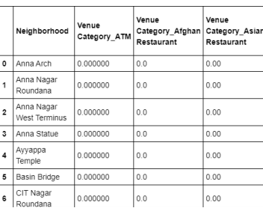
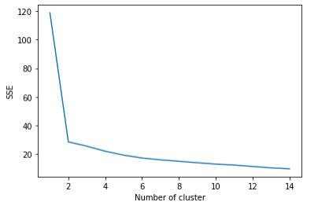
Methodology
Done Data preprocessing to get clear data and one- hot encoded the data to model the data.
Also while producing graph for number of cluster, I produced a graph to explore all the values for n_clusters and then finding the best by exploring the elbow graph.

Slide 7
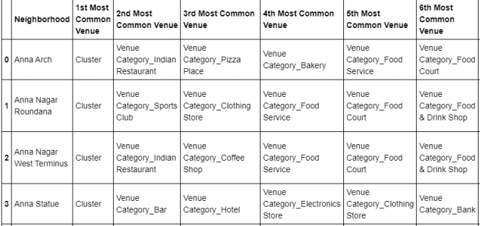
Result

Slide 8
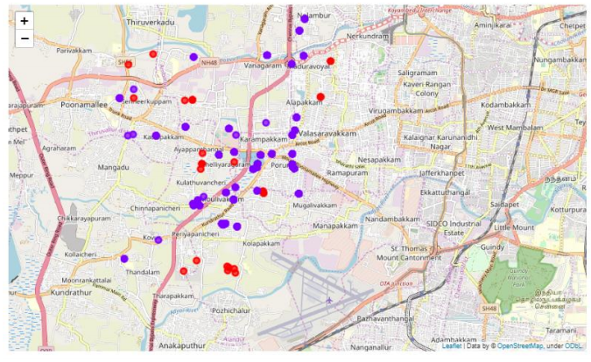
Map Clusters

Slide 9
Conclusion
The recommender system is a system that makes use of Foursquare API to determine nearby venues. It is a powerful data driven model whose efficiency may decrease with more data but accuracy will increase.Thus we have developed the Chennai based Attraction recommendation System using FourSquare API.

Slide 10

Thank You!

