Slide 1
vistul
文件创建于: 2020/5/13 13:50:05

Slide 2
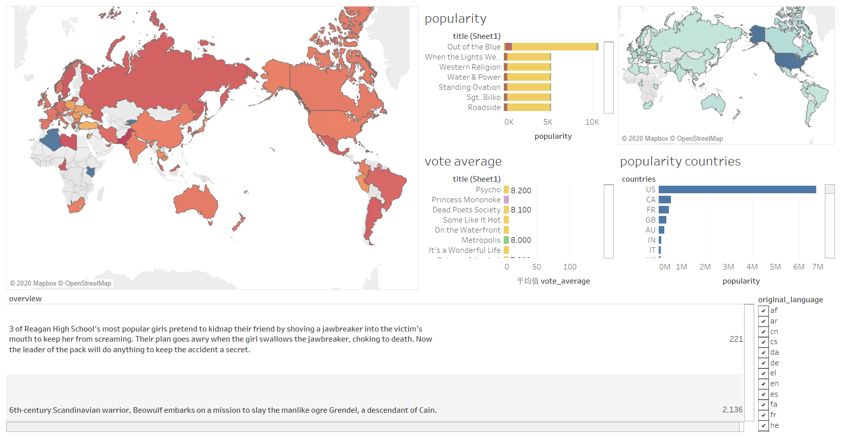
Sorted by popularity and
Vote average
Vote average for countries
Selected by original language

Slide 3
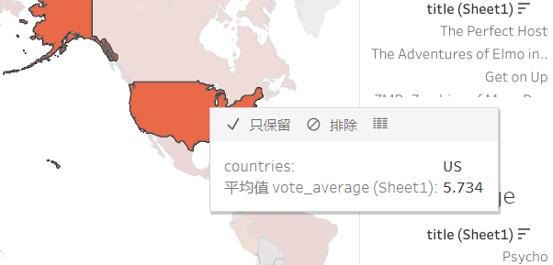

Slide 4
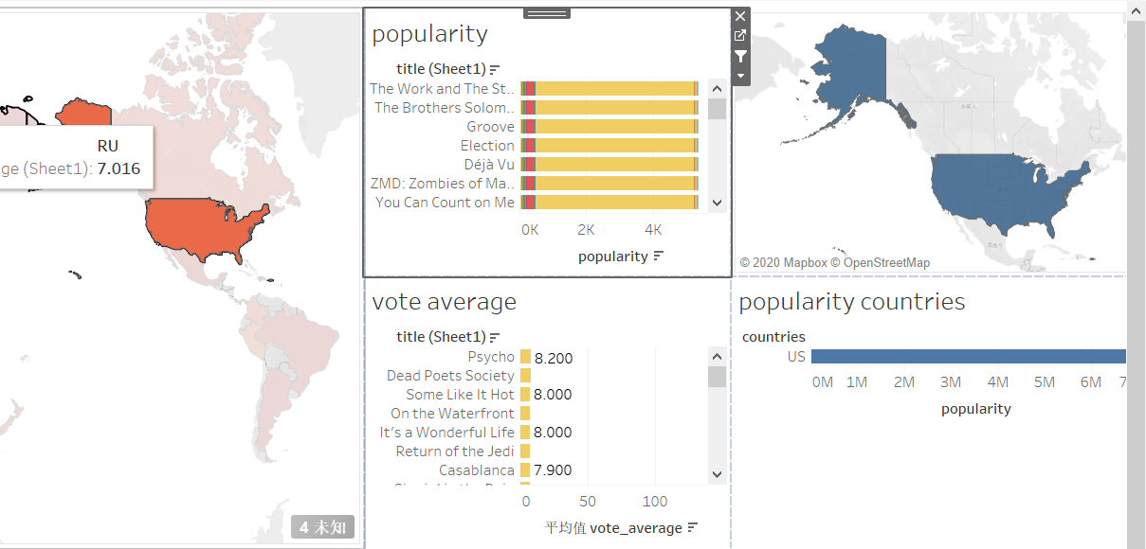
back

Slide 5
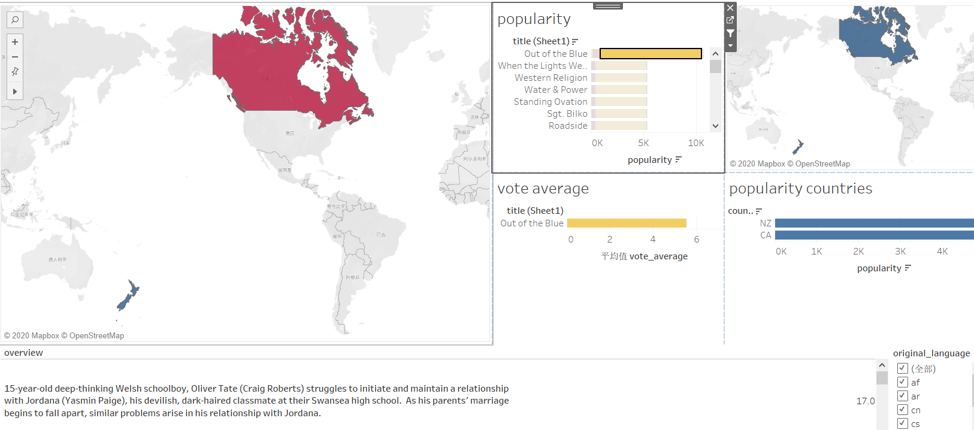
overview

Slide 6
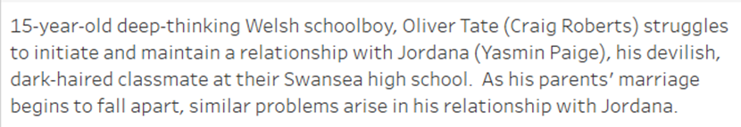
back
*

Slide 7
