Slide 1
Foresight CNV Pipeline
Mohammad Shahrokh Esfahani 11/01/2021

Slide 2
Differences with the SU implementation
The coverage calculations are implemented similarly for both on-target and off-target pieces (limiting to 163 and 99 for the flag)
Fragment coverage is calculated in both (in the older version read counts were used in the off-target part)
For samtools deduped files a mapping quality of at least 20 is required. Also, a maximum fragment length (default 1000bp) is imposed (for both bc and samtools deduped files).
GC bias correction is done in the log space and then transferred back to avoid negative values.
Bins or regions with a coefficient of variation (CoV) of greater than 1 are removed from the final annotation summarization (the CoV’s are calculated using the control cohort)
Bins or regions with zero coverage in at least 33% of control samples are removed from the further analysis
Bins with GC-content of zero are completely removed because GC-corrected values were not reliable.
All the bins overlapping with centromeres are removed.
The final Z-scores are calculated in a formal manner, i.e., de-mean and divide by STD (as opposed to just dividing by STD)
Minor: a sample info file is now required to match on-target (bc-deduped) files with off-target bams.

Slide 3
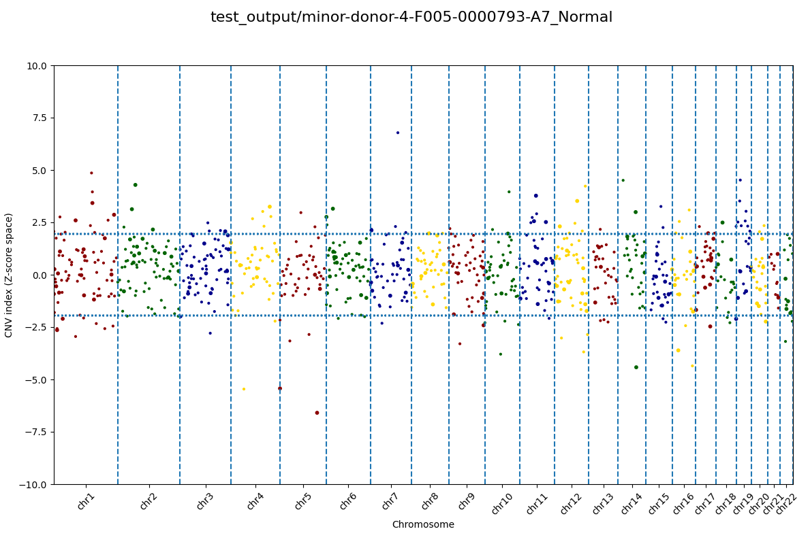
Example

Slide 4

Idea to robustify the final combined Z-score
There are regions where the constituent bins have a wide range of Z-scores
May not necessarily be indicative of a contiguous copy number aberration and rather low coverage event
Median alone is not the best way to summarize
To guard against these situation, in addition to the unweighted Stouffer’s method, we report a version with that information incorporated in:
For on-target: calculate the IQR CoV as follows: across the constituent bases (denote it by IQR_On)
For off-target: calculate the IQR CoV across the constituent bins (denote it by IQR_Off)
Define two weight factors: W_On = 1- IQR_On/(IQR_On+IQR_Off) and W_Off = 1-W_On.
The final weighted Z-score is then defined as (W_On x Z_On + W_Off x Z_Off)/Sqrt(W_On^2 + W_Off^2)
CoV = $\frac{Q_{75}−Q_{25}}{Q_{50}}$

