Slide 1
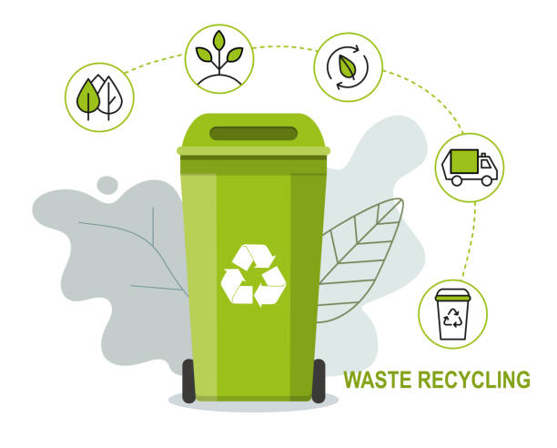
Waste Classification

Slide 2







Introduction
Waste is a significant global issue. Consumers can be confused about how to determine the correct way to dispose a large variety of materials used in packaging.
Our motivation was to find a method for sorting trash. This has the potential to make processing plants more efficient and help reduce waste, as it is not always the case that the employees sort everything with 100% accuracy.
As the rate of garbage generation gradually increases, the past garbage disposal methods will be eliminated, so the classification of garbage has become an inevitable choice.
Our classification problem involves receiving images of a single or many objects and classifying it into its material type.
Our work proposes a Deep Learning approach using computer vision to automatically identify the type of waste and classify it into 6 main classes
By using Computer Vision, we can predict the category of garbage that an object belongs to based on just an image.

Slide 3
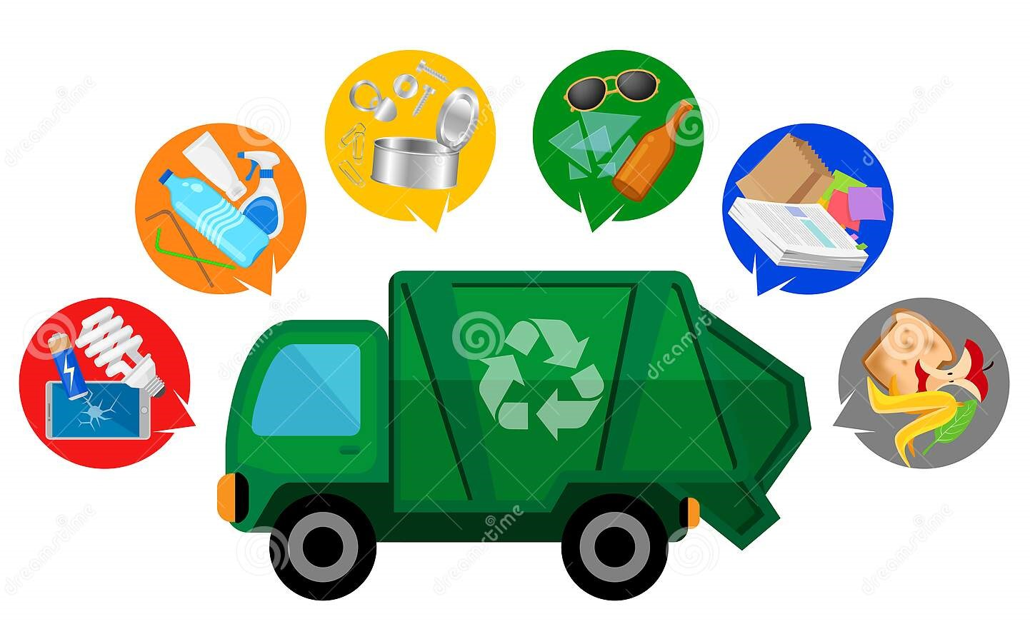
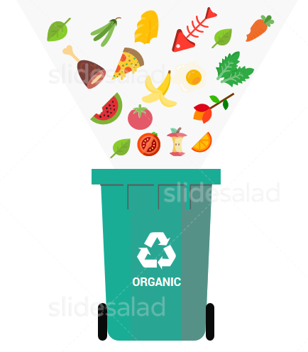


Classes

Slide 4
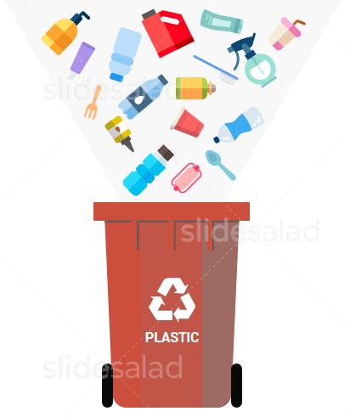
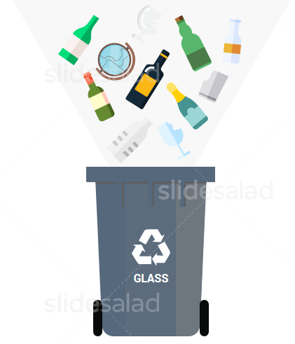
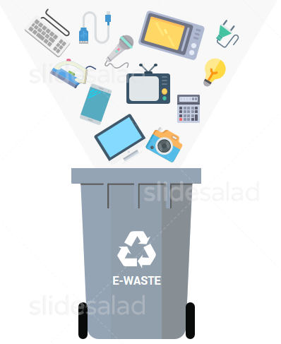
Classes

Slide 5
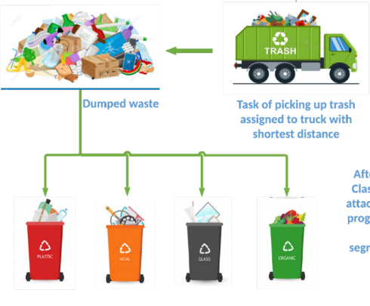






Main Idea :
Waste Process
Converted
Heated
Processed
Fuel
ENERGY : Gas
Electricity

Slide 6




Preparation ( Choice of work and collaboration tools )

Slide 7
Method :
Collecting training images
Labelling using MAKE SENSE.ai
Training dataset in Google Collab
Testing dataset
1
2
3

Slide 8

Thank You !

