Slide 1
Backpropagation from a Systems Perspective
Matthias Seeger
Principal Applied Scientist
Amazon Web Services

Slide 2
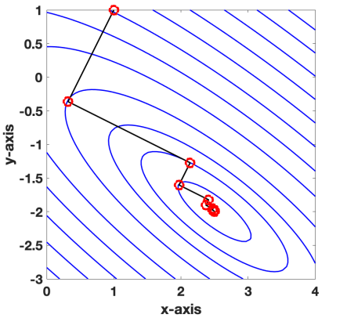
Recall (Recap from Last Week 😀)
Training Neural Network: Minimize Loss Function
Model parameters
Data case: Input, output
Notes:
Quick recap of what we covered last week:
- Neural networks are trained by minimizing a loss function over a dataset

Slide 3
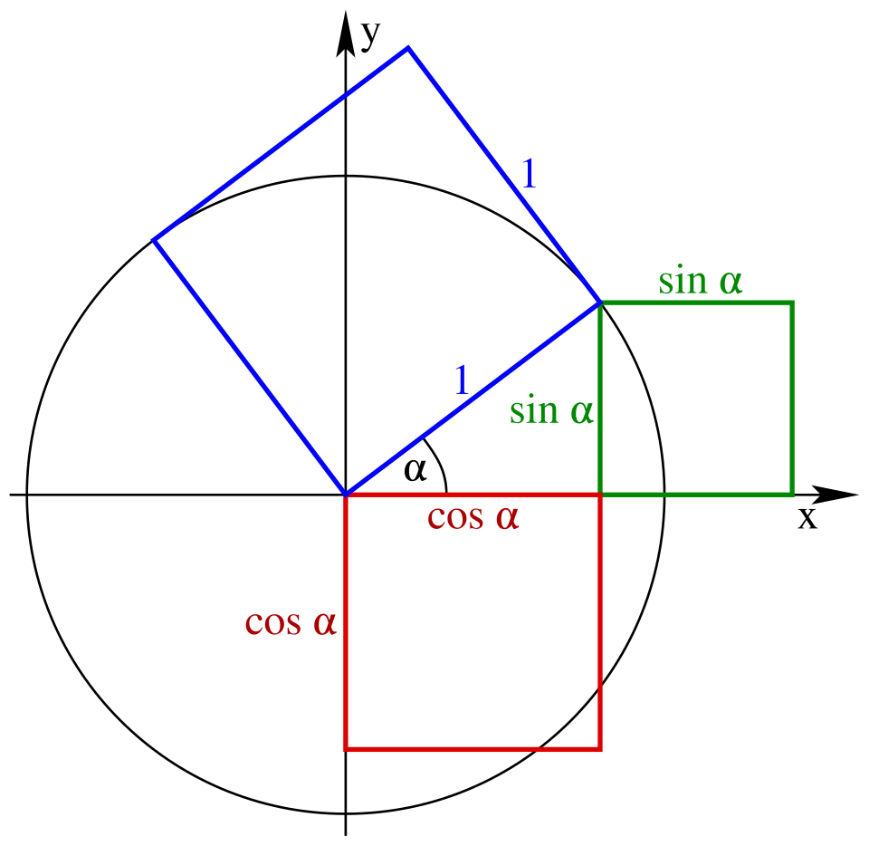
Recall (Recap from Last Week 😀)
Training Neural Network: Minimize Loss Function
Negative Gradient: Direction of Steepest Descent
Notes:
- How to update weights w? Steepest descent along negative gradient of loss

Slide 4
Recall (Recap from Last Week 😀)
Training Neural Network: Minimize Loss Function
Negative Gradient: Direction of Steepest Descent
Stochastic Gradient Descent: Sample on small data batch B
Notes:
Gradient would be too expensive to compute on large dataset
Instead: Gradient on loss over small, randomly drawn batch
Direction: noisy, but useful + tractable to compute

Slide 5
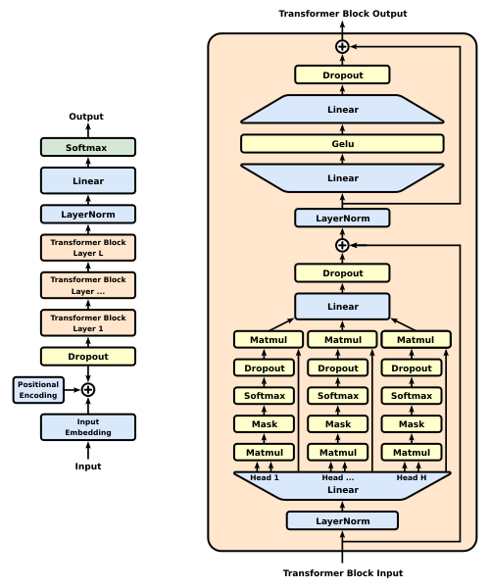
Transformer Models (GPT)
Many parameters (weights) to tune: 4 B(illion – “small” these days)
Layered structure: 36 layers (same form; independent weights)
Massive graph of simple units, mapping dense float arrays
Notes:
Topic for today: How to compute this gradient for SotA deep models?

Slide 6

Backpropagation: The Good
Forward pass: Compute $l\left(w\right)$ 1 $×$ bottom→top
Compute $∇_{w} l(w)$? 4 B $×$ forward?

Slide 7

Backpropagation: The Good
Forward pass: Compute $l\left(w\right)$ 1 $×$ bottom→top
Compute $∇_{w} l(w)$? 4 B $×$ forward?
No!
Forward pass: 1 $×$ bottom→top
Backward pass: 1 $×$ top→bottom
Buy 2,
get 4 Billion free!

Slide 8

Backpropagation: The Good
Reverse-mode Automatic Differentiation
(a.k.a. Error Backpropagation)
Simple modular method
Work out $∇(…)$ for basic blocks → Use on any complex architecture

Slide 9
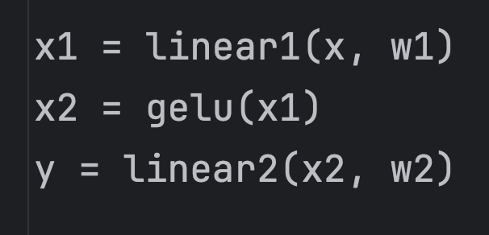
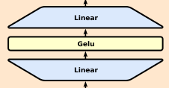
Computation Graph
x
linear1
x1
gelu
x2
linear2
y
w1
w2

Slide 10
Forward Pass
x
linear1
x1
gelu
x2
linear2
y
w1
w2

Slide 11
Forward Pass
x
linear1
x1
gelu
x2
linear2
y
w1
w2

Slide 12
Forward Pass
x
linear1
x1
gelu
x2
linear2
y
w1
w2

Slide 13
Forward Pass
x
linear1
x1
gelu
x2
linear2
y
w1
w2

Slide 14
Backward Pass
x
linear1
x1
gelu
x2
linear2
y
w1
w2

Slide 15
Backward Pass
x
linear1
x1
gelu
x2
linear2
y
w1
w2

Slide 16
Backward Pass
x
linear1
x1
gelu
x2
linear2
y
w1
w2

Slide 17
Backward Pass
x
linear1
x1
gelu
x2
linear2
y
w1
w2

Slide 18
Local Operations
x
linear1
x1
w1
x
linear1
x1
w1

Slide 19
Local Operations
x
linear1
x1
w1
x
linear1
x1
w1

Slide 20
Local Operations
x
linear1
x1
w1
x
linear1
x1
w1

Slide 21
Local Operations
x
linear1
x1
w1
x
linear1
x1
w1

Slide 22
Local Operations
x
linear1
x1
w1
x
linear1
x1
w1

Slide 23
Local Operations
x
linear1
x1
w1
x
linear1
x1
w1

Slide 24
Backpropagation: The Bad
x
linear1
x1
gelu
x2
linear2
y
w1
w2
Storage

Slide 25

Backpropagation: The Bad
Qwen3-4B model:
L = 36 layers, d = 2560 emb.dim.
n = 500,000 context width
Layer outputs alone: 46 B numbers!
Graph storage $≫$ weights
GPUs have little RAM

Slide 26
Backpropagation: The Bad
Numerical roundoff errors:
Use 16-bit floats
“Vanishing/exploding gradients”
Art of deep learning: Conditioning!
Residual connections

Slide 27
Backpropagation: The Bad
Numerical roundoff errors:
Use 16-bit floats
“Vanishing/exploding gradients”
Art of deep learning: Conditioning!
Residual connections
Normalizations

Slide 28
Backpropagation: The Bad
Numerical roundoff errors:
Use 16-bit floats
“Vanishing/exploding gradients”
Art of deep learning: Conditioning!
Residual connections
Normalizations
ReLU, GeLU, …

Slide 29

Trade-Off: Activation Checkpointing
The good: 1 $×$ forward, 1 $×$ backward
The bad: Lots of GPU memory
Activation checkpointing:
Forward: Layer outputs → CPU
Backward: Replay forward
Still OK: 2 $×$ forward, 1 $×$ backward
Nice: Much less GPU memory

Slide 30
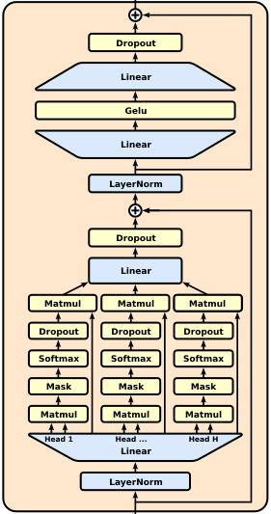

Activation Checkpointing
x
y1
y2
CPU

Slide 31
Activation Checkpointing: Forward Pass
x
y1
y2
CPU

Slide 32
Activation Checkpointing: Backward Pass
x
y1
y2
CPU

Slide 33
Activation Checkpointing: Backward Pass (Replay)
x
y1
y2
CPU

Slide 34
Activation Checkpointing: Backward Pass
x
y1
y2
CPU

Slide 35
Activation Checkpointing: Backward Pass (Replay)
x
y1
y2
CPU

Slide 36
Activation Checkpointing: Backward Pass
x
y1
y2
CPU

Slide 37
It’s the GPU Memory, Stupid!
Tricks to save GPU memory in backpropagation:
Activation checkpointing; CPU offloading
Quantization
Linear recurrences (research talk)
Operator fusion: Larger blocks, fewer nodes

Slide 38
Summary
Error Backpropagation:
Very efficient gradient computation for layered architectures
Automatic and modular
Two phases:
Forward: Populate nodes in computation graph
Backward: Replace node values with gradients
Achilles Heel: Needs lots of GPU memory
Trade-offs: More compute, less memory

Slide 39
Questions?
https://mseeger.github.io/ https://github.com/awslabs/keys_values

