Slide 1


Open Data Dashboards & Python Web Scraping
PyData DC 2016
Marie Whittaker
mseew
@mariecwhittaker

Slide 2





A bit about me
Studied economics
here
Worked at for 3 years
using data to prevent these
Now with
monitoring the economy of the 51st State

Slide 3
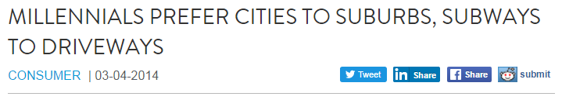
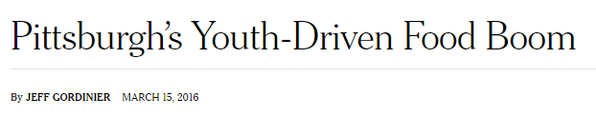
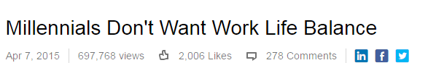

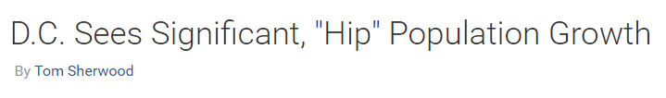
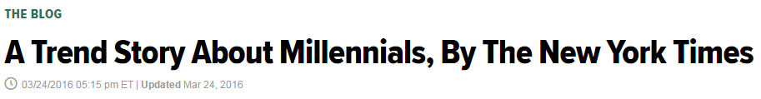
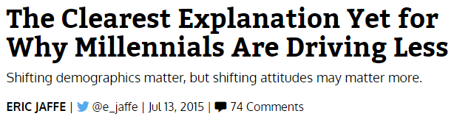
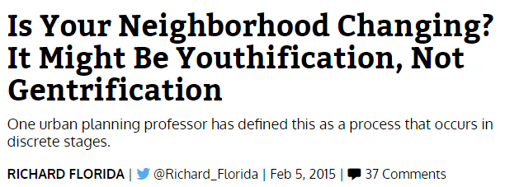
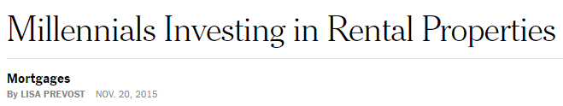

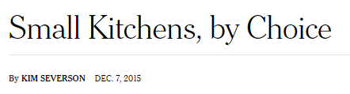
What is data competing with?

Slide 4
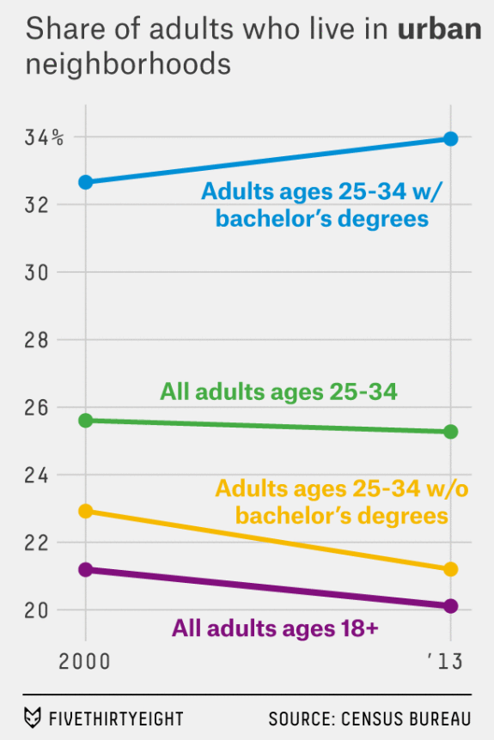
What is data competing with?

Slide 5
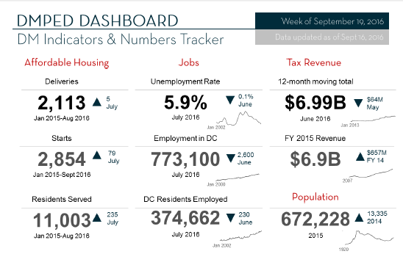
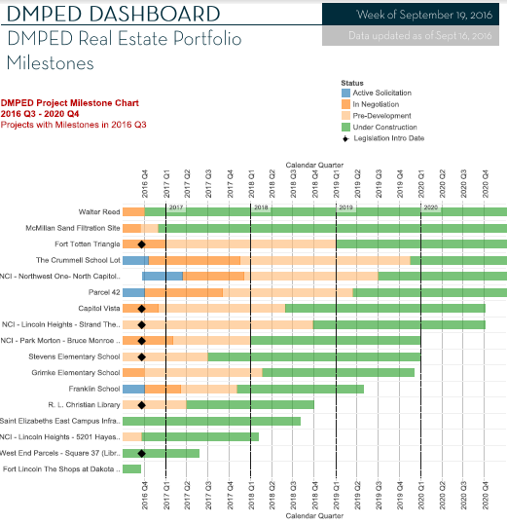
A dashboard is one answer

Slide 6
What makes a good dashboard?

Slide 7
What makes a good dashboard?
1. It’s consistent.
2. It includes the right data.

Slide 8
What makes a good dashboard?
3. It answers the questions you get asked most frequently.
4. (Sometimes) it raises more questions for you to dive into elsewhere.

Slide 9
Who are dashboards for?

Slide 10
Who are dashboards for?
The audience
For initial context-setting
For a quick reference

Slide 11
Who are dashboards for?
The audience
For initial context-setting
For a quick reference
The creator

Slide 12
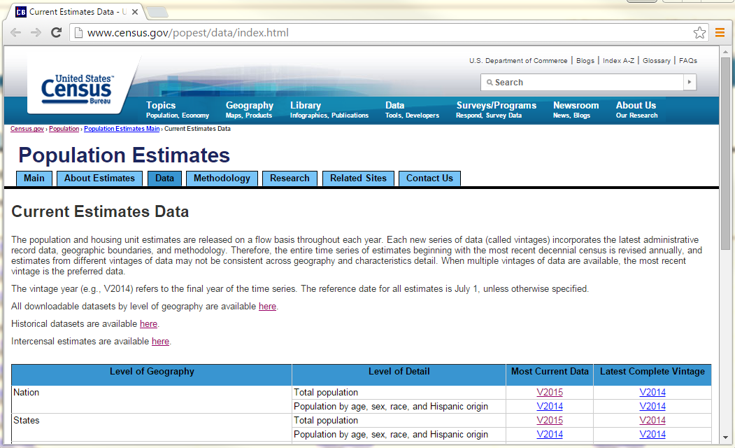
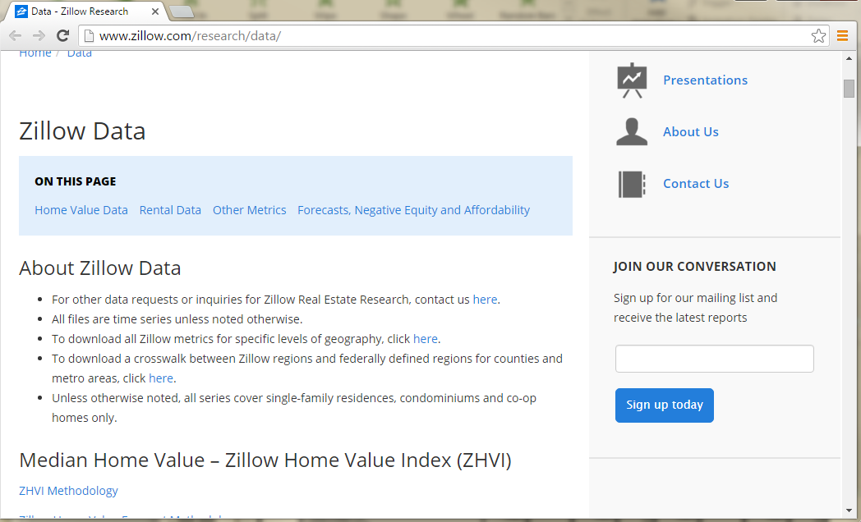
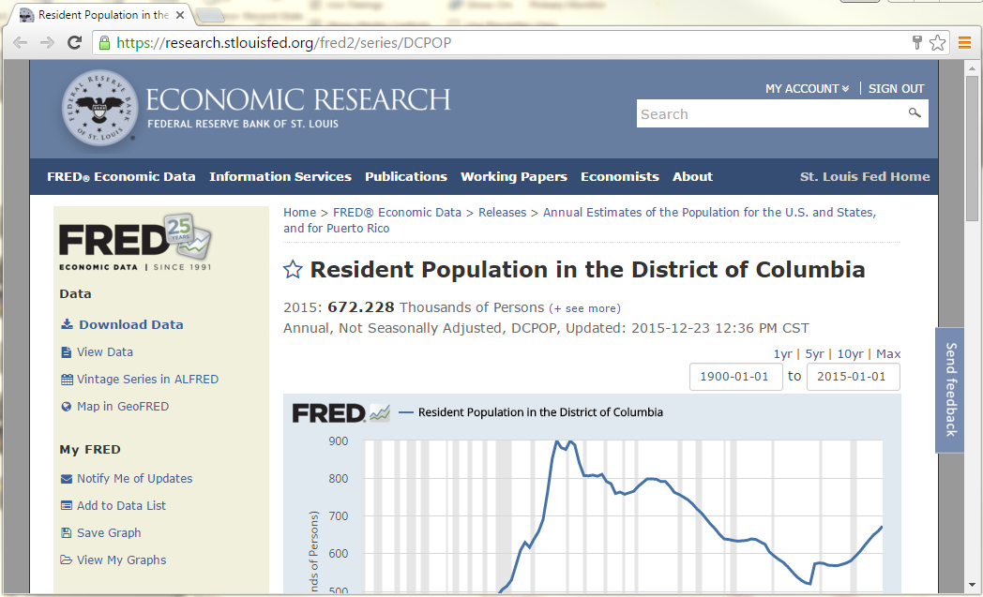
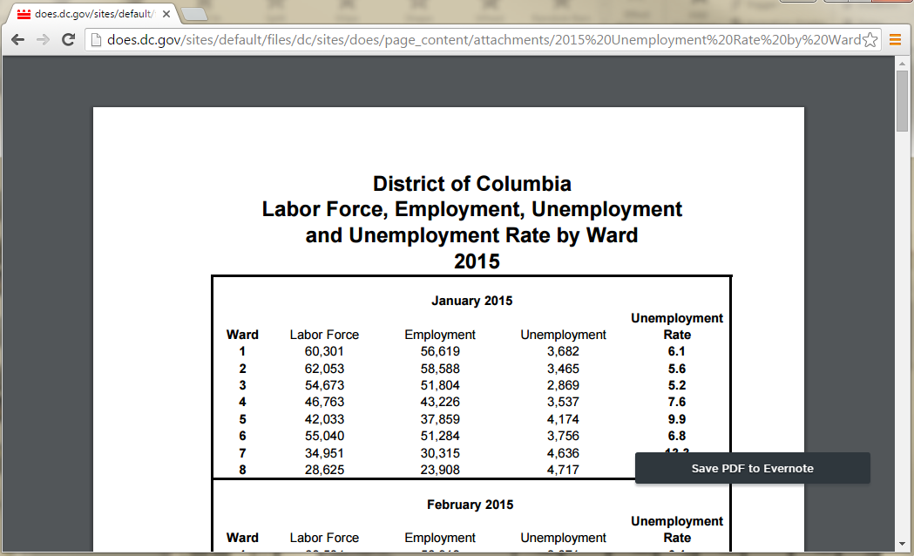
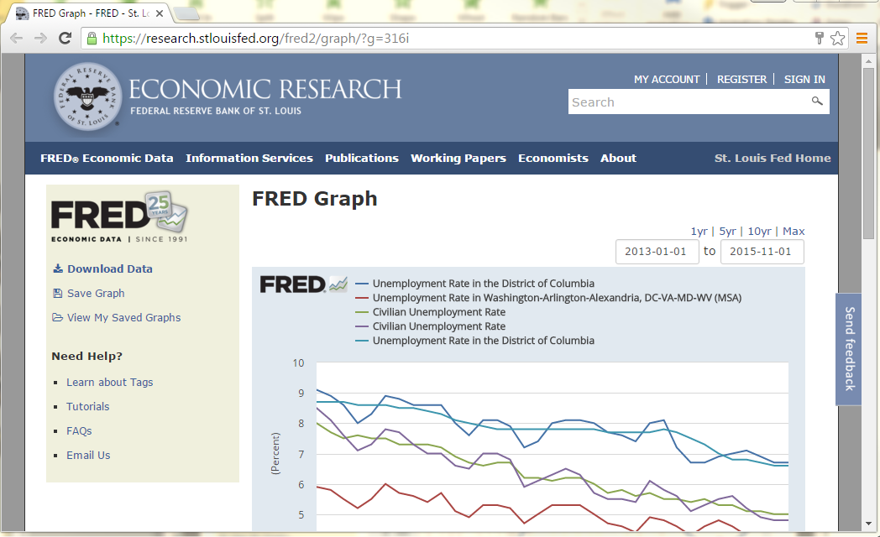
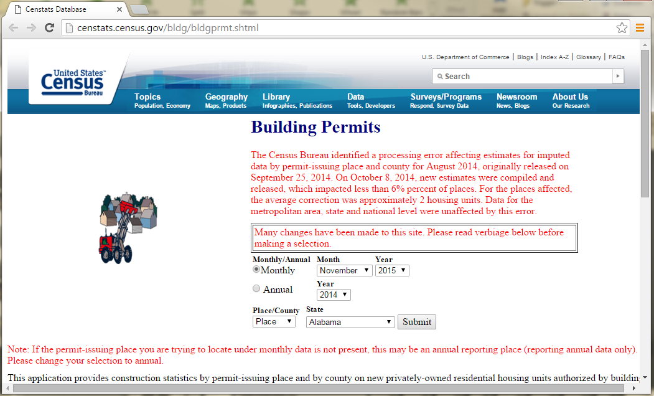
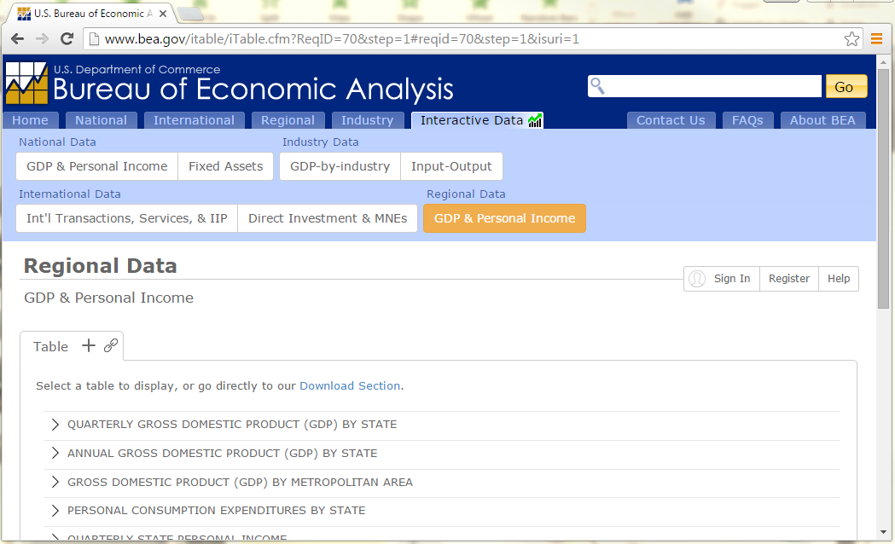
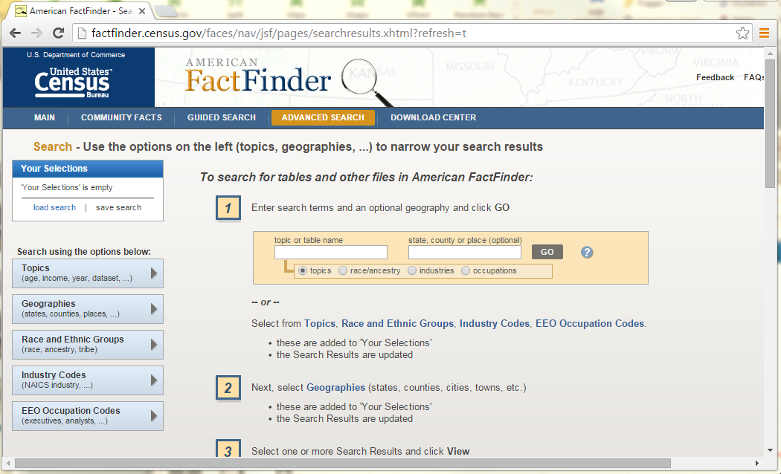
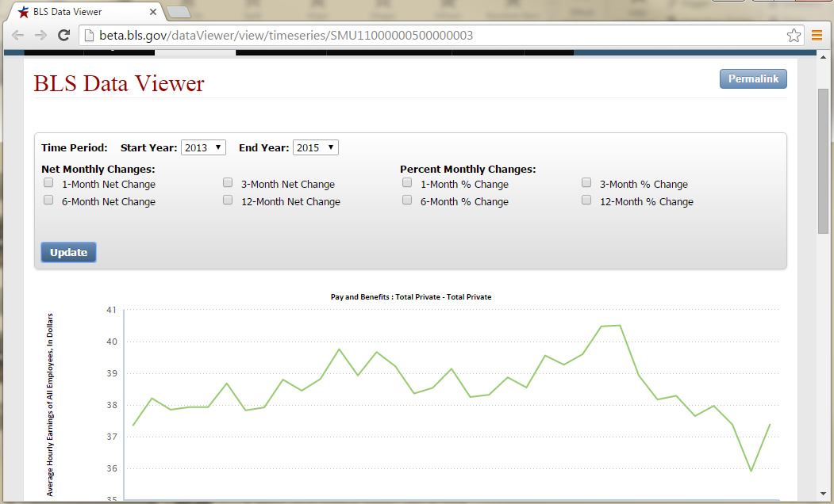
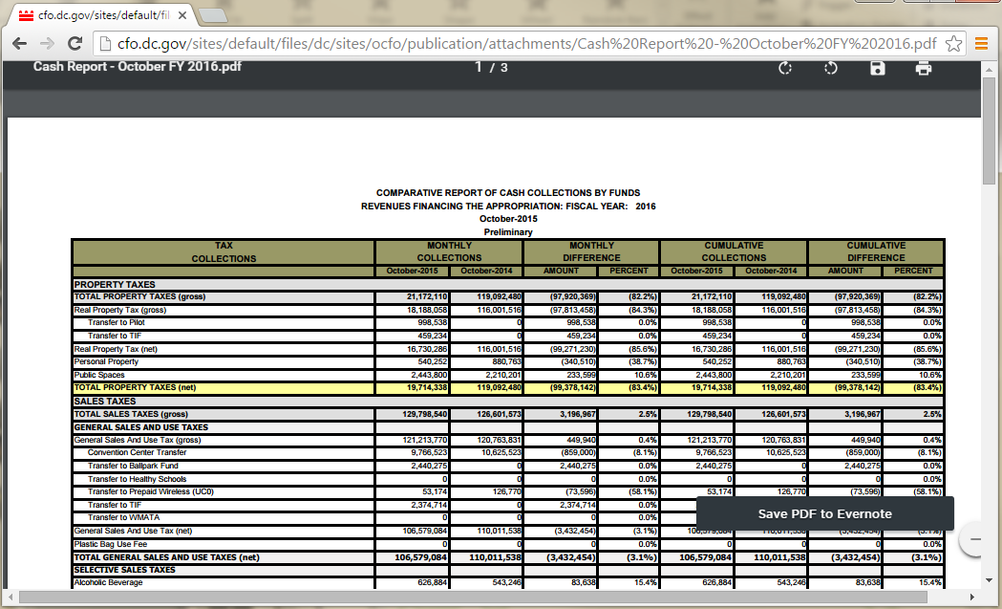
Problem?

Slide 13





Workflow
1
2
3
Scrape
Reshape
Design
&
6
5
4
Feedback
Embed
Host
&

Slide 14

Workflow
1
2
3
Scrape
Reshape
Design
6
4
Feedback
Host
&

Slide 15
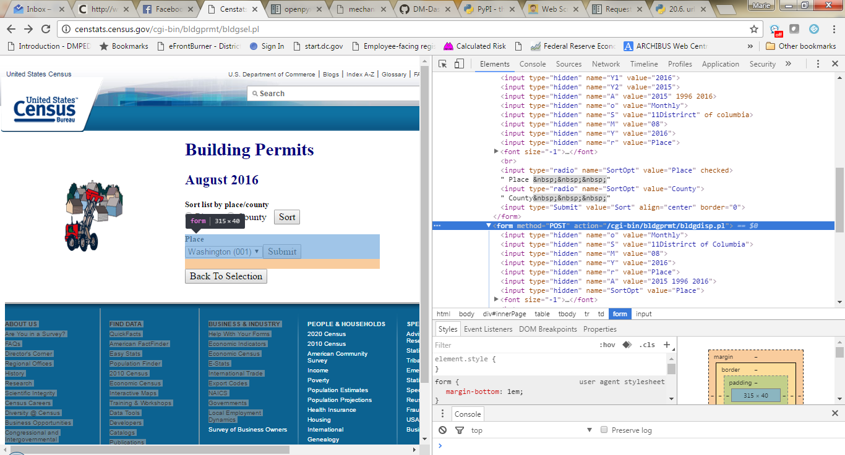

Slide 16
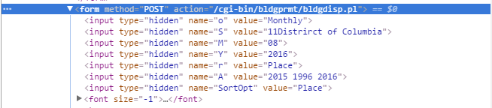

Slide 18
Helpful packages
(Like fredapi)
For calling hidden API keys in a local config file.
For parsing HTML.
For emulating a browser.
Useful when data can only be reached via web forms.
requests
xlrd
xlsxwriter
openpyxl
pandas
Reads excel files.
Writes excel files.
Also writes excel files. Plays well with pandas.
Does everything – I use for reshaping.
json
Various APIs
Various wrappers
configparser
BeautifulSoup
mechanize

Slide 19

Helpful packages

Slide 20
Revisions
Total Personal Income | % Change, Indexed to 2010
2 weeks ago
1 week ago

Slide 21
Demo
http://open.dc.gov/economic-intelligence/

Slide 22
THANKS!
https://Github.com/dcgov

