Slide 1
SE 314
Labwork 1

Slide 2
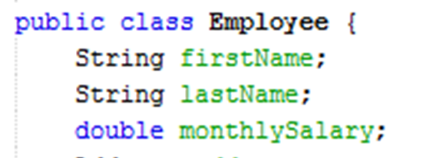
Employee class
Step 1: Create a Employee class which has firstName, lastName, monthlySalary and attributes.

Slide 3
Main.java
Step 2: Create Employee instances in main.java and displays these employees.
Look at the output. Does it make sense? Why or why not?
Step 3: Add the following lines to Main.java just before the end of the main() method:
employee.monthlySalary = -1500;
Compile and run the program.

Slide 4
Employee class
Look at the last line of output. Does it make sense? Why or why not?
We need to fix the problem caused by declaring the data.
Step 4: Fix declaration of data and Add the following methods to Employee.java.
setMonthlySalary(double monthlySalary)
setRaise(double percentage)
double getYearlySalary()

Slide 5
Adding New Fields and Methods to Employee class
String birthdayOfBoss as a field.
double profitOfCompany()
Look at the new Employee class after adding new methods and fields. Does it make sense? Why or why not?

Slide 6


Address class

