Slide 1
SE 314
Labwork 4

Slide 2
Problem Statement: Binary Search and Assertions
Write a Java program which implements binary search algorithm.
Binary search function should take 2 parameters; positive integer array and integer value which will be searched in array.
Program must use positive integer array and array should be entered by user at start of program.
Use all necessary assertions to handle errors.

Slide 3
Enable Assertions in Netbeans and Eclipse IDE
Enabling Assertions in Eclipse IDE
http://tutoringcenter.cs.usfca.edu/resources/enabling-assertions-in-eclipse.html
Enabling Assertions in Netbeans IDE
https://wiki.openoffice.org/wiki/Assertions_in_NetBeans

Slide 4
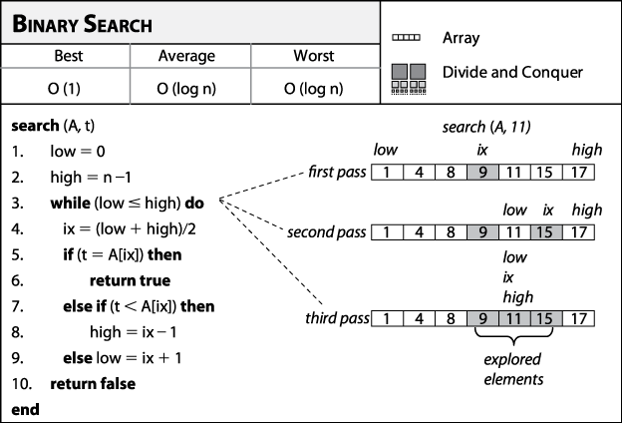
Hint for Binary Search

