Slide 1
SE 314
Labwork 6

Slide 2
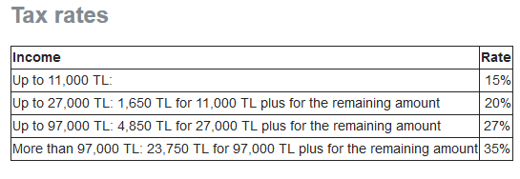
Problem Statement:
Write a program that determines yearly income tax amount for waged workers. When the user enters monthly earnings, the application should calculate and print the tax amount to be paid. Use the following rules table for tax calculations

