Slide 1
Docker Overview
The presentation aims to give understanding of Docker
Rajendra Mhetre
Notes:
<number>

Slide 2
Agenda
What is Docker ?
QuickStart
Docker Hub
“Docker” Command
DockerFile
Docker commit – update image
Data Volumes
Docker Alternatives
Notes:
<number>

Slide 3
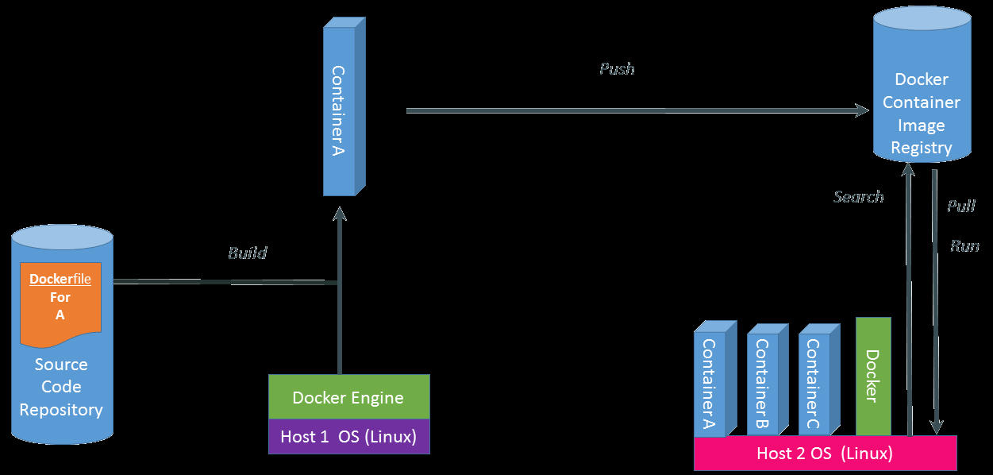
What is Docker?
Docker is a tool allow us to run multiple processes in their own containers on a machine without the overhead of virtual machines
It does give process separation and to the processes it looks like they're running in their own Linux environment.
Docker is build,ship and run any app anywhere.

Slide 4
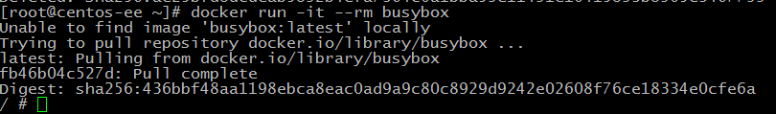
QuickStart
Busybox base image
BusyBox combines tiny versions of many common UNIX utilities into a single small executable. Coming in somewhere between 1 and 5 Mb in on-disk size.
How to Run BusyBox
Note the buxybox prompt (/ #) at the end

Slide 5
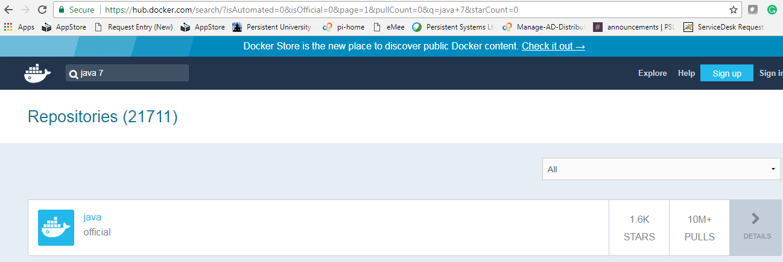
Docker Hub
What is docker Hub?
Docker Hub is a cloud-based repository in which Docker users and partners create, test, store and distribute container images. Through Docker Hub, a user can access public, open source image repositories, as well as use a space to create their own private repositories, automated build functions, webhooks and work groups.

Slide 6
“Docker” Command
Options | Description
images | List all local images
run | Create a container from an image and execute a command in it
pull | Download image from repository
rmi | Delete a local image
ps | List all running containers
ps –a | List all containers (including. stopped)
start | Start a stopped container
stop | Stop a stopped container
rm | Delete a container
commit | Create an image from a container
tag | Tag an image
search | Search for the image in the docker repository
Inspect | Shows information about running container

Slide 7
DockerFile
A Dockerfile is a text document that contains all the commands we would normally execute manually in order to build a Docker image. For Example
FROM java:7
ENV CATALINA_HOME /usr/local/tomcat
RUN mkdir -p "$CATALINA_HOME“
WORKDIR $CATALINA_HOME
ENV TOMCAT_TGZ_URL http://www-eu.apache.org/dist/tomcat/tomcat-8/v8.5.24/bin/apache-tomcat-8.5.24.tar.gz
RUN curl -SL "$TOMCAT_TGZ_URL" -o tomcat.tar.gz \
&& tar -xvf tomcat.tar.gz --strip-components=1 \
EXPOSE 8080
CMD ["catalina.sh", "run"]
java:7-jre is used as the base Image. On that image, we are setting environment variable using ENV. Run takes a command as its argument and run it to from image. Workdir is used to set path for CMD command .EXPOSE is used to associate a specified port to enable networking between the running process inside the container and the outside world i.e port redirection.CMD is to provide default for an executing container

Slide 8
DockerFile - Description
FROM
The Base image for subsequent instructions. The First non-comment instruction in dockerfile.
MAINTAINER
Instruction allows you to set the Author field of the generated images.
RUN:
Instruction will execute any commands in a new layer on top of the current image and commit the results.
CMD:
There can only be one CMD instruction in a Dockerfile. If you list more than one CMD then only the last CMD will take effect.
EXPOSE :
Instructions informs Docker that the container will listen on the specified network ports at runtime.
ENV:
Instruction sets the environment variable.
WORKDIR :
Working directory for the RUN, CMD and ENTRYPOINT instructions can be set using the WORKDIR.

Slide 9
DockerFile – Build Docker Image
Docker can build images automatically by reading the instructions from a Dockerfile.
By calling docker build from terminal, we can build docker image. Docker build execute Dockerfile step by step and create image
To create a Docker image from a Dockerfile
Make a directory where you can create the Dockerfile, for example:
mkdir –p /var/demo
Write the Dockerfile
Use the docker build command to create the image
docker build -t test/image /var/demo
docker images
Having built the image, we can test it by creating a container instance
docker run -d -P test/image

Slide 10
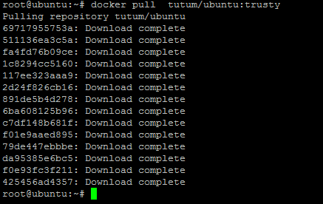
DockerFile – Pull Image
On Dockor Host
Image pulled : Ubuntu
Pull image from Docker hub registry
command : docker pull tutum/ubuntu:trusty
See Pulled Images
docker images

Slide 11
DockerFile – Run image
On Docker Host
Run the image or start the container using
“docker run –d –P tutum/ubuntu:trusty”
-P is used for port – forwarding ,cause we treat docker container just like a VM and IP assigned to those container are not accessible from other machine. so ,we need to forward the port to host machine. If IP are accessible from other machine then no need of port forwarding.
Command return Container ID ,used to distinguish container’s running on Docker
Container list
“docker ps” command (use -a to list all the containers including stopped onces)
Login to Container

Slide 12
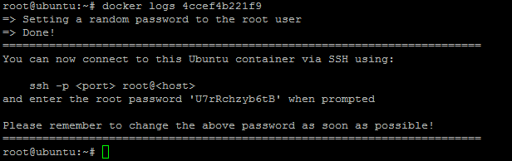

DockerFile – Login to container
To see Docker Container password
Docker logs <conatinerID>
Do ssh from Docker Host
“ssh root@localhost -p 49153”
See the prompt ,now we are inside the docker container.
To come out from Container type ‘exit’.
To delete container use

Slide 13
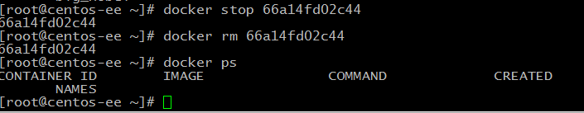

Docker commit
Create a new image from a container’s chagnes
Docker commit [OPTIONS] CONTAINER [REPOSITORY[:TAG]]
Stop and remove container
Recreate container from updated image
Note the changes made to the image are reflected in the new container

Slide 14
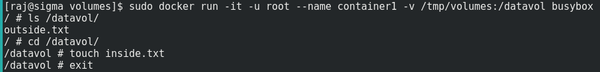

Data Volumes
Volumes are the preferred mechanism for persisting data generated by and used by Docker containers. Quite simply, volumes are directories (or files) that are outside of the container File System and exist as normal directories and files on the host filesystem.
Default volume
Default host folder for volumes is : /var/lib/docker/volumes/
Specify host folder volume
(SELinux)sudo chcon -Rt svirt_sandbox_file_t /tmp/volumes
Copy files From and To container

Slide 15
Docker Alternatives
Core OS' rkt (rocket)
Kubernetes
Amazon AWS ECS (CaaS)
Docker CaaS (Offerings from other cloud vendors)
Apache Mesos' based DC/OS
Digital Ocean
Microsoft Azure Service Fabric
Canonical and LXD – from Ubuntu
Notes:
<number>

Slide 16
Thank you

