Slide 1
UI Auto Regression from GITHUB ACTIONS

Slide 2
Table of Contents
Introduction
Why Github Actions
Components of Github Actions
Jenkins Vs Github Actions
Runners
Parallel Execution
Sharing test artifacts across jobs
Limitations

Slide 3
Introduction
GitHub Actions makes it easy to automate all your software workflows, now with world-class CI/CD.
Build, test, and deploy your code right from GitHub. Make code reviews, branch management, and issue triaging work the way you want
Actions are event driven, meaning you can run series of commands after a particular event has occurred.

Slide 4
Components of Github Actions
Workflows
Events
Jobs
Steps
Actions
Runners

Slide 5
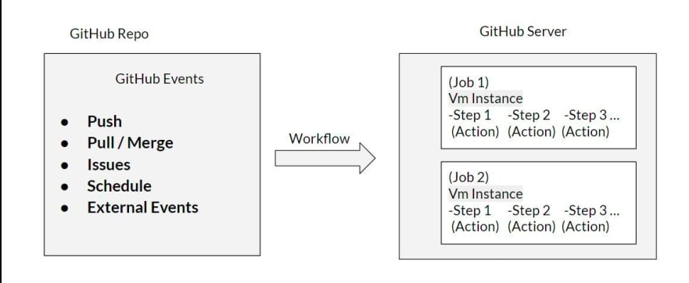
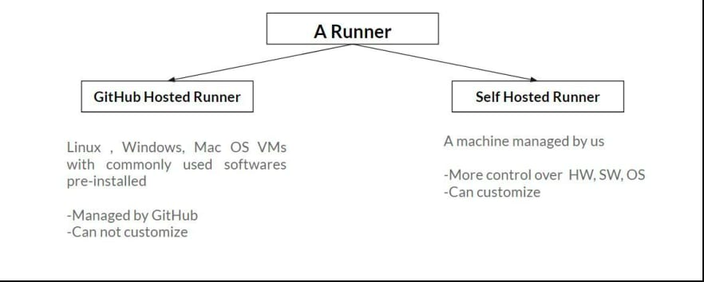

Slide 6
Workflows : It is an automated procedure for repository made up of one or more jobs which can be scheduled or triggered by event. Workflows are created inside .github/worflows directory by adding .yml file.
Events : They are responsible for triggering workflow.
Push
Pull request
create tag
create branch
Issue comment created
Issue labeled applied
Issue is opened
Make private repo public
Scheduled
Jobs :Set of steps executing on runner. By default, workflows having multiple jobs runs in parallel, you need to configure it for sequential run.
Interdependency between jobs can be configured

Slide 7
Steps : Individual task that runs commands in job. It can be a predefined action from github marketplace or a custom command. Each step executes on same runner allowing to share data among each other.
Actions : They are standalone commands that are combined into steps to create a job, building block of a workflow. Actions can be custom one or can be used from marketplace. It must be included as a step in job.
Runners : Server that has Github actions runner application installed. We can use github hosted runners or our own hosted runner for running job and fetching back output, logs, reports to github. Github hosted runners are based on ubuntu linux, MS windows and Mac OS. Each job in a workflow runs in fresh Virtual EnvironmentE(Github Hosted runner).

Slide 8
Why Github Actions
Built into Github : Github Actions is fully integrated into Github and therefore doesn't require and external site.
Multi-container testing : Actions allow you to test multi-container setups by adding support for Docker and docker-compose files to your workflow.
Multiple CI templates : Github provides multiple templates for all kinds of CI configurations which make it extremely easy to get started.
Great free plan : Actions are completely free for every open-source repository and include 2000 free build minutes per month for all your private repositories. If that is not enough for your needs you can pick another plan or go the self-hosted route.

Slide 9
Automation Regression Workflow
Test Preparation
Distribute tests evenly in groups
Each group to have 10 tests
Test Execution
Use output from test preparation job
Execute test groups in parallel on runner
Post Results
Upload test-output(screenshots,logs,reports)
Send summary of execution to teams channel
Automation Regression

Slide 10
Events
Manual Dispatch
Scheduled Run
Workflow
Test Preparation
Runner 1
Set Matrix for test group of provider
Test Config
Test Execution
Runner 2
Group 1
Group 2
Group 3
Group 4
Group 5
Actions
Git Checkout
Install Python Dependencies
Install chrome
Run pytest for test execution
Upload test results
Post Results
Runner 3
Upload test results
Send test summary to DI/teams

Slide 11
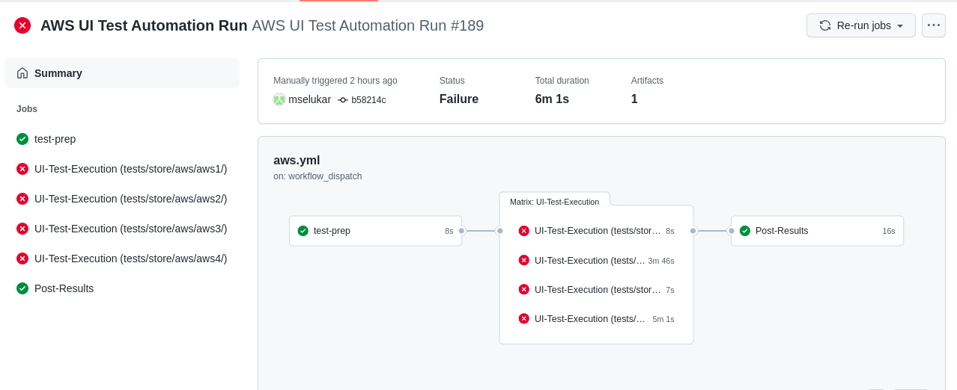
AWS Regression Workflow

Slide 12
Limitations
Inputs are limited to 10 only
One repository can contain many different workflows but only 20 workflows can be running at the same time.
Concurrent jobs are also limited but this is based on your GitHub plan. For free plans, we're limited to 20 concurrent jobs. This limit increases with the pro team and enterprise plans. On top of that, jobs are limited to six hours of runtime. That's almost a full day's work for your workflow to get done, whatever it needs to do.
If your workflows use actions that interact with the GitHub API, you'll be limited to making 1000 API requests per hour.

