Slide 1
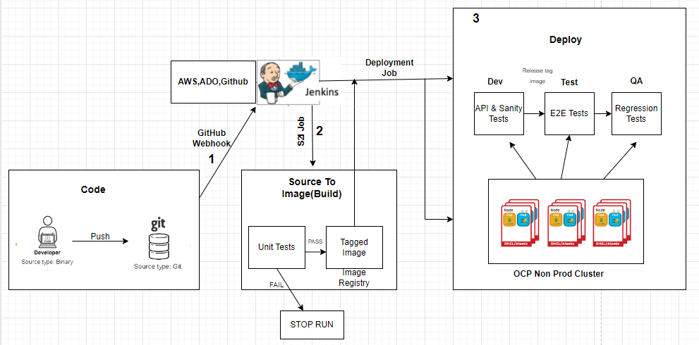
Pipeline Architecture

Slide 2
Architecture Overview
Developer makes code changes and commits code to the local git repo.After a review, code changes are pushed into the “pre-release” branch where a trigger has been set up to kick off an automated build.
Unit tests are executed during the build procedure. Static code analysis is also performed to pass the source code quality gate. Build artifacts are published into an artifact repository.
If Unit tests are passed, then pipeline continues with next stages. Build image is pushed to image repo.
Jenkins/Any other tool deploys the image to “Dev” namespace (called “Project” in OpenShift) where API and Sanity test cases are kicked off. Developers are also able to perform manual/ad-hoc testing as well (teams often use tools such as postman)If test cases pass, image is tagged with release name and Jenkins promotes (deploys tagged image) to the Test project (i.e. namespace) for functional and e2e testing.
If e2e tests pass, image is tagged again and publish into a production image repository for deployment to staging or pre-prod/prod.

Slide 3
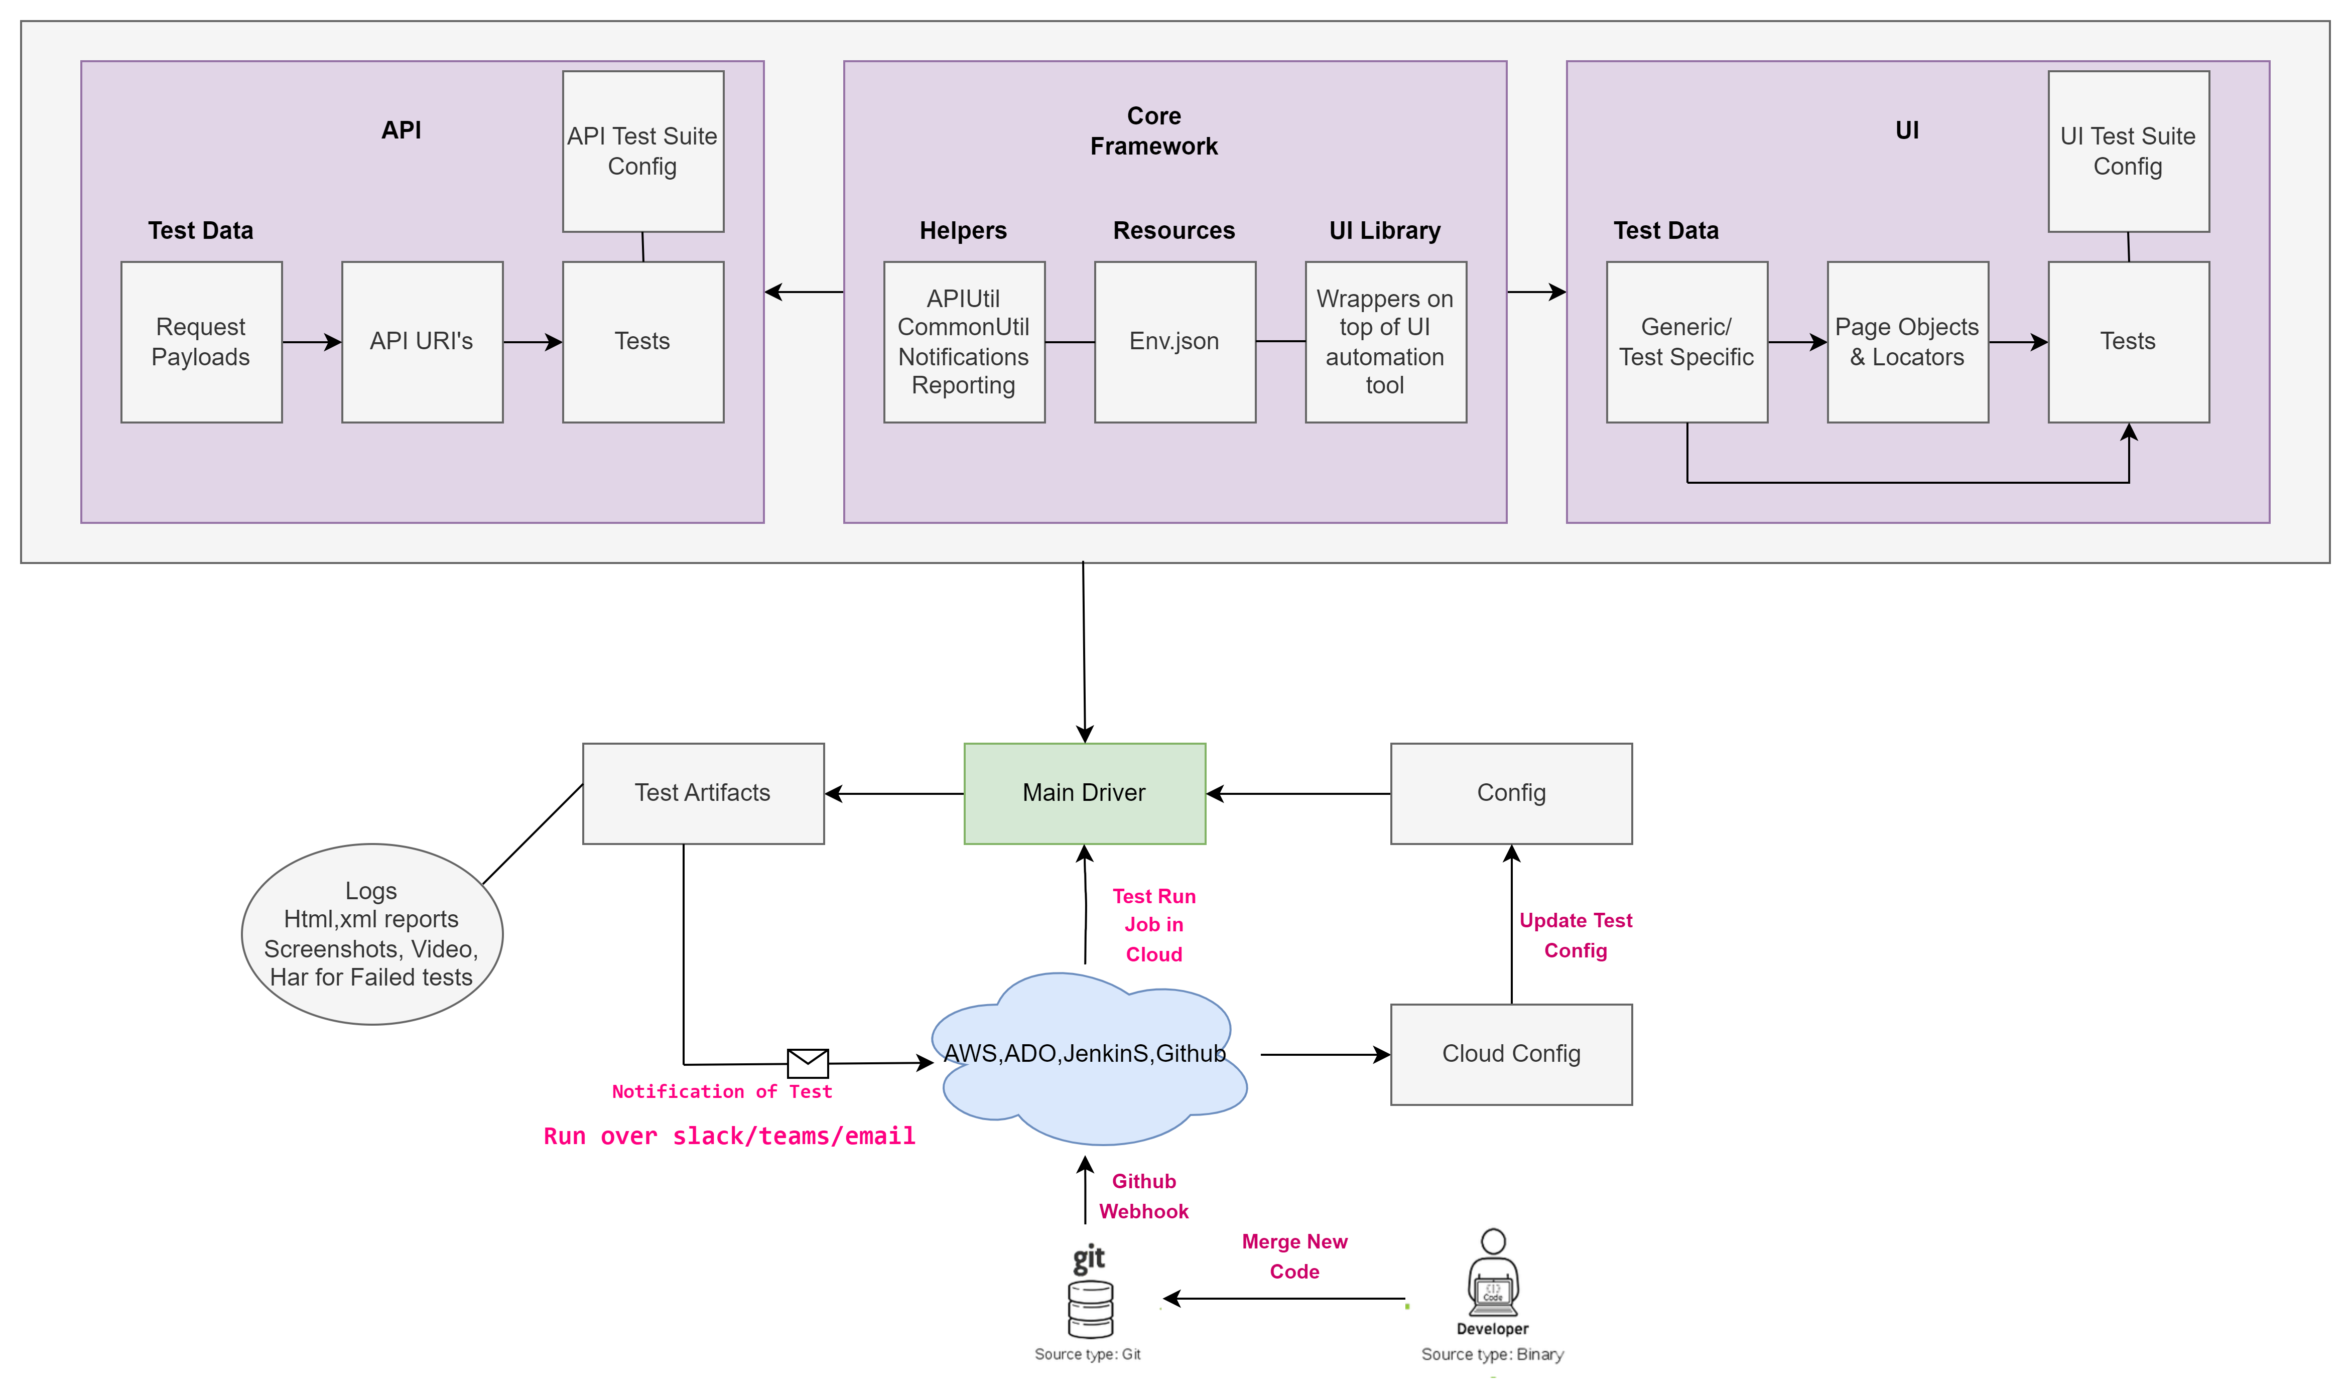

Slide 4
Test Automation Framework Overview
Main Driver - It is the starting point of the framework. It consist of the tasks for setting up the Environment, initializing test suites and test data, logging, html reporting, setting up global objects, invoking browser drivers etc. Main Driver script uses config file that contains test run configuration like environment, user credentials, browser type and other parameters controlled by user. Depending on test types(UI/API), tests utilizes core framework.
Core framework has
Helpers
ApiUtil - Common functions for crud operations like GET,POST,PUT,PATCH,DLETE using http/request library.
CommonUtil – Utility functions to be used across framework
Resources - Test environment configuration with user credentials in json/yml format.
UI Library - Functions on top of underlying automation tool. This involves custom functions for click, select, type etc. events
UI
Test Data - Generic test data that can be used across different test cases and test specific data.
Locators - Element locators defined by css, xpath and other attributes.
Page Object - Object representing application page. It contains method for each element on page depending on its type and uses locators defined.
Tests - Test scripts developed using functions defined in page objects, these page object functions represent a test step and validations/assertions are implemented in test itself.
UI Test Suite Config - YML/JSON file that contains mapping of test cases with test suites. These test suites are then used for sequential and parallel runs in CI/CD.
API
Test Data - It contains json/xml files which is used as a payload for API.
API URI’s - URL for payload
Tests – End to end test developed using ApiUtl, test data and URL. Validations are done on response object and code.
Test Artifacts – The output of test execution is a collection of logs, html report, har, video and screenshot of failed tests. Artifacts are used by testers to measure the performance of test run, code quality, identify application issues.

