Slide 1
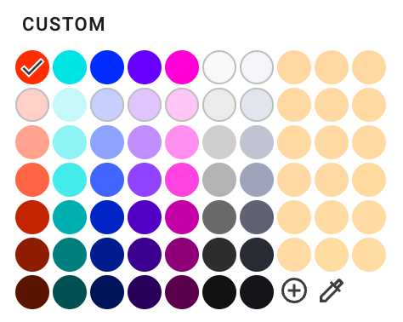
Color
Use this palette. Copy the table to your slide to sample if needed.
FF3300 | 00E7E7 | 0033FF | 7300FF | FF00DB | F9F9F9 | F5F6FA
FFD6CC | CCFAFA | CCD6FF | E3CCFF | FFCCF7 | EEEEEE | E6E8F0
FFAD99 | 99F5F5 | 99ADFF | C799FF | FF99F0 | D4D4D4 | C6CAD8
FF704C | 4CEEEE | 4C70FF | 9D4CFF | FF4CE5 | BBBBBB | A8ADC2
CC2800 | 00B8B8 | 0028CC | 5C00CC | CC00AF | 757575 | 696D7E
991E00 | 008A8A | 001E99 | 450099 | 990083 | 333333 | 2E313D
661400 | 005C5C | 001466 | 2E0066 | 660057 | 111111 | 15161B
Brand red is #FF3300. Don't use #F20000, #FF0000, or other near reds.
Greys are for graphics, lines, and fills. Cool ramp is also available.
For charts, give each series its own color family.
Use teal for a positive cue, and dark red or cyan for a highlight.
Pasting this table should give you a clean custom palette in slides. Ignore the placeholder peach colors. ———>

Slide 2
Typography
One typeface — DM Sans. Two weights — Regular and Medium.
Aa
DM Sans Regular
Body copy, labels, captions
Aa
DM Sans Medium
Headings and emphasis
Do
Do set everything in DM Sans
Do use black (#000000) for default text
Do use Medium to emphasize
Do set text in Regular + Medium only
Do use sentence and title case
Don’t
Don’t use Arial, Calibri or other fonts
Don’t apply bold (synthetic) to DM Sans
Don’t use SemiBold, Bold or Light weights
Don’t use all caps when possible

