Slide 1
Lab_Interning: String Interning Implementation
J. Nelson Amaral

Slide 2
Motivation

Slide 3
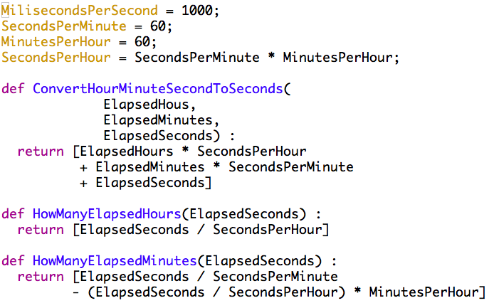
298 no-space characters

Slide 4
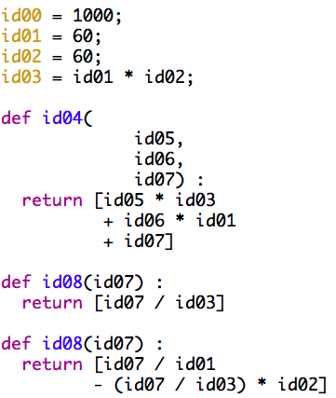
199 no-space characters
33% reduction in size

Slide 5
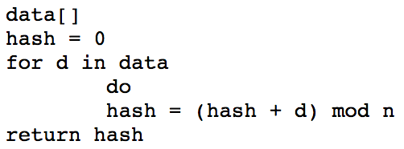
Hashing Algorithm
13
hash
0
77
+
% 32
77
Input
MinutesPerHour
ASCII Codes:
77

Slide 6
Hashing Algorithm
22
hash
13
118
+
% 32
105
Input
MinutesPerHour
ASCII Codes:
77
105

Slide 7
Hashing Algorithm
27
hash
22
123
+
% 32
110
Input
MinutesPerHour
ASCII Codes:
77
105
110

Slide 8
Hashing Algorithm
11
hash
22
139
+
% 32
117
Input
MinutesPerHour
ASCII Codes:
77
105
110
117
…

Slide 9
String Interning Table
⟨string⟩
hash
Each one of these entries in the
table is called a bucket
+
% n
n
. . .
000 … 000
Create immutable copy
Place address of immutable copy into the table entry.
Return unique ID
02
01
00

Slide 10
String Interning Table
⟨string⟩
In this slides we will refer to the
unbounded data structure used for
the overflowing of a bucket as a tank
hash
+
% n
Search tank for string.
n
If not found:
create immutable copy
insert string into tank.
return unique id
. . .
1bbbb…bb
If found:
return unique ID.
02
01
0x078E 7400
0x078E 7440
00
0x078E 7348
0bbbb…bb is the address of
an interned string
0x0808 400C

Slide 11
String Interning Table
⟨string⟩
Compare input with
interned string.
hash
If it matches:
return unique id
+
% n
n
If it does not match:
create a new tank.
add interned string address
create immutable copy
add copy address
replace bucket content
return unique ID
. . .
1cccc…cc
0bbbb…bb
02
01
00
0xhhhh hhhh
0bbbb…bb is the address of
an interned string
0xnnnn nnnn

Slide 12
Why this works?
0xfFFF FFFF
. . .
Kernel Space
0x8000 0000
0x7FFF FFFF
. . .
0x0000 0000

Slide 13
internString
Parameter:
$a0: address of a string to be interned
Return Value:
$v0: unique ID for the string
Strings with same value must always return the same ID
independent of their memory address.
Must create immutable copy if string was not interned before.

Slide 14
getInternedString
Parameter:
$a0: unique interned string ID
Return Value:
$v0: string address
if string was interned before.
$v0: 0
if string was not interned before.

Slide 15
internFile
Parameter:
$a0: pointer to a file in mutable memory
Return Value:
$v0: address of list of interned strings
$v1: number of identifiers in the list
strings are separated by one or more spaces or line feed characters
end of file is signaled by an End of Transmission (EOT) character
must make immutable copies of each string.

Slide 16
Guarantee
Your implementation will be presented with
at most 128 different strings.

