Slide 1
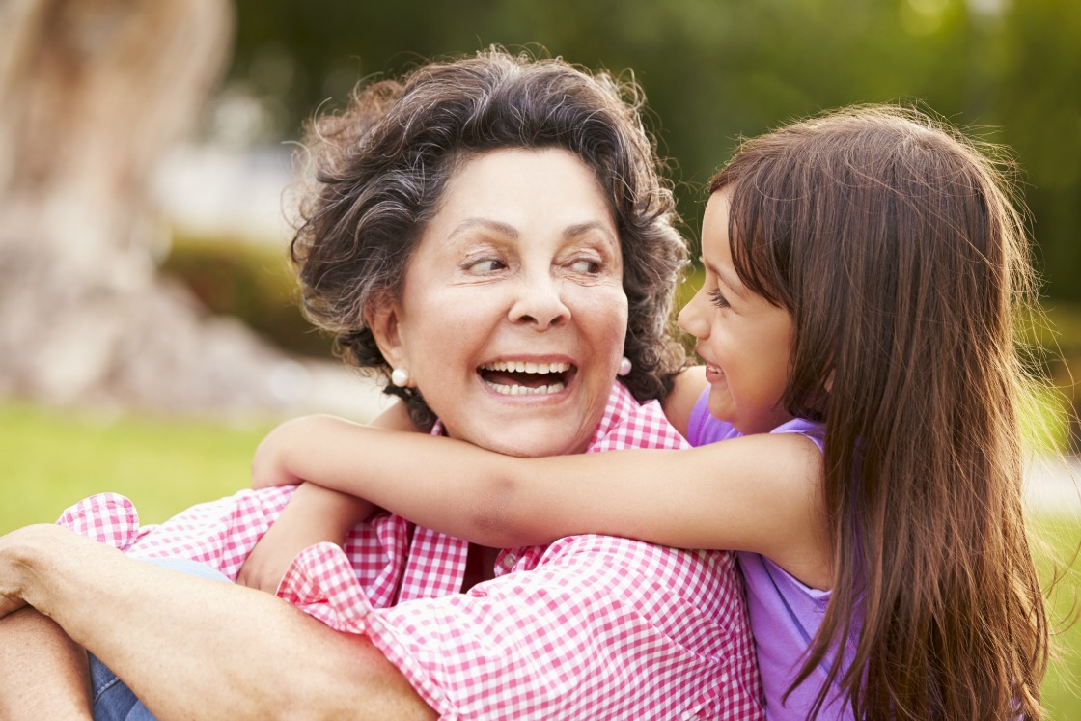
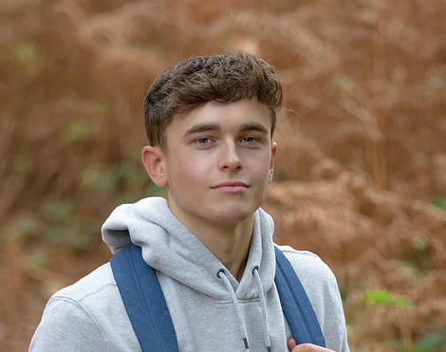

Señora Ramirez
Daniel Velez
Paula Ruiz
Grandmother, 67
Student, 15
Nurse, 29
Bio: Señora Ramirez is a kind, loving grandmother to a big family. Her daughter moved out recently, and Ramirez must handle a lot of household issues on her own again. Her partner is retired and infirm, and Ramirez worries about being able to balance all the health concerns both her and her partner may have.
Bio: Daniel is an energetic teen. He works hard at school and in sports, and helps his mother take care of his siblings in his spare time. He’s aware that his big family wastes a lot of electricity and energy, and he worries about the stress that puts on his parents. Daniel also is stressed about doing well in school, but as the oldest brother he doesn’t want to seem weak and unload his concerns to his family.
Bio: Paula is a busy nurse at the local hospital. She has a million things on her mind, from her preteen son to her home to her job. Paula worries about the safety of her son when he’s home alone at the apartment, but due to her job she can’t be home consistently. She wishes she had an organized domain to collect all her thoughts!
Frustrations:
Worried about her son and the safety of the city
Knows she has bills to pay and chores to do, but doesn’t know how to keep track of it all
Frustrations:
Doesn’t really know how to use a computer to find all the info she needs
Doesn’t want to go all the way to the farmacia just to get questions answered
Concerned about safety for both her and her daughter in the city
Frustrations:
Worried about bills considering the current economy and is always thinking of ways to save on electricity
Stressed about getting to university and getting a job after
Doesn’t have a resource to turn to about his anxieties

